Slide 1
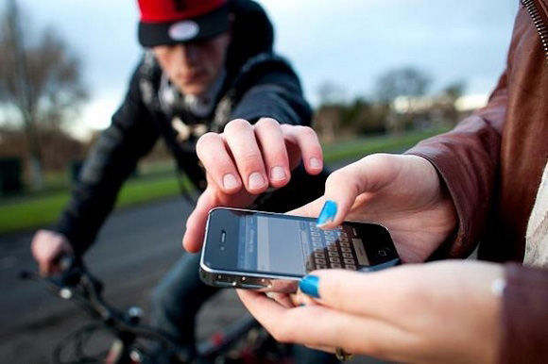
Problem
Now, Mr. Khuong has application, which help him to know what he should do.
But theft is everywhere. And Mr. Khuong is timid, suspicious, afraid man. He doesn’t want to lost his mobile.

Slide 2
Solution
Provide application on smart wear.
Help user view map and see notification.

Slide 3
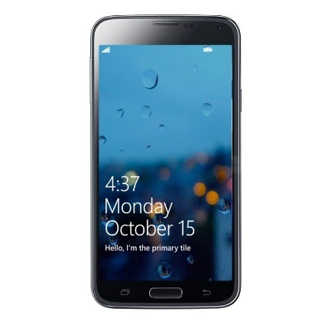
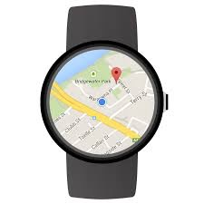
architecture
Pair
Bluetooth

Slide 4
architecture
Synchronize

Slide 5
architecture
Message API

Slide 6
architecture
Data API
Message API

Slide 7
architecture
Data API
Message API
Data Map

Slide 8
DEMO
Navigate each turn on motorbike
Notify to user
Notify to wear

