Slide 1
A
B

Slide 2
A
B

Slide 3
C
A
B

Slide 4
C
d
A
B

Slide 5
A
B
C

Slide 6
A
B
C

Slide 7
A
B
C

Slide 8
A
B
d
C

Slide 9
E
A
C
D
B

Slide 10
E
A
C
D
B

Slide 11
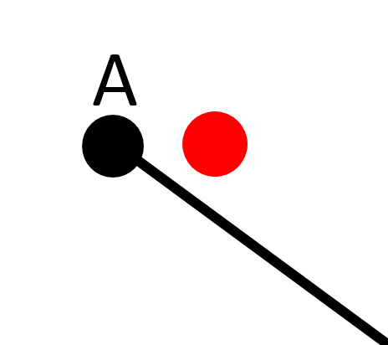
E
A
C
D
B

Slide 12
E
A
C
D
B

Slide 13
E
A
C
D
B

Slide 14
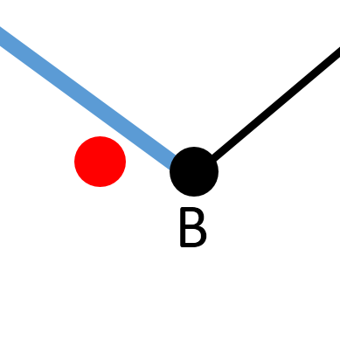
E
A
C
D
B

Slide 15
Notify: prepare to turn left
E
A
C
D
B

Slide 16
E
A
C
D
B

Slide 17
Notify: prepare to turn right
E
A
C
D
B

Slide 18
E
A
C
D
B

Slide 19
Notify: wrong way
E
A
C
D
B

Slide 20
E
A
C
D
B

Slide 21
E
50
A
C
D
B

Slide 22
E
50
A
C
45
D
B

Slide 23
E
50
20
A
C
45
D
B

Slide 24
E
50
20
A
C
15
45
D
B

Slide 25
E
50
13
A
C
20
15
45
D
B

Slide 26
E
A
C
D

Slide 27
E
A
C
D

Slide 28
E
E
A
C
D
Red Point is on the left of blue vector
D

Slide 29
Notify: navigate to left
E
A
C
D

