Slide 1
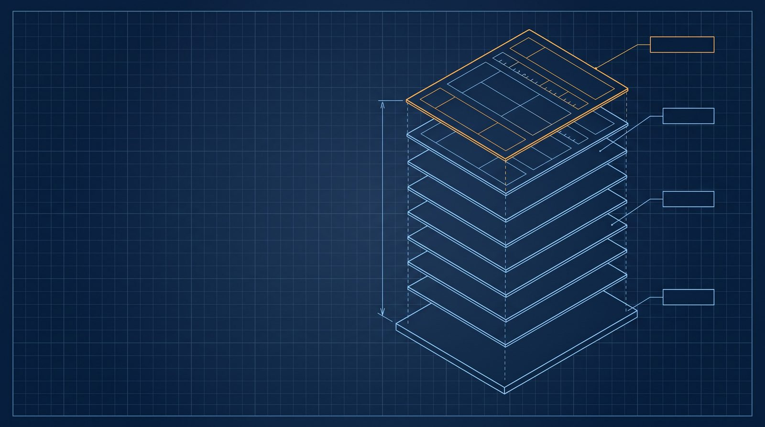
PAGE 1
SHEET 00 · ENGINEERING TECH TALK
B-TREE
Why SQLite Is
Everywhere
4096 B
Not a replacement for Oracle —
a replacement for fopen()
ONE FILE
Quote and figures throughout: official SQLite documentation, sqlite.org
Notes:
Most of us meet SQLite as the little database in a test suite, so it is easy to file it under toys. The SQLite authors put it differently: think of SQLite not as a replacement for Oracle, but as a replacement for fopen. That one sentence explains almost everything in the next twenty minutes. The drawing behind me is the whole idea in one picture: a single file that opens up into fixed-size pages, starting with page one. Every figure I quote today comes straight from the official documentation on sqlite.org.

Slide 2
01 · EVERYWHERE
SQLite likely outnumbers all other engines combined
IN EVERY…
THE ARITHMETIC
Android device
Safari web browser
>4.0 billion
iPhone and iOS device
instance of Skype
smartphones in active use (4.0e9)
Mac
instance of iTunes
Windows 10/11 installation
Dropbox client
hundreds
Firefox web browser
TurboTax and QuickBooks
Chrome web browser
of SQLite database files held on each phone
ALSO IN…
>1e12
PHP
Python
most TVs and set-top boxes
most automotive multimedia systems
…countless millions more
Probably the 2nd most deployed library after zlib — and since it is
often statically linked many times per device, it might be the 1st.
SQLite databases likely in active use — over one trillion
SHT 02/12
Source: sqlite.org/mostdeployed
Notes:
Start with the claim that sounds like marketing: SQLite is likely used more than all other database engines combined. The evidence is a list of hosts. It ships in every Android device, every iPhone and iOS device, every Mac, every Windows 10 and 11 installation, and in Firefox, Chrome, and Safari. It is inside every copy of Skype, iTunes, the Dropbox client, TurboTax and QuickBooks; it comes with PHP and Python; and it runs in most television sets, set-top boxes, and car multimedia systems. Now the arithmetic: there are more than four billion smartphones in active use, each holding hundreds of SQLite database files, so there are probably over one trillion SQLite databases in use right now. The project's own best guess is that it is the second most deployed library after zlib, and because it is often statically linked many times per device, it might even be the first.

Slide 3
02 · SERVERLESS BY DESIGN
No server: the library is the database engine
CLIENT/SERVER ENGINE
SQLITE
THE SINGLE FILE
application
application
Zero-configuration: nothing
to install or administer
SQL over the network
SQLite library
Holds every table, index,
trigger, and view
sqlite3.c
server process
linked in, same process
Copies freely between 32/64-bit
and big/little-endian machines
reads and
writes directly
Library under 900 KiB with
all features enabled
one ordinary
Database up to 281 TB
its data files
disk file
A US Library of Congress
recommended storage format
A long-running server to install, configure,
and administer before the first query.
No separate server process.
Open the file and run SQL.
SHT 03/12
Source: sqlite.org/about, /whentouse
Notes:
Why can it be everywhere? Because there is nothing to deploy. On the left is the model we all know: the application sends SQL over the network to a long-running server process, which owns its data files, and someone has to install, configure, and administer that server first. On the right, SQLite is a library linked into the application's own process, and it reads and writes one ordinary disk file directly. There is no separate server. That single file holds every table, index, trigger, and view, and it copies freely between 32-bit and 64-bit machines and between big-endian and little-endian ones. The library is under 900 kibibytes with every feature enabled, a database can reach 281 terabytes, and the US Library of Congress lists the format as a recommended storage format.

Slide 4
03 · HOW IT WORKS — THE LAYER STACK
SQLite compiles SQL to bytecode, then runs it on a VM
01
Interface
main.c · vdbeapi.c
CORE
02
Tokenizer
tokenize.c
COMPILE
sqlite3_prepare_v2()
turns SQL text into a bytecode
program held in a sqlite3_stmt
03
Parser
parse.y (Lemon)
SQL COMPILER
04
Code Generator
select.c · where*.c
EXECUTE
05
Bytecode Engine (VDBE)
vdbe.c
CORE
sqlite3_step() runs it on the
virtual machine, row by row
06
B-tree
btree.c
Pager (page cache)
STORE
07
pager.c · wal.c
BACKEND
B-trees ask the pager for fixed-
size pages; the VFS does the I/O
08
OS Interface (VFS)
os_unix.c · os_win.c
SHT 04/12
Source: sqlite.org/arch
Notes:
So what is inside that library? SQLite compiles SQL into bytecode and then runs that bytecode on a virtual machine, and the code is organised as one stack of eight layers. At the top is the interface. The next three layers, tokenizer, parser, and code generator, form the SQL compiler. The bytecode engine, the VDBE, executes the program, and together with the interface it forms the core. Below it, the backend has three layers: the B-tree, the pager or page cache, and the OS interface, called the VFS. In API terms, sqlite3 prepare v2 is the compile step that produces a bytecode program in a sqlite3 statement object, sqlite3 step runs it on the virtual machine, and the backend stores everything as B-trees made of fixed-size pages. We will now walk down this stack, compiler first.

Slide 5
04 · HOW IT WORKS — COMPILE PATH (LAYERS 02–04)
From SQL text to a bytecode program
01
Interface
SQL TEXT
SELECT name FROM users WHERE id = ?
02
Tokenizer
TOKENIZER
PARSER
CODE GENERATOR
VDBE
03
Parser
Splits SQL text into
tokens; hand-coded
in tokenize.c.
The tokenizer calls
the parser
— threadsafe, faster.
Gives tokens meaning
by context; generated
by Lemon from parse.y
— reentrant, thread-
safe, no leaks on
syntax errors.
Walks the parse tree
and emits bytecode.
where*.c + select.c
are the query planner,
picking among possibly
millions of algorithms.
sqlite3_stmt holds
one bytecode program;
sqlite3_step() runs
it until done, a row,
a fatal error, or
an interrupt.
04
Code Gen
05
VDBE
06
B-tree
07
Pager
sqlite3_prepare_v2() · compile
sqlite3_step() · run
08
VFS
YACC/BISON habit: the parser calls the tokenizer.
SQLite inverts it: the tokenizer calls the parser.
SHT 05/12
Source: sqlite.org/arch
Notes:
Here is the top half of the stack, layers two to four, highlighted on the rail. Take one statement, a select with a bound parameter. The tokenizer, hand-coded in tokenize.c, splits the text into tokens, and here is a detail worth remembering: in SQLite the tokenizer calls the parser, the reverse of the YACC and Bison habit, which makes it thread-safe and faster. The parser gives tokens meaning from their context; it is generated by the Lemon parser generator from parse.y, and it is reentrant, thread-safe, and does not leak memory on syntax errors. The code generator walks the parse tree and emits bytecode; the files where.c and select.c form the query planner, which picks among possibly millions of ways to compute the answer. All of that is what sqlite3 prepare v2 does. The result is one bytecode program in a sqlite3 statement object, and sqlite3 step runs it on the VDBE until it finishes, produces a row, hits a fatal error, or is interrupted.

Slide 6
05 · HOW IT WORKS — STORAGE PATH (LAYERS 06–08)
Down the stack: one file, many B-trees, fixed pages
B-tree asks for page N
Pager caches pages, provides rollback,
VFS reads and writes the OS file
01
Interface
atomic commit, and file locking
os_unix.c · os_win.c
02
Tokenizer
100 B · page 1 only
8 or 12 B
usually 0 B
DB header
page header
cell pointers →
unallocated space
← cell content area
rsvd
03
Parser
One b-tree page, regions in file order (widths not to scale). Pointers grow forward, cells grow back.
04
Code Gen
INTERIOR PAGE → CHILDREN
THE FILE, BY THE PAGE
05
VDBE
K1
K2
K3
Page size 4096 B by default; any
power of two from 512 to 65 536
06
B-tree
Every read and write is whole pages
leaf
leaf
leaf
leaf
One b-tree per table and per index;
sqlite_schema is rooted at page 1
07
Pager
An interior page holds K keys and K+1 child pointers.
08
VFS
Table b-tree — 64-bit signed rowid key; data only in leaves
≈4.29e9 pages × 64 KiB ≈ 281 TB max
file begins with "SQLite format 3"
Index b-tree — arbitrary key; no data stored
SHT 06/12
Source: sqlite.org/arch, /fileformat2
Notes:
Now the bottom half of the rail, layers six to eight. The B-tree layer asks for a page by number, the pager caches pages and provides rollback, atomic commit, and file locking, and the VFS does the actual reads and writes on the operating system's file. Every read and write is a whole page, 4096 bytes by default, and the page size can be any power of two from 512 to 65,536. This strip is one B-tree page in file order: a 100-byte database header that exists only on page one, an 8-byte header for leaf pages or 12 bytes for interior pages, the cell pointer array growing forward, unallocated space, the cell content area growing back from the end, and a reserved region that is usually empty. An interior page holds K keys and K plus one child pointers. Table B-trees use a 64-bit signed rowid key and keep data only in the leaves; index B-trees use arbitrary keys and store no data. There is one B-tree per table and per index, all in the same file, with the schema table rooted at page one. About 4.29 billion pages of 64 kibibytes is where the 281 terabyte limit comes from, and every valid file begins with the string SQLite format 3.

Slide 7
06 · ATOMIC COMMIT — TWO MECHANISMS
Rollback journal vs write-ahead log
ROLLBACK JOURNAL
The default mode.
database file
journal file
③ COMMIT =
Save the old pages,
overwrite in place.
① copy original pages
the journal file
is deleted
crash or ROLLBACK: play the journal back
② write the changes directly into the database
WRITE-AHEAD LOG
Since 3.7.0 (2010-07-21).
database file
WAL file -wal
② COMMIT =
writer
a commit record
appended to the WAL
Append the new,
leave the database
alone.
① changes
appended
The database file is never
touched to commit.
readers use the original
SHT 07/12
Source: sqlite.org/wal
Notes:
Pages have to change atomically, even if the power fails, and SQLite has two ways to do it. The default is the rollback journal: first copy the original pages into a separate journal file, then write the changes directly into the database. The commit happens at the moment the journal file is deleted, and if the process crashes or rolls back, the journal is played back into the database to restore it. Since version 3.7.0, released in July 2010, there is the write-ahead log, which inverts the idea. The database file is left alone, the writer appends the changed pages to a separate WAL file, and a commit is simply a commit record appended to that log. Because the database file is never touched to commit, readers can keep using the original while commits proceed.

Slide 8
07 · INSIDE WAL MODE
WAL: readers never block the writer
WAL file -wal · frames in append order
The single writer appends
new frames at the end; each
reader keeps its own snapshot.
reader A end mark
reader B end mark
database file
Checkpoint copies WAL pages back into the database, stopping at the oldest active reader's end mark.
Automatic once the WAL reaches 1000 pages; when fully checkpointed and idle, the WAL rewinds to its start.
HOW IT STAYS CONSISTENT
WHY WAL
WHAT IT COSTS
One end mark per read = one snapshot
Significantly faster in most scenarios
Same host only — no network filesystem
A shared-memory wal-index finds pages
fast, so all processes share one host
Readers and the writer run concurrently
Extra -wal and -shm files beside the DB
More sequential disk I/O
1–2% slower for read-mostly work
One WAL file → one writer at a time
Far fewer fsync() calls
Prefers small transactions; rollback
modes suit ones over ~100 MB
A long reader can stall the checkpointer
SHT 08/12
Source: sqlite.org/wal
Notes:
Let's zoom into that WAL file. Frames are appended in order by the single writer. When a read transaction starts, it remembers the last valid commit record as its end mark, so each reader sees one consistent snapshot even while the writer keeps appending. A reader takes the newest copy of a page that appears before its own end mark, otherwise it reads the database file, and a shared-memory wal-index makes that lookup fast. That shared memory is also why every process must be on the same host. Eventually a checkpoint copies WAL pages back into the database, stopping at the oldest active reader's end mark, which is why one long-running reader can stall it. By default this happens automatically once the WAL reaches 1000 pages, and when everything is checkpointed and idle the WAL rewinds to its start. The payoff is real: WAL is significantly faster in most scenarios, readers and the writer run concurrently, disk I/O is more sequential, and there are far fewer fsync calls. The costs are that it works only on one host and not over a network filesystem, it adds the wal and shm files beside the database, it can be one or two percent slower for read-mostly work, and it prefers small transactions, so rollback modes suit transactions beyond roughly a hundred megabytes.

Slide 9
08 · WHY YOU CAN TRUST IT — TESTING
The test code is 590 times larger than the library
TEST CODE VS. LIBRARY CODE
590×
HARNESS
SCALE
TEST CASES
GUARANTEE
TCL tests
1,390 script files,
23.2 MB
51,445 distinct;
millions of runs
Primary suite during
development
TH3
1,055.4 KSLOC of C;
proprietary
50,362 distinct;
~2.4 M instances
100% branch + 100%
MC/DC coverage of the core
tests and test scripts
92,053.1 KSLOC
SQL Logic
Test
1.12 GB of test data
7.2 M queries
Same answers as
PostgreSQL, MySQL,
SQL Server, Oracle 10g
dbsqlfuzz
336 seed files;
proprietary
~1 billion
mutations a day
Mutates SQL and the
database file together
the library itself
155.8 KSLOC
Square areas drawn to scale · SQLite 3.42.0 (2023-05-16)
Also: out-of-memory, I/O-error, crash and power-loss tests. A pre-release
TH3 soak runs about 248.5 million tests.
SHT 09/12
Source: sqlite.org/testing
Notes:
Why trust a library that sits in a trillion places? Look at the testing. As of version 3.42.0, the library is about 155.8 thousand lines of C, and the project carries about 92 million lines of test code and test scripts, roughly 590 times as much. The two squares are drawn to scale. That test effort is split across four independent harnesses. The TCL tests are the primary suite during development, with 51,445 distinct test cases that expand to millions of runs. TH3 is a proprietary harness of about 1,055 thousand lines of C that delivers 100 percent branch coverage and 100 percent MC/DC coverage of the core, the coverage level behind what sqlite.org calls aviation-grade testing. SQL Logic Test runs 7.2 million queries and checks that SQLite gives the same answers as PostgreSQL, MySQL, SQL Server, and Oracle 10g. And the dbsqlfuzz fuzzer runs about a billion mutations a day, mutating SQL and the database file together. On top of that come out-of-memory, I/O error, crash, and power-loss tests, and a pre-release TH3 soak of about 248.5 million tests.

Slide 10
09 · WHY YOU CAN TRUST IT — LICENSE
No license to comply with: it is public domain
“Anyone is free to copy, modify, publish, use, compile, sell, or
distribute the original SQLite code … for any purpose, commercial
or non-commercial, and by any means.”
— SQLite Copyright page. All code and documentation are dedicated to the public domain.
Every author signs a
public-domain affidavit
Every line written from
scratch, traceable to
its original author
Open-source, but not
open-contribution: no
patch without an affidavit
Originals kept in a firesafe at Hwaci
Where public domain is not recognized, Hwaci sells a Warranty of Title;
proceeds fund continuing improvement and support of SQLite.
SHT 10/12
Source: sqlite.org/copyright
Notes:
The second trust factor is legal, and it is the simplest one in this deck: there is no license to comply with. In the project's own words, anyone is free to copy, modify, publish, use, compile, sell, or distribute the original SQLite code for any purpose, commercial or non-commercial, and by any means. That holds because every author signs an affidavit dedicating their work to the public domain, with the originals kept in a firesafe at Hwaci, and because every line is written from scratch and traceable to its author. The consequence is that SQLite is open-source but not open-contribution: no patch is accepted without such an affidavit. And for organisations in places that do not recognise the public domain, Hwaci sells a Warranty of Title, and the proceeds fund SQLite's continued development.

Slide 11
10 · CHOOSING IT — THE OFFICIAL CHECKLIST
Three questions before you pick SQLite
Is the data separated from the
application by a network?
yes
WHERE IT WORKS WELL
1
client/server
Embedded devices and the internet of things
Application file format
no
Websites under ~100K hits/day
Many concurrent writers that
cannot queue and take turns?
yes
Data analysis
2
client/server
SQLite: unlimited readers, one writer at a time; writes usually take milliseconds
Cache for enterprise data
no
Server-side database (e.g. one DB per user)
Big data — more than one file
can hold? (limit: 281 TB)
yes
Data transfer format
3
client/server
File archive or data container
no
Internal or temporary databases
Otherwise → choose SQLite
100K hits/day is a conservative estimate,
not a hard upper bound — SQLite has been
demonstrated at 10 times that traffic.
SHT 11/12
Source: sqlite.org/whentouse
Notes:
So when should you reach for it? The official checklist is three questions, asked in order. First, is the data separated from the application by a network? If so, choose a client/server engine, because the high-bandwidth link between engine and disk should not cross the network. Second, do many writers need to write at the same instant without queuing? SQLite allows unlimited readers but one writer at a time, and since a write usually takes milliseconds, writers can often take turns, but if they cannot, use client/server. Third, will the data outgrow one file? The limit is 281 terabytes, and long before that a centralised server is worth considering. If the answer to all three is no, choose SQLite. That covers a lot of ground: embedded and IoT devices, application file formats, websites under about 100,000 hits a day, data analysis, caching enterprise data, server-side databases such as one database per user, data transfer, archives, and internal or temporary databases. And that 100,000 figure is conservative; SQLite has been shown to handle ten times that traffic.

Slide 12
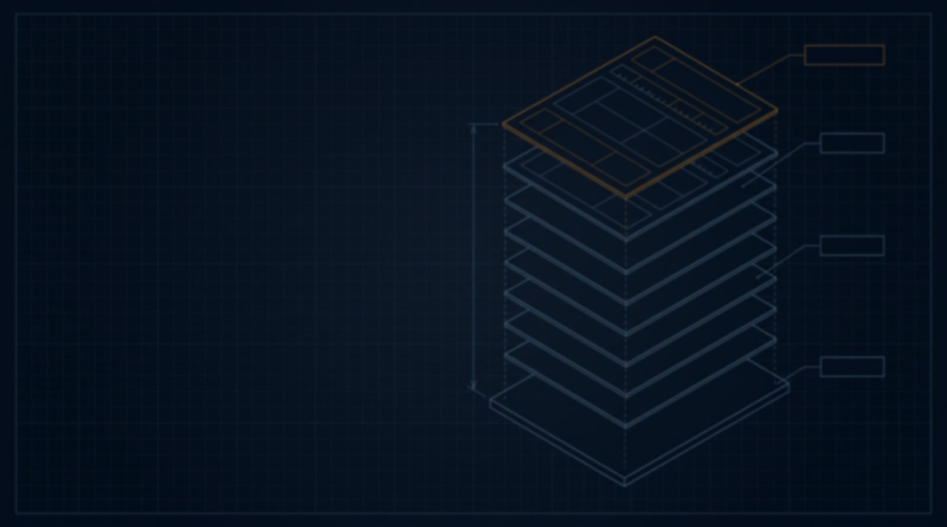
SHEET 12 · TAKEAWAY
SQLite competes
with fopen()
Reach for SQLite wherever you would have reached for fopen().
In-process, one ordinary file,
zero configuration
Test code 590× the library,
100% branch and MC/DC
Public domain — free for
any purpose, no license
Small. Fast. Reliable. Choose any three.
Motto and every figure in this deck: sqlite.org (about, mostdeployed, arch, fileformat2, wal, testing, copyright, whentouse)
Notes:
Put it together and the opening line makes sense: SQLite competes with fopen, not with Oracle. It is in-process, one ordinary file, with zero configuration. Its test code is 590 times the size of the library, with 100 percent branch and MC/DC coverage. And it is in the public domain, free for any purpose with no license. So the takeaway for us is practical: wherever you would have reached for fopen and a home-grown file format, reach for SQLite instead. Or, as the project's motto puts it: small, fast, reliable, choose any three.

