Slide 1
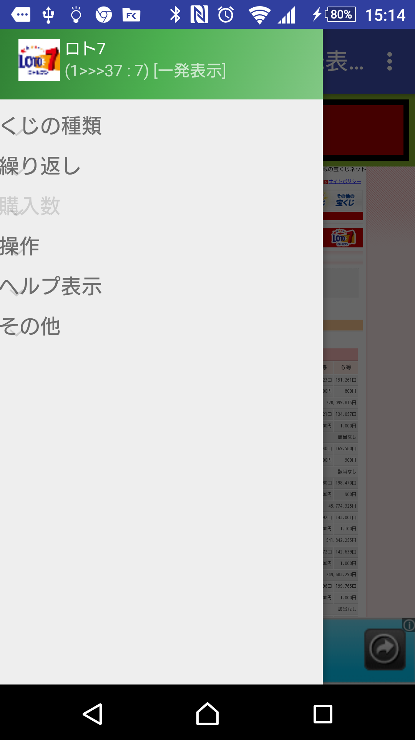
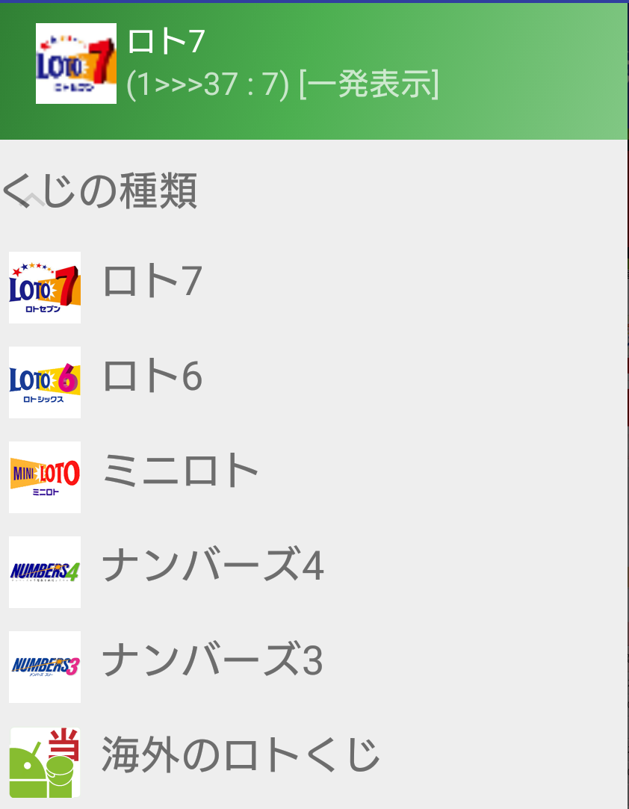
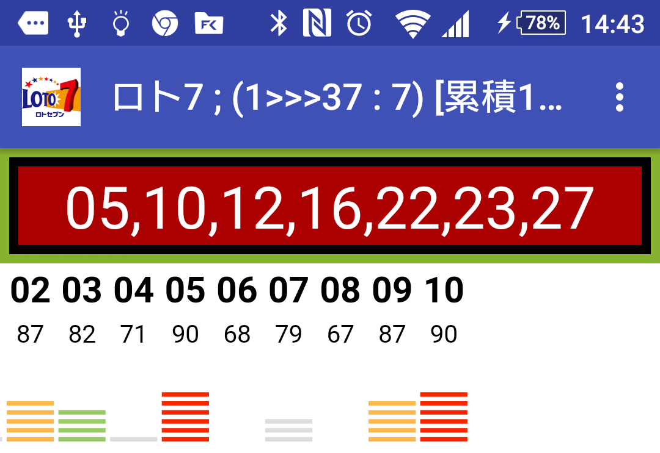
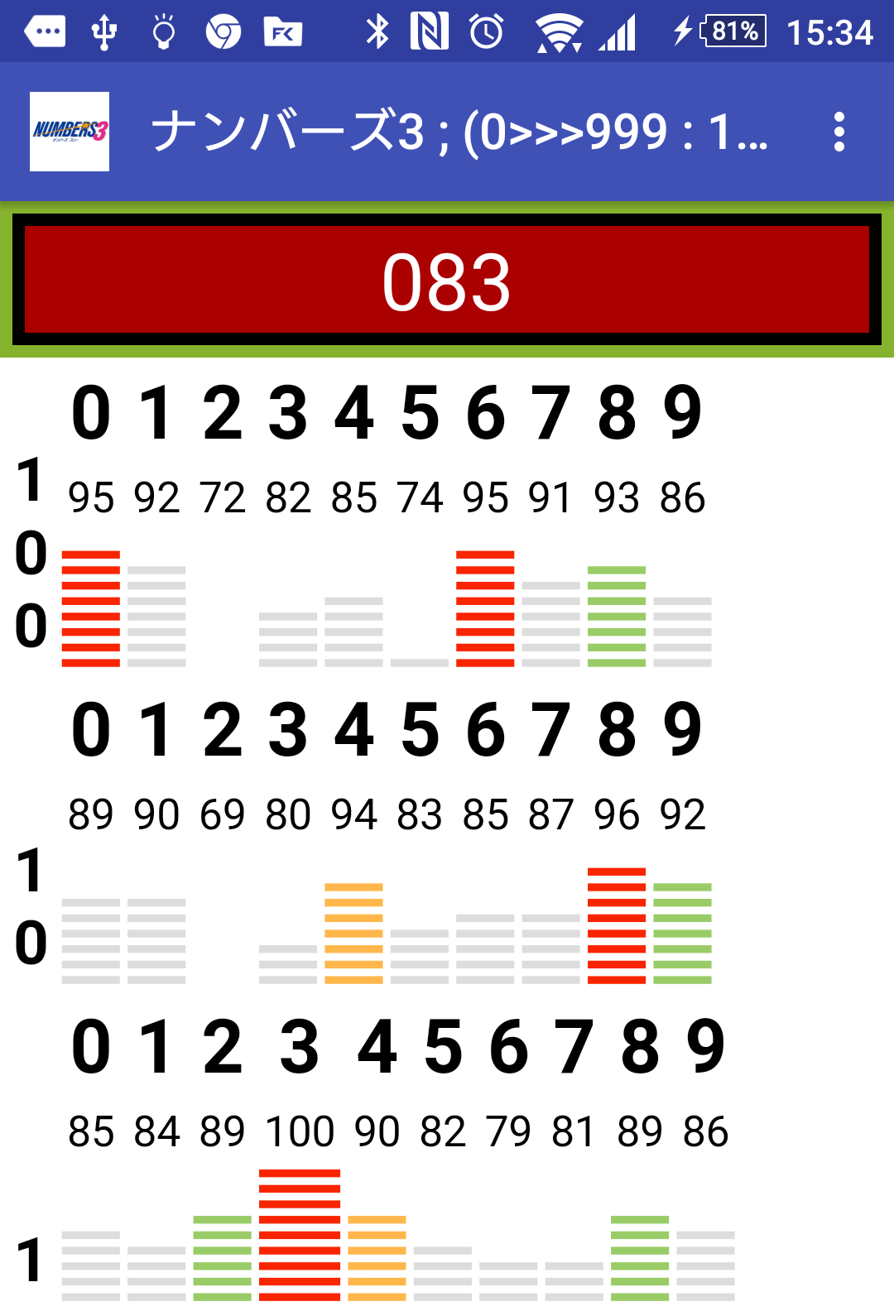
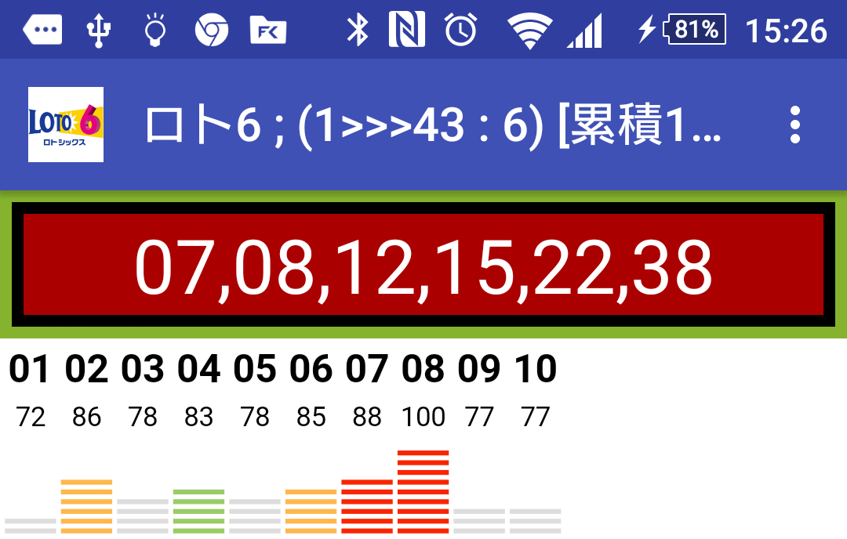
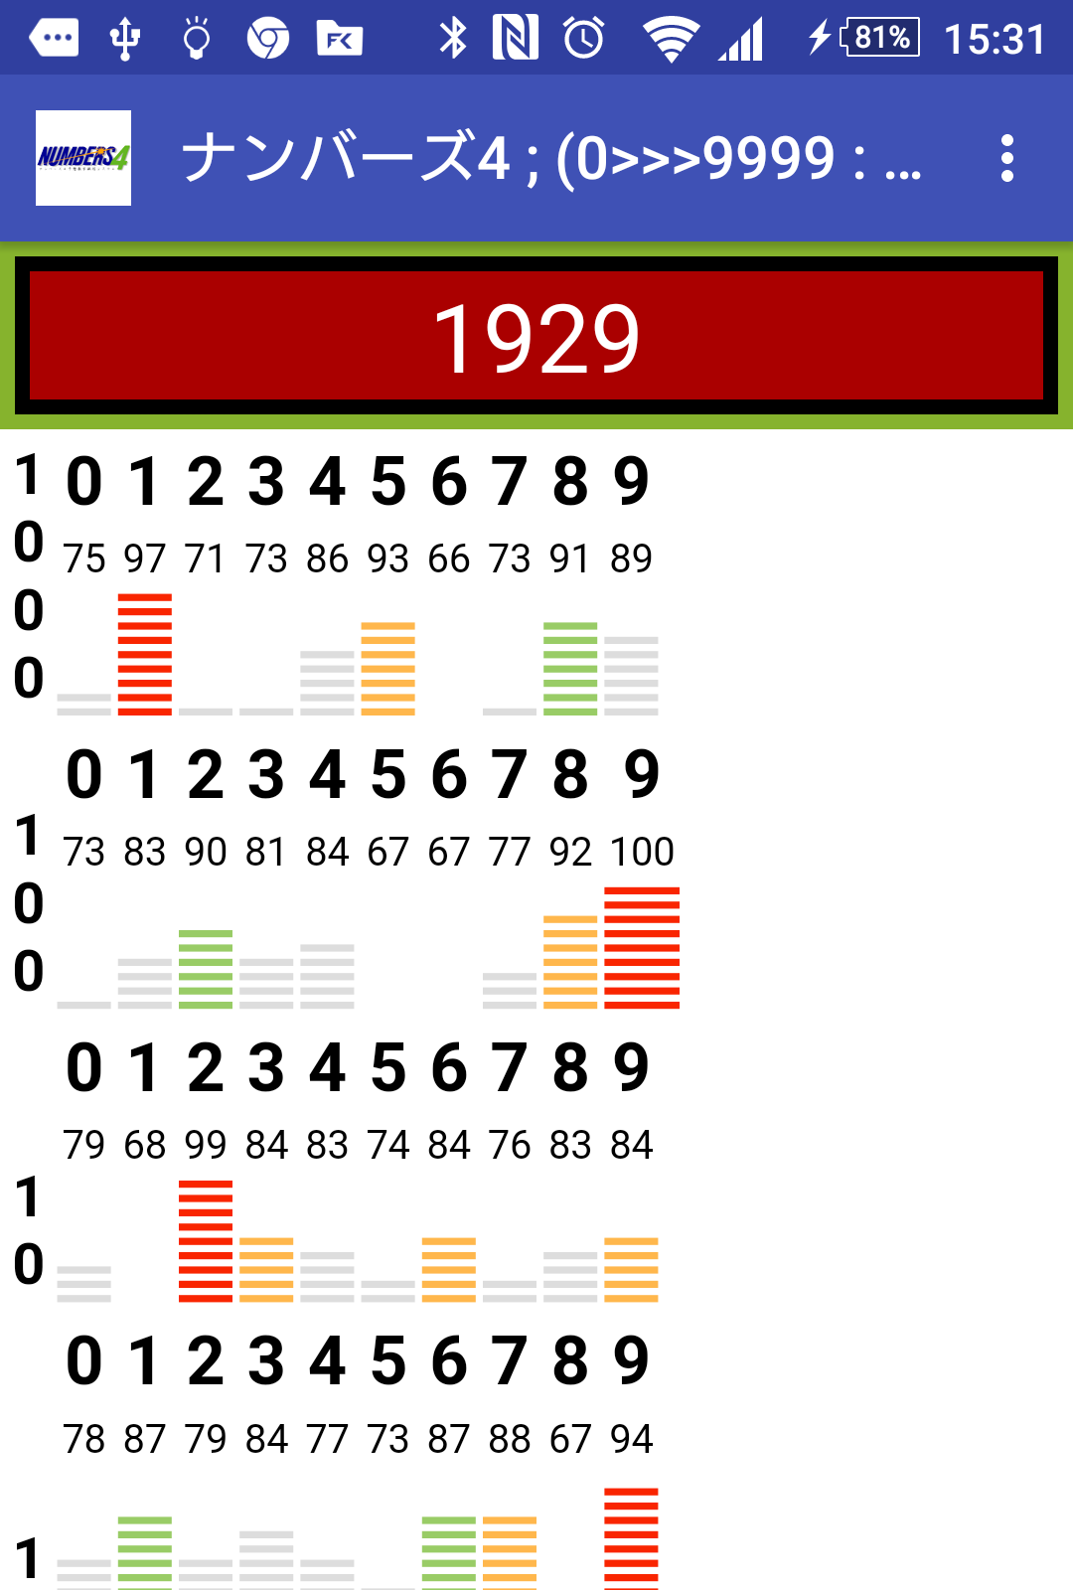
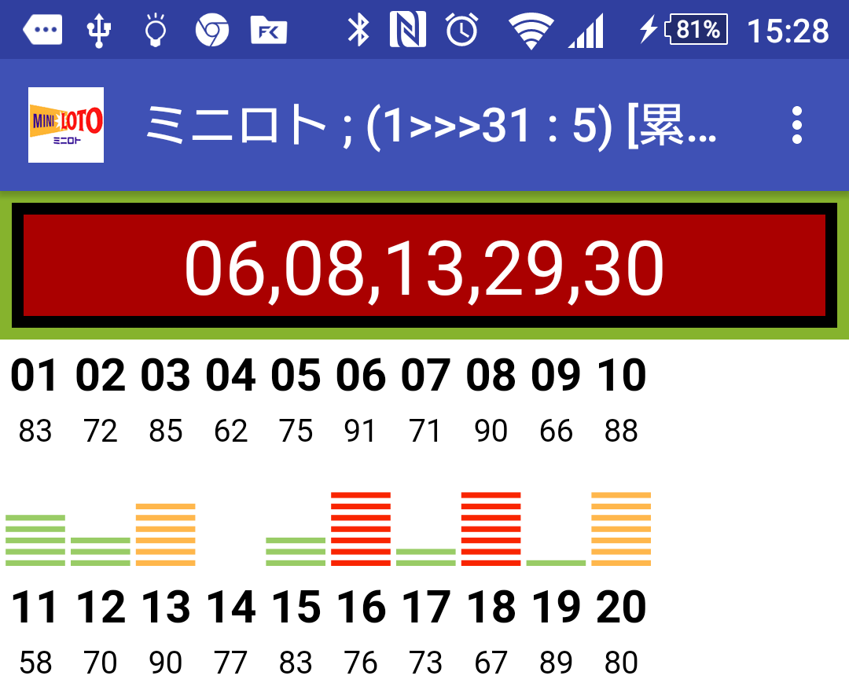
シンプルで手軽、さまざまな海外の数字くじにも対応する乱数発生器
Atare君
あなたが滞在している国を電話回線から判別。
新しいくじは“その他”で設定
時間が無ければ「繰り返し」で
”一発表示”
気休めでも精度を精度を上げたい時は“乱数累積”で
※乱数の筈なのになぜか良く出る数字から選択
切替カンタン

Slide 2
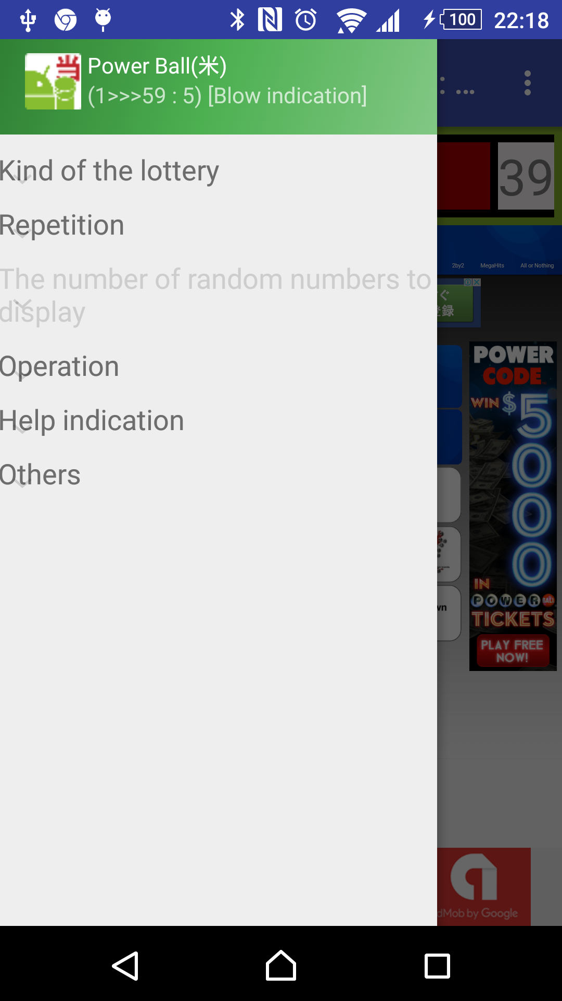
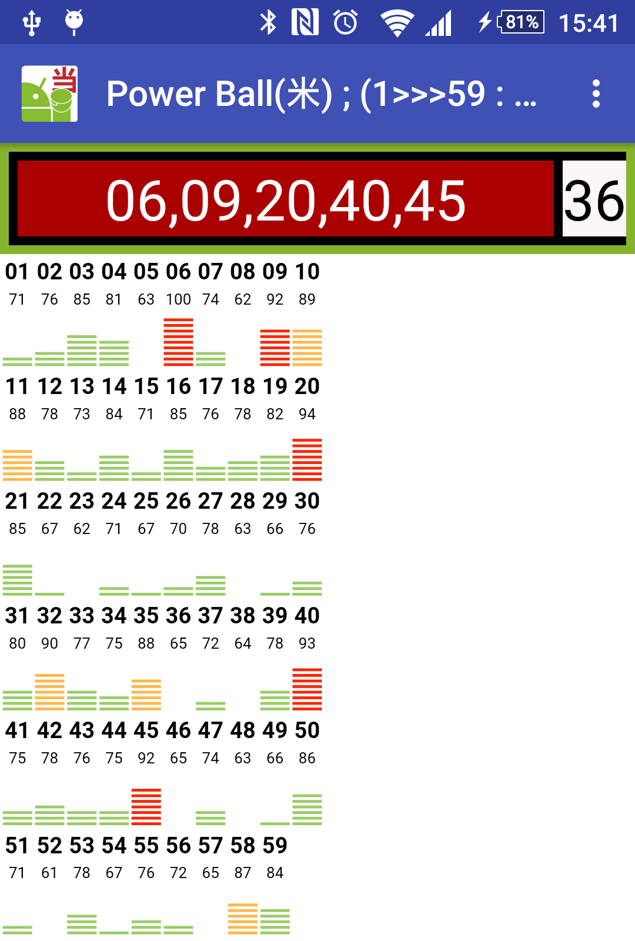
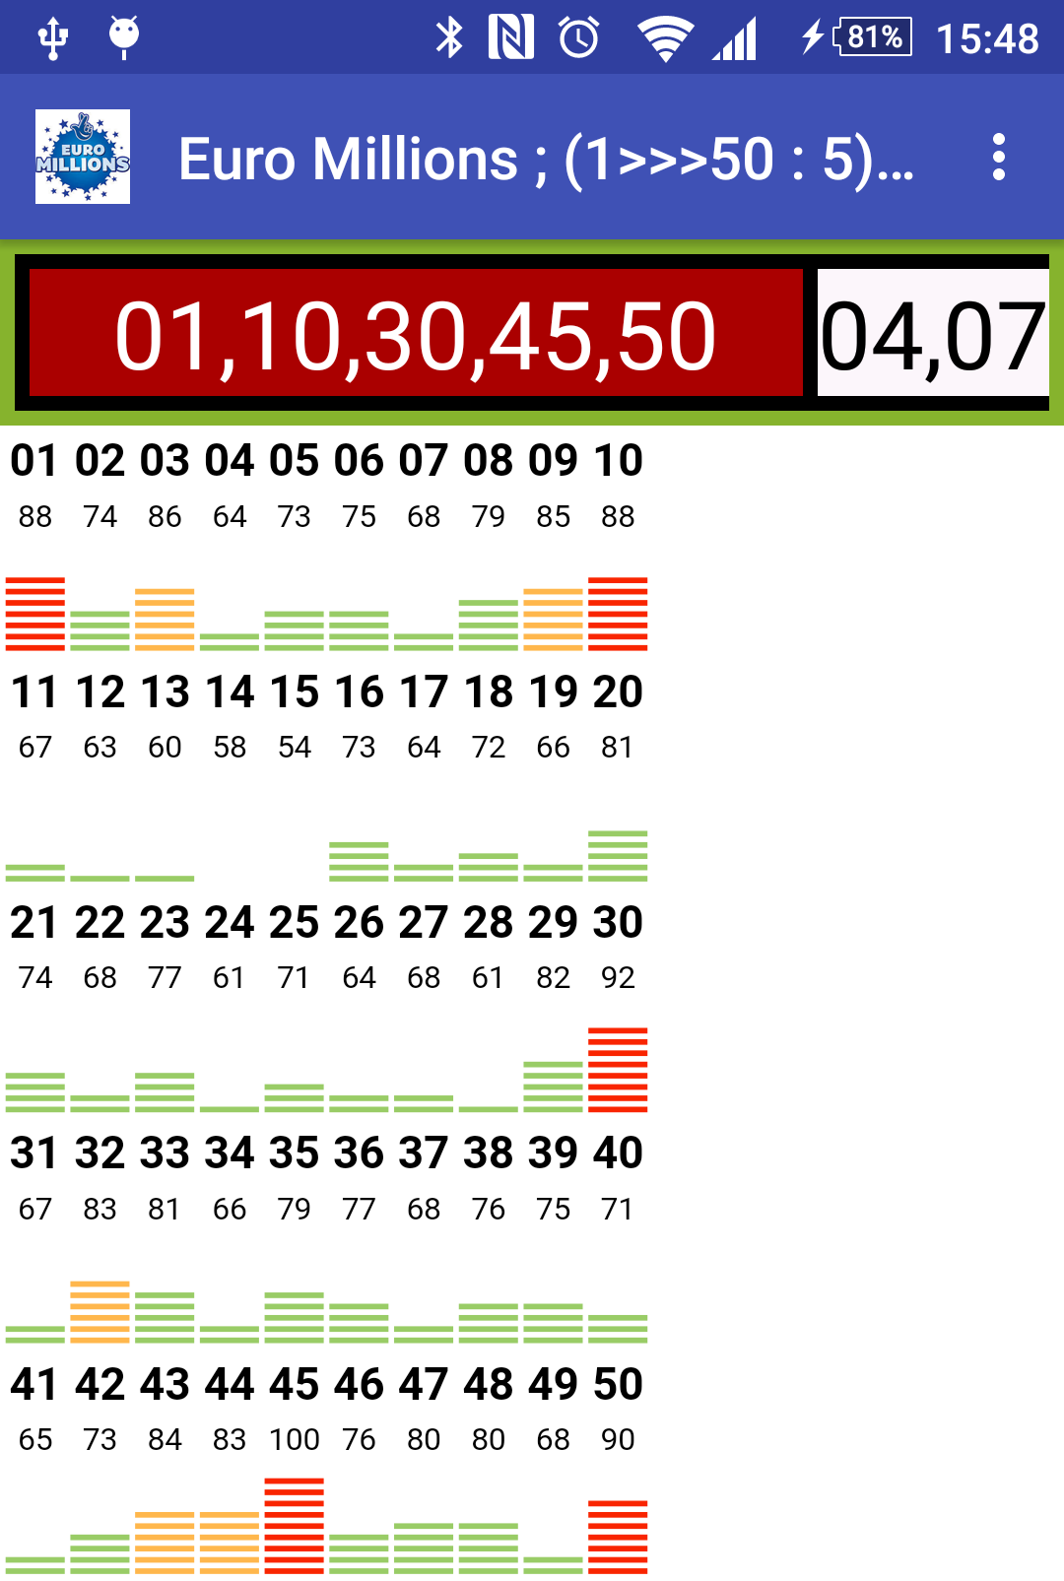
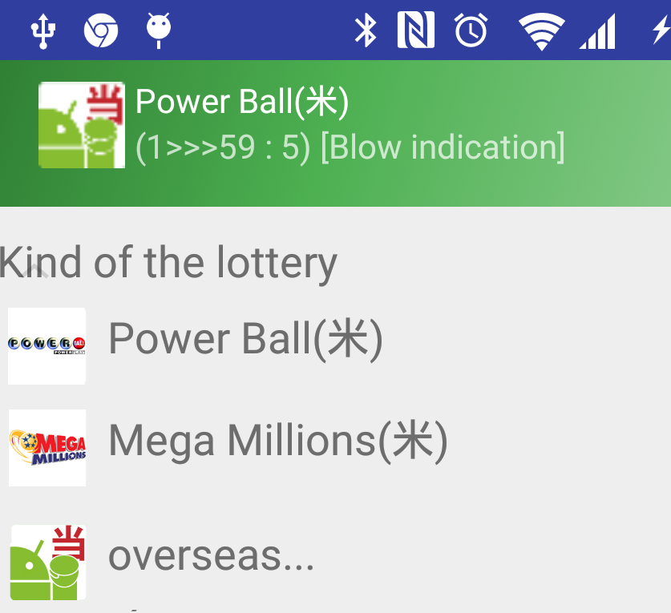
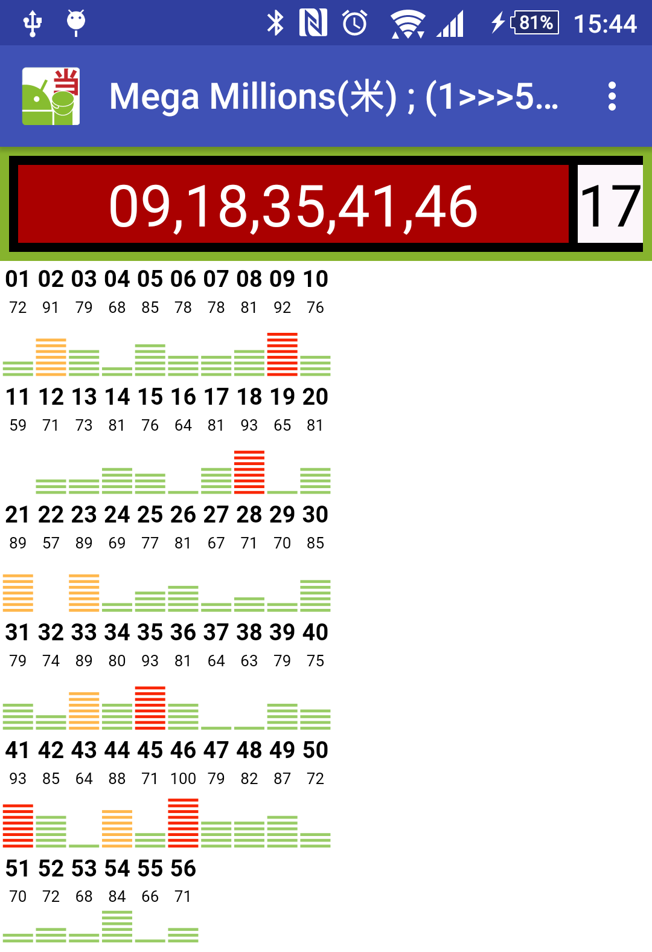
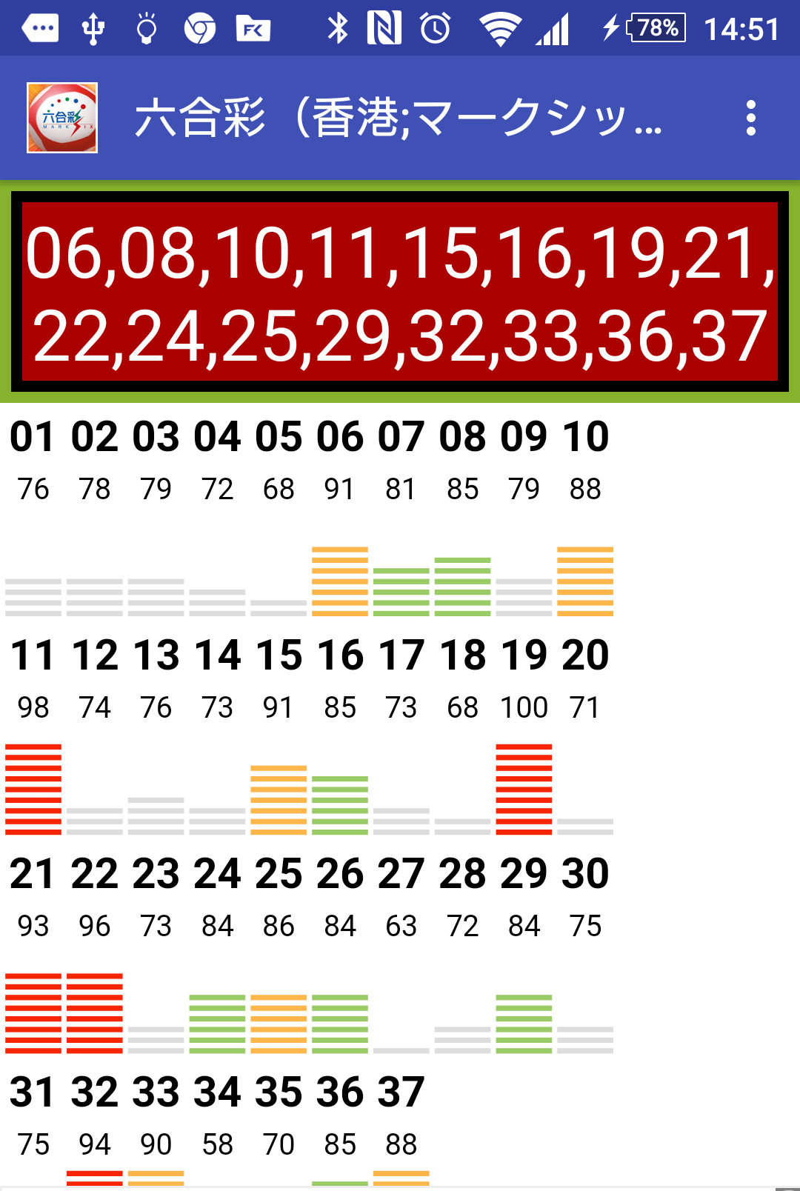
It is simple and is simple & The random number generator which supports various overseas number lotteries
Atare kun
The country where you stay in is distinguished by a phone line.
The new lottery sets it in "others"
Reshuffling is simple
If there is not time; "blow indication“
When even soothing wants to give precision with precision, "it is random number accumulation"
※Though it should be a random number, it is chosen among a number selling well for some reason

