Slide 1
Data understanding
Lecturer: Assoc.Prof. Nguyễn Phương Thái
VNU University of Engineering and Technology
Slide: from Assoc.Prof. Phan Xuân Hiếu, Updated: February 1, 2024
data understanding
1 / 106
Notes:
Hiểu dữ liệu là bước quan trọng trong mô hình CRISP-DM (tổng 6 bước).

Slide 2
Outline
Introduction
Get to know your data
Data attribute
Univariate, bivariate, and multivariate data Complex and structured data
Descriptive statistics of data Measuring the central tendency of data Measuring the dispersion of data
Relationships in data
Correlation and Pearson correlation Spearman’s rank correlation
Pearson’s chi–square test for categorical data Correlation versus causation
Excercises, References, and Summary
data understanding
2 / 106

Slide 3
Outline
Introduction
Get to know your data
Data attribute
Univariate, bivariate, and multivariate data Complex and structured data
Descriptive statistics of data Measuring the central tendency of data Measuring the dispersion of data
Relationships in data
Correlation and Pearson correlation Spearman’s rank correlation
Pearson’s chi–square test for categorical data Correlation versus causation
Excercises, References, and Summary
data understanding
3 / 106

Slide 4
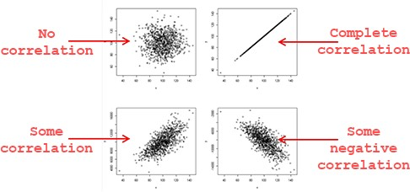
Play with data first
Understand the nature and characteristics of data first.
Data types
Noisy, incomplete, missing, imbalanced . . . data Data summarization (descriptive statistics) Data shape and distribution
Correlation in data
Other explicit and implicit dependencies in data
Machine learning and deep learning models later!
data understanding
4 / 106
Notes:
Ví dụ “vui” về sự tương quan (sự tương quan giữa lượng kem tiêu thụ và số lượng chết đuối của trẻ). Trong thực tế, sự tương quan giúp mô tả mối quan hệ giữa các yếu tố trong nhiều lĩnh vực như kinh tế, giáo dục, khoa học xã hội. Tuy nhiên, cần lưu ý rằng tương quan không đồng nghĩa với nhân quả. Ví dụ, nếu hai biến có sự tương quan cao, điều này không có nghĩa là một biến là nguyên nhân gây ra biến kia. Tương quan chỉ cho thấy sự liên hệ, không phải quan hệ nguyên nhân-hệ quả.

Slide 5

Do things right or do the right things?
Is there a strong correlation between the inputs and the target? Displaying ads based on preferences? why “yes” and why “no”? Predicting users’ gender based on reading behaviors?
Doing data clustering for any given dataset?
Doing topic analysis for very sparse data (lack of co-occurrences)?
Mining frequent patterns from a database having several (very) popular items?
data understanding
5 / 106

Slide 6
Cross–industry standard process for data mining (CRISP–DM)
The cross–industry standard process for data mining (CRISP–DM) is a process model that serves as the base for a data science process. It has six sequential phases:
Business understanding Data understanding Data preparation Modeling
Evaluation Deployment
Published in 1999 to standardize data mining processes across industries, it has since become the most common methodology for data mining, analytics, and data science projects.
1
2
3
4
5
6
data understanding

Slide 7
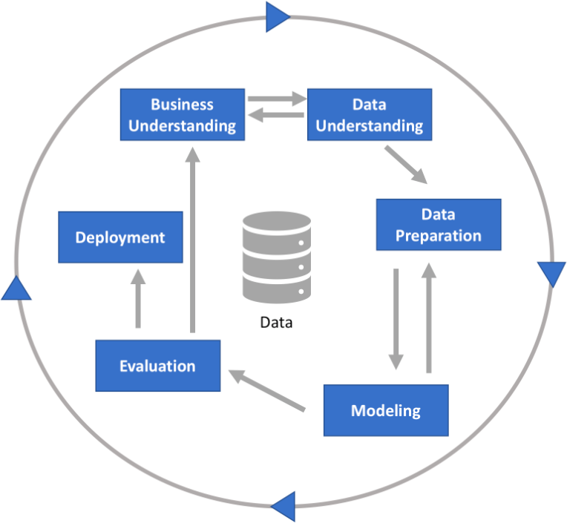
CRISP–DM process
data understanding

Slide 8
CRISP–DM phase 1: Business understanding
This phase focuses on understanding the objectives and requirements of the project. It includes four tasks:
Determine business objectives:
thoroughly understand, from a business perspective, what the customer/company really wants to accomplish, and then define business success criteria.
Assess situation:
determine resources availability, project requirements, assess risks and contingencies, and conduct a cost–benefit analysis.
Determine data mining goals:
in addition to defining the business objectives, you should also define what success looks like from a technical data mining perspective.
Produce project plan:
select technologies and tools and define detailed plans for each project phase.
data understanding

Slide 9
CRISP–DM phase 2: Data understanding
This phase drives the focus to identify, collect, and analyze the data sets that can help you accomplish the project goals. This phase also has four tasks:
Collect initial data:
acquire the necessary data and (if necessary) load it into your analysis tool.
Describe data:
examine the data and document its surface properties like data format, number of records, or field identities.
Explore data:
dig deeper into the data. Query it, visualize it, and identify relationships among the data.
Verify data quality:
how clean/dirty is the data? Document any quality issues.
data understanding

Slide 10
CRISP–DM phase 3: Data preparation
This phase prepares the final data for modeling. It has five tasks:
Select data:
determine which data sets will be used and document reasons for inclusion/exclusion.
Clean data:
often this is the lengthiest task. Without it, you will likely fall victim to garbage-in, garbage-out. A common practice during this task is to correct, impute, or remove erroneous values.
Construct data:
derive new attributes that will be helpful. For example, derive someone’s body mass index from height and weight fields.
Integrate data:
create new data sets by combining data from multiple sources.
Format data:
re-format data as necessary. For example, you might convert string values that store numbers to numeric values so that you can perform mathematical operations.
data understanding

Slide 11
Outline
Introduction
Get to know your data
Data attribute
Univariate, bivariate, and multivariate data Complex and structured data
Descriptive statistics of data Measuring the central tendency of data Measuring the dispersion of data
Relationships in data
Correlation and Pearson correlation Spearman’s rank correlation
Pearson’s chi–square test for categorical data Correlation versus causation
Excercises, References, and Summary
data understanding

Slide 12
Outline
Introduction
Get to know your data
Data attribute
Univariate, bivariate, and multivariate data Complex and structured data
Descriptive statistics of data Measuring the central tendency of data Measuring the dispersion of data
Relationships in data
Correlation and Pearson correlation Spearman’s rank correlation
Pearson’s chi–square test for categorical data Correlation versus causation
Excercises, References, and Summary
data understanding

Slide 13
Data attribute
An attribute is a data field, representing a characteristic or feature of a data object. Often called:
Field, column, or attribute in database.
Dimension in data warehousing.
Variable in statistics.
Feature, dimension in machine learning.
Example: attributes describing a student object can include:
student–id, name, gender, yob, phone–number, address, etc.
Observed values for a given attribute are known as observations.
data understanding
Notes:
Thuật ngữ quan trọng: thuộc tính

Slide 14
Attribute data types
Nominal or categorical attributes Binary attributes
Ordinal attributes Numeric attributes
Interval–scaled attributes Ratio–scaled attributes
Discrete vs. continuous attributes
data understanding
Notes:
Kiểu thuộc tính

Slide 15
Nominal or categorical attributes
The values of a nominal attribute are symbols or names of things.
Each value represents some kind of category, code, or state. Thus nominal attributes are also referred to as categorical.
The values do not have any meaningful order. Math operations are not meaningful. Examples:
Occupation: teacher, dentist, programmer, farmer, etc.
HairColor: black, brown, blond, red, gray, white, etc.
CustomerID: values are numeric or alpha–numeric, but can be seen as strings.
From the view of descriptive statistics:
No sense to find the mean (average) or median (middle) values. The mode (the most commonly occurring value) may exist.
data understanding
Notes:
- Thuộc tính định danh. Thuộc tính phân loại.
Lưu ý về thống kê mô tả: Đây là các phương pháp được sử dụng để tóm tắt và mô tả các đặc điểm cơ bản của dữ liệu, thường thông qua các chỉ số như trung bình, trung vị, phương sai, độ lệch chuẩn, và các biểu đồ biểu diễn dữ liệu.

Slide 16
Binary attributes
A binary attribute is a nominal attribute with only two categories/states: 0 or 1:
0 typically means that the attribute is absent, and 1 means that it is present.
It is also referred to as boolean if the two states correspond to true and false. Examples:
IsStudent: no or yes; false or true; 0 or 1.
CovidTest: negative or positive.
A binary attribute is symmetric if both of its states are equally valuable and carry the same weight. One example is the gender with two states male and female.
A binary attribute is asymmetric if the two states are not equally important.
Example: the positive and negative outcomes of a medical test for HIV.
By convention, we code the most important outcome, which is usually the rarest one, by 1 (e.g., HIV positive) and the other by 0 (e.g., HIV negative).
data understanding
16 / 106

Slide 17
Ordinal attributes
An ordinal attribute:
Has meaningful order or ranking among its values.
But the magnitude between successive values is not known.
Examples:
Size of drinks: small, medium, large. Grade: A+, A, B+, B, etc.
Rating: 1 (very dissatisfied ), 2 (dissatisfied ), 3 (neutral ), 4 (satisfied ), and 5 (very satisfied ).
Ordinal attributes may also be obtained from the discretization of numeric quantities by splitting the value range into a finite number of ordered categories.
From the view of descriptive statistics:
The mode and median values are existing. But the mean cannot be defined.
data understanding
Notes:
Thuộc tính có thứ bậc, thuộc tính có thứ tự
- Mode: Giá trị xuất hiện nhiều nhất (Trong thống kê, mode là giá trị xuất hiện với tần suất lớn nhất trong một tập hợp dữ liệu).
- Median: Trung vị (Là giá trị nằm ở giữa một tập hợp dữ liệu đã được sắp xếp theo thứ tự. Nếu số lượng phần tử là lẻ, trung vị là giá trị ở giữa, còn nếu là chẵn, trung vị là trung bình của hai giá trị giữa).

Slide 18
Numeric attributes
A numeric attribute
is a quantitative and measurable quantity, represented in integer or real values.
Numeric attributes can be:
Interval-scaled Ratio-scaled
data understanding

Slide 19
Interval–scaled attributes
Interval–scaled attributes are measured on a scale of equal–size units. The values have order and can be positive, 0, or negative.
This attribute type allows to compare and quantify the difference between values. Examples:
Temperature: 15oC, 18oC, 20oC, 25oC, 30oC, 37oC, etc.
CalendarYear: 1010, 1945, 1954, 2010, 2020, 2022, etc.
Temperature has no true zero–point (could not say 30oC is twice as warm as 15oC) From the view of descriptive statistics:
Can compute the mean, median, and mode values.
data understanding
Notes:
- Thuộc tính được chia theo khoảng được đo trên thang đo các đơn vị có kích thước bằng nhau. Các giá trị của thuộc tính được chia theo khoảng có thứ tự và có thể là dương, 0 hoặc âm. Do đó, ngoài việc cung cấp thứ hạng các giá trị, các thuộc tính như vậy cho phép chúng ta so sánh và định lượng sự khác biệt giữa các giá trị.

Slide 20
Ratio–scaled attributes
A ratio–scaled attribute is a numeric attribute with an inherent zero–point. If a measurement is ratio–scaled: a value is a multiple (or ratio) of another value. The is a meaningful order or ranking among values.
Examples:
Salary: US$2000 is twice as much as US$1000.
Other examples: Weight, Height, Longitude, Latitude, etc.
From the view of descriptive statistics:
Can compute the mean, median, and mode values.
data understanding
Notes:
Một thuộc tính tỷ lệ là một thuộc tính số có điểm gốc bằng 0 tự nhiên. Điều này có nghĩa là, nếu một phép đo có thang tỷ lệ, chúng ta có thể nói về một giá trị là bội số (hoặc tỷ lệ) của giá trị khác. Ngoài ra, các giá trị được sắp xếp theo thứ tự, và chúng ta cũng có thể tính toán sự chênh lệch giữa các giá trị, cũng như trung bình, trung vị và giá trị mode.

Slide 21
Discrete versus continuous attributes
Mining algorithms often talk of attributes as being either discrete or continuous. Each type may be processed differently.
A discrete attribute has a finite or countably infinite set of values:
May or may not be represented as integers.
HairColor, Gender, DrinkSize have a finite number of values, and so are discrete. May have numeric values: 0 and 1 for binary attributes; 0 to 150 for the attribute Age.
An attribute is countably infinite if the set of possible values is infinite but the values can be put in a one-to-one correspondence with natural numbers. For example, the attribute CustomerID is countably infinite.
data understanding

Slide 22
Discrete versus continuous attributes (cont’d)
If an attribute is not discrete, it is continuous.
The terms numeric attribute and continuous attribute are often used interchangeably in the literature.
This can be confusing because, in the classic sense, continuous values are real numbers, whereas numeric values can be either integers or real numbers.
data understanding

Slide 23
Outline
Introduction
Get to know your data
Data attribute
Univariate, bivariate, and multivariate data Complex and structured data
Descriptive statistics of data Measuring the central tendency of data Measuring the dispersion of data
Relationships in data
Correlation and Pearson correlation Spearman’s rank correlation
Pearson’s chi–square test for categorical data Correlation versus causation
Excercises, References, and Summary
data understanding

Slide 24
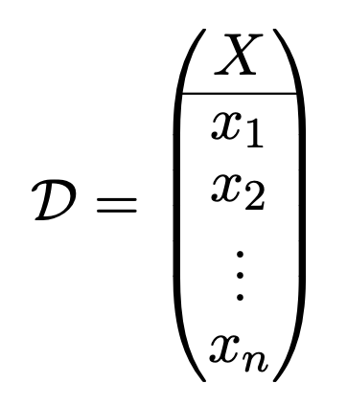
Univariate data
Univariate data is a type of data which consists observations from only one variable (X), i.e., a single characteristic or attribute:
(1)
Univariate data types: nominal/categorical (binary, finite, infinite) and numerical (discrete, continuous).
data understanding

Slide 25
Univariate data (cont’d)
Examples:
The Covid-19 test results of a sample of 12 persons:
D = {neg, pos, neg, neg, neg, pos, neg, neg, pos, neg, neg, neg}
Marks of a student for the last 15 courses:
D = {A, A+, B, B, A, B+, A+, A, B, C, C, A, B+, B, A}
Messi’s goals for Barcelona from 2004–2005 to 2020–2021:
D = {1, 8, 17, 16, 38, 47, 53, 73, 60, 41, 58, 41, 54, 45, 51, 31, 38}
The average high temperature in Hanoi for 12 months (oC):
D = {19.7, 20.1, 22.9, 27.2, 31.4, 32.9, 33.1, 32.3, 31.2, 28.8, 25.3, 22.0}
Univariate data analysis involves descriptive statistics like central tendency (mean, median, mode), dispersion (range, variance, quartiles, standard deviation), etc.
Univariate data visualization can be frequency distribution tables, bar charts, histograms, pie charts, etc.
data understanding
Notes:
- Phân tích dữ liệu đơn biến bao gồm thống kê mô tả như xu hướng trung tâm (trung bình, trung vị, mốt), phân tán (phạm vi, phương sai, tứ phân vị, độ lệch chuẩn), v.v.
- Hình ảnh hóa dữ liệu đơn biến có thể là bảng phân phối tần suất, biểu đồ thanh, biểu đồ histogram, biểu đồ hình tròn, v.v.

Slide 26
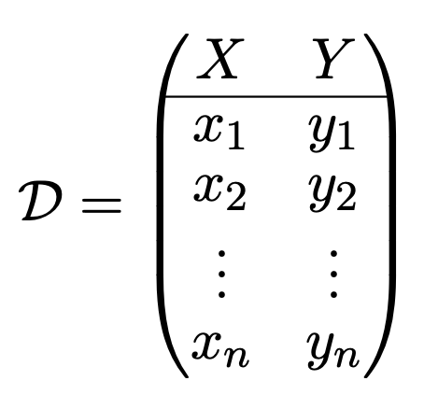
Bivariate data
Bivariate data is a type of data which consists observations from two variables (X,
Y ), i.e., considering two characteristics or attributes at the same time:
(2)
Like univariate data, X and Y can be either categorical or numerical.
data understanding

Slide 27
Bivariate data examples
Season | Apps | Goals
2004-05 | 9 | 1
2005-06 | 25 | 8
2006-07 | 36 | 17
2007-08 | 40 | 16
2008-09 | 51 | 38
2009-10 | 53 | 47
2010-11 | 55 | 53
2011-12 | 60 | 73
2012-13 | 50 | 60
2013-14 | 46 | 41
2014-15 | 57 | 58
2015-16 | 49 | 41
2016-17 | 52 | 54
2017-18 | 54 | 45
2018-19 | 50 | 51
2019-20 | 44 | 31
2020-21 | 47 | 38
Hours | GPA
6 | 3.2
9 | 3.8
10 | 3.9
13 | 3.6
6 | 2.5
5 | 2.7
7 | 2.9
19 | 3.9
20 | 3.8
14 | 3.4
10 | 3.1
7 | 2.6
4 | 2.2
8 | 2.9
4 | 3.2
Ad spend | Revenue
$14,500 | $59,000
$19,000 | $64,000
$22,400 | $89,000
$28,900 | $86,000
$30,000 | $94,000
$32,000 | $104,000
$29,000 | $89,000
$28,000 | $82,000
$32,000 | $88,000
$35,000 | $103,000
$29,000 | $94,000
$38,000 | $140,000
The advertising spend and the total revenue of 12 consecutive quarters
The number of hours studied per week and the GPA
Messi’s #apps, #goals for Barcelona
data understanding
Notes:
- The advertising spend and the total revenue of 12 consecutive quarters
-

Slide 28
Bivariate data analysis
Determining the potential relationship (correlation, association, dependency, causality, etc.) between two variables X and Y .
Regression (and classification):
Predicting or forecasting a value for one variable (e.g., Y – the dependent variable) if we know the value of the other (X – the independent variable); or
Inferring the causal relationships between the dependent and the independent variables.
Bivariate analysis can also be descriptive (central tendency, variability) or inferential (e.g., inferring properties of an underlying distribution, properties of a population, etc.)
Bivariate visualization with two–way frequency table, two–way proportion table, stacked bar chart, side–by–side bar chart, scatter plot, dot plot, grouped boxplots, grouped histograms, heatmap, etc.
data understanding
Notes:
- Xác định mối quan hệ tiềm năng (tương quan, liên kết, phụ thuộc, nhân quả, v.v.) giữa hai biến X và Y.
- Hồi quy (và phân loại):
+ Dự đoán hoặc dự báo giá trị cho một biến (ví dụ: Y – biến phụ thuộc) nếu chúng ta biết giá trị của biến kia (X – biến độc lập); hoặc
+ Suy ra mối quan hệ nhân quả giữa biến phụ thuộc và biến độc lập.
- Phân tích hai biến cũng có thể mang tính mô tả (xu hướng trung tâm, tính biến thiên) hoặc suy luận (ví dụ: suy ra các đặc tính của phân phối cơ bản, các đặc tính của quần thể, v.v.)
- Hình ảnh trực quan hai biến với bảng tần suất hai chiều, bảng tỷ lệ hai chiều, biểu đồ thanh xếp chồng, biểu đồ thanh cạnh nhau, biểu đồ phân tán, biểu đồ chấm, biểu đồ hộp nhóm, biểu đồ histogram nhóm, bản đồ nhiệt, v.v.

Slide 29
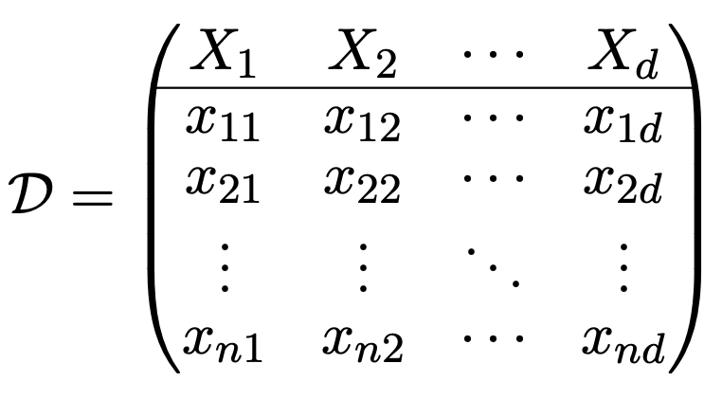
Multivariate data
Multivariate data is a type of data which consists observations from d variables/attributes (X₁, X₂, . . . , X_{d}), i.e., considering d characteristics or attributes at the same time. This is actually a n × d matrix as follows:
(3)
In the row view, the data can be considered as a set of n points or vectors in the
d-dimensional attribute space:
x_{i} = (x_{i1}, x_{i2}, . . . , x_{id})^{T}
Like univariate and bivariate data, X₁, X₂, . . . , X_{d} can be either categorical or numerical.
data understanding

Slide 30
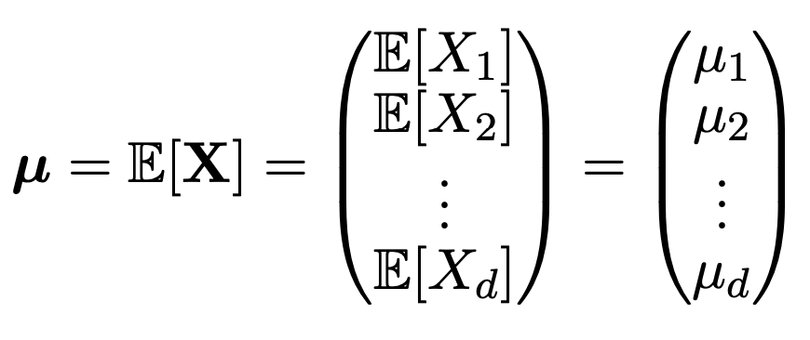
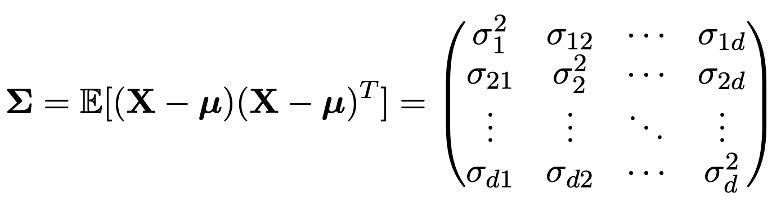
Multivariate data analysis
Multivariate mean vector:
(4)
Covariance matrix:
(5)
Classification, regression, clustering, association mining, etc. Visualization: a lot of ways and tools.
data understanding
Notes:
Ma trận hiệp phương sai:

Slide 31
IID data
IID data mean the all the observations (data points) in the a data sample are independent and identically (distributed) drawn from variable(s).
Univariate, bivariate, and multivariate data described above are assumed to be IID.
Univariate data: x_{i} (i = 1..n) are i.i.d from variable/attribute X.
Bivariate data: (x_{i}, y_{i}) (i = 1..n) are i.i.d from two variables/attributes (X, Y ). Multivariate data: (x_{i1}, x_{i2}, . . . , x_{id}) (i = 1..n) are i.i.d from d variables/attributes (X₁,
X₂, . . . , X_{d}).
However, i.i.d is a strong assumption. In reality, data points are not completely independent. There are some explicit or implicit dependencies among them.
The dependencies among data points can be temporal (time), spatial (e.g., position, neighbors, etc.), structural (e.g., edges, links, etc.), referential, etc.
Data with dependencies can be called dependency–oriented data or complex and structured data.
data understanding

Slide 32
Outline
Introduction
Get to know your data
Data attribute
Univariate, bivariate, and multivariate data Complex and structured data
Descriptive statistics of data Measuring the central tendency of data Measuring the dispersion of data
Relationships in data
Correlation and Pearson correlation Spearman’s rank correlation
Pearson’s chi–square test for categorical data Correlation versus causation
Excercises, References, and Summary
data understanding

Slide 33
Complex and structured data
Time–series data
Discrete sequences and strings Spatial data
Spatiotemporal data Network and graph data Other forms of data
data understanding

Slide 34
Time–series data
Time–series data contain values that are typically generated by continuous measurement over time.
For example, an environmental sensor will measure the temperature continuously, whereas an electrocardiogram (ECG) will measure the parameters of a subject’s heart rhythm.
Such data typically have implicit dependencies built into the values received over time. For example, the adjacent values recorded by a temperature sensor will usually vary smoothly over time, and this factor needs to be explicitly used in the data mining process.
The nature of the temporal dependency may vary significantly with the application. For example, some forms of sensor readings may show periodic patterns of the measured attribute over time.
data understanding
Notes:
- Dữ liệu chuỗi thời gian chứa các giá trị thường được tạo ra bằng phép đo liên tục theo thời gian.
- Ví dụ, cảm biến môi trường sẽ đo nhiệt độ liên tục, trong khi điện tâm đồ (ECG) sẽ đo các thông số về nhịp tim của đối tượng.
- Dữ liệu như vậy thường có các phụ thuộc ngầm được tích hợp vào các giá trị nhận được theo thời gian. Ví dụ, các giá trị liền kề được ghi lại bởi cảm biến nhiệt độ thường sẽ thay đổi trơn tru theo thời gian và yếu tố này cần được sử dụng rõ ràng trong quy trình khai thác dữ liệu.
- Bản chất của sự phụ thuộc theo thời gian có thể thay đổi đáng kể tùy theo ứng dụng. Ví dụ, một số dạng đọc cảm biến có thể hiển thị các mẫu tuần hoàn của thuộc tính được đo theo thời gian.

Slide 35
Time–series data (cont’d)
Attributes in time–series data are classified into two types:
Contextual attributes: These are the attributes that define the context on the basis of which the implicit dependencies occur in the data. For example, in the case of sensor data, the time stamp at which the reading is measured may be considered the contextual attribute. Sometimes, the time stamp is not explicitly used, but a position index is used.
Behavioral attributes: These represent the values that are measured in a particular context. In the sensor example, the temperature is the behavioral attribute value. It is possible to have more than one behavioral attribute. For example, if multiple sensors record readings at synchronized time stamps, then it results in a multidimensional time–series data set.
The contextual attributes typically have a strong impact on the dependencies between the behavioral attribute values in the data.
data understanding
Notes:
- Thuộc tính trong dữ liệu chuỗi thời gian được phân loại thành hai loại:
+ Thuộc tính theo ngữ cảnh: Đây là các thuộc tính xác định ngữ cảnh mà trên cơ sở đó các phụ thuộc ngầm xảy ra trong dữ liệu. Ví dụ, trong trường hợp dữ liệu cảm biến, dấu thời gian mà giá trị đọc được đo có thể được coi là thuộc tính theo ngữ cảnh. Đôi khi, dấu thời gian không được sử dụng rõ ràng, nhưng chỉ số vị trí được sử dụng.
+ Thuộc tính hành vi: Chúng biểu thị các giá trị được đo trong một ngữ cảnh cụ thể. Trong ví dụ về cảm biến, nhiệt độ là giá trị thuộc tính hành vi. Có thể có nhiều hơn một thuộc tính hành vi. Ví dụ, nếu nhiều cảm biến ghi lại các giá trị đọc tại các dấu thời gian được đồng bộ hóa, thì kết quả sẽ là một tập dữ liệu chuỗi thời gian đa chiều.
- Các thuộc tính theo ngữ cảnh thường có tác động mạnh đến các phụ thuộc giữa các giá trị thuộc tính hành vi trong dữ liệu.

Slide 36
Time–series data definition
Multivariate time–series data [2]:
A time–series of length n and dimensionality d contains d numeric features at each of n time stamps t₁, t₂, . . . , t_{n}. Each timestamp contains a component for each of the d series. Therefore,
the set of values received at timestamp t_{i} is Y¯_{i} = (y¹, y², . . . , y^{d}). The value of the j^{th} series at
¯ ¯
i i i
j
¯
timestamp t is y . The time–series data are {
Y , Y , . . . , Y }
i
1 2
_{n} .
i
For example, consider the case where two sensors at a particular location monitor the temperature and pressure every second for a minute. This corresponds to a multidimensional series with d = 2 and n = 60. In some cases, the timestamps t₁, t₂,
. . . , t_{n} may be replaced by index values from 1 through n, especially when the timestamp values are equally spaced apart.
Time-series data are relatively common in many sensor applications, health, weather forecasting, and financial market analysis.
data understanding

Slide 37
Discrete sequences and strings
Discrete sequences can be considered the categorical analog of time–series data. As in the case of time–series data, the contextual attribute is a time stamp or a position index in the ordering. The behavioral attribute is a categorical value;
Therefore, discrete sequence data are defined in a similar way to time–series data.
Multivariate discrete sequence data [2]:
A discrete sequence of length n and dimensionality d contains d discrete feature values at each of
n different timestamps t₁, t₂, . . . , t_{n}. Each of the n components Y¯_{i} contains d discrete behavioral
attributes (y¹, y², . . . , y^{d}), collected at the i^{th} timestamp.
i i i
data understanding

Slide 38
Discrete sequences and strings (cont’d)
For example, consider a sequence of Web accesses, in which the Web page address and the originating IP address of the request are collected for 100 different accesses. This represents a discrete sequence of length n = 100 and dimensionality d = 2.
A particularly common case in sequence data is the univariate scenario, in which the value of d is 1. Such sequence data are also referred to as strings.
In theory, it is possible to have series that are mixed between categorical and numerical data.
Another important variation is the case where a sequence does not contain categorical attributes, but a set of any number of unordered categorical values. For example, supermarket transactions may contain a sequence of sets of items. Each set may contain any number of items. Such setwise sequences are not really multivariate sequences, but are univariate sequences.
Thus, discrete sequences can be defined in a wider variety of ways, as compared to time–series data because of the ability to define sets on discrete elements.
data understanding

Slide 39
Discrete sequences and strings (cont’d)
In some cases, the contextual attribute may be a position based on physical placement. In such cases, the timestamp may be replaced by an index representing the position of the value in the string, starting at 0 or 1. Examples:
Event logs: A wide variety of computer systems, Web servers create event logs on the basis of user activity. An example of an event log is a sequence of user actions at a financial Web site:
Login Password Login Password Login Password . . .
This particular sequence may represent a scenario where a user is attempting to break into a password-protected system, and it may be interesting in anomaly detection.
Biological data: In this case, the sequences may correspond to strings of nucleotides or amino acids. The ordering of such units provides information about the characteristics of protein function. Therefore, the data mining can be used to determine interesting patterns reflecting different biological properties.
Discrete sequences are often more challenging for mining algorithms because they do not have the smooth value continuity of time–series data.
data understanding

Slide 40
Spatial data
In spatial data, many nonspatial attributes (e.g., temperature, pressure, image pixel color intensity) are measured at spatial locations.
For example, sea-surface temperatures are often collected by meteorologists to forecast the occurrence of hurricanes. In such cases, the spatial coordinates correspond to contextual attributes, whereas attributes such as the temperature correspond to the behavioral attributes.
Typically, there are two spatial attributes. As in the case of time–series data, it is also possible to have multiple behavioral attributes. For example, in the sea-surface temperature application, one might also measure other behavioral attributes such as the pressure.
data understanding
Notes:
- Trong dữ liệu không gian, nhiều thuộc tính phi không gian (ví dụ: nhiệt độ, áp suất, cường độ màu pixel ảnh) được đo tại các vị trí không gian.
- Ví dụ, nhiệt độ bề mặt biển thường được các nhà khí tượng học thu thập để dự báo sự xuất hiện của bão. Trong những trường hợp như vậy, tọa độ không gian tương ứng với các thuộc tính theo ngữ cảnh, trong khi các thuộc tính như nhiệt độ tương ứng với các thuộc tính hành vi.
- Thông thường, có hai thuộc tính không gian. Giống như trong trường hợp dữ liệu chuỗi thời gian, cũng có thể có nhiều thuộc tính hành vi. Ví dụ, trong ứng dụng nhiệt độ bề mặt biển, người ta cũng có thể đo các thuộc tính hành vi khác như áp suất.

Slide 41
Spatial data (cont’d)
Spatial data [2]:
A d-dimensional spatial data record contains d behavioral attributes and one or more contextual attributes containing the spatial location. Therefore, a d-dimensional spatial data set is a set of d dimensional records X¯₁, X¯₂, . . . , X¯_{n}, together with a set of n locations L₁, L₂, . . . , L_{n}, such that the record X¯_{i} is associated with the location L_{i}.
The aforementioned definition provides broad flexibility in terms of how record X¯_{i} and location L_{i} may be defined.
For example, the behavioral attributes in record X¯_{i} may be numeric or categorical, or a mixture of the two. In the meteorological application, X¯_{i} may contain the temperature and pressure attributes at location L_{i}.
Furthermore, L_{i} may be specified in terms of precise spatial coordinates, such as latitude and longitude, or in terms of a logical location, such as the city or state.
data understanding
Notes:
- Định nghĩa nêu trên cung cấp tính linh hoạt rộng rãi về cách bản ghi X¯i và vị trí Li có thể được định nghĩa.
- Ví dụ, các thuộc tính hành vi trong bản ghi X¯i có thể là số hoặc theo danh mục, hoặc là sự kết hợp của cả hai. Trong ứng dụng khí tượng, X¯i có thể chứa các thuộc tính nhiệt độ và áp suất tại vị trí Li.
- Hơn nữa, Li có thể được chỉ định theo tọa độ không gian chính xác, chẳng hạn như vĩ độ và kinh độ, hoặc theo vị trí hợp lý, chẳng hạn như thành phố hoặc tiểu bang.

Slide 42
Spatial data (cont’d)
Spatial data mining is closely related to time–series data mining, in that the behavioral attributes in most commonly studied spatial applications are continuous, although some applications may use categorical attributes as well.
Therefore, value continuity is observed across contiguous spatial locations, just as value continuity is observed across contiguous time stamps in time–series data.
data understanding
Notes:
- Khai thác dữ liệu không gian có liên quan chặt chẽ với khai thác dữ liệu chuỗi thời gian, ở chỗ các thuộc tính hành vi trong hầu hết các ứng dụng không gian được nghiên cứu phổ biến nhất là liên tục, mặc dù một số ứng dụng cũng có thể sử dụng các thuộc tính theo danh mục.
- Do đó, tính liên tục của giá trị được quan sát thấy trên các vị trí không gian liền kề, cũng giống như tính liên tục của giá trị được quan sát thấy trên các dấu thời gian liền kề trong dữ liệu chuỗi thời gian.

Slide 43
Spatiotemporal data
A particular form of spatial data is spatiotemporal data, which contains both spatial and temporal attributes.
The precise nature of the data also depends on which of the attributes are contextual and which are behavioral. Two kinds of spatiotemporal data are most common:
Both spatial and temporal attributes are contextual : This kind of data can be viewed as a direct generalization of both spatial data and temporal data. This kind of data is particularly useful when the spatial and temporal dynamics of particular behavioral attributes are measured simultaneously. For example, consider the case where the variations in the sea-surface temperature need to be measured over time. In such cases, the temperature is the behavioral attribute, whereas the spatial and temporal attributes are contextual.
The temporal attribute is contextual, whereas the spatial attributes are behavioral : Strictly speaking, this kind of data can also be considered time–series data. However, the spatial nature of the behavioral attributes also provides better interpretability and more focused analysis in many scenarios. The most common form of this data arises in the context of trajectory analysis.
data understanding

Slide 44
Network and graph data
In network and graph data, the data values may correspond to nodes in the network, whereas the relationships among the data values may correspond to the edges in the network.
In some cases, attributes may be associated with nodes in the network.
Although it is also possible to associate attributes with edges in the network, it is much less common to do so.
Network data [2]:
A network G = (N, E) contains a set of nodes N and a set of edges E, where the edges in E represent the relationships between the nodes. In some cases, an attribute set X¯_{i} may be associated with node i, or an attribute set Y¯_{ij} may be associated with edge (i, j).
data understanding

Slide 45
Network and graph data (cont’d)
The edge (i, j) may be directed or undirected. For example, the Web graph may contain directed edges corresponding to directions of hyper–links between pages, whereas friendships in Facebook are undirected.
A second class of graph mining problems is that of a database containing many small graphs such as chemical compounds. The challenges in these two classes of problems are very different. Some examples of data that are represented as graphs:
Web graph: The nodes correspond to the Web pages, and the edges correspond to hyperlinks. The nodes have text attributes corresponding to the content in the page.
Social networks: The nodes correspond to social network actors; the edges correspond to friendship links. The nodes may have attributes corresponding to social page content. Some specialized forms of social networks are email or chat-messenger networks, the edges may have content associated with them.
Chemical compound databases: The nodes correspond to the elements and the edges correspond to the chemical bonds between the elements. The structures in these chemical compounds are very useful for identifying important reactive and pharmacological properties of these compounds.
data understanding

Slide 46
Network and graph data (cont’d)
Network data are a very general representation and can be used for solving many similarity–based applications on other data types;
For example, multidimensional data may be converted to network data by creating a node for each record in the database, and representing similarities between nodes by edges. Such a representation is used quite often for many similarity–based data mining applications, such as clustering.
It is possible to use community detection algorithms to determine clusters in the network data and then map them back to multidimensional data.
data understanding

Slide 47
Other forms of data
Text data: can be seen as discrete sequences; each element is a word or token.
Natural language data: can be seen as discrete sequences; each element can be character, token, word, phrase, sentence, paragraph.
Speech data: can be seen as discrete sequences or time–series data.
Image data: can be seen as spatial data.
Video data: can be seen as discrete sequences or time–series data where each element is a frame.
data understanding

Slide 48
Outline
Introduction
Get to know your data
Data attribute
Univariate, bivariate, and multivariate data Complex and structured data
Descriptive statistics of data Measuring the central tendency of data Measuring the dispersion of data
Relationships in data
Correlation and Pearson correlation Spearman’s rank correlation
Pearson’s chi–square test for categorical data Correlation versus causation
Excercises, References, and Summary
data understanding

Slide 49
Outline
Introduction
Get to know your data
Data attribute
Univariate, bivariate, and multivariate data Complex and structured data
Descriptive statistics of data Measuring the central tendency of data Measuring the dispersion of data
Relationships in data
Correlation and Pearson correlation Spearman’s rank correlation
Pearson’s chi–square test for categorical data Correlation versus causation
Excercises, References, and Summary
data understanding

Slide 50
Measuring the central tendency of data
Suppose D = {x₁, x₂, . . . , x_{n}} is a data sample (i.e., univariate data) consisting of n
observations of a variable or attribute X.
If we were to plot the observations in D, where would most of the values fall? This
gives us an idea of the central tendency of the data. Measures of central tendency include:
Mean Median Mode Midrange
data understanding

Slide 51
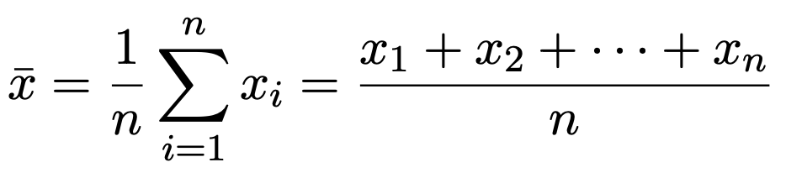
Mean
The most common and effective numeric measure of the “center” of a set of data is the (arithmetic) mean, i.e., the average.
The mean of D = {x₁, x₂, . . . , x_{n}}, denoted x¯, is:
(6)
Examples:
Messi’s goals for Barcelona from 2004–2005 to 2020–2021:
D = {1, 8, 17, 16, 38, 47, 53, 73, 60, 41, 58, 41, 54, 45, 51, 31, 38}
_{x¯ =} 1 + 8 + 17 + · · · + 51 + 31 + 38 ₌ 672 _{= 39.53}
17 17
Salary (in $k) of 12 employees in a company (shown in increasing order):
D = {30, 36, 47, 50, 52, 52, 56, 60, 62, 70, 110, 215}
_{x¯ =} 30 + 36 + 47 + · · · + 70 + 110 + 215 ₌ 840 ₌ ₇₀
12 12
data understanding

Slide 52
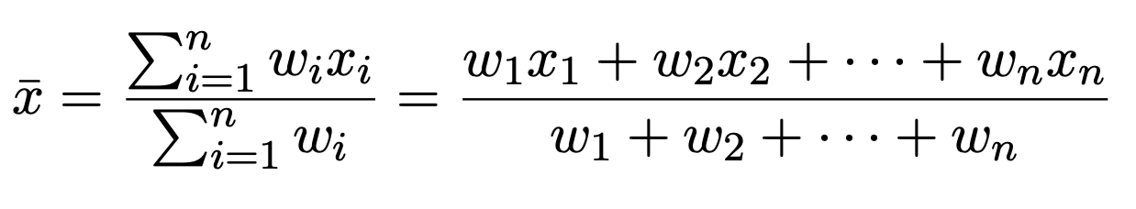
Weighted mean or weighted average
Sometimes, each value x_{i} in D may be associated with a weight w_{i} (for i = 1..n). The weights reflect the significance, importance, or occurrence frequency attached to their respective values. In this case, the weighted mean (weighted average) is:
(7)
data understanding

Slide 53
Mean and its issues
Although the mean is the most well–known quantity for describing a data sample, it is not always the best way of measuring the center of the data.
A major problem with the mean is its sensitivity to extreme values (e.g.,
outliers). Even a small number of extreme values can corrupt the mean.
For example, the mean salary above may be substantially pushed up by that of a few highly paid managers ($110k, $215k). Similarly, the mean score of a class in an exam could be pulled down quite a bit by a few very low scores.
To offset the effect caused by a small number of extreme values, we can instead use the trimmed mean, which is the mean obtained after chopping off values at the high and low extremes. For example, we can sort the values observed for salary and remove the top and bottom 2% before computing the mean.
data understanding
Notes:
- Mặc dù giá trị trung bình là đại lượng được biết đến nhiều nhất để mô tả một mẫu dữ liệu, nhưng nó không phải lúc nào cũng là cách tốt nhất để đo trung tâm của dữ liệu.
- Một vấn đề lớn với giá trị trung bình là độ nhạy của nó với các giá trị cực đoan (ví dụ:
giá trị ngoại lai). Ngay cả một số lượng nhỏ các giá trị cực đoan cũng có thể làm hỏng giá trị trung bình.
- Ví dụ, mức lương trung bình ở trên có thể tăng đáng kể do một số nhà quản lý được trả lương cao (110.000 đô la, 215.000 đô la). Tương tự như vậy, điểm trung bình của một lớp trong kỳ thi có thể giảm khá nhiều do một số điểm rất thấp.
- Để bù đắp cho hiệu ứng do một số lượng nhỏ các giá trị cực đoan gây ra, thay vào đó, chúng ta có thể sử dụng giá trị trung bình đã cắt bớt, là giá trị trung bình thu được sau khi cắt bỏ các giá trị ở mức cực cao và cực thấp. Ví dụ, chúng ta có thể sắp xếp các giá trị quan sát được đối với mức lương và loại bỏ 2% trên cùng và dưới cùng trước khi tính giá trị trung bình.

Slide 54
Median
For skewed (asymmetric) data, a better measure is the median.
Median is the middle value in a set of ordered data values. It is the value that separates the higher half of a data set from the lower half.
In probability and statistics, the median generally applies to numeric data. However, it may apply to ordinal data.
Given D = {x₁, x₂, . . . , x_{n}} is a sample from a variable/attribute X, let
D′ = {x′₁, x₂′ , . . . , x′_{n}} is the list of values after sorting D in increasing order.
If n is odd, then the median is the middle value of D′. If n is even, then the median is not unique; it is the two middlemost values and any value in between. If X is a numeric attribute in this case, by convention, the median is taken as the average of the two middlemost values.
data understanding

Slide 55
Median (cont’d)
In other words, if X is numeric, the median is:
x′_{a} + x′_{b}
median =
(8)
2
where a = ⌈ ^{n} ⌉ (is the smallest integral value greater than or equal to ^{n} ) and
2 2
n n
b = ⌊ + 1⌋ (is the largest integral value less than or equal to + 1).
2
2
Examples:
Messi’s goals for Barcelona from 2004–2005 to 2020–2021:
D′= {1, 8, 17, 16, 38, 47, 53, 73, 60, 41, 58, 41, 54, 45, 51, 31, 38}.
D = {1, 8, 16, 17, 31, 38, 38, 41, 41, 45, 47, 51, 53, 54, 58, 60, 73}
median = x′₉ = 41
Salary (in $k) of 12 employees in a company (shown in increasing order):
D = {30, 36, 47, 50, 52, 52, 56, 60, 62, 70, 110, 215}
52 + 56 108
median =
= = 54 (more reasonable than x¯ = 70)
2 2
data understanding

Slide 56
Mode
The mode is another measure of central tendency.
The mode for a set of data is the value that occurs most frequently in the set. Therefore, it can be determined for both qualitative and quantitative attributes.
It is possible for the greatest frequency to correspond to several different values, which results in more than one mode. Data sets with one, two, or three modes are respectively called unimodal, bimodal, and trimodal. In general, a data set with two or more modes is multimodal.
If each data value occurs only once, then there is no mode. Examples:
Messi’s goals for Barcelona from 2004–2005 to 2020–2021:
{1, 8, 17, 16, 38, 47, 53, 73, 60, 41, 58, 41, 54, 45, 51, 31, 38}. mode = 38 or 41 (bimodal).
Salary (in $k) of 12 employees in a company:
{30, 36, 47, 50, 52, 52, 56, 60, 62, 70, 110, 215}. mode = 52.
Marks of a student for the last 15 courses:
{A, A+, B, B, A, B+, A+, A, B, C, C, A, B+, B, A}. mode = A.
data understanding

Slide 57
Midrange
The midrange can also be used to assess the central tendency of a numeric data set. It is the average of the largest and smallest values in the set.
Examples: salary (in $k) of 12 employees in a company:
D = {30, 36, 47, 50, 52, 52, 56, 60, 62, 70, 110, 215}. midrange =
30+215
2
= 122.5.
The midrange value is even more affected by outlier values than the mean.
data understanding

Slide 58
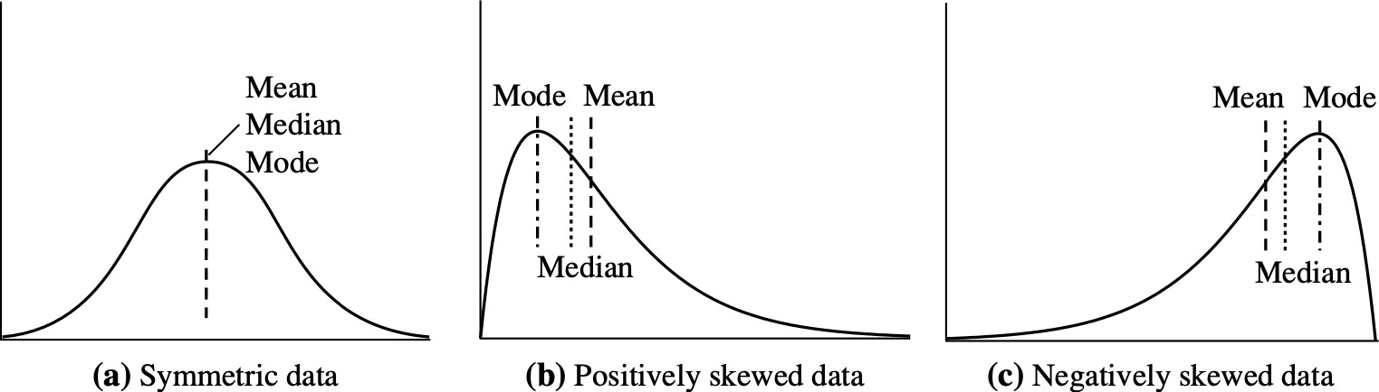
Mean, median, and mode for skewed data
Mean, median, and mode of symmetric versus positively and negatively skewed data [1]
In a unimodal frequency curve with perfect symmetric data distribution, the mean, median, and mode are all at the same center value (figure a).
Data in most real applications are not symmetric. They may instead be either positively skewed, where the mode occurs at a value that is smaller than the median (figure b), or negatively skewed, where the mode occurs at a value greater than the median (figure c).
data understanding

Slide 59
Outline
Introduction
Get to know your data
Data attribute
Univariate, bivariate, and multivariate data Complex and structured data
Descriptive statistics of data Measuring the central tendency of data Measuring the dispersion of data
Relationships in data
Correlation and Pearson correlation Spearman’s rank correlation
Pearson’s chi–square test for categorical data Correlation versus causation
Excercises, References, and Summary
data understanding

Slide 60
Measuring the dispersion of data
Range
Quantiles
Quartiles
Interquartile range
Five–number summary
Boxplots
Outliers
Variance and standard deviation
data understanding

Slide 61
Range
Let D = {x₁, x₂, . . . , x_{n}} be univariate data consisting of n observations sampling from a numeric variable/attribute X.
The range of D is the difference between the largest (max()) and smallest (min())
values in S. Examples:
Messi’s goals for Barcelona from 2004–2005 to 2020–2021:
D = {1, 8, 17, 16, 38, 47, 53, 73, 60, 41, 58, 41, 54, 45, 51, 31, 38}
Range = 73 - 1 = 72.
Salary (in $k) of 12 employees in a company:
D = {30, 36, 47, 50, 52, 52, 56, 60, 62, 70, 110, 215}
Range = 215 - 30 = 185.
data understanding

Slide 62
Quantiles
Suppose that the data points/values in the data sample D are sorted in increasing numeric order.
Imagine that we can pick certain data points so as to split D into equal-size
consecutive sets/parts.
These data points are called quantiles. Quantiles are points taken at regular intervals of a data sample, dividing it into essentially equal-size consecutive sets/parts.
The k^{th} q-quantile for a given data sample is the value x such that at most k/q of
the data values are less than x and at most (q − k)/q of the data values are more
than x, where k is an integer such that 0 < k < q. There are q − 1 q-quantiles. There are some well-known q-quantiles:
4-quantiles (Quartiles): 3 quartiles split the data into four parts
10-quantiles (Deciles): 9 deciles split the data into 10 parts
100-quantiles (Percentiles): 99 percentiles split the data into 100 parts
data understanding

Slide 63
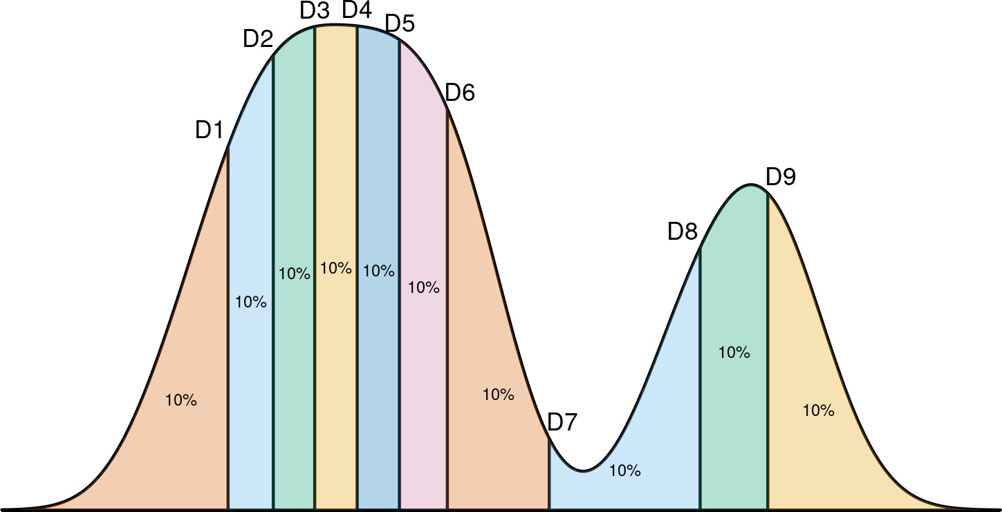
10–quantiles or deciles
10–quantiles (also called deciles) are 9 values (D1, D2, . . . , D9) dividing the data distribution into 10 equal–size consecutive parts [source: Internet]
data understanding

Slide 64
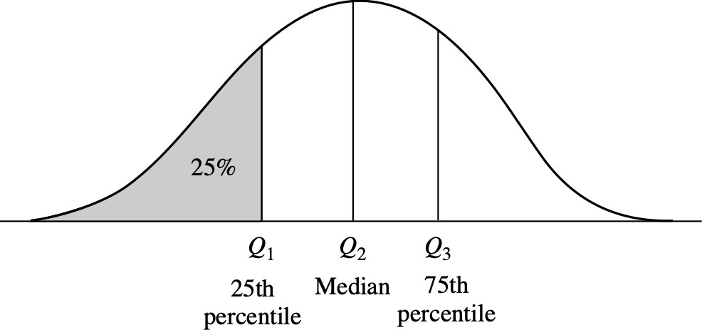
Quartiles
Quartiles divide the distribution into four equal–size consecutive subsets [1]
Quartiles are three values (Q₁, Q₂, Q₃) dividing the (sample) distribution into four equal–size consecutive parts.
The first quartile (Q₁) corresponds to the 25th percentile.
The second quartile (Q₂) corresponds to the 50th percentile, i.e., the median. The third quartile (Q₃) corresponds to the 75th percentile.
data understanding

Slide 65
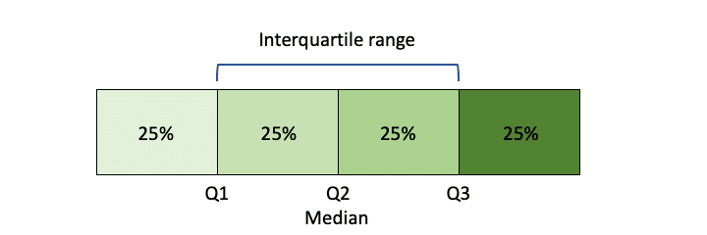
Interquartile range
The distance between the first and third quartiles is a simple measure of spread that gives the range covered by the middle half of the data. This distance is called the interquartile range (IQR) and is defined as
IQR = Q₃ − Q₁ (9)
Example:
Salary (in $k) of 12 employees in a company (shown in increasing order):
D = {30, 36, 47, 50, 52, 52, 56, 60, 62, 70, 110, 215}.
Q₁ = $47,000 and Q₃ = $62,000.
IQR = $62,000 - $47,000 = $15,000.
data understanding

Slide 66
Five–number summary
No single numeric measure of spread (e.g., IQR) is very useful for describing skewed distributions.
In the symmetric distribution, the median (and other measures of central tendency) splits the data into equal–size halves. This does not occur for skewed distributions.
Therefore, it is more informative to also provide the two quartiles Q₁ and Q₃, along with the median.
Because Q₁, the median, and Q₃ together contain no information about the end–points (e.g., tails) of the data, a fuller summary of the shape of a distribution can be obtained by providing the lowest and highest data values as well.
This is known as the five–number summary. The five–number summary of a distribution consists of the median (Q₂), the quartiles Q₁ and Q₃, and the smallest and largest individual observations, written in the order of
{Minimum, Q₁, Median, Q₃, Maximum}
data understanding

Slide 67
Boxplots (a.k.a box-and-whisker plots)
Boxplots are a popular way of visualizing a distribution. A boxplot incorporates the five–number summary as follows:
Typically, the ends of the box are at the quartiles (Q₁ and Q₃) so that the box length is the interquartile range.
The median is marked by a line within the box.
Two lines (called whiskers) outside the box extend to the smallest (Minimum) and largest (Maximum) observations/values.
Boxplots with outliers:
When dealing with a moderate number of observations, it is worthwhile to plot potential outliers individually.
The whiskers are extended to the extreme low and high observations only if these values are less than 1.5 × IQR beyond the quartiles.
Otherwise, the whiskers terminate at the most extreme observations occurring within 1.5 × IQR of the quartiles.
data understanding

Slide 68
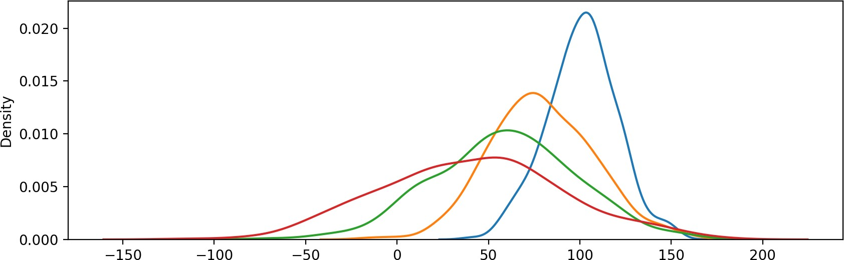
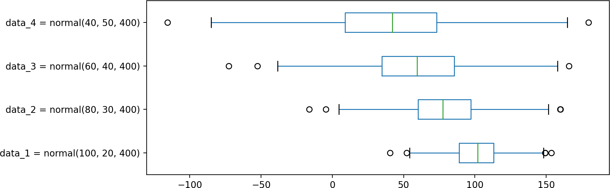
Boxplot examples
data understanding

Slide 69
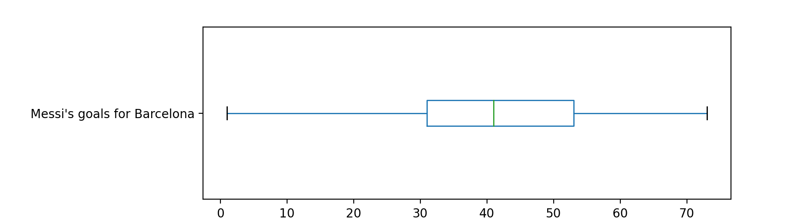
Boxplot examples (cont’d)
Messi’s goals for Barcelona from 2004–2005 to 2020–2021:
D′ = {1, 8, 17, 16, 38, 47, 53, 73, 60, 41, 58, 41, 54, 45, 51, 31, 38}
D = {1, 8, 16, 17, 31, 38, 38, 41, 41, 45, 47, 51, 53, 54, 58, 60, 73}
Minimum = 1
Q₁ = 31
Median (Q₂) = 41
Q₃ = 53
Maximum = 73
data understanding

Slide 70
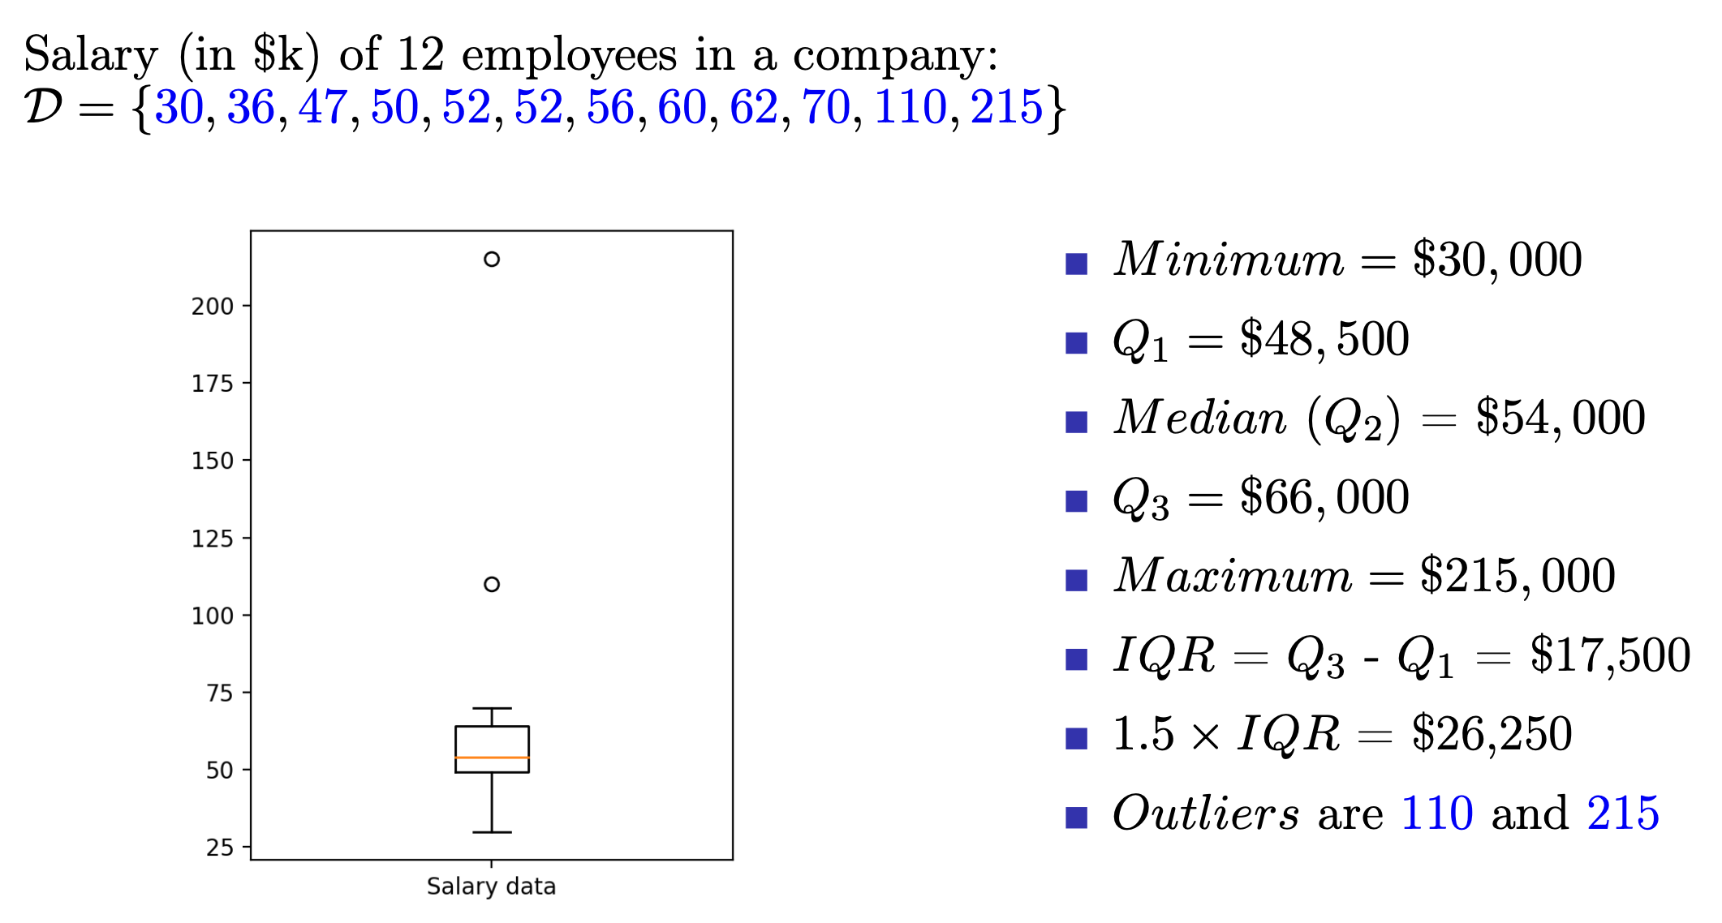
Boxplot examples (cont’d)
data understanding

Slide 71
What is boxplot useful for?
Boxplots are especially useful for showing the central tendency, the data dispersion, the skewness of data distributions, and the outliers:
The position of the median → the central tendency. The box length → the data dispersion.
The position of the box relative to the both ends (i.e., Minimum and Maximum)
→ the skewness of the distribution.
The data values too far from Q₁ (i.e., smaller than Q₁ − 1.5 × IQR) and Q₃ (i.e., larger than Q₃ + 1.5 × IQR) → outliers.
data understanding

Slide 72
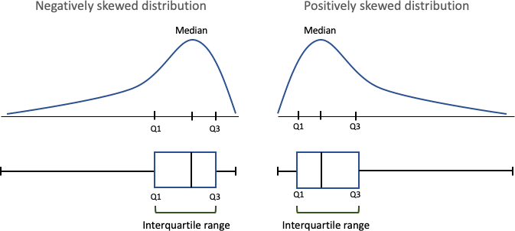
How boxplots depict skewed data
Boxplots for skewed distributions [source: Internet]
data understanding

Slide 73
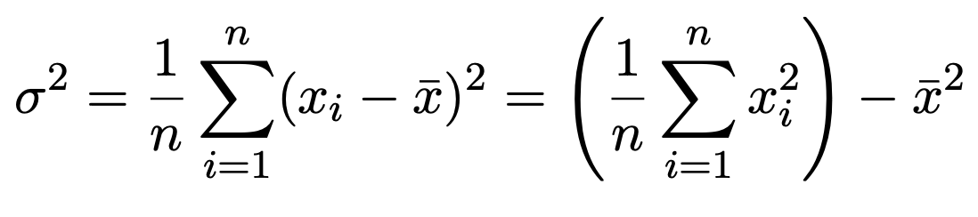
Variance and standard deviation
Variance and standard deviation are measures of data dispersion. They indicate how spread out a data distribution is.
A low standard deviation means that the data observations tend to be very close to the mean, while a high standard deviation indicates that the data are spread out over a large range of values.
Let D = {x₁, x₂, . . . , x_{n}} be a sample of n data observations/values from a numeric variable/attribute X. Let x¯ be the mean of D. The variance (σ²) of the observations in S is
(10)
The standard deviation, σ, of the observations is the square root of the variance.
data understanding

Slide 74
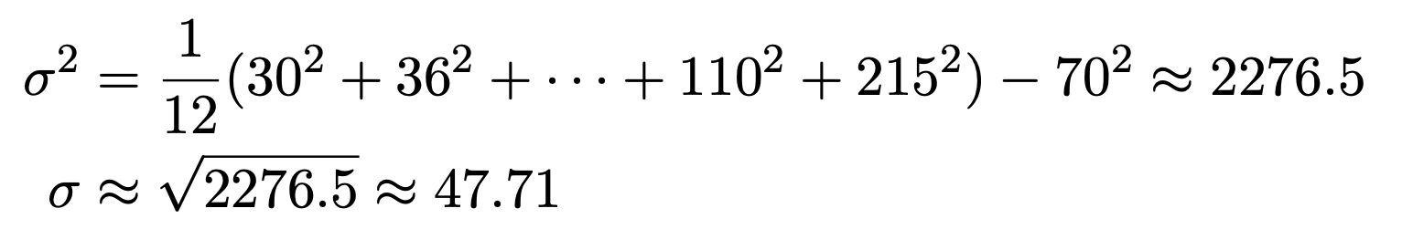
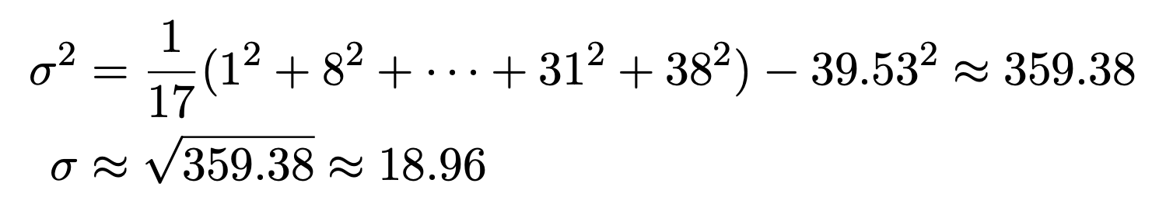
Examples of variance and standard deviation
Salary (in $k) of 12 employees in a company (shown in increasing order):
D = {30, 36, 47, 50, 52, 52, 56, 60, 62, 70, 110, 215} with mean x¯ = 70.
Messi’s goals for Barcelona from 2004–2005 to 2020–2021:
D = {1, 8, 17, 16, 38, 47, 53, 73, 60, 41, 58, 41, 54, 45, 51, 31, 38} with mean x¯ = 39.53.
data understanding

Slide 75
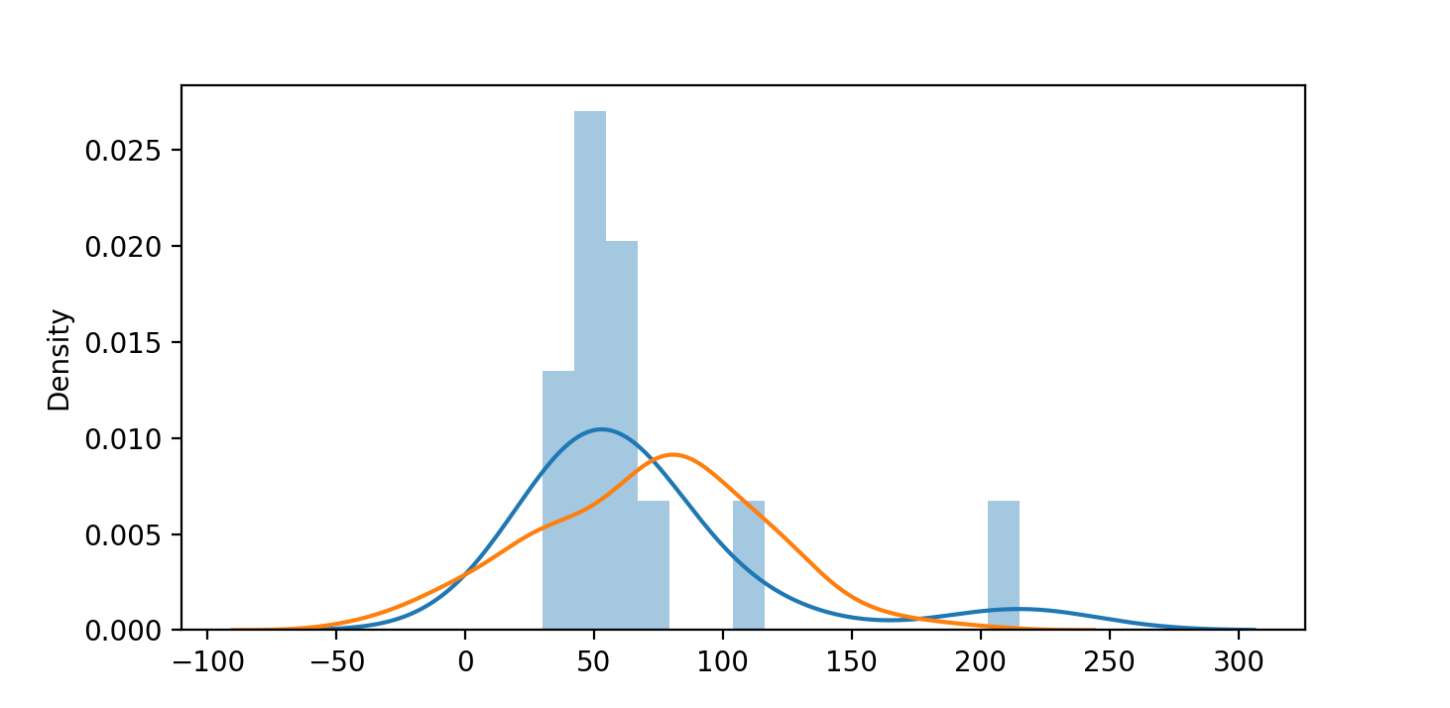
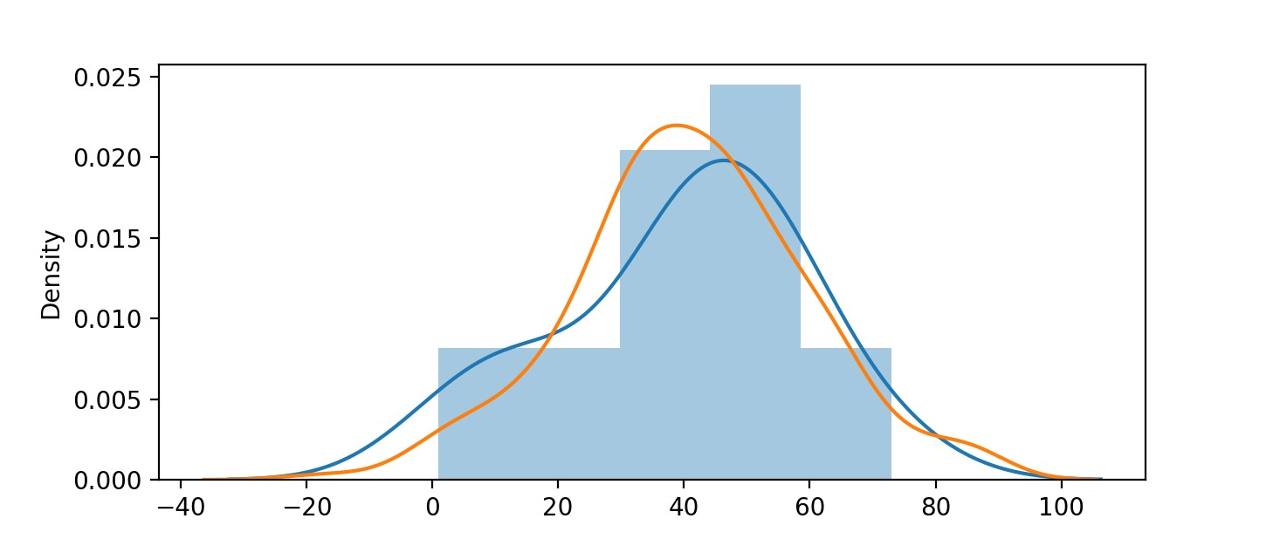
Sample vs. inferred distributions: salary and Messi cases
Salary case: blue line is the sample distribution; yellow line is the inferred (normal) distribution – numpy.random.normal(70, 47.71, 200)
Messi case: blue line is the real sample distribution; yellow line is the inferred (normal) distribution – numpy.random.normal(39.53, 18.96, 200)
data understanding

Slide 76
Outline
Introduction
Get to know your data
Data attribute
Univariate, bivariate, and multivariate data Complex and structured data
Descriptive statistics of data Measuring the central tendency of data Measuring the dispersion of data
Relationships in data
Correlation and Pearson correlation Spearman’s rank correlation
Pearson’s chi–square test for categorical data Correlation versus causation
Excercises, References, and Summary
data understanding

Slide 77
Outline
Introduction
Get to know your data
Data attribute
Univariate, bivariate, and multivariate data Complex and structured data
Descriptive statistics of data Measuring the central tendency of data Measuring the dispersion of data
Relationships in data
Correlation and Pearson correlation Spearman’s rank correlation
Pearson’s chi–square test for categorical data Correlation versus causation
Excercises, References, and Summary
data understanding
77 / 106

Slide 78
Correlation
Correlation is a type of statistical relationship that reflects the strength and direction of association between two random variables or two data attributes (i.e., bivariate data).
Positive correlation means that both variables change in the same direction.
Negative correlation means that the variables change in opposite directions.
Zero correlation means there is no dependency or relationship between the variables.
One of the most familiar measure of dependence between two variables is Pearson correlation. It is a measure of linear correlation between two sets of data. Pearson correlation works well if the relationship between variables is linear and if the variables are roughly normal. However, it is not robust for handling outliers, non–linear as well as skewed distributions. In this case, Spearman’s rank correlation should be used.
data understanding
78 / 106

Slide 79
Pearson correlation coefficient for a population
Pearson correlation coefficient of two variables X and Y is the covariance of the two variables divided by the product of their standard deviations.
cov(X, Y )
ρ_{XY} =
(11)
σ_{X}σ_{Y}
where:
cov(X, Y is the covariance between X and Y .
σ_{X} is the standard deviation of X. σ_{Y} is the standard deviation of Y .
Because cov(X, Y ) = E[(X − µ_{X} )(Y − µ_{Y} )]:
₌ E[(X − µ_{X} )(Y − µ_{Y} )]
ρ
XY
(12)
σ_{X}σ_{Y}
where:
µ_{X} and µ_{Y} are the means of X and Y .
E is the expectation.
data understanding
79 / 106

Slide 80
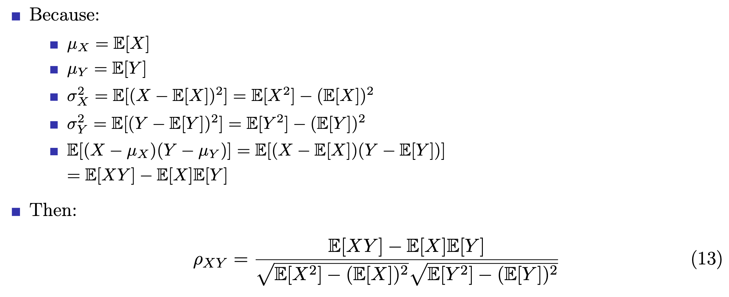
Pearson correlation coefficient for a population (cont’d)
data understanding
80 / 106

Slide 81
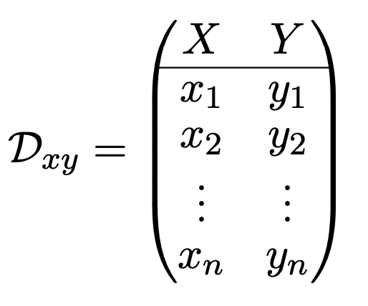
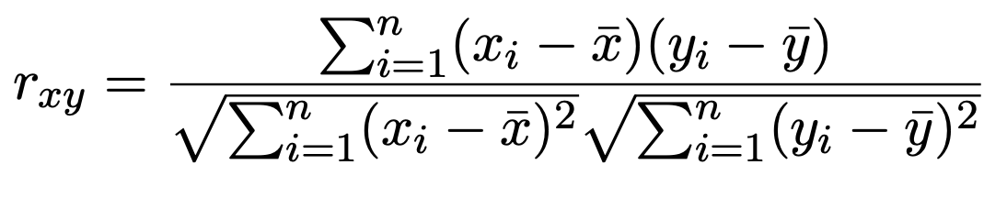
Pearson correlation coefficient for a sample
Let D_{xy} be a bivariate data sample consisting of n data points being sampled from two variables/attributes X and Y as follows:
(14)
The sample Pearson correlation coefficient between the two variables in D_{xy}, denoted as r_{xy}, is defined as follows:
(15)
where:
x¯ and y¯ are the sample means of {x₁, x₂, . . . , x_{n}} and {y₁, y₂, . . . , y_{n}}, respectively.
data understanding
81 / 106

Slide 82
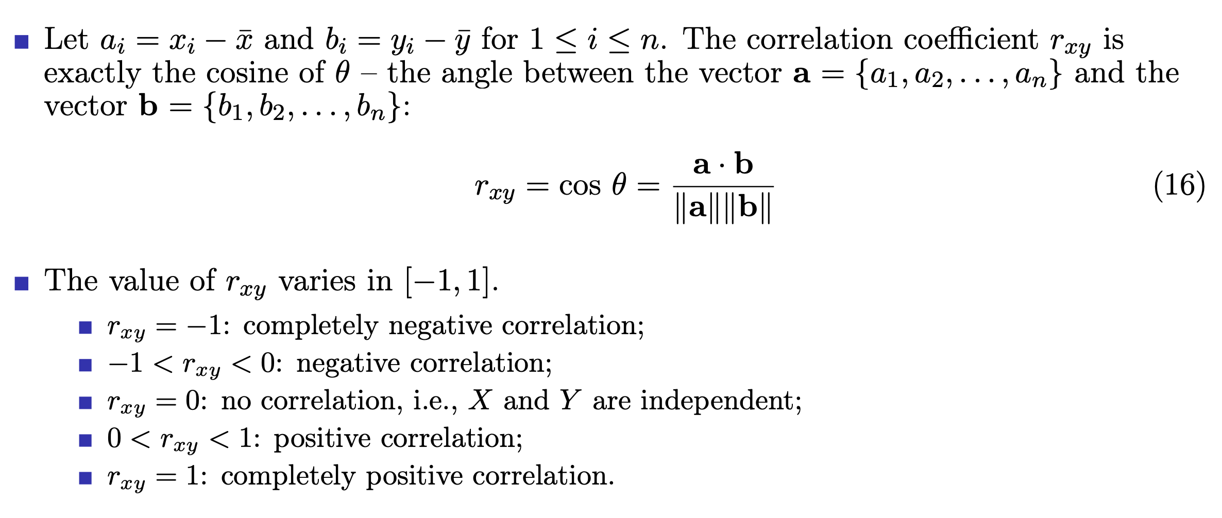
Pearson correlation coefficient for a sample (cont’d)
data understanding
82 / 106

Slide 83
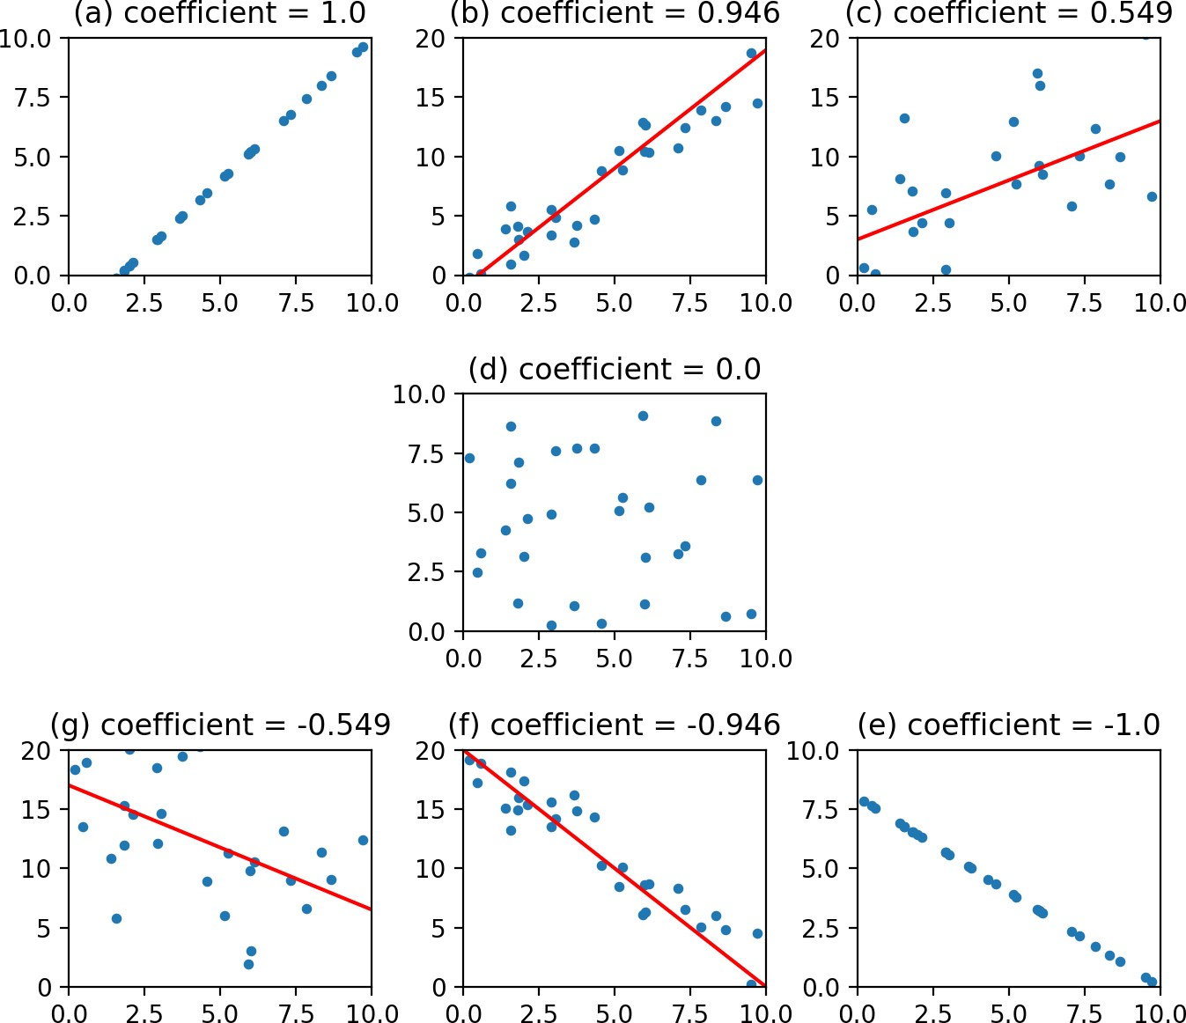
Levels of correlation (Pearson correlation coefficients)
data understanding
83 / 106

Slide 84
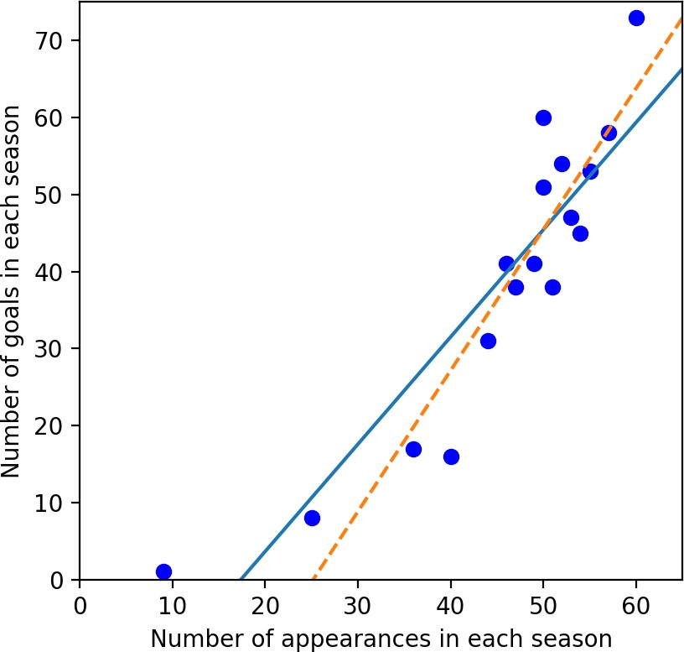
Pearson correlation between the numbers of Messi’s appearances & goals
Season | Apps | Goals
2004-05 | 9 | 1
2005-06 | 25 | 8
2006-07 | 36 | 17
2007-08 | 40 | 16
2008-09 | 51 | 38
2009-10 | 53 | 47
2010-11 | 55 | 53
2011-12 | 60 | 73
2012-13 | 50 | 60
2013-14 | 46 | 41
2014-15 | 57 | 58
2015-16 | 49 | 41
2016-17 | 52 | 54
2017-18 | 54 | 45
2018-19 | 50 | 51
2019-20 | 44 | 31
2020-21 | 47 | 38
Pearson correlation coefficient = 0.9021 Blue line: regression with all data
Yellow line: regression after removing the data of the first season
Messi’s appss and goals for Barcelona
data understanding
84 / 106

Slide 85
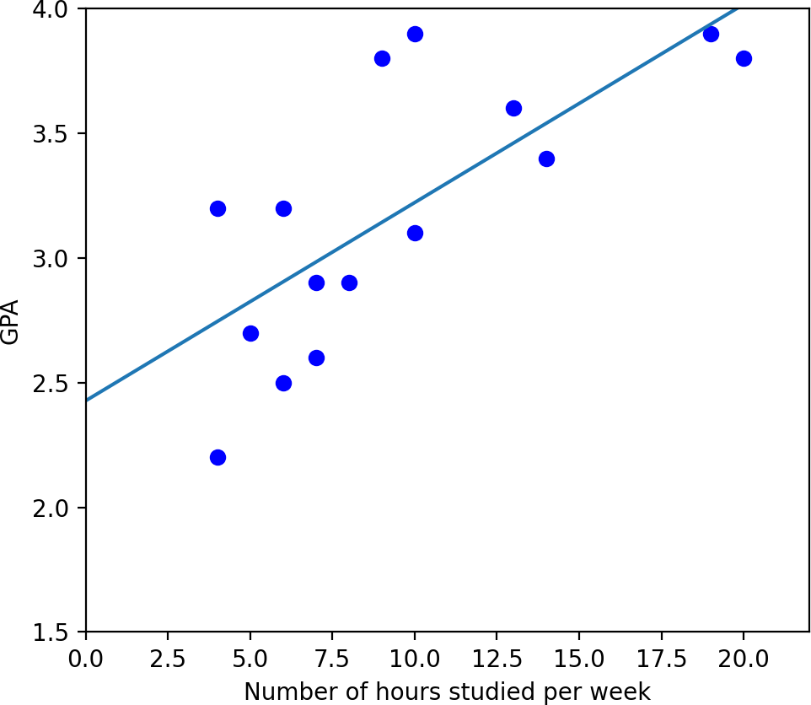
Pearson correlation between hours studied and GPA
Hours | GPA
6 | 3.2
9 | 3.8
10 | 3.9
13 | 3.6
6 | 2.5
5 | 2.7
7 | 2.9
19 | 3.9
20 | 3.8
14 | 3.4
10 | 3.1
7 | 2.6
4 | 2.2
8 | 2.9
4 | 3.2
Pearson correlation coefficient = 0.7315 Blue line: linear regression
The number of hours studied per week and the GPA
data understanding
85 / 106

Slide 86
Outline
Introduction
Get to know your data
Data attribute
Univariate, bivariate, and multivariate data Complex and structured data
Descriptive statistics of data Measuring the central tendency of data Measuring the dispersion of data
Relationships in data
Correlation and Pearson correlation Spearman’s rank correlation
Pearson’s chi–square test for categorical data Correlation versus causation
Excercises, References, and Summary
data understanding
86 / 106

Slide 87
Spearman’s rank correlation
Spearman’s rank correlation is an alternative that mitigates the effect of outliers and skewed distributions;
To compute Spearman’s correlation, we have to compute the rank of each value, which is its index in the sorted sample;
For example, in the sample [1, 2, 5, 7] the rank of the value 5 is 3, because it appears third in the sorted list. Then we compute Pearson’s correlation for the ranks.
data understanding
87 / 106

Slide 88
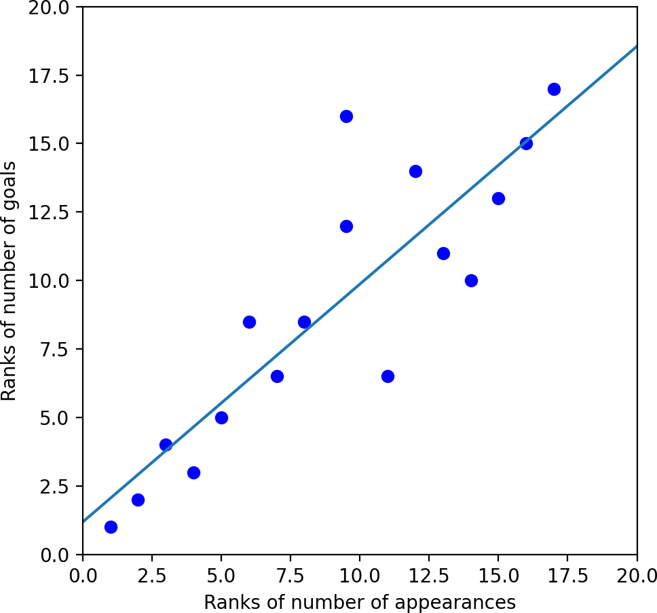
Spearman correlation between Messi’s apps and goals
Season | Apps (Ranks) | Goals (Ranks)
04-05 | 9 (1.0) | 1 (1.0)
05-06 | 25 (2.0) | 8 (2.0)
06-07 | 36 (3.0) | 17 (4.0)
07-08 | 40 (4.0) | 16 (3.0)
08-09 | 51 (11.0) | 38 (6.5)
09-10 | 53 (13.0) | 47 (11.0)
10-11 | 55 (15.0) | 53 (13.0)
11-12 | 60 (17.0) | 73 (17.0)
12-13 | 50 (9.5) | 60 (16.0)
13-14 | 46 (6.0) | 41 (8.5)
14-15 | 57 (16.0)) | 58 (15.0)
15-16 | 49 (8.0) | 41 (8.5)
16-17 | 52 (12.0) | 54 (14.0)
17-18 | 54 (14.0) | 45 (10.0)
18-19 | 50 (9.5) | 51 (12.0)
19-20 | 44 (5.0) | 31 (5.0)
20-21 | 47 (7.0) | 38 (6.5)
Spearman correlation coefficient = 0.8692
Messi’s apps and goals for Barcelona
data understanding
88 / 106

Slide 89
Outline
Introduction
Get to know your data
Data attribute
Univariate, bivariate, and multivariate data Complex and structured data
Descriptive statistics of data Measuring the central tendency of data Measuring the dispersion of data
Relationships in data
Correlation and Pearson correlation Spearman’s rank correlation
Pearson’s chi–square test for categorical data Correlation versus causation
Excercises, References, and Summary
data understanding
89 / 106

Slide 90
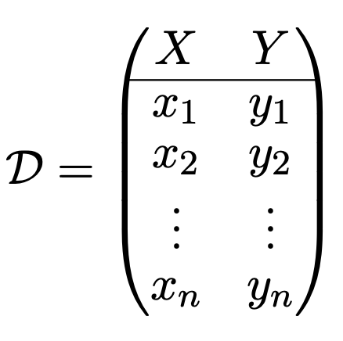
Pearson’s chi–square test for categorical data
For nominal/categorical data, a correlation relationship between two attributes/variables X and Y can be discovered by a χ² (chi-square) statistical test.
Suppose X has r distinct values, namely a₁, a₂, . . . , a_{r}; and Y has c distinct values, namely b₁, b₂, . . . , b_{c}.
Suppose we have a bivariate data sample consisting of n data tuples drawn from both X and Y as follows:
(17)
Let (X_{i}, Y_{j} ) denote the joint event that X takes on value a_{i} and Y takes on value b_{j} , or X = a_{i} and Y = b_{j} for short.
data understanding
90 / 106

Slide 91
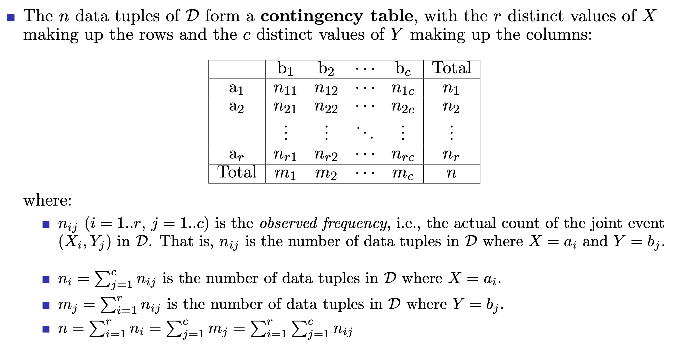
Contingency table
data understanding
91 / 106

Slide 92
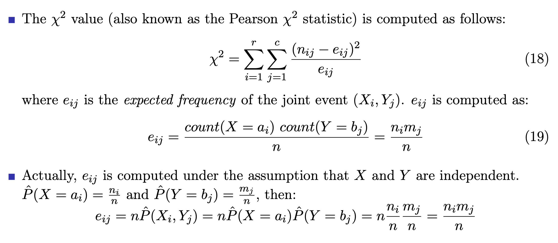
Pearson’s chi–square test statistic calculation
data understanding
92 / 106

Slide 93
Pearson’s chi–square test hypotheses
The sum in equation (18) is computed over all of the r × c cells of the contingency
table.
Note that the cells that contribute the most to the χ² value are those for which the actual count (n_{ij} ) is very different from the expected frequency (e_{ij} ).
For the Pearson’s chi–square test, the null hypothesis H_{o} is that X and Y are independent, i.e., there is no correlation between them. The alternative hypothesis H_{a} is that there is a correlation relationship between X and Y .
The test is based on a significance level, with (r − 1) × (c − 1) degrees of freedom.
If the null hypothesis can be rejected, then we say that X and Y are statistically correlated.
data understanding
93 / 106

Slide 94
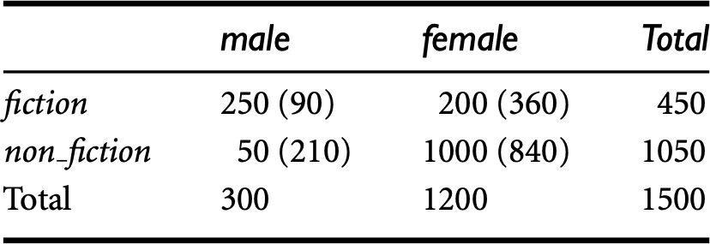
Pearson’s chi–square test example
2 × 2 contingency table between gender and preferred_reading [1]
A group of 1500 people was surveyed. The gender of each person was noted. Each person was polled as to whether his or her preferred type of reading material was fiction or nonfiction.
Thus, we have two attributes, gender and preferred_reading. The observed frequency (or count) of each possible joint event is summarized in the contingency table above. In which, the numbers in parentheses are the expected frequencies. For example:
count(female) × count(fiction) 1200 × 450
e₁₂ =
= = 360
n
1500
data understanding
94 / 106

Slide 95
Pearson’s chi–square test example (cont’d)
Using equation (18) for χ² computation, we get:
(250 − 90)² (50 − 210)² (200 − 360)² (1000 − 840)²
2
χ =
+ + +
90 210 360 840
= 284.44 + 121.90 + 71.11 + 30.48 = 507.93
For this 2 × 2 table, the degrees of freedom are (2 − 1)(2 − 1) = 1.
For 1 degree of freedom, the χ² value needed to reject the null hypothesis at the
0.001 significance level is 10.828 (taken from the table of upper percentage points of
the χ² distribution, typically available from any textbook on statistics).
Since our computed value is above this, we can reject the null hypothesis that gender and preferred_reading are independent and conclude that the two attributes are (strongly) correlated for the given group of people.
data understanding
95 / 106

Slide 96
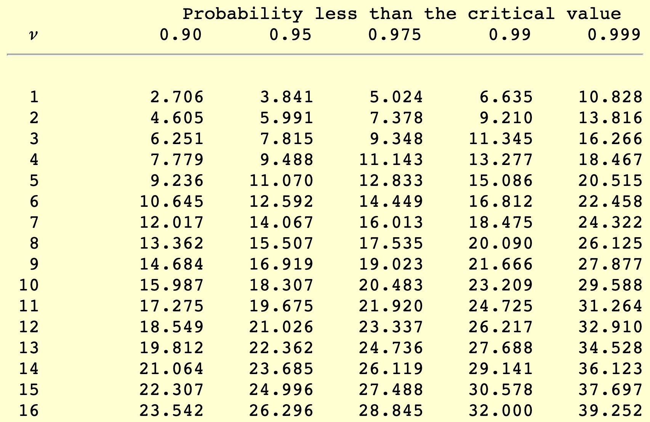
Upper–tail critical values of chi–square distribution
Upper–tail critical values with v degrees of freedom
data understanding
96 / 106

Slide 97
Outline
Introduction
Get to know your data
Data attribute
Univariate, bivariate, and multivariate data Complex and structured data
Descriptive statistics of data Measuring the central tendency of data Measuring the dispersion of data
Relationships in data
Correlation and Pearson correlation Spearman’s rank correlation
Pearson’s chi–square test for categorical data Correlation versus causation
Excercises, References, and Summary
data understanding
97 / 106

Slide 98
Correlation versus causation
Correlation describes an association between variables: when one variable changes, so does the other. A correlation is a statistical indicator of the relationship between variables.
Causation means that changes in one variable brings about changes in the other. There is a cause–and–effect relationship between variables. The two variables are correlated with each other, and there is also a causal link between them.
If variables X and Y are correlated, there are several possible explanations: X causes Y , or Y causes X, or X and Y cause each other, or some other set of factors causes both X and Y . The last case is the third variable(s) problem.
Causation means correlation, but correlation does not necessarily imply causation.
data understanding
98 / 106

Slide 99
Outline
Introduction
Get to know your data
Data attribute
Univariate, bivariate, and multivariate data Complex and structured data
Descriptive statistics of data Measuring the central tendency of data Measuring the dispersion of data
Relationships in data
Correlation and Pearson correlation Spearman’s rank correlation
Pearson’s chi–square test for categorical data Correlation versus causation
Excercises, References, and Summary
data understanding
99 / 106

Slide 100
Excercises
1 Suppose that the data for analysis includes the attribute age. The age values for the data tuples are (in increasing order) {13, 15, 16, 16, 19, 20, 20, 21, 22, 22, 25, 25, 25, 25, 30, 33, 33, 35, 35, 35, 35, 36, 40, 45, 46, 52, 70}.
What is the mean of the data? What is the median?
What is the mode of the data? Comment on the data’s modality (i.e., bimodal, trimodal, etc.).
What is the midrange of the data?
Can you find (roughly) the first quartile (Q₁) and the third quartile (Q₃) of the data? Give the five–number summary of the data.
Show a boxplot of the data.
What is the variance and standard deviation of the data?
c
d
e
f
g
data understanding
100 / 106

Slide 101
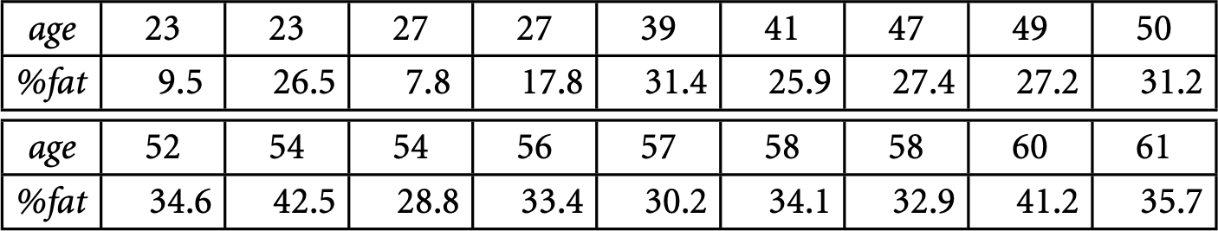
Excercises (cont’d)
2 Suppose that a hospital tested the age and body fat data for 18 randomly selected adults with the following results:
Calculate the mean, median, variance, and standard deviation of age and %fat. Draw the boxplots for age and %fat.
Draw a scatter plot for these two variables.
Calculate the Pearson and Spearman correlation coefficients between the two attributes.
a
b
c
d
data understanding
101 / 106

Slide 102
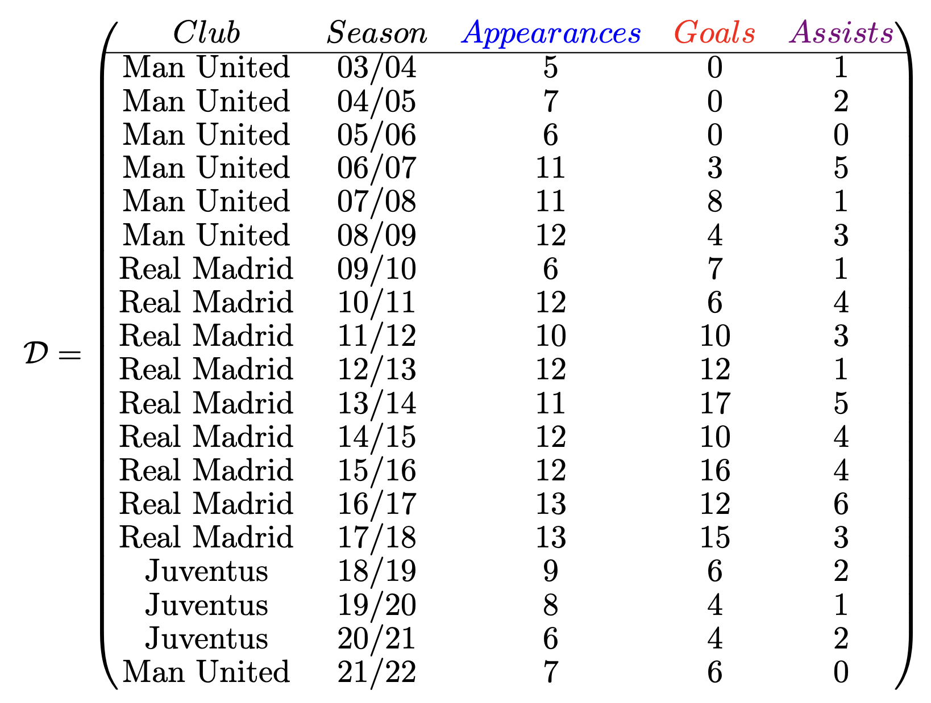
Excercises (cont’d)
data understanding
102 / 106

Slide 103
Excercises (cont’d)
3 Let D (in the previous slide) be the number of appearances, goals, and assists of Cristiano Ronaldo in Champions League from season 2003/2004 to 2021/2022.
Calculate the mean, median, mode, variance, standard deviation of three attributes appearances, goals, and assists.
Find the first quartile (Q₁) and the third quartile (Q₃) of three three attributes appearances, goals, and assists.
Show the boxplots of the three attributes appearances, goals, and assists.
Show the scatter plots of appearances and goals; of appearances and assists; of goals and assists.
Compute the covariance matrix of the three attributes appearances, goals, and assists.
data understanding
103 / 106

Slide 104
Excercises (cont’d)
4 800 students of three majors (math, history, and computer science) were asked whether they like playing computer games or not. The survey data are summarized in the following contingency table:
 | Like games | Do | not | like | games | Total
Math | 130 | 100 |  |  |  | 230
History | 35 | 165 |  |  |  | 200
Computer science | 280 | 90 |  |  |  | 370
Total | 445 | 355 |  |  |  | 800
Calculate the expected frequency of each cell in the table above.
Using Pearson’s chi–square test to confirm that there is a correlation between study major and playing computer games or not?
data understanding
104 / 106

Slide 105
References
J. Han, M. Kamber, and J. Pei. Data Mining: Concepts and Techniques. Morgan Kaufmann, Elsevier, 2012 [Book1].
C. Aggarwal. Data Mining: The Textbook. Springer, 2015 [Book2].
J. Leskovec, A. Rajaraman, and J. D. Ullman. Mining of Massive Datasets. Cambridge University Press, 2014 [Book3].
M. J. Zaki and W. M. Jr. Data Mining and Analysis: Fundamental Concepts and Algorithms. Cambridge University Press, 2013 [Book4].
D. Easley and J. Kleinberg. Networks, Crowds, and Markets: Reasoning About a Highly Connected World. Cambridge University Press, 2010 [Book5].
J. VanderPlas. Python Data Science Handbook: Essential Tools for Working with Data. O’Reilly, 2017 [Book6].
J. Grus. Data Science from Scratch: First Principles with Python. O’Reilly, 2015 [Book7].
data understanding
105 / 106

Slide 106
Summary
Explaining why data understanding is critical before doing any data analysis and mining tasks.
Knowing different types of data attributes such as categorical, binary, numeric, etc.
Introducing various data forms like univariate, bivariate, multivariate as well as more complex and structured data like time–series, sequences, spatial, network/graph, and stream data.
Understanding and knowing how to measure the central tendency as well as the variability of data; knowing some statistics and visualization tools like boxplot to understand the sample distribution.
Studying the potential relationships between data variables/attributes via important concepts like covariance, correlation, Pearson, Spearman correlation, Pearson’s chi–square test, as well as explaining the difference between correlation and
causation.
data understanding
106 / 106

