Slide 1
Distance and similarity
Lecturer: Assoc.Prof. Nguyễn Phương Thái
VNU University of Engineering and Technology
Slide: from Assoc.Prof. Phan Xuân Hiếu, Updated: February 28, 2024
data understanding
1 / 106
Notes:
Hiểu dữ liệu là bước quan trọng trong mô hình CRISP-DM (tổng 6 bước).

Slide 2
Outline
Introduction
Similarity measures for numeric vectors
Similarity measures for data distributions
Similarity measures for nominal data
Similarity measures for ordinal data
Similarity measures for mix of data types
Similarity measures for sets
Similarity measures for sequence data
References and Summary
distance and similarity

Slide 3
Outline
Introduction
Similarity measures for numeric vectors
Similarity measures for data distributions
Similarity measures for nominal data
Similarity measures for ordinal data
Similarity measures for mix of data types
Similarity measures for sets
Similarity measures for sequence data
References and Summary
distance and similarity

Slide 4
Why is distance and similarity measurement important?
Distance and similarity are key parts of various data mining problems where we need to compare two or more data instances. Typical examples are k-NN, kernel–based methods, or many clustering algorithms.
Changing distance/similarity measures can lead to the change of data mining results significantly.
Using the “right ” similarity measure for a particular data mining problem, for a particular dataset is critical.
There are various distance metrics and similarity measures for different types/forms of data.
This lecture introduces basic and well–known distance and similarity measures commonly used in data mining applications.
distance and similarity

Slide 5
Distance metric
Let X be a set or space. A distance metric on X is a function d : X × X → [0, +∞). For
all data instances/points x, y, z ∈ X, distance d must satisfy the following axioms: Identity – the distance from a point to itself is zero:
d(x, x) = 0
(1)
Positivity – the distance between two distinct points is always positive:
d(x, y) > 0 (2)
Symmetry – the distance from x to y is always the same as the distance from y to x:
d(x, y) = d(y, x) (3)
Triangle inequality:
d(x, z) ≤ d(x, y) + d(y, z)
(4)
distance and similarity

Slide 6
Outline
Introduction
Similarity measures for numeric vectors
Similarity measures for data distributions
Similarity measures for nominal data
Similarity measures for ordinal data
Similarity measures for mix of data types
Similarity measures for sets
Similarity measures for sequence data
References and Summary
distance and similarity

Slide 7
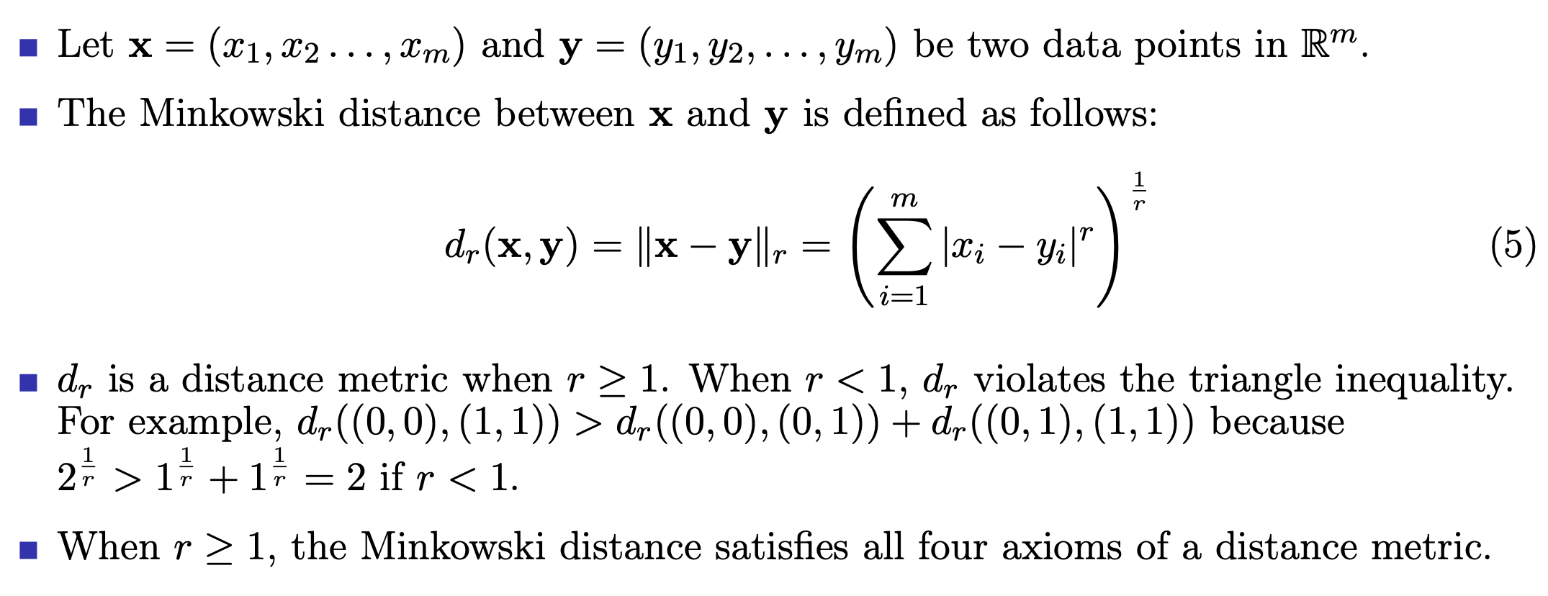
Minkowski distance
distance and similarity

Slide 8
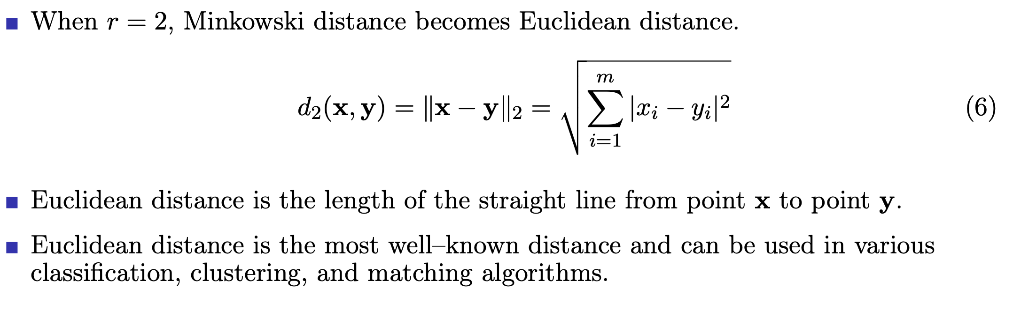
Euclidean distance
distance and similarity

Slide 9
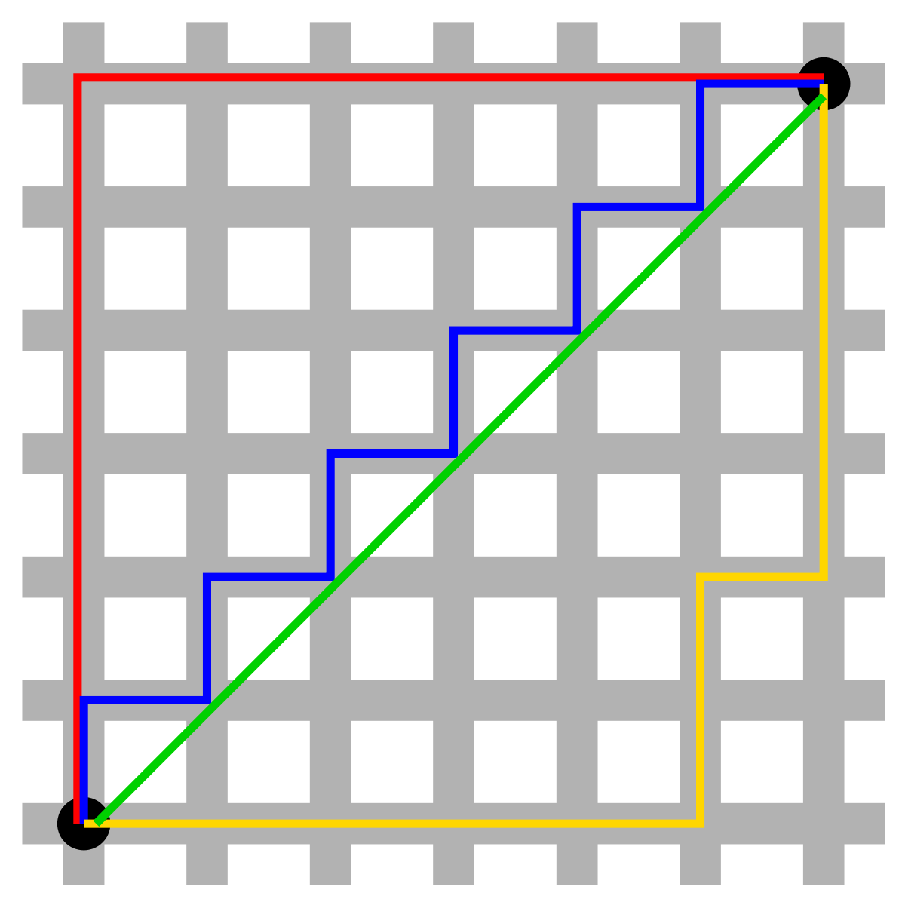
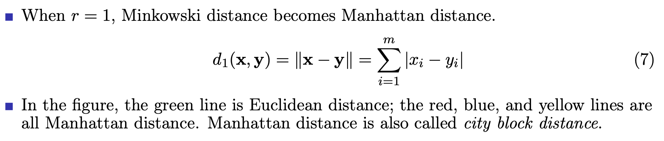
Manhattan distance
Euclidean and Manhattan distances [source: Wikipedia/Quora]
distance and similarity

Slide 10
Hamming distance
Hamming distance between two numeric vectors is defined as the number of dimensions at which the their values are different.
Hamming distance is normally used for vectors of binary or categorical values. Hamming distance satisfies the four axioms of a distance metric.
For example: the hamming distance between (1, 0, 1, 0, 1)^{T} and (1, 1, 1, 1, 0)^{T} is 3.
distance and similarity

Slide 11
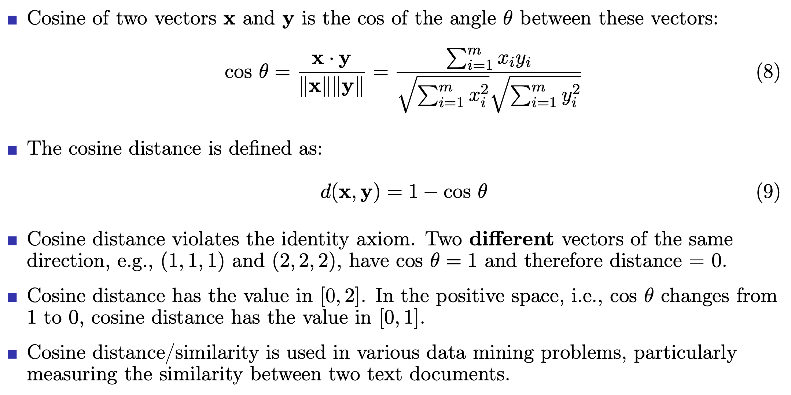
Cosine distance
distance and similarity

Slide 12
Outline
Introduction
Similarity measures for numeric vectors
Similarity measures for data distributions
Similarity measures for nominal data
Similarity measures for ordinal data
Similarity measures for mix of data types
Similarity measures for sets
Similarity measures for sequence data
References and Summary
distance and similarity

Slide 13
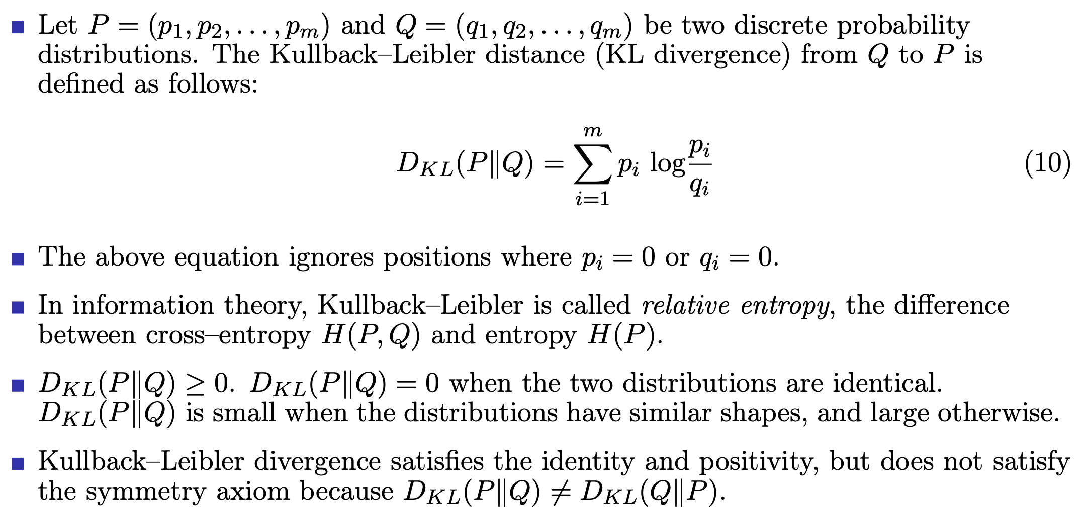
Kullback–Leibler distance
distance and similarity

Slide 14
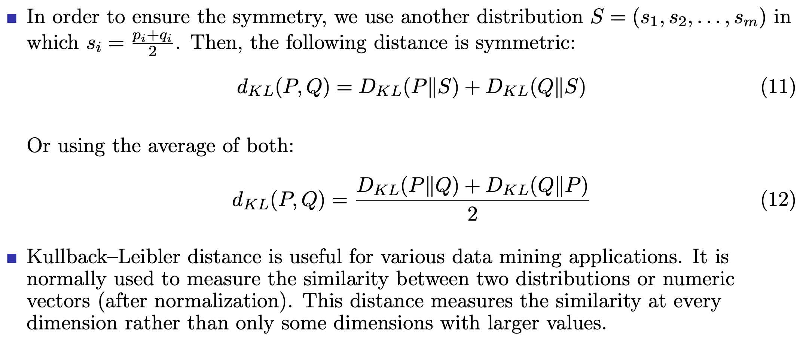
Kullback–Leibler distance (cont’d)
distance and similarity

Slide 15
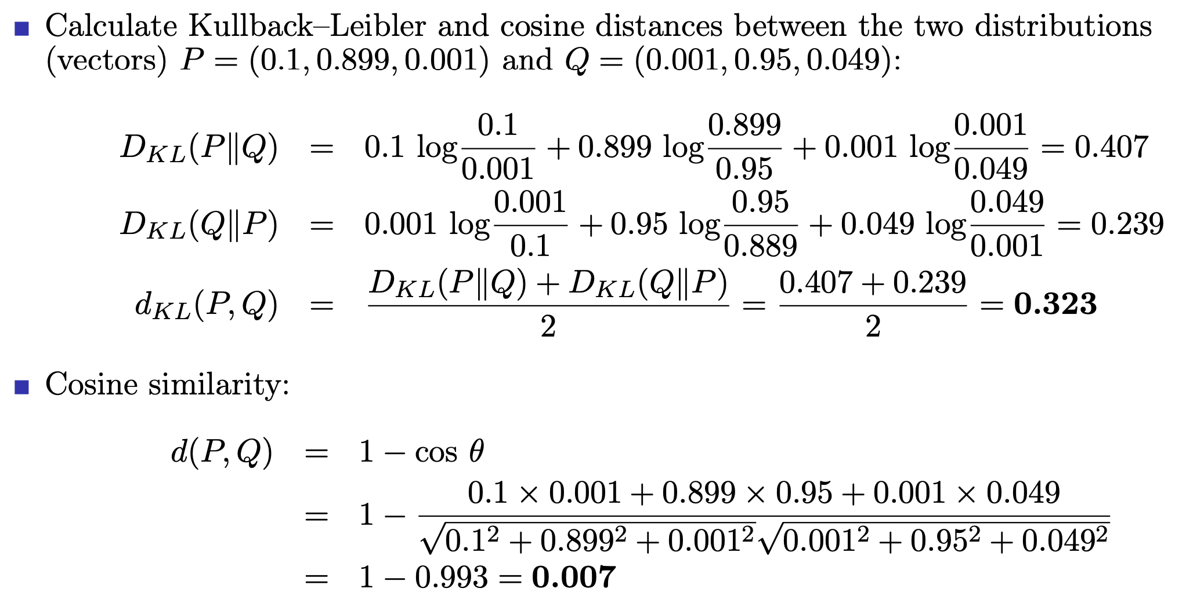
Examples of Kullback–Leibler or cosine distances
distance and similarity

Slide 16
Using Kullback–Leibler or cosine distances?
In the previous example, the second dimension of the two vectors (p₂ = 0.899 and
q₂ = 0.95) dominates the cosine similarity despite the fact that the values at the first and the second dimensions (0.1 vs. 0.001 and 0.001 vs. 0.049) are much different.
In terms of the angle θ, the cosine similarity of 0.007 is appropriate because the θ
angle between the two vectors is very small.
However, in terms of probability distribution, these two vectors are much different. If we want to highlight this difference, KL divergence is more suitable to use.
Therefore, KL distance is more than a distance measure, it can be seen as a constraint over every dimension when measuring the similarity.
distance and similarity

Slide 17
Outline
Introduction
Similarity measures for numeric vectors
Similarity measures for data distributions
Similarity measures for nominal data
Similarity measures for ordinal data
Similarity measures for mix of data types
Similarity measures for sets
Similarity measures for sequence data
References and Summary
distance and similarity

Slide 18
Similarity measure for nominal/categorical attributes
A nominal or categorical attribute can take on two (binary) or more states. For example, gender = male or female; province = Hanoi, Thai Nguyen, Nghe An, etc.
The states of a nominal attribute can be denoted by letters, symbols, or integer numbers. Notice that, integers, in this case, are used to encode states/categories. They have no meaning in ordering or comparison.
Let x_{i} = (x_{i1}, x_{i2}, . . . , x_{im}) and x_{j} = (x_{j1}, x_{j2}, . . . , x_{jm}) be two data instances represented in m nominal attributes. The distance between the two instances is:
m − s
d(x , x ) = (13)
i j
m
where s is the number of matches, i.e., the number of attributes for which x_{i} and x_{j}
are in the same state (same value).
Weights for attributes can be used to highlight attributes that are more important than others.
distance and similarity

Slide 19
Outline
Introduction
Similarity measures for numeric vectors
Similarity measures for data distributions
Similarity measures for nominal data
Similarity measures for ordinal data
Similarity measures for mix of data types
Similarity measures for sets
Similarity measures for sequence data
References and Summary
distance and similarity

Slide 20
Similarity measure for ordinal attributes
The values of an ordinal attribute have a meaningful order or ranking. For example, the attribute size has three values: small, medium, and large.
Ordinal attributes may also be obtained from the discretization of numeric attributes by splitting the value range into a finite number of categories. These categories are organized into ranks.
“How are ordinal attributes handled ?” The treatment of ordinal attributes is quite similar to that of numeric attributes when computing distance between data instances.
distance and similarity

Slide 21

Similarity measure for ordinal attributes (cont’d)
Let an ordinal attribute X_{a} has K_{a} ordered states/values, representing the ranking
1, 2, . . . , K_{a}. Suppose a data instance x_{i} has the value x_{ia} on the attribute X_{a}. Replace x_{ia} by its rank, r_{ia} ∈ {1, 2, . . . , K_{a}}.
If we want to normalize its rank value onto [0.0, 1.0], then:
(14)
$$z_{ia}=\frac{r_{ia}−1}{K_{a}−1}$$
Then, we can apply any distance metric for numeric data like Euclidean, Manhattan, cosine, etc. to the transformed ordinal attribute (using r_{ia} or its normalized value z_{ia}).
distance and similarity

Slide 22
Outline
Introduction
Similarity measures for numeric vectors
Similarity measures for data distributions
Similarity measures for nominal data
Similarity measures for ordinal data
Similarity measures for mix of data types
Similarity measures for sets
Similarity measures for sequence data
References and Summary
distance and similarity

Slide 23
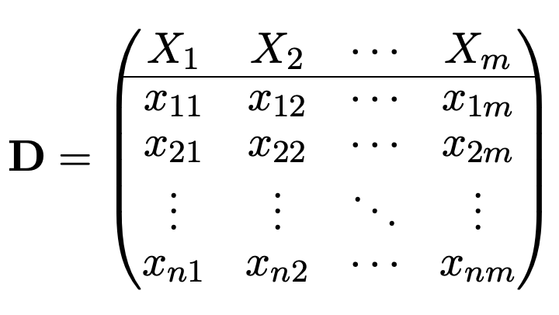
Multivariate data revisited
Multivariate data is a type of data which consists observations from m variables/attributes (X₁, X₂, . . . , X_{m}), i.e., considering m characteristics or attributes at the same time. This is actually a n × m matrix as follows:
(15)
In the row view, the data can be considered as a set of n data instances in the
d-dimensional attribute space:
x_{i} = (x_{i1}, x_{i2}, . . . , x_{im})^{T}
Like univariate and bivariate data, X₁, X₂, . . . , X_{m} can be nominal/categorical (including binary), ordinal, or numeric.
distance and similarity

Slide 24
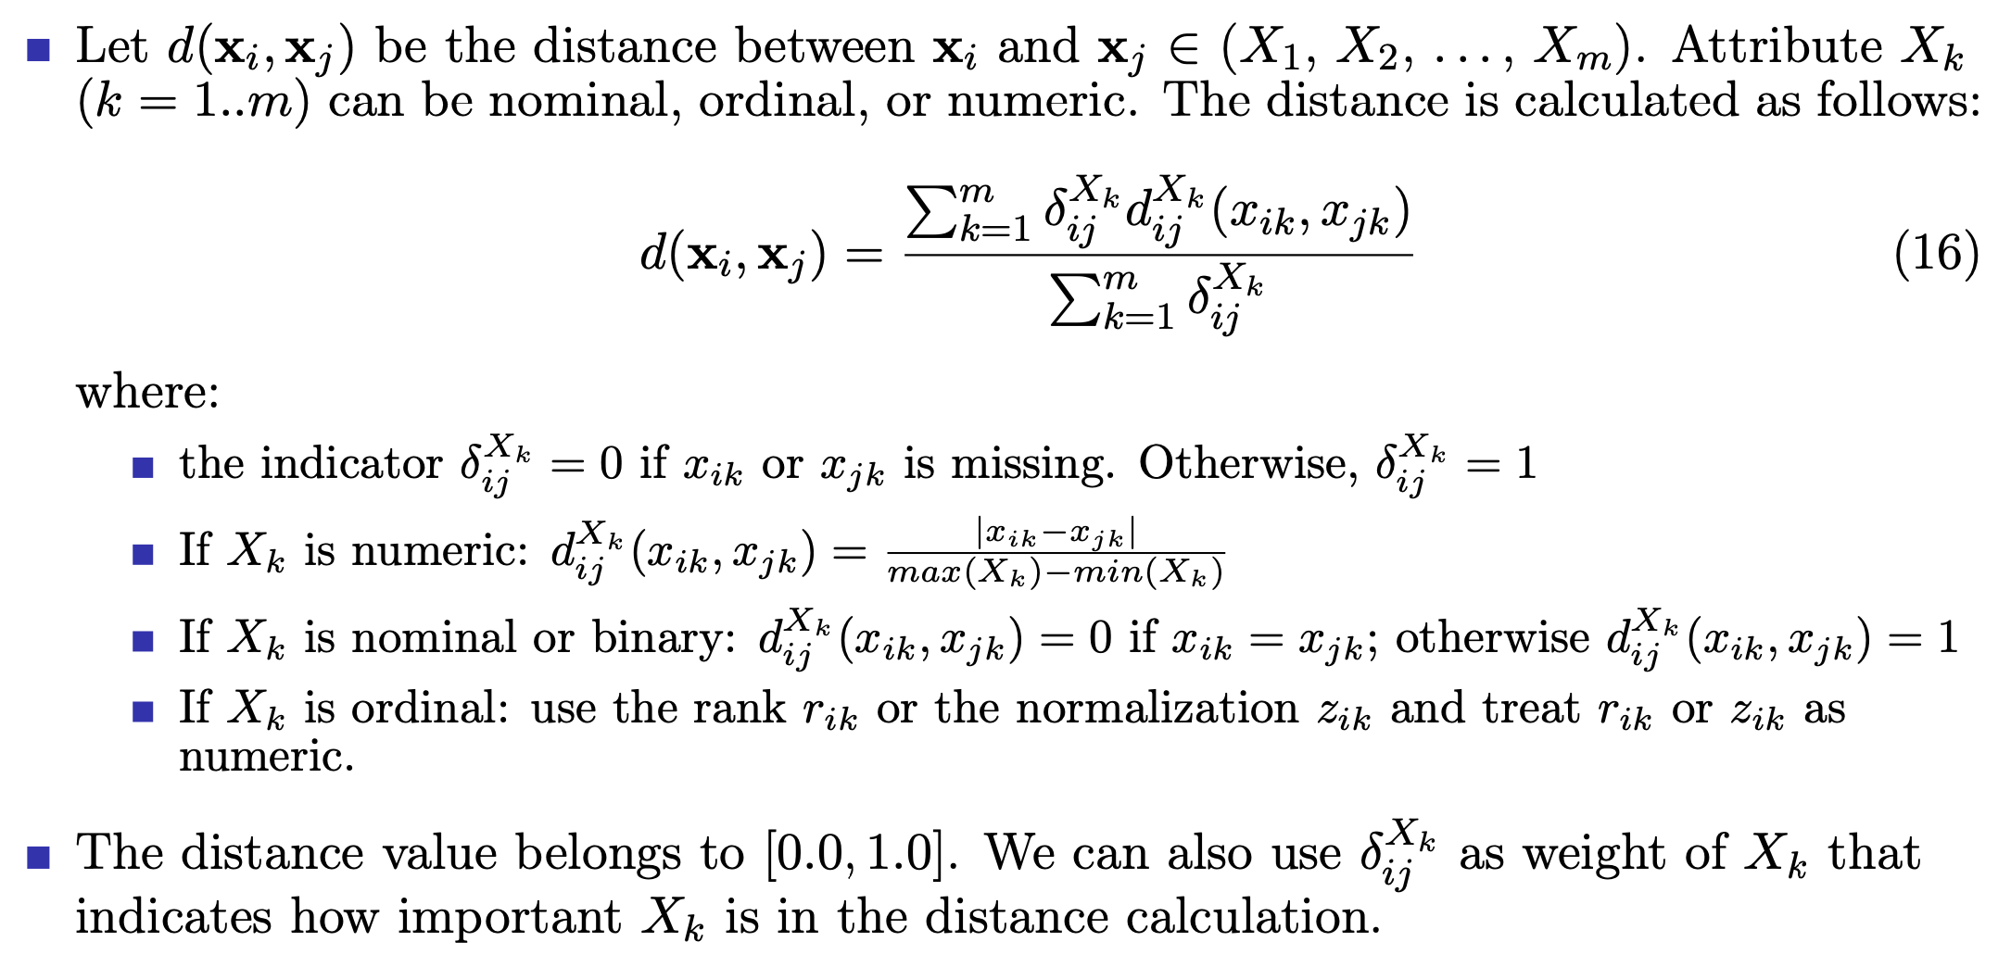
Similarity measure for mix of nominal, ordinal, and numeric data
distance and similarity

Slide 25
Outline
Introduction
Similarity measures for numeric vectors
Similarity measures for data distributions
Similarity measures for nominal data
Similarity measures for ordinal data
Similarity measures for mix of data types
Similarity measures for sets
Similarity measures for sequence data
References and Summary
distance and similarity

Slide 26
Jaccard distance
Let A and B be two sets. The Jaccard index of A and B is defined as follows:
J (A, B) = ^{|A ∩ B|}
|A ∪ B|
Then, the Jaccard distance between A and B is defined as:
(17)
d(A, B) = 1 − J (A, B) = 1 − ^{|A ∩ B|}
(18)
|A ∪ B|
Jaccard distance satisfies all four axioms of a distance metric.
Jaccard distance is used to measure the similarity between two sets where the order of data elements is not important.
Different from distance on vectors, Jaccard distance can be computed between two sets of different number of elements (i.e., different in cardinality).
distance and similarity

Slide 27
Outline
Introduction
Similarity measures for numeric vectors
Similarity measures for data distributions
Similarity measures for nominal data
Similarity measures for ordinal data
Similarity measures for mix of data types
Similarity measures for sets
Similarity measures for sequence data
References and Summary
distance and similarity

Slide 28
Edit distance
Edit distance is a well–known metric for measuring the similarity between discrete sequences like text strings, DNA sequences, etc.
Given two sequences or strings, this distance measures the minimum number of operations required to transform one string into the other.
This distance is widely used in text mining, natural language processing, approximate search, and bioinformatics.
There are several variants of this distance depending on the types of operations used to transform strings. Levenshtein distance uses three operations: deletion, insertion, and substitution of a character in the string.
Levenshtein distance is one of the most popular metric in the edit distance family and often used interchangeably with edit distance.
distance and similarity

Slide 29
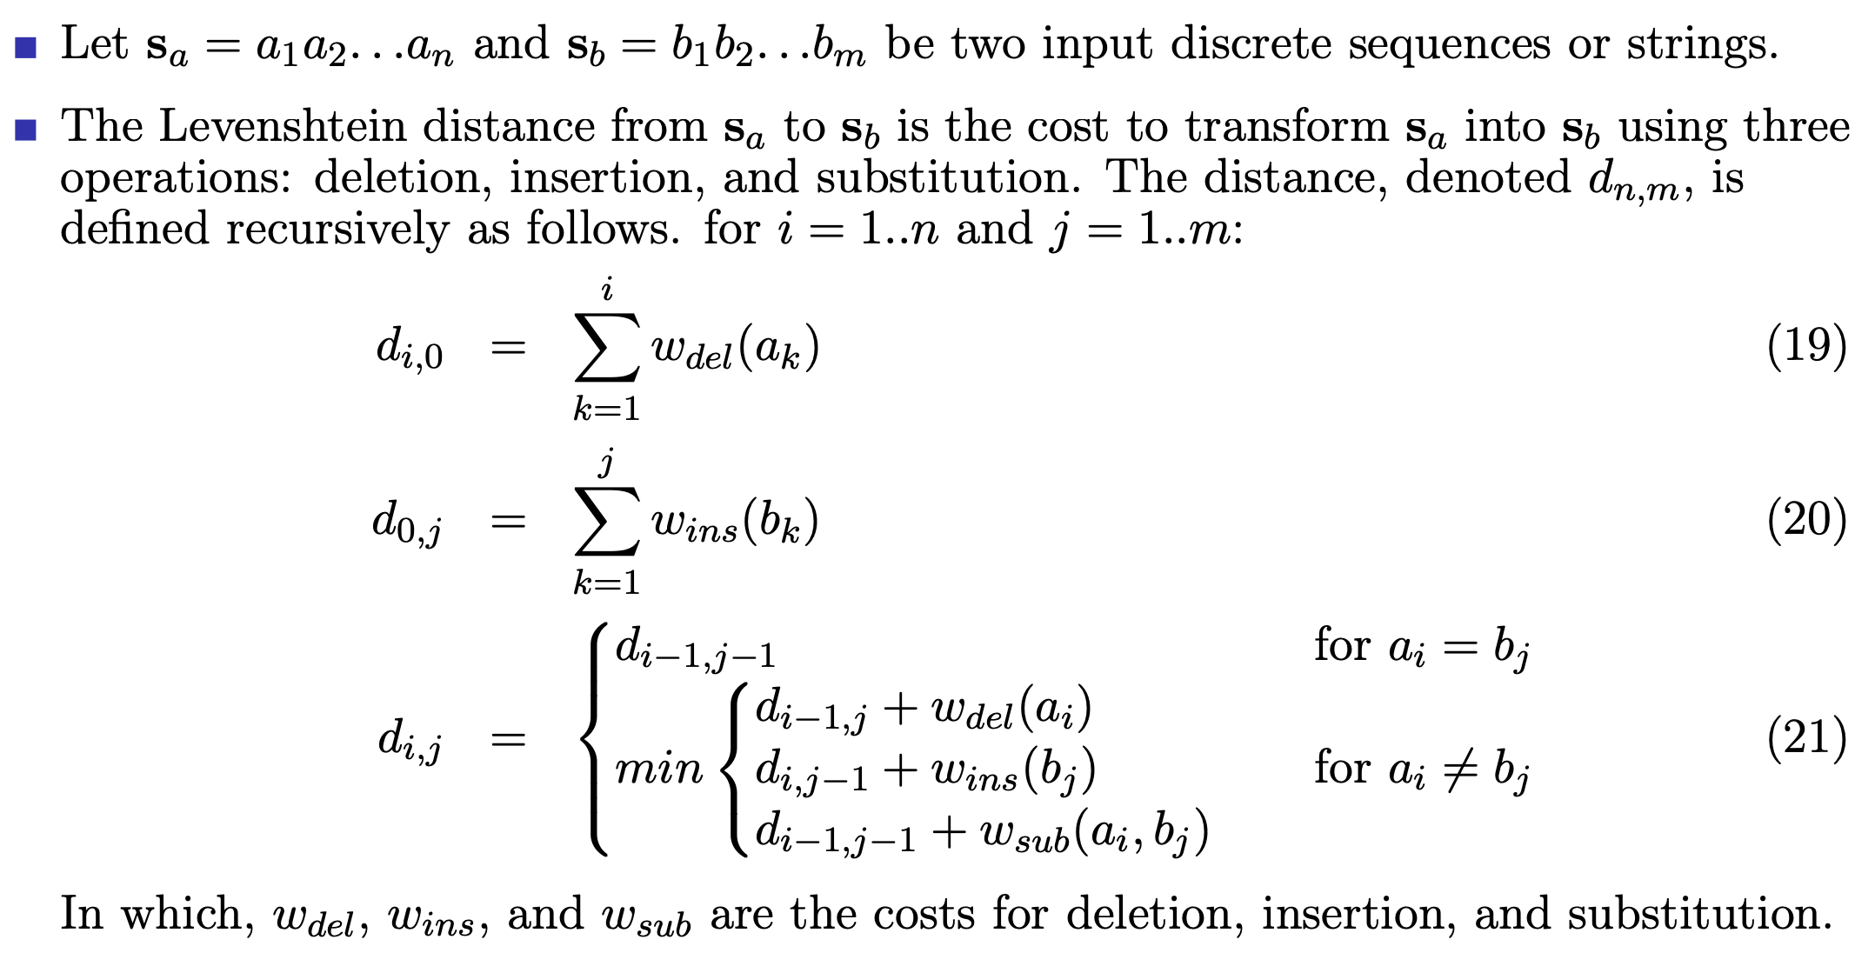
Levenshtein distance – algorithm
distance and similarity

Slide 30
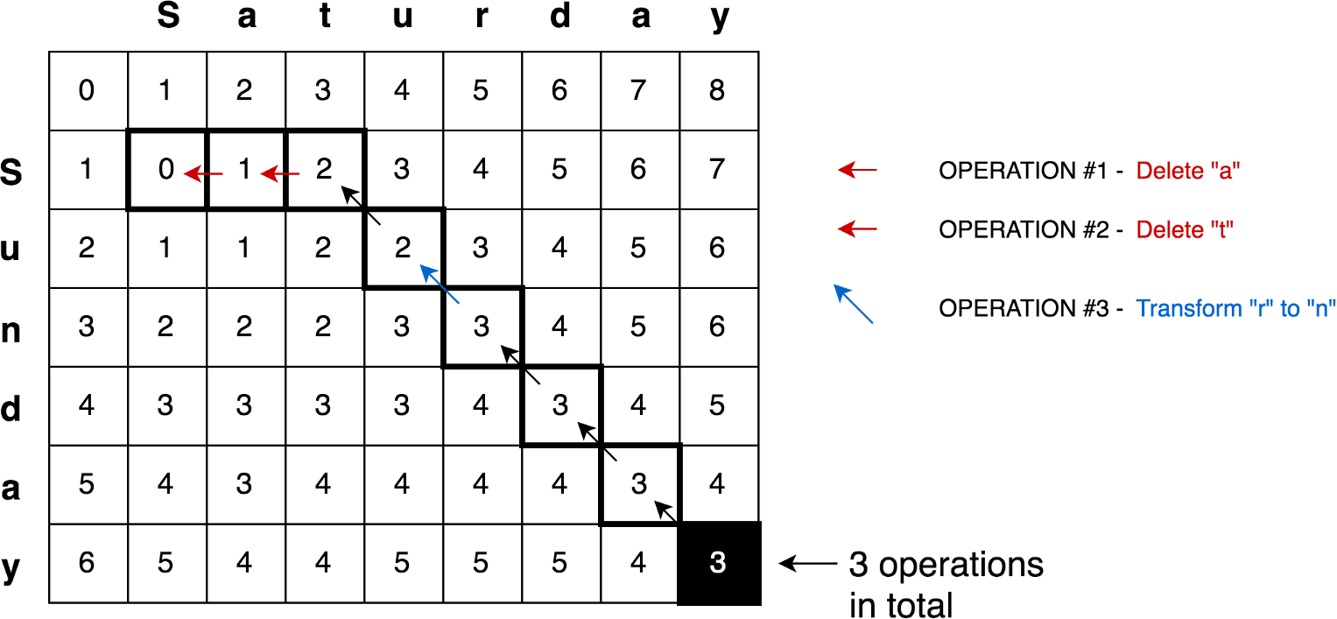
Example of Levenshtein distance
Levenshtein distance calculation by dynamic programming [source: Internet]
distance and similarity

Slide 31
Outline
Introduction
Similarity measures for numeric vectors
Similarity measures for data distributions
Similarity measures for nominal data
Similarity measures for ordinal data
Similarity measures for mix of data types
Similarity measures for sets
Similarity measures for sequence data
References and Summary
distance and similarity

Slide 32
References
J. Han, M. Kamber, and J. Pei. Data Mining: Concepts and Techniques. Morgan Kaufmann, Elsevier, 2012 [Book1].
C. Aggarwal. Data Mining: The Textbook. Springer, 2015 [Book2].
J. Leskovec, A. Rajaraman, and J. D. Ullman. Mining of Massive Datasets. Cambridge University Press, 2014 [Book3].
M. J. Zaki and W. M. Jr. Data Mining and Analysis: Fundamental Concepts and Algorithms. Cambridge University Press, 2013 [Book4].
D. Easley and J. Kleinberg. Networks, Crowds, and Markets: Reasoning About a Highly Connected World. Cambridge University Press, 2010 [Book5].
J. VanderPlas. Python Data Science Handbook: Essential Tools for Working with Data. O’Reilly, 2017 [Book6].
J. Grus. Data Science from Scratch: First Principles with Python. O’Reilly, 2015 [Book7].
distance and similarity

Slide 33
Summary
Introduce most popular distance metrics for numeric data like Euclidean, Manhattan, cosine.
Introduce the distance between data distributions Kullback–Leibler divergence and how this distance is different from cosine.
Introduce the distance calculation for nominal/categorical data (including binary), ordinal data, as well as the mix of nominal, ordinal, and numeric.
Introduce the distance measure between sets: Jaccard index and Jaccard distance.
Introduce one of the most important similarity measure for discrete sequences or strings: edit distance and its most popular variant, Levenshtein distance.
distance and similarity

