Slide 1


Slide 2


Slide 3
GitHub
Place to easily share code and files
Allows for collaboration
Can share publicly or privately
Build off of other peoples projects

Slide 4

Navigate to GitHub.com

Slide 5
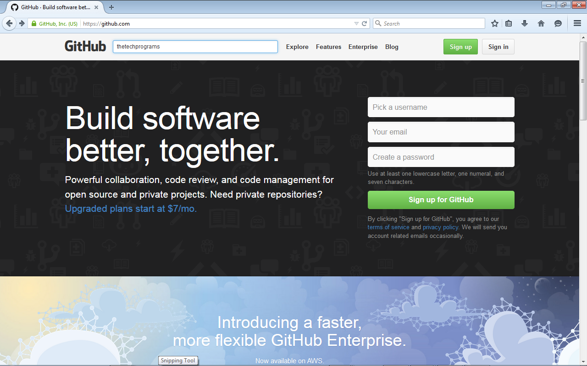
Search for Repositories

Slide 6
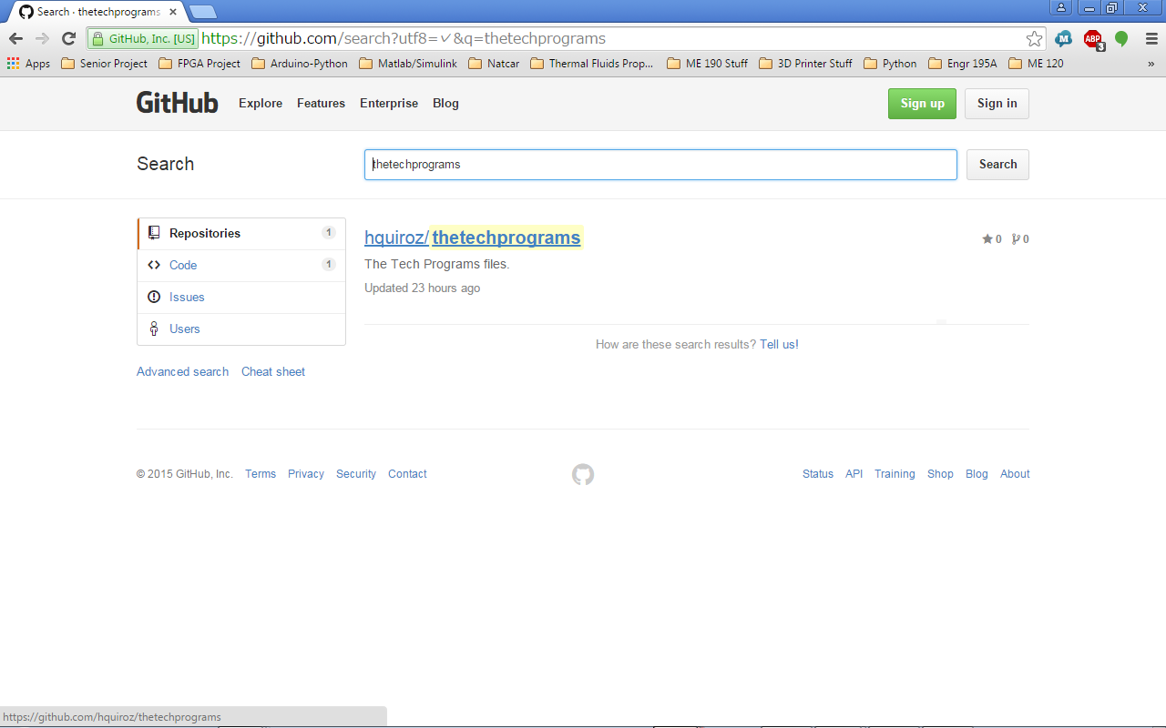
Select a Repository

Slide 7
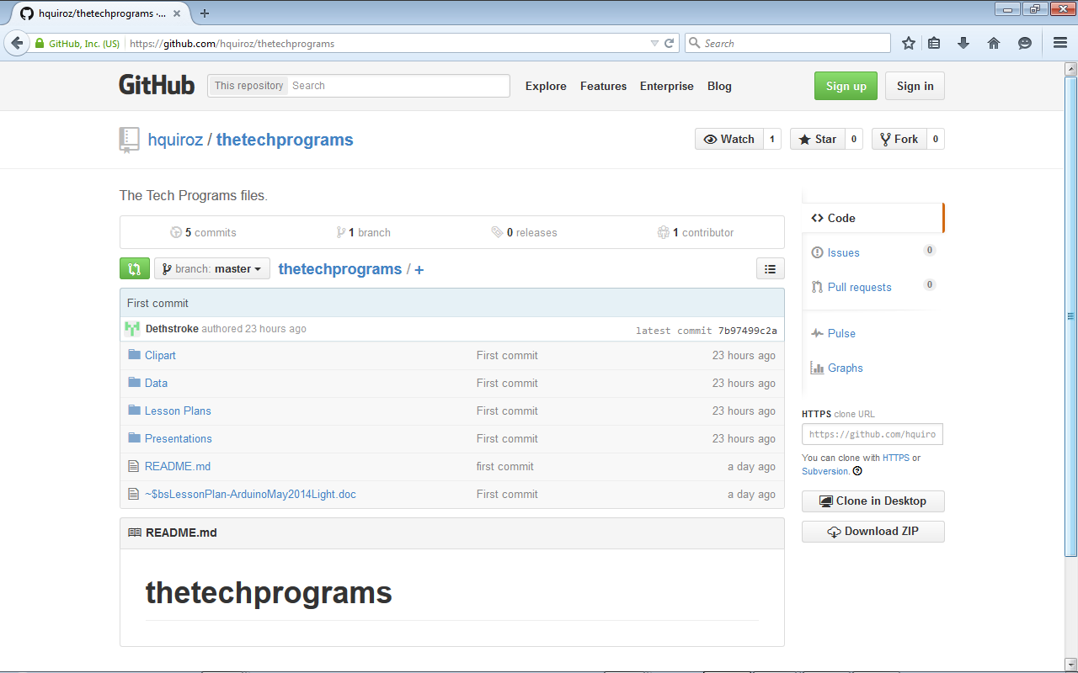
Repository Page
Note: You can access other Repositories created by this user by selecting username
hquiroz

Slide 8
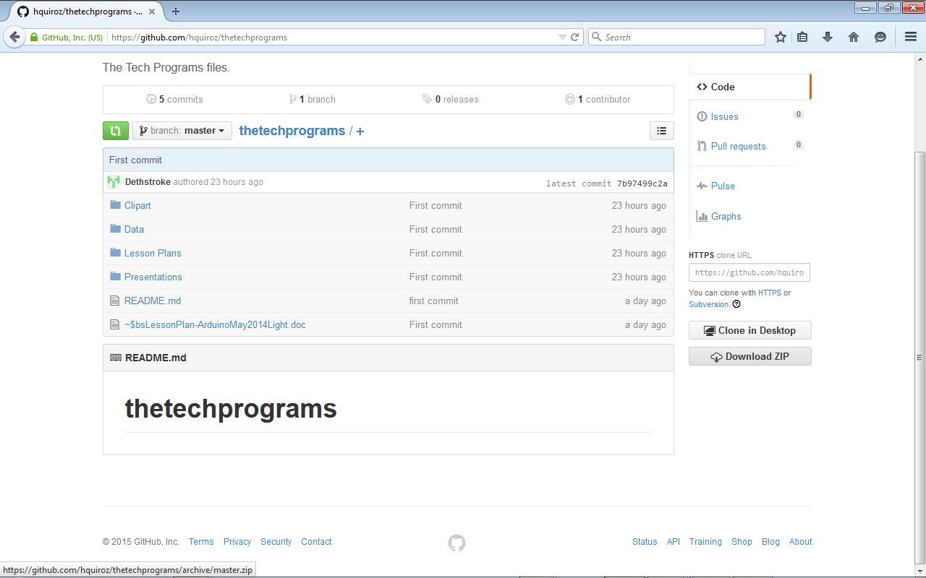
Click Download ZIP

Slide 9
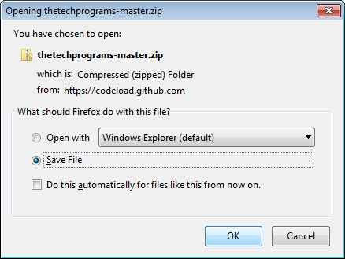
Select Save File
On Firefox select Save File option
All other internet browsers save to downloads folder or similar working directory

Slide 10
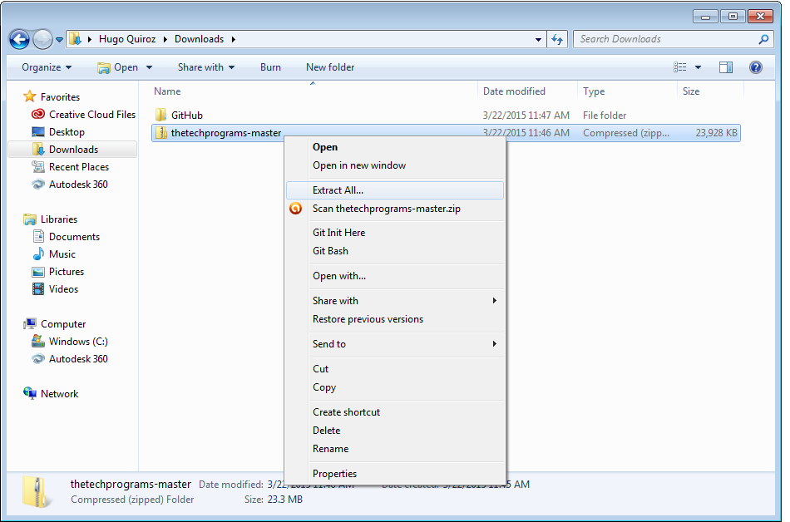
Extract File
Right Click on ZIP Folder
Scroll and Click Extract All option

Slide 11
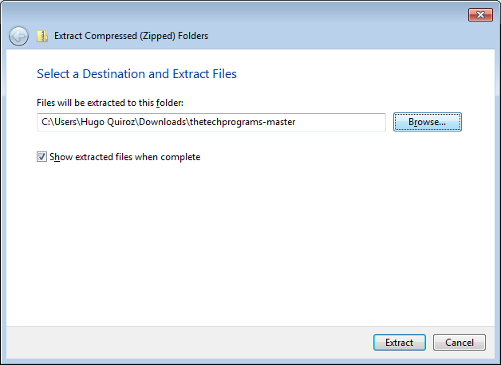
Select Browse

Slide 12
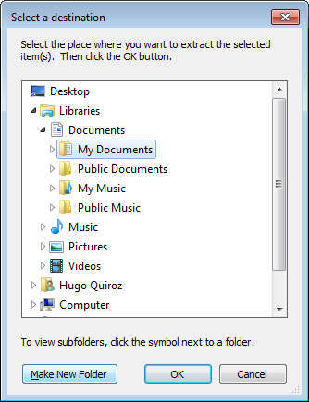
Extract to Working Directory
Navigate to easy to find working directory
My Documents
My Documents>Arduino
Create GitHub folder under My Documents
My Documents>GitHub
Select OK

Slide 13
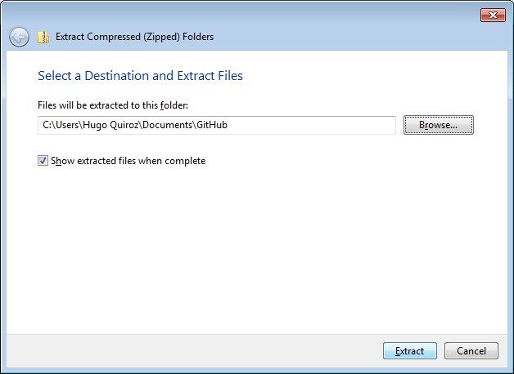

Slide 14
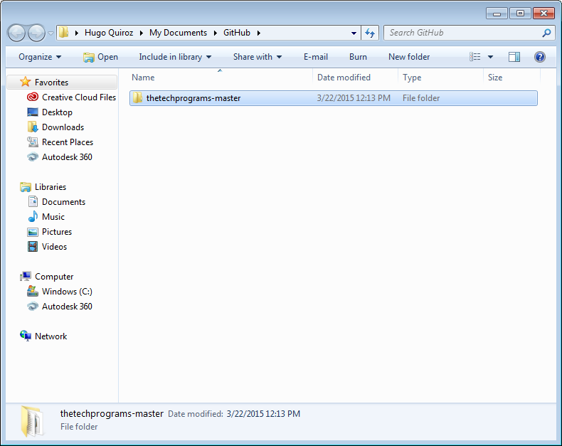
Locate Folder through Windows Explorer

Slide 15
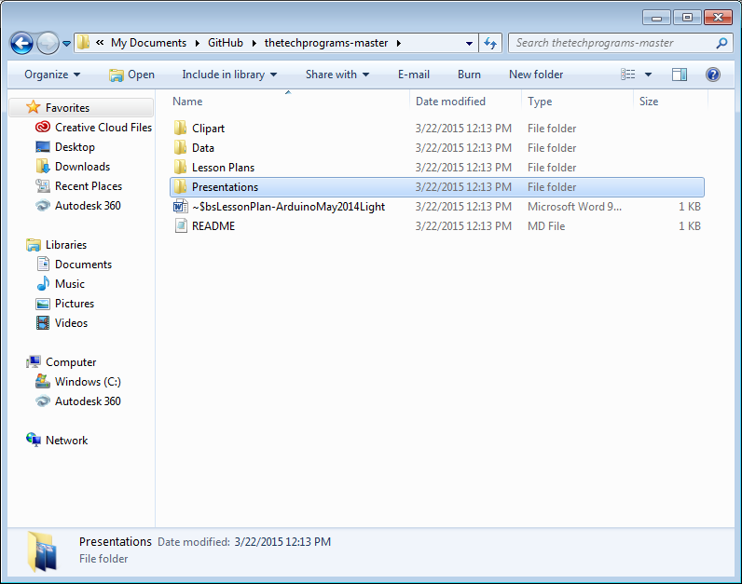
Access Files

