Slide 1


Slide 2
Lights at The Tech
Software
Hardware
Challenge 1 – LED Blink
Challenge 2 – Light Resistance
Challenge 3 – LED Array
Challenge 4 – Love-O-Meter

Slide 3



Software
Arduino IDE
Fritzing
GitHub

Slide 4
Hardware
Arduino UNO
Breadboard
LED’s
Resistors
Photoresistor
LM335 Temperature Sensor
Jumper Wires

Slide 5
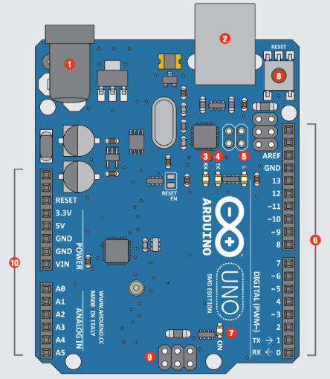
Arduino UNO
# | Function | Notes
1 | Power In | 9V battery 7-12
2 | Power In | Computer USB
3 | LED Receiving | Shows when programming
4 | LED Trans- mitting | When running program
5 | LEDTrouble shooting. | Program running proper
6 | Pins | Input, Output, Digital, Ground
7 | Power Indicator | Confirms Arduino power
8 | Reset | Manually reset
9 | ICSP Pins | Bypass boot loader
10 | Pins | Analog, Ground

Slide 6
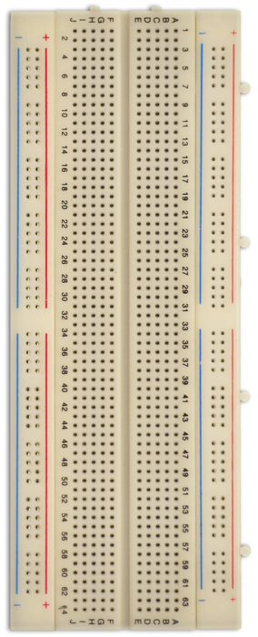
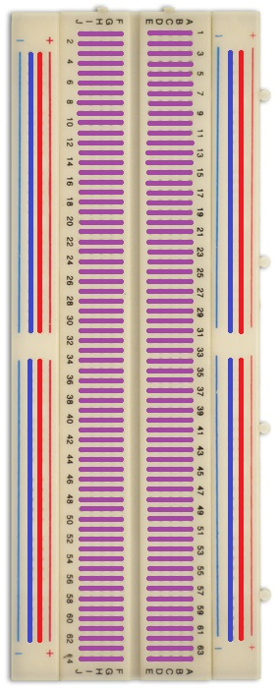
Breadboard
Vertical Rails
Blue and Red Rails
Conventionally Power & GND
Interconnected Vertically
Horizontal Rails
Purple Rails
Interconnected Horizontally
Build circuit here

Slide 7
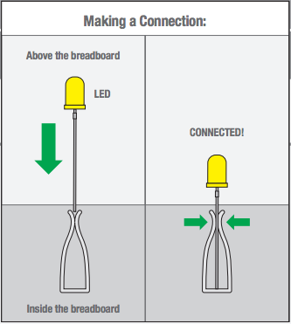
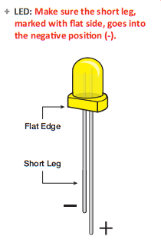
Light Emitting Diode (LED)
LED
Current can only flow in one direction
Short Leg to GND and Long Leg to Power
Will not “emit light” if connected backwards

Slide 8
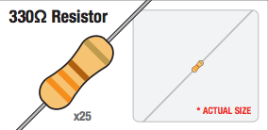
Resistor
Provides resistance to flow of current
Used for:
Power Dissipation
Voltage Divider

Slide 9
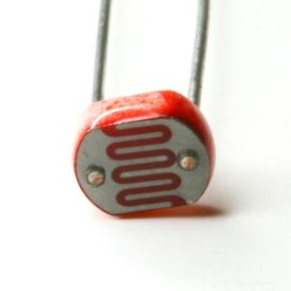
Photo-resistor
Photo-resistor
Light Sensitive Resistor
Resistance changes with more or less exposure to light

Slide 10
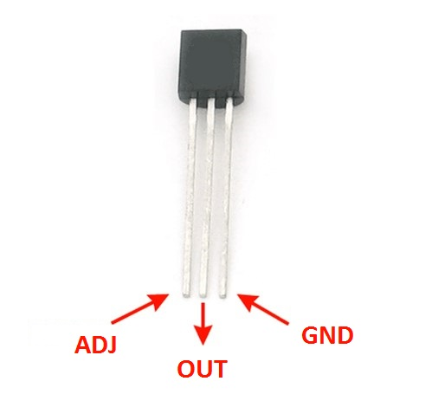
LM335 Temperature Sensor
LM335
ADJ – adjust temperature reading precision
OUT – Signal Out
GND – Ground

Slide 11
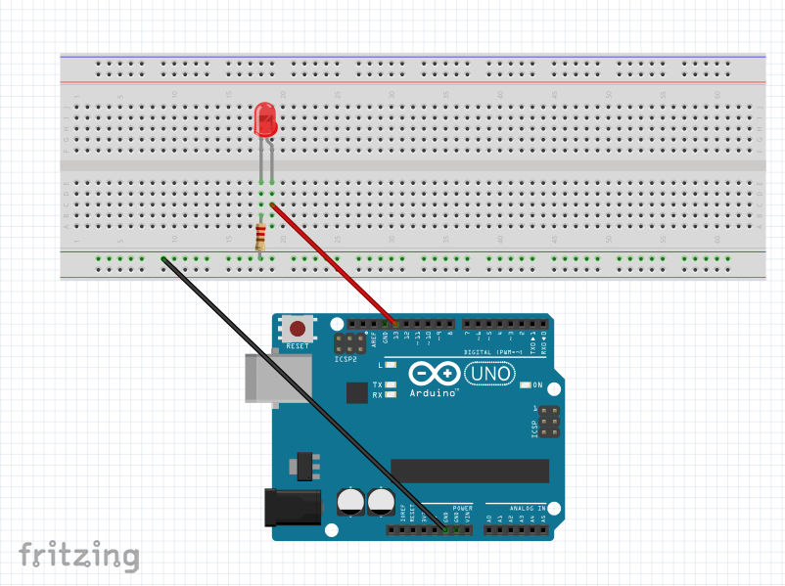
Challenge 1 – LED Blink
1 - LED
1 - 330 Ohms resistor
Jumper Wires

Slide 12
More for #1
Physically:
move the pin to 12, change it in your code 3 places, does it still work?
move your resistor to anywhere in the negative column; works?
move the blue wire to another hole in its’ row, does it work?
move your resistor, LED, and wire to another set of rows on the breadboard, does it still work? (in the same configuration)
are there other ways this circuit works?
Programming:
HIGH = on, LOW = off
1000 Delay = 1 second or 1,000 milliseconds.
Change the delay! Anywhere from 0 to infinity! Has to be a positive int. Has to be a whole number.
What is the smallest delay you can have where you still see a blink?
Add patterns of HIGH and LOW (edit-copy-paste) change a little, upload, see what happens.

Slide 13
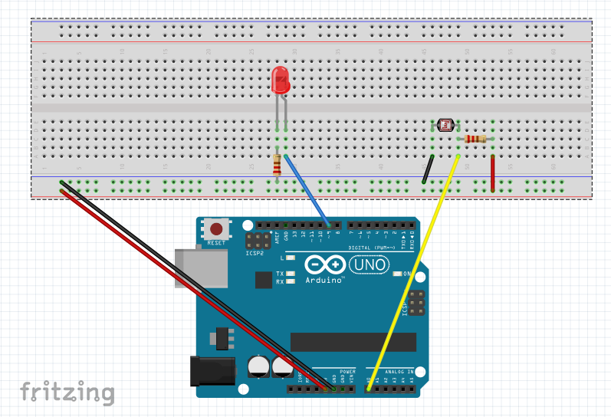
Challenge 2: Play with Light Resistance
1 - LED
1 - 330 Ohms resistor
1 - LDR Photocell
1 - 15KOhm resistor
Jumper Wires

Slide 14
More for #2
Physically:
Cover the Photo-Resistor all the way. What happens?
Place your phone light directly over your photo-resistor and slowly pull away. What happens to the LED?
Flip the placement of the photo-resistor and 15KOhm resistor. Does it still work?
Programming:
In the map function switch the order of low_val and high_val. Run the code, does it still work? How is it different?
“Uncomment” the line Serial.print(sensorValue); Turn on the serial monitor, what do you see?
With the serial monitor still on, place your phone light directly over the photo-resistor. What number do you see? Replace the number 300 at the top of the code with this number. Run the code, notice any difference?

Slide 15
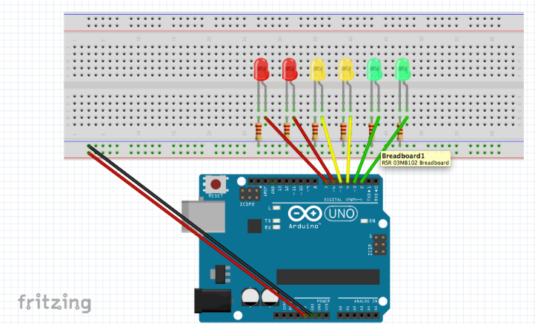
Challenge 3: Play with an Array of LEDs
6 - LEDs
6 - 330 Ohm Resistors
Jumper Wires

Slide 16
More for #3
Physically
Hit the red/brown reset button near the USB jack. Does the code still run or has it been erased?
Switch the LED’s around in your favorite arrangement.
Switch the jumper wires around from pins 2-7 (not GND and 5V)
Programming
Change the code so that the LED’s cascade faster/slower.
Change the code so that the LED’s light up in order. Hint ( int ledPins[] = {} )
Create your own sketch, try to make a caterpillar, a series of lights that chase each other
Try to make the lights do a pattern where they move from the outside in or the inside out.
Change the code so that the lights cascade slow at first and then faster.

Slide 17
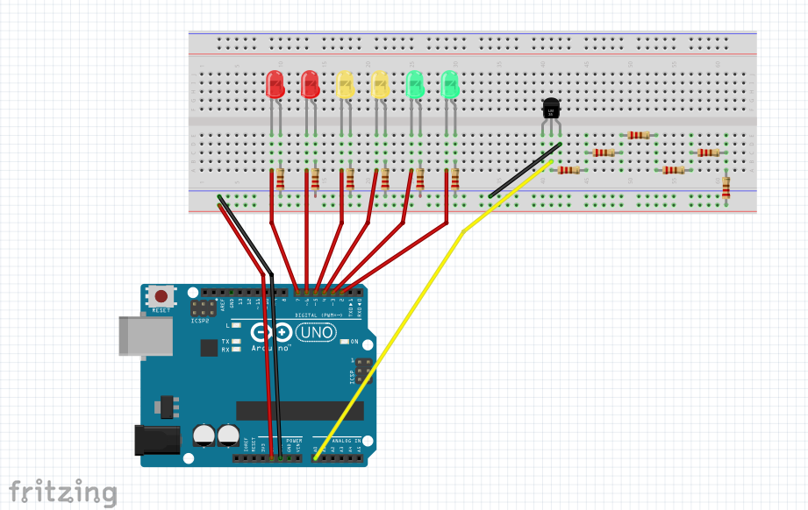
Challenge 4: Make a Love-O-Meter
6 - LEDs
6 - 330 Ohm Resistors
1 - Temperature Sensor
Jumper Wires

Slide 18
More for #4
Physically
Flip the connection on one of the LED’s does it still work?
Remove the wire going to A0 what happens?
Remove one of the resistors connected to the temperature sensor does it still work?
Remove the USB cable and plug it back into the Arduino? Does the program still work?
Programming
Uncomment the lines that print the degrees in Celsius? Run the code and open the serial monitor. What do you see?
With the serial monitor still on, read what is the lowest value the temperature sensor will go down to? What is the highest?
Incorporate these two thresholds into your code. The current thresholds are 25 and 30.
This code has several iterations of the same command. Can you think of a way to shorten this? With an array maybe?

Slide 19
Ultimate Challenge
Look at all the materials you have used so far can you think of a design you would like to make with these materials? Ask the workshop facilitator how you might go about this design.

