Slide 1


Slide 2
Lights at The Tech
Software
Hardware
Challenge 1 – LED Blink
Challenge 2 – Light Resistance
Challenge 3 – LED Array
Challenge 4 – Love-O-Meter

Slide 3



Software
Arduino IDE
Fritzing
GitHub

Slide 4
Hardware
Arduino UNO
Breadboard
LED’s
Resistors
Photoresistor
LM335 Temperature Sensor
Jumper Wires

Slide 5
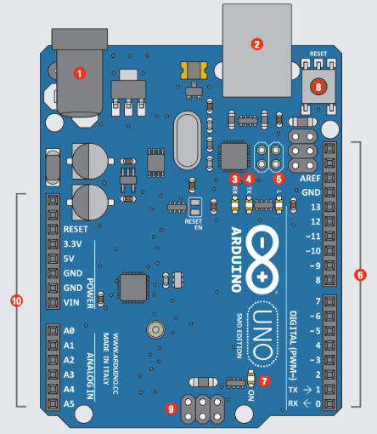
Arduino UNO
# | Function | Notes
1 | Power In | 9V battery 7-12
2 | Power In | Computer USB
3 | LED Receiving | Shows when programming
4 | LED Trans- mitting | When running program
5 | LEDTrouble shooting. | Program running proper
6 | Pins | Input, Output, Digital, Ground
7 | Power Indicator | Confirms Arduino power
8 | Reset | Manually reset
9 | ICSP Pins | Bypass boot loader
10 | Pins | Analog, Ground

Slide 6
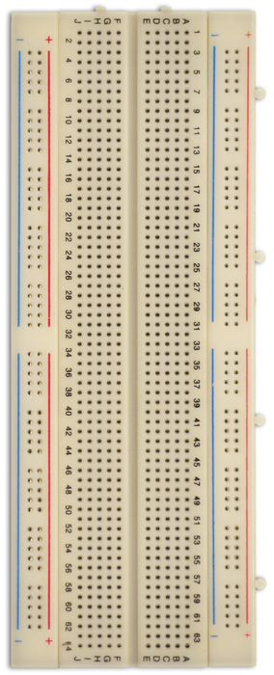
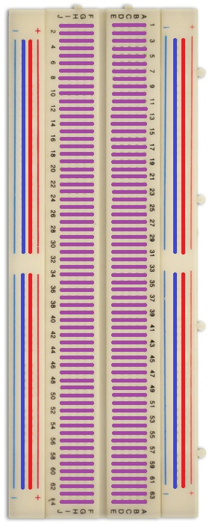
Breadboard
Vertical Rails
Blue and Red Rails
Conventionally Power & GND
Interconnected Vertically
Horizontal Rails
Purple Rails
Interconnected Horizontally
Build circuit here

Slide 7
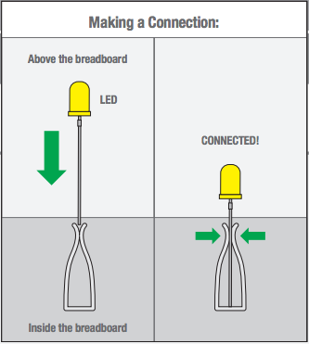
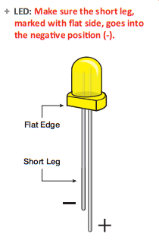
Light Emitting Diode (LED)
LED
Current can only flow in one direction
Short Leg to GND and Long Leg to Power
Will not “emit light” if connected backwards

Slide 8
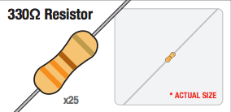
Resistor
Provides resistance to flow of current
Used for:
Power Dissipation
Voltage Divider

Slide 9
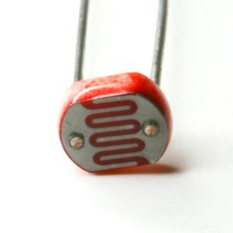
Photo-resistor
Photo-resistor
Light Sensitive Resistor
Resistance changes with more or less exposure to light

Slide 10
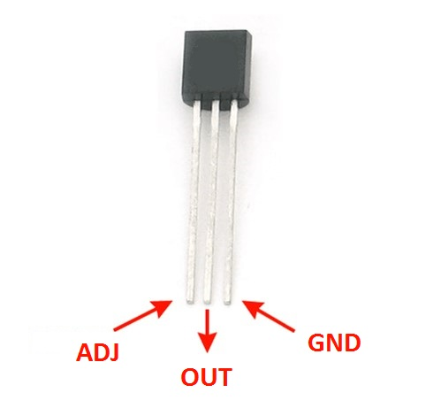
LM335 Temperature Sensor
LM335
ADJ – adjust temperature reading precision
OUT – Signal Out
GND – Ground

Slide 11
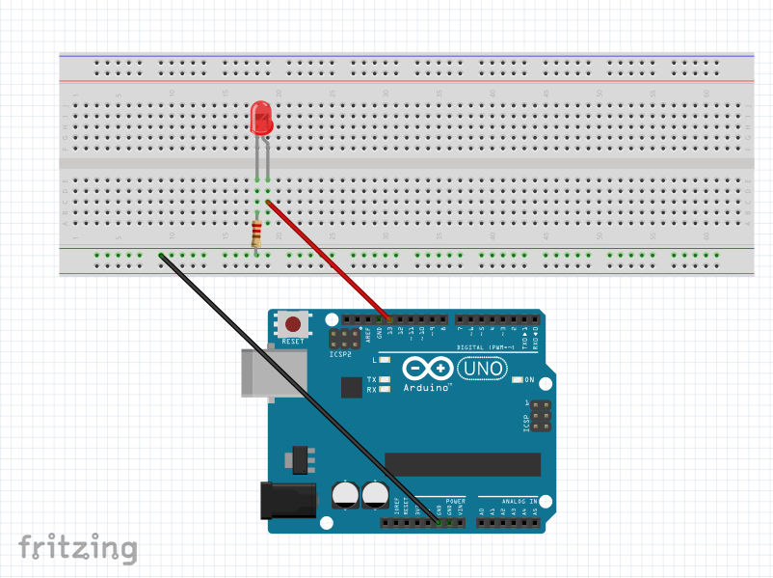
Challenge 1 – LED Blink
1 - LED
1 - 330 Ohms resistor
Jumper Wires

Slide 12
More for #1
Physically:
move the pin to 12, change it in your code 3 places, does it still work?
move your resistor to anywhere in the negative column; works?
move the blue wire to another hole in its’ row, does it work?
move your resistor, LED, and wire to another set of rows on the breadboard, does it still work? (in the same configuration)
are there other ways this circuit works?
Programming:
HIGH = on, LOW = off
1000 Delay = 1 second or 1,000 milliseconds.
Change the delay! Anywhere from 0 to infinity! Has to be a positive int. Has to be a whole number.
What are the smallest delay ints you can have where you still see a blink?
Add patterns of HIGH and LOW (edit-copy-paste) change a little, upload, see what happens.

Slide 13
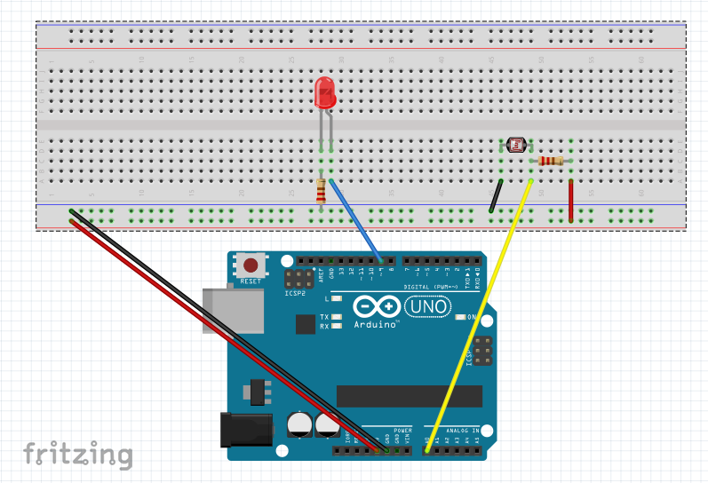
Challenge 2: Play with Light Resistance
1 - LED
1 - 330 Ohms resistor
1 - LDR Photocell
1 - 15K Ohm resistor
Jumper Wires

Slide 14
More for #2
Physically:
manualTune() and autoTune() You can use only one at a time, so comment one in, comment the other out.
This sketch introduces the map and constrain function
Change in the manualTune, “0” and “1023” to “300” and “800” as recommended in the comments! Try other values too! What about “800” and “300” (backwards), does it work???
Flash a light on your system what happens
Programming:
Look at the serial monitor
Uncomment the sensorvalue what are the limits
Flip the low val and high val

Slide 15
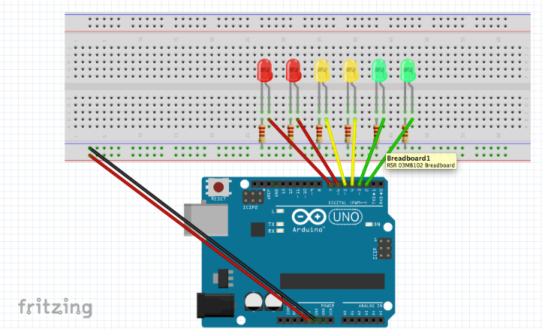
Challenge 3: Play with an Array of LEDs
6 - LEDs
6 - 330 Ohm Resistors
Jumper Wires

Slide 16
More for #3
Try each of the functions one at a time, commenting out the others
Adjust the delays
Try to make a pattern/rhythm with blinks
Swap pins and change the code just to test yourself
Edit-copy-paste into a new code window and see if you can still make it work.
Select certain patterns, deconstruct them, change one thing and see what happens, change one small thing, upload.
Examine the random code, there are tips in the comments of how to make it more random
Create your own sketch, try to make a caterpillar, a series of lights that chase each other
Try to make the lights do a pattern where they move from the outside in or the inside out.
change

Slide 17
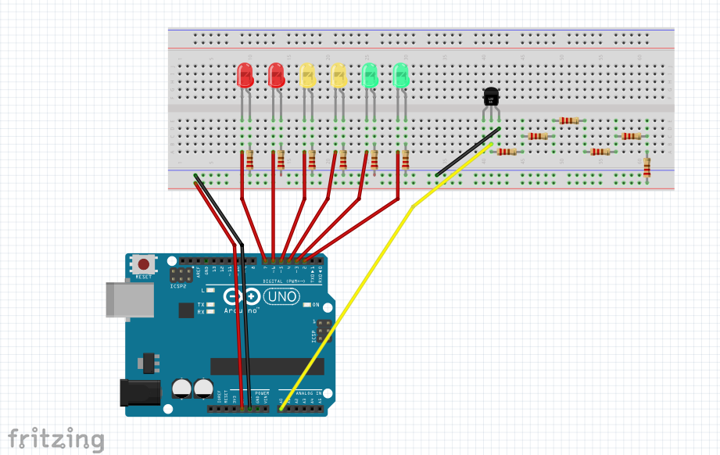
Challenge 4: Make a Love-O-Meter
6 - LEDs
6 - 330 Ohm Resistors
1 - Temperature Sensor
Jumper Wires

Slide 18
More for #4
D
F
F
G
g
G
T
T
T
T
T
T
T

