Slide 1


Slide 2
http://arduino.cc/en/Main/Software
DOWNLOAD Arduino IDE:

Slide 3





Slide 4
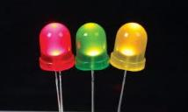
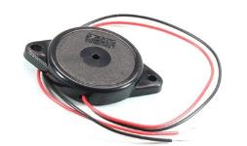
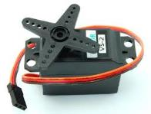
Member Workshops
Light Up My World……...........May 3
Breadboard Piano…………May 10
Servo Artist…………………….May 24

Slide 5
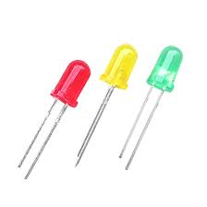
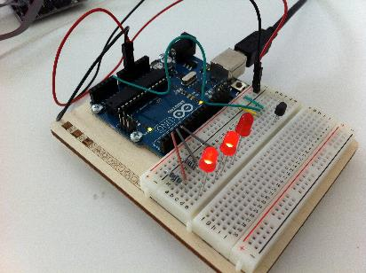
Light Up My World The Tech Museum of Innovation
Innovate with Arduino and lab instructor Tenaya Hurst

Slide 6
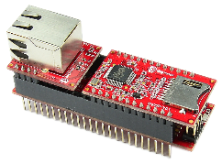
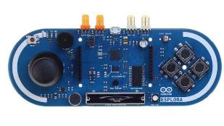
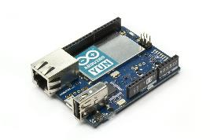
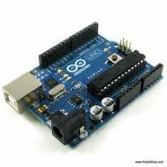
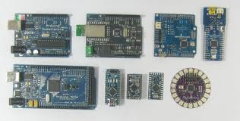
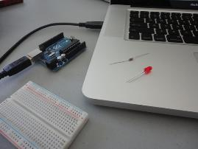

Slide 7
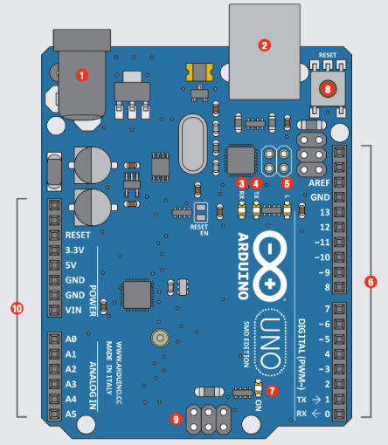
Arduino Parts
# | Function | Notes
1 | Power In | 9V battery 7-12
2 | Power In | Computer USB
3 | LED Receiving | Shows when programming
4 | LED Trans- mitting | When running program
5 | LEDTrouble shooting. | Program running proper
6 | Pins | Input, Output, Digital, Ground
7 | Power Indicator | Confirms Arduino power
8 | Reset | Manually reset
9 | ICSP Pins | Bypass boot loader
10 | Pins | Analog, Ground

Slide 8
Analog Signal vs. Digital Signal
Has a range of values
a signal that can be any value between two limits.
Denoted by Sine waves
Best for audio and video
Draw more power
Memory – wave signal
Can be affected in accuracy by external noise
On or Off
A signal that can be one of two values
Denoted by Square waves
Best for electronics
Draw less power
Memory – binary bit
More reliable with data

Slide 9
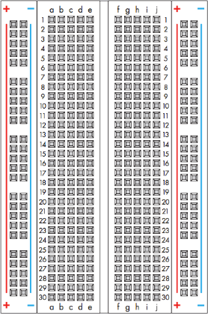
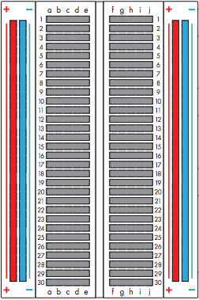
Breadboard – solderless, reusable, prototyping perforated plastic block with metal tie points to make connections Bus strips – the positive and negative vertical connections

Slide 10

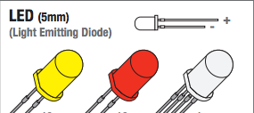


Slide 11
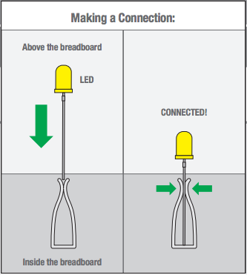
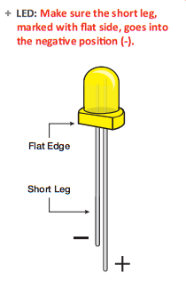
LED - Light Emitting Diode releases energy in the form of photons, this effect is called electroluminescence

Slide 12
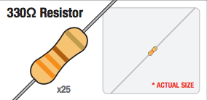
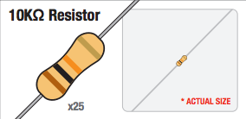
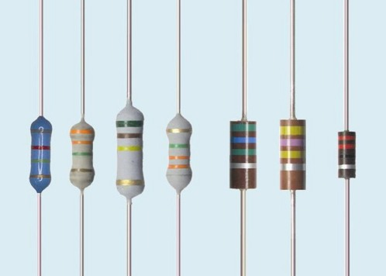
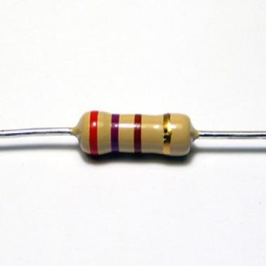
Resistors

Slide 13
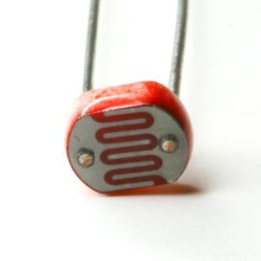
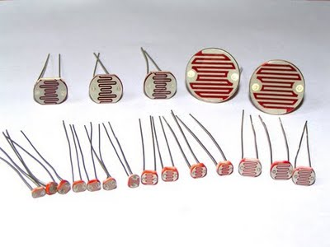
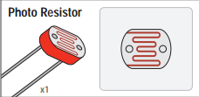
LDR Photocell

Slide 14
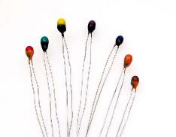
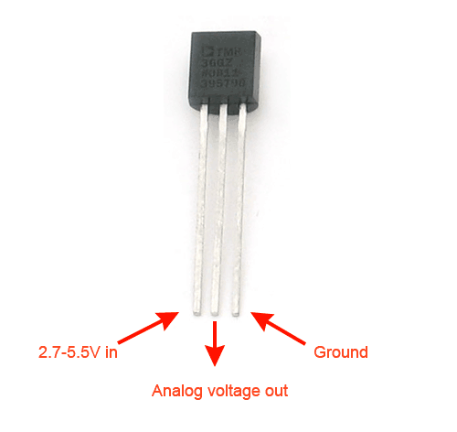
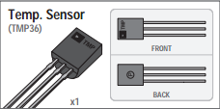
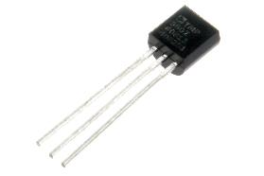
Temperature Resistor

Slide 15
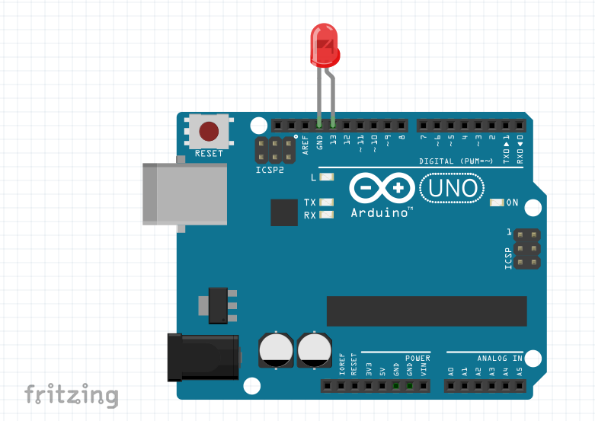

Slide 16
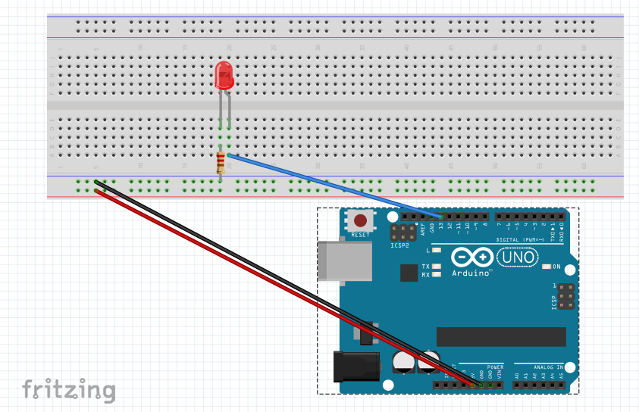
Challenge 1: Blink your LED
1 LED
1 330 Ohms resistor
3 wires
GitHub – TMChallenge1Light
sdflksdjflsdkfjslkfjlsdkjf

Slide 17
More for #1
Programming:
HIGH = on, LOW = off
1000 Delay = 1 second or 1,000 milliseconds.
Change the delay! Anywhere from 0 to infinity! Has to be a positive int. Has to be a whole number.
What are the smallest delay ints you can have where you still see a blink?
Add patterns of HIGH and LOW (edit-copy-paste) change a little, upload, see what happens.
Physically:
move the pin to 12, change it in your code 3 places, does it still work?
move your resistor to anywhere in the negative column; works?
move the blue wire to another hole in its’ row, does it work?
move your resistor, LED, and wire to another set of rows on the breadboard, does it still work? (in the same configuration)
are there other ways this circuit works?

Slide 18
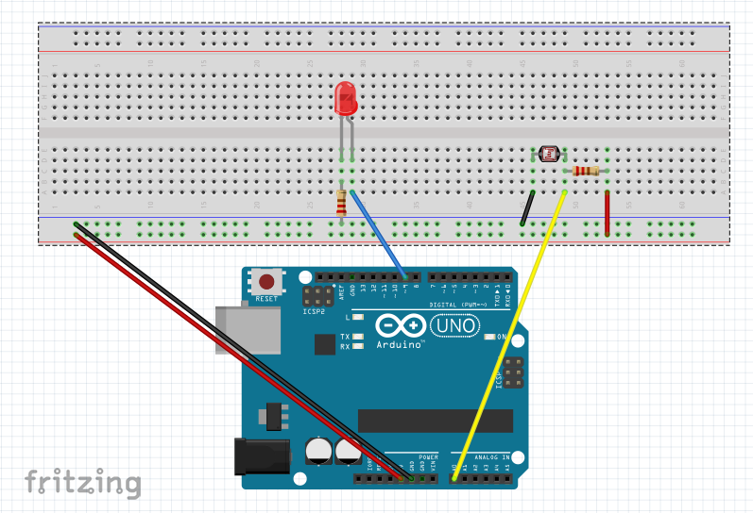
Challenge 2: Play with Light Resistance
1 LED 6 wires
1 330 Ohms resistor
1 LDR Photocell
1 10K Ohms resistor
GitHub – TMChallenge2Light
sdflksdjflsdkfjslkfjlsdkjf

Slide 19
More for #2
Programming:
change
change
change
change
change
Physically:
manualTune() and autoTune() You can use only one at a time, so comment one in, comment the other out.
This sketch introduces the map and constrain function
Change in the manualTune, “0” and “1023” to “300” and “800” as recommended in the comments! Try other values too! What about “800” and “300” (backwards), does it work???
change

Slide 20
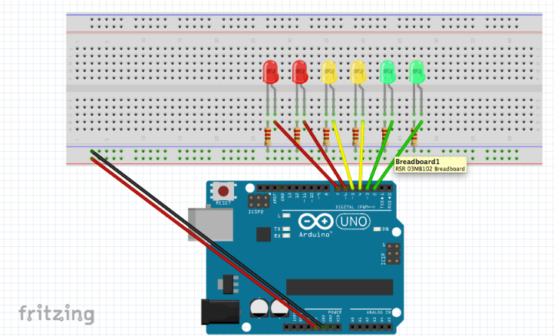
Challenge 3: Play with an Array of LEDs
6 LEDs
6 330 Ohms resistors
8 wires
GitHub – TMChallenge3Light
sdflksdjflsdkfjslkfjlsdkjf

Slide 21
More for #3
Examine the random code, there are tips in the comments of how to make it more random
Create your own sketch, try to make a caterpillar, a series of lights that chase each other
Try to make the lights do a pattern where they move from the outside in or the inside out.
change
Try each of the functions one at a time, commenting out the others
Adjust the delays
Try to make a pattern/rhythm with blinks
Swap pins and change the code just to test yourself
Edit-copy-paste into a new code window and see if you can still make it work.
Select certain patterns, deconstruct them, change one thing and see what happens, change one small thing, upload.

Slide 22
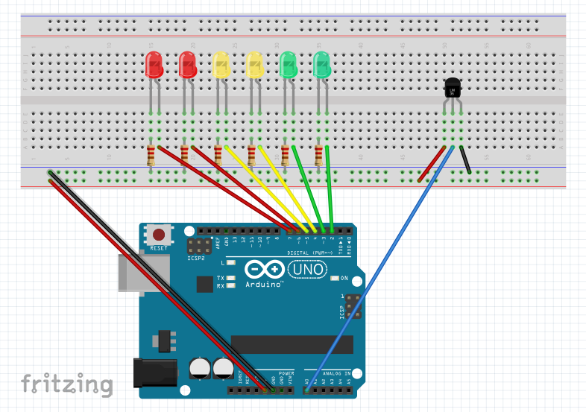
Challenge 4: Make a Love-O-Meter
6 LEDs
6 330 Ohms resistor
1 Temperature Sensor
11 wires
GitHub – TMChallenge4Light
sdflksdjflsdkfjslkfjlsdkjf

Slide 23
More for #4
T
T
T
T
T
T
T
T
T
T
T
T
T
T
D
F
F
G
g
G
G
G
g

