Slide 1


Slide 2
http://arduino.cc/en/Main/Software
DOWNLOAD Arduino IDE:

Slide 3





Slide 4
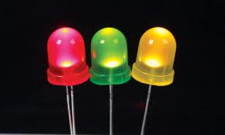
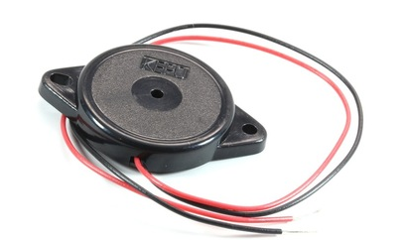
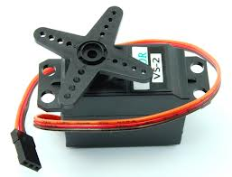
Member Workshops
Light Up My World……...........May 3
Breadboard Piano…………May 10
Servo Artist…………………….May 24

Slide 5
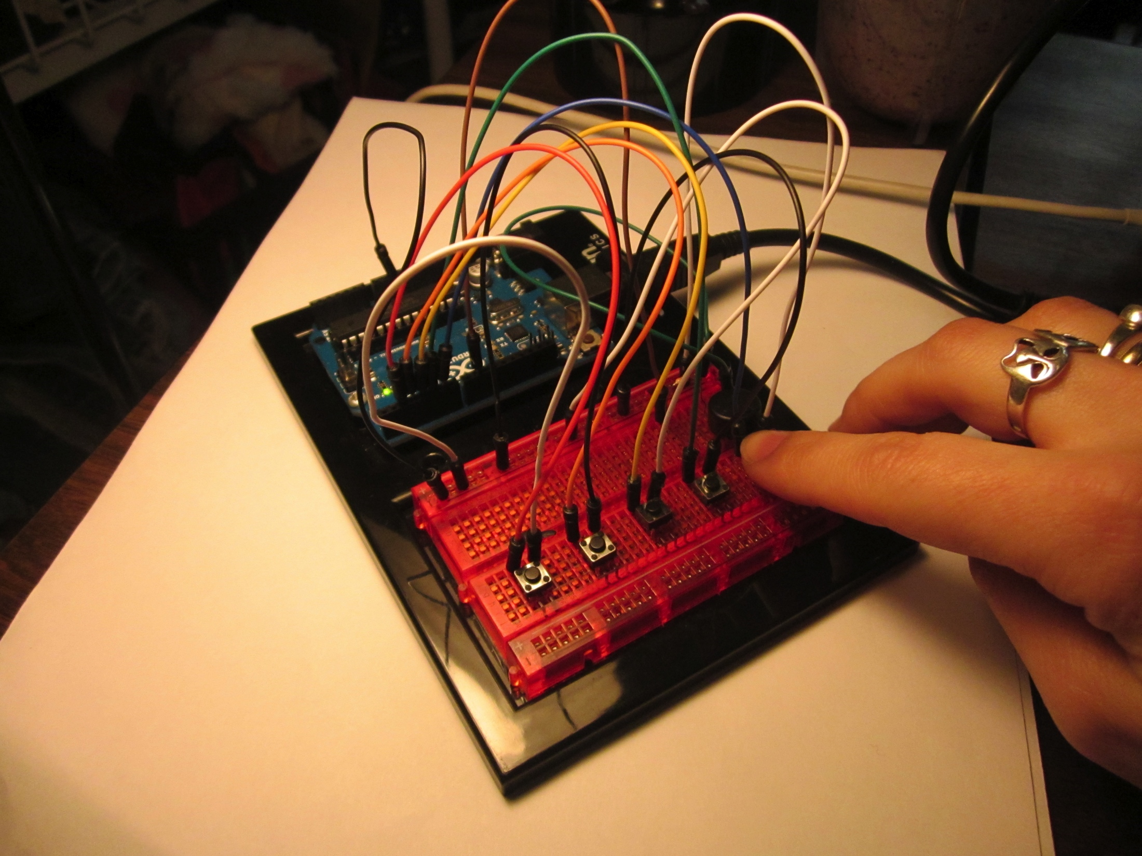
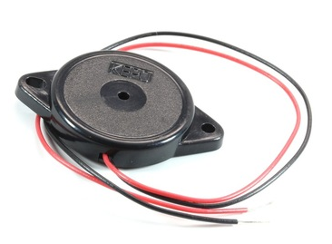
Breadboard Piano The Tech Museum of Innovation
Innovate with Arduino and lab instructor Tenaya Hurst

Slide 6
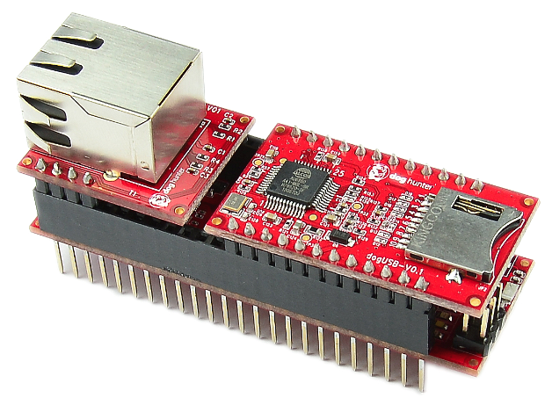
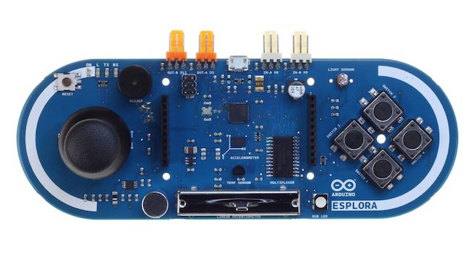
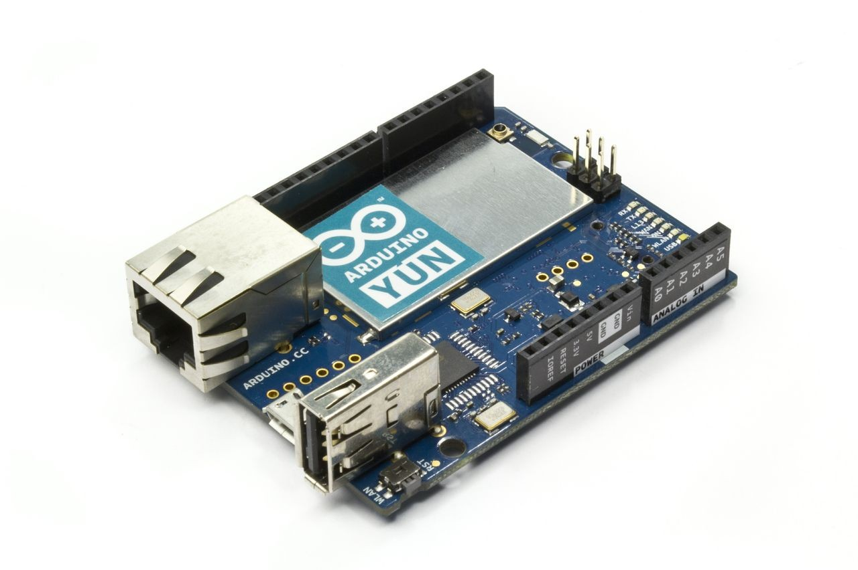
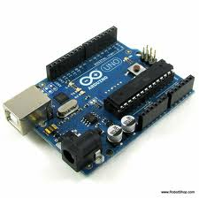
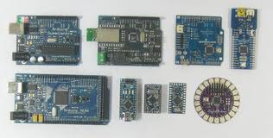
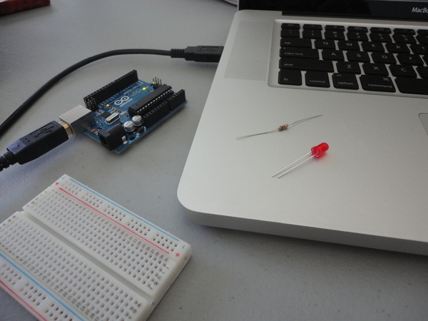

Slide 7
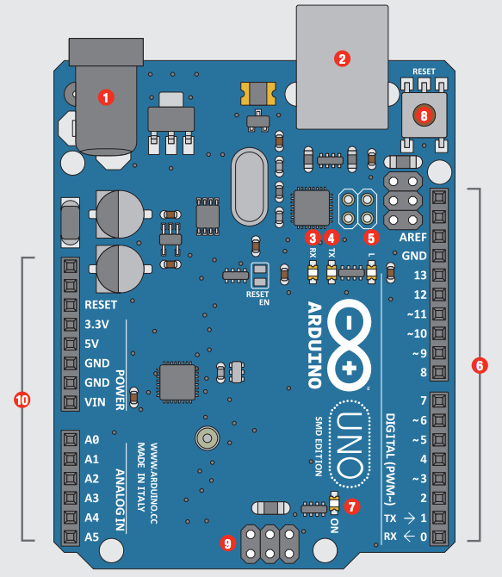
Arduino Parts
# | Function | Notes
1 | Power In | 9V battery 7-12
2 | Power In | Comp USB
3 | LED Receiving | Shows when programming
4 | LED Trans- mitting | When running program
5 | LEDTrouble shooting. | Program running proper
6 | Pins | Input, Output, Digital, Ground
7 | Power Indicator | Confirms Arduino power
8 | Reset | Manually reset
9 | ICSP Pins | Bypass boot loader
10 | Pins | Analog, Ground

Slide 8
Analog Signal vs. Digital Signal
Has a range of values
a signal that can be any value between two limits.
Denoted by Sine waves
Best for audio and video
Draw more power
Memory – wave signal
Can be affected in accuracy by external noise
On or Off
A signal that can be one of two values
Denoted by Square waves
Best for electronics
Draw less power
Memory – binary bit
More reliable with data

Slide 9
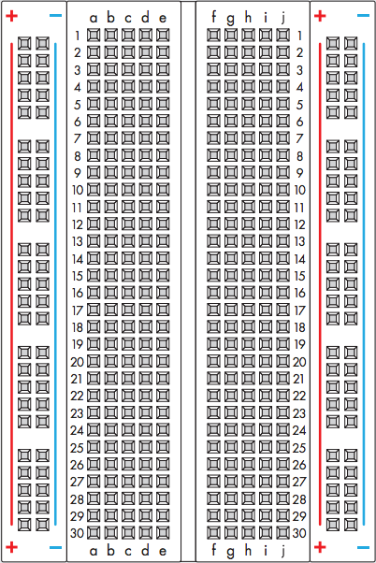
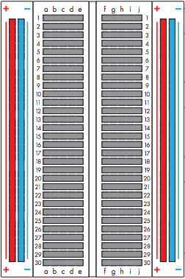
Breadboard – solderless, reusable, prototyping perforated plastic block with metal tie points to make connections Bus strips – the positive and negative vertical connections

Slide 10
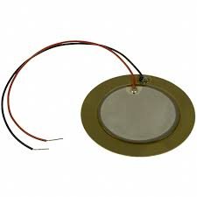
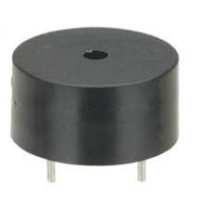
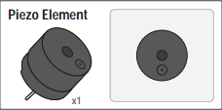
Piezo

Slide 11
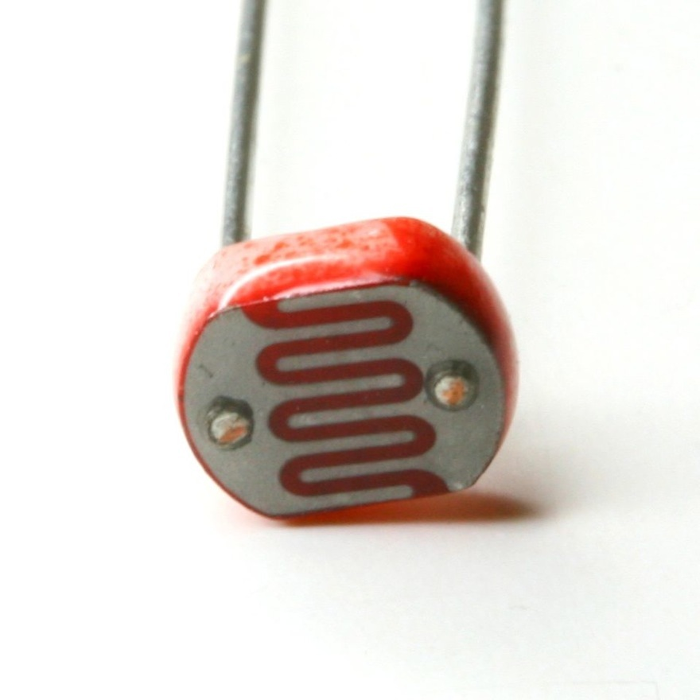
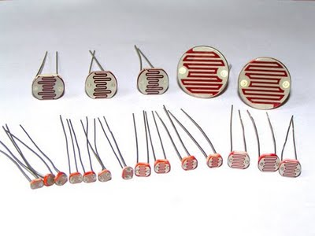
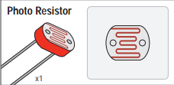
LDR Photocell

Slide 12
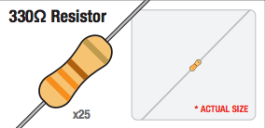
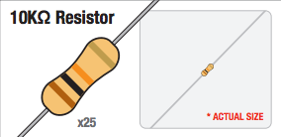
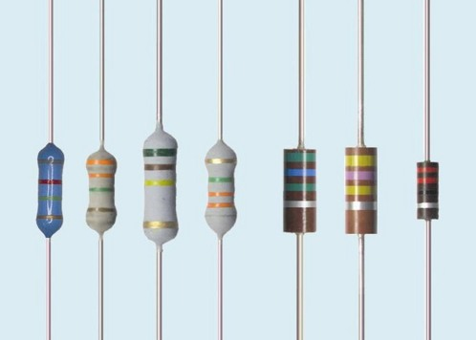
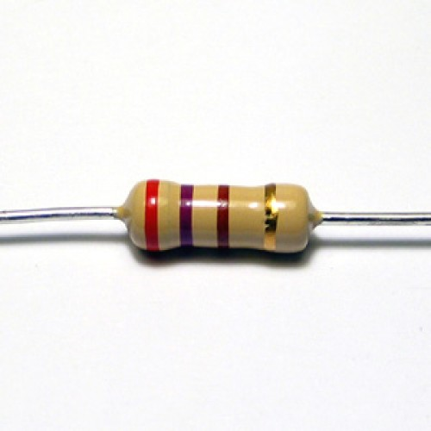
Resistors

Slide 13
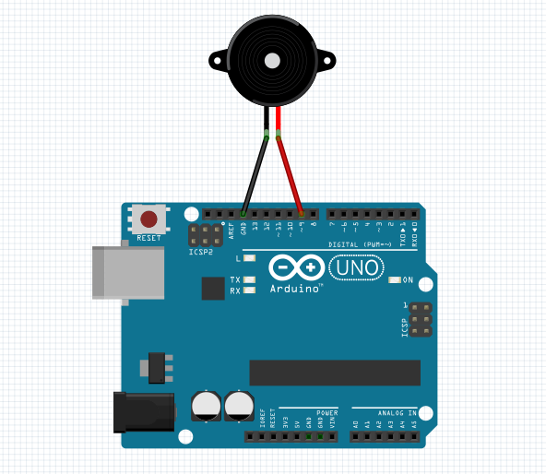
Challenge 1: Play Music through Programming
1 Piezo
File → Examples → PiezoMusic
Upload Code by clicking the checkmark icon

Slide 14
More for #1
Piezo notes are
Note B0 is 31
Note C1 is 33 etc
Note CS5 is 554 (note above our highest note in our Circuit 11 program.
Highest note is D8 - 4699
Highest note is DS8 - 4978
Make a song!
Change the pattern slowly, get a handle on the rests and beats needed
Make sure every time you change the code, change it all the places you need to if you add notes.
Look at the notes options and try programming in different pitches.
Open Examples – 02.Digital – toneMelody to see the Pitches tab

Slide 15
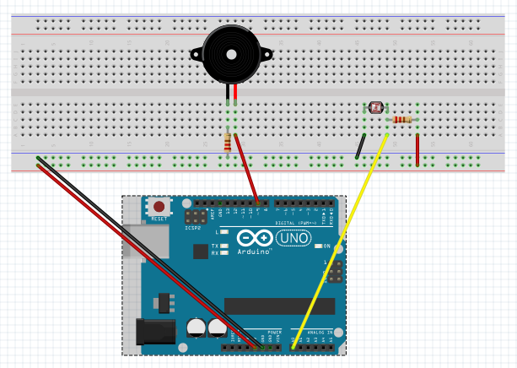
Challenge 2: Play Music with Light Resistance
1 Piezo 6 wires
1 1M Ohms resistor
1 LDR photocell
1 10K Ohms resistor
GitHub – TMChallenge2Breadboard Piano
sdflksdjflsdkfjslkfjlsdkjf

Slide 16
More for #2
change
change
Control your Piezo
change
change
change
change

Slide 17
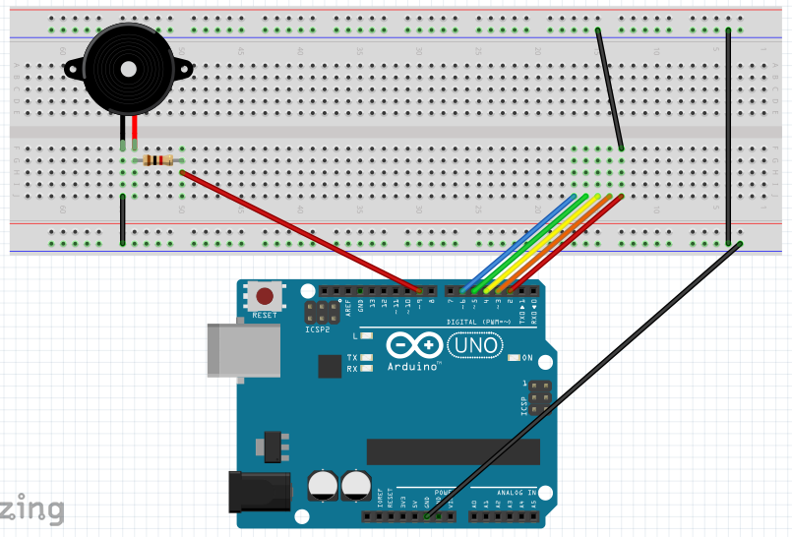
Challenge 3: Play your Piezo, note by note
1 Piezo
1 1M Ohms resistor
10 wires
GitHub – TMChallenge3_4BreadboardPiano
sdflksdjflsdkfjslkfjlsdkjf

Slide 18
More for #3
change
change
Control your Piezo
change
change
change
change

Slide 19
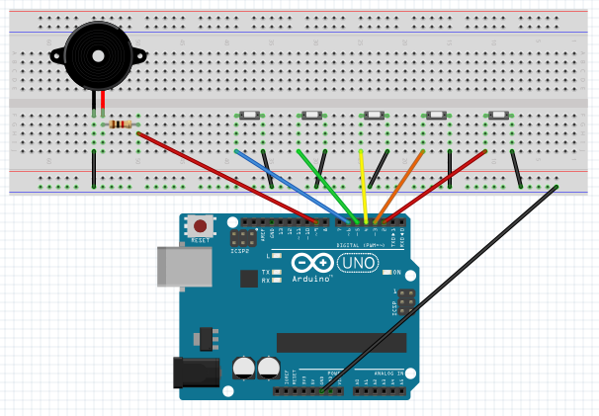
Challenge 4: Make a Breadboard Piano
1 Piezo
1 1M Ohms resistor
13 wires
5 buttons
GitHub – TMChallenge3_4BreadboardPiano
sdflksdjflsdkfjslkfjlsdkjf

