Slide 1

WIPRO NGA Program – 25SUB4530_CP_JAVA
Capstone Project Presentation – 9th Feb & 10th Feb 2026
Project Title Here – Expense Tracker Application
Presented by – Het Raval (58663) & Julakanti Tharun (58671)
www.rpsconsulting.in

Slide 2

Expense Tracker Application
Introduction :
Managing daily expenses manually can be difficult and time-consuming. Many users(Personal/Organizational) are unable to track where their money is being spent, which leads to poor financial planning.
The Expense Tracker Application is designed to solve this problem by providing a digital platform where users can record, categorize, and analyze their expenses in an organized way.
The application provides a simple interface and real-time updates so users can easily monitor their spending habits and make better financial decisions.
2024 - RPS Consulting all rights reserved

Slide 3
Expense Tracker Application
Problem Statement :
In daily life, individuals and organizations face challenges such as:
--Difficulty tracking expenses manually
--Lack of visibility into spending habits
--No centralized system for expense management
--Time-consuming calculations
--Limited reporting and filtering options
A digital system is required to simplify expense tracking and provide meaningful insights into spending patterns.
2024 - RPS Consulting all rights reserved

Slide 4
Expense Tracker Application
Objective :
→Primary Objectives
--To build a web application that tracks expenses efficiently
--To provide visibility into user spending habits
--To help users manage their finances better
→Secondary Objectives
--Categorize expenses
--Generate summaries and reports
--Provide filters for analysis
--Ensure scalability and easy deployment
2024 - RPS Consulting all rights reserved

Slide 5
Expense Tracker Application
Key Features :
The system provides the following features:
--Add new expense entries
--Edit or delete expenses
--Categorize expenses (Food, Travel, Utilities, etc.)
--Filter expenses by date
--Filter expenses by category
--View total expenses
--Dashboard summary
--Optional charts for analysis
--Responsive user interface
2024 - RPS Consulting all rights reserved

Slide 6
Expense Tracker Application
System Architecture :
The application follows a 3-tier architecture:
#Presentation Layer
--Angular frontend
--User interface
--Displays expense data
#Application Layer
--Spring Boot backend
--REST APIs
#Data Layer
--MySQL
--Stores expenses and categories
Flow :
User → Angular UI → REST API → Database → Response → UI
2024 - RPS Consulting all rights reserved

Slide 7
Expense Tracker Application
Technology Stack :
#Frontend
--Angular framework
--TypeScript
--HTML, CSS
--Angular services for API calls
#Backend
--Spring Boot
--Spring Data JPA
--REST API architecture
--Maven build tool
#Database
--MYSQL
#DevOps
--Docker for containerization
--Azure App Service for hosting
2024 - RPS Consulting all rights reserved

Slide 8
Expense Tracker Application
Function Module :
1. Expense Module
--Add expense
--Update expense
--Delete expense
--View expense list
2. Category Module
--Create category
--Assign category to expense
--Manage categories
3. Reporting Module
--Total expenses
--Filter by date
--Filter by category
--Monthly summary
2024 - RPS Consulting all rights reserved

Slide 9
Expense Tracker Application
User Interface:
The Angular frontend provides:
--Dashboard page
--Add expense form
--Expense list view
--Filter options
--Summary section
--Optional charts
The UI updates in real time when
expenses are added or deleted.
Application Workflow:
User opens application:
1. User adds expense
2. User selects category
3. Data sent to backend API
4. Backend stores data in database
5. Dashboard updates
6. User views reports
This ensures smooth and real-time expense tracking.
2024 - RPS Consulting all rights reserved

Slide 10
Expense Tracker Application
DevOps & Deployment :
→Docker
--Containerizes frontend and backend
--Ensures consistent environment
→Azure
--Hosts backend APIs
--Hosts frontend application
--Supports scalability
→Benefits
--Easy deployment
--Cloud hosting
--High availability
2024 - RPS Consulting all rights reserved

Slide 11
Expense Tracker Application
Advantages & Limitations :
Advantages :
--Easy to use
--Saves time
--Organized expense tracking
--Real-time updates
--Scalable architecture
--Cloud deployment ready
Limitations :
--No authentication (initial version)
--Single user system
--Basic reports only
These limitations can be improved in future versions.
2024 - RPS Consulting all rights reserved

Slide 12
Expense Tracker Application
API Endpoints :
Authentication APIs--
POST /api/auth/login – User login
POST /api/auth/register – User registration
Expense APIs --
POST /api/expenses – Add new expense
GET /api/expenses?userId= – Get expenses by user
GET /api/expenses/total?userId=&type= – Get total expense (optional type)
GET /api/expenses/by-category?userId=&categoryId= – Expenses by category
GET /api/expenses/by-date?userId=&from=&to= – Expenses by date range
DELETE /api/expenses/{expenseId} – Delete expense
2024 - RPS Consulting all rights reserved

Slide 13
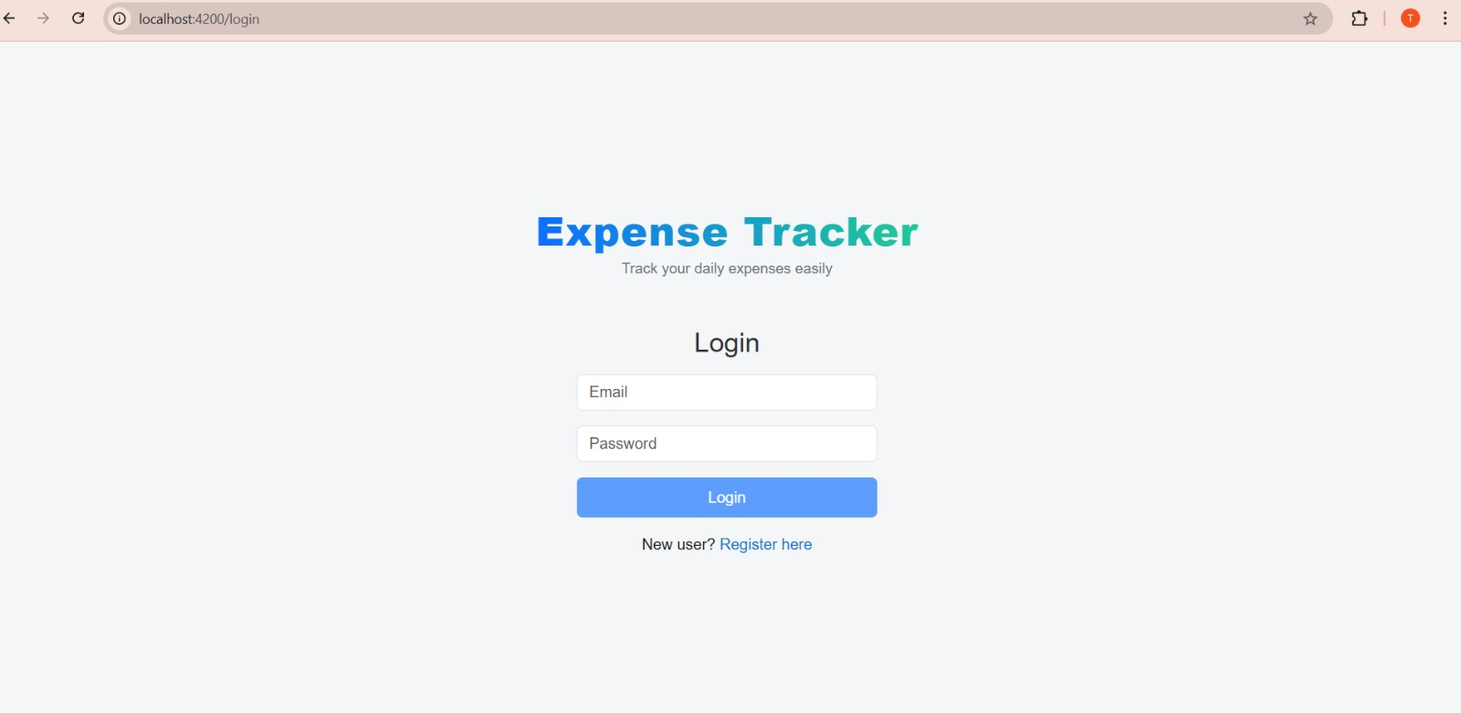
Expense Tracker Application
Sample Output with Validations :
Login Page
2024 - RPS Consulting all rights reserved

Slide 14
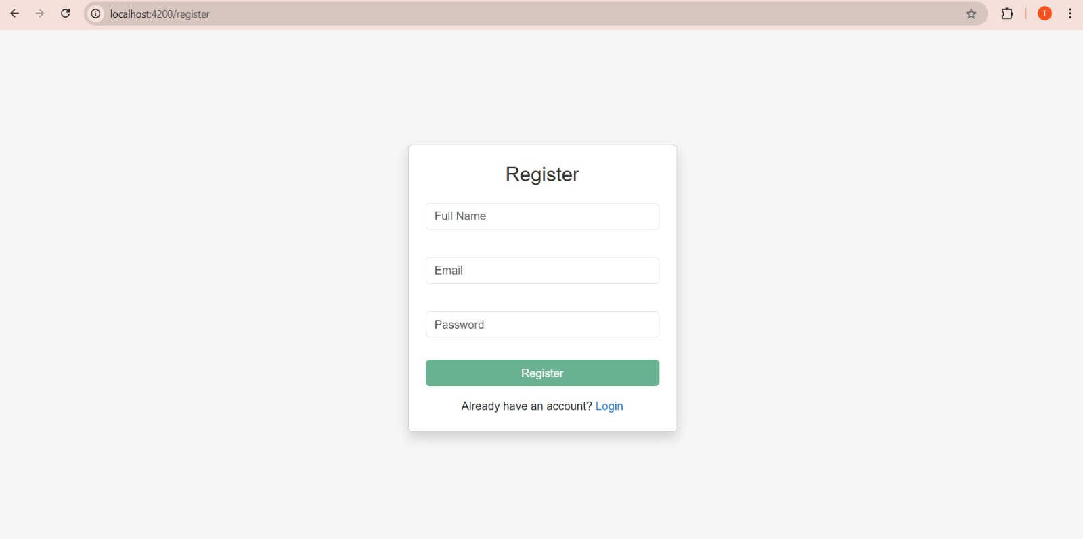
Expense Tracker Application
Register Page
2024 - RPS Consulting all rights reserved

Slide 15
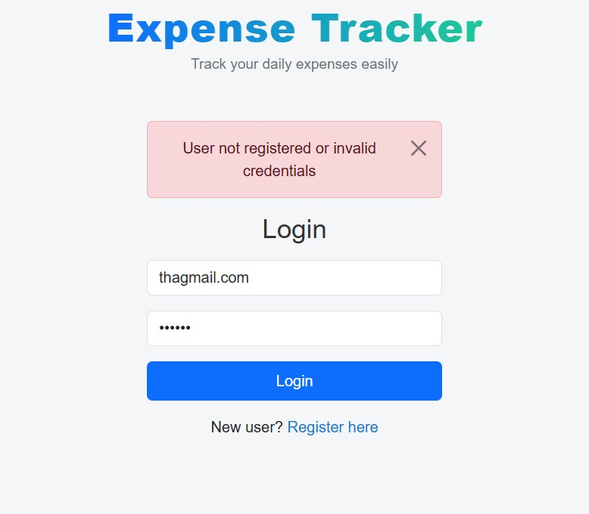
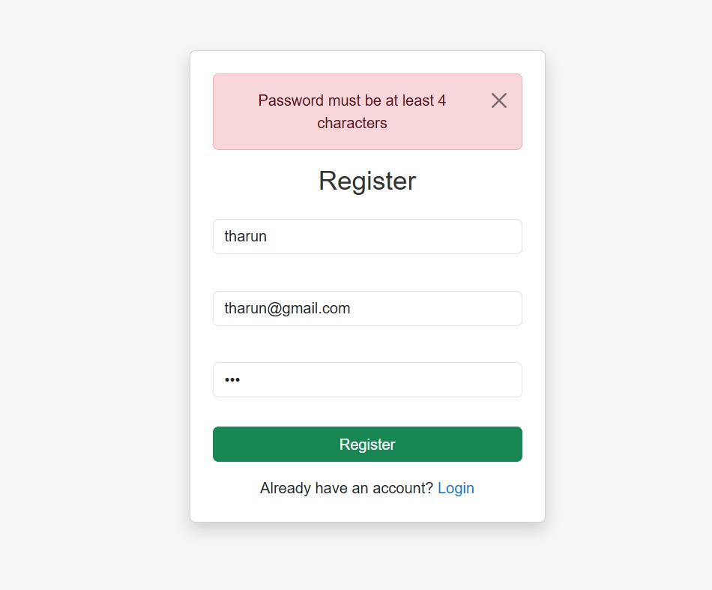
Expense Tracker Application
Login Validation
Register Validation
2024 - RPS Consulting all rights reserved

Slide 16
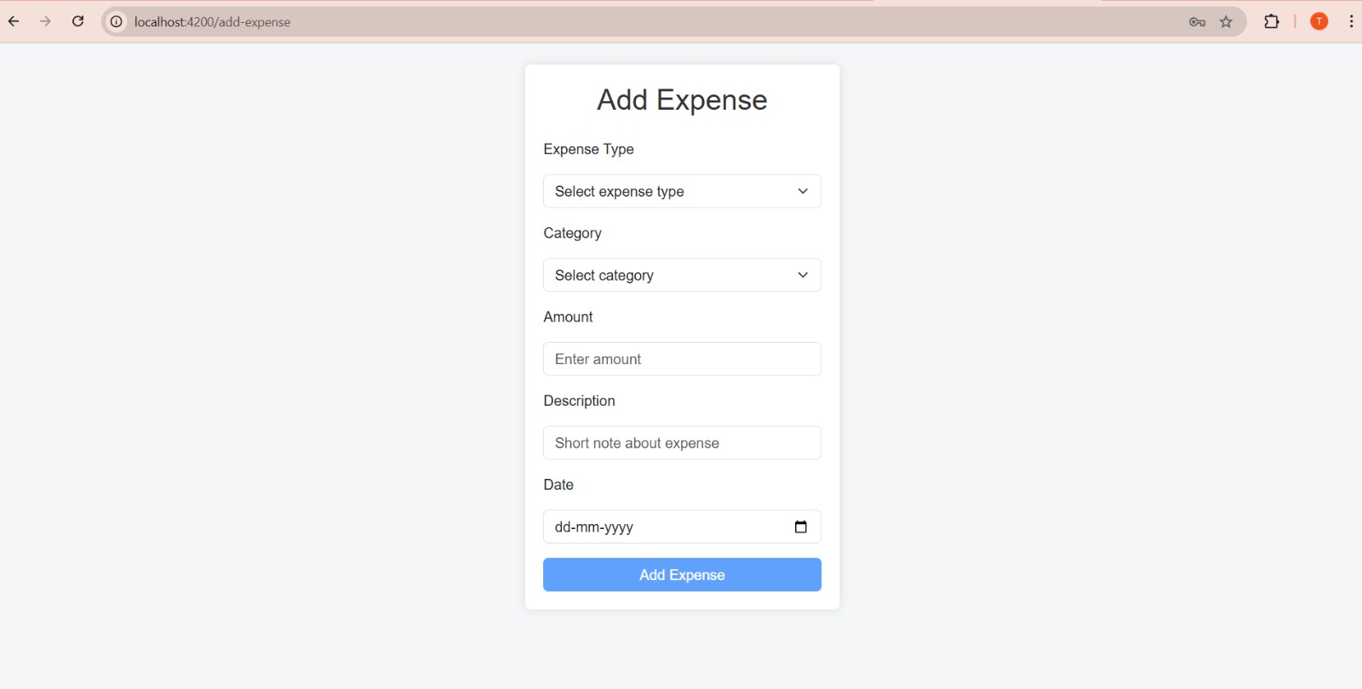
Expense Tracker Application
Expense Web-Page
2024 - RPS Consulting all rights reserved

Slide 17
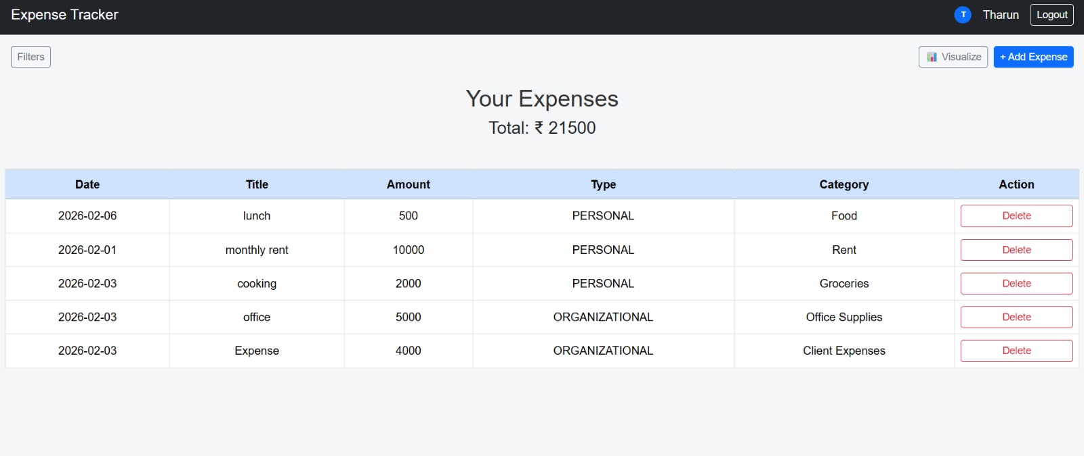
Expense Tracker Application
View Dashboard Page
2024 - RPS Consulting all rights reserved

Slide 18
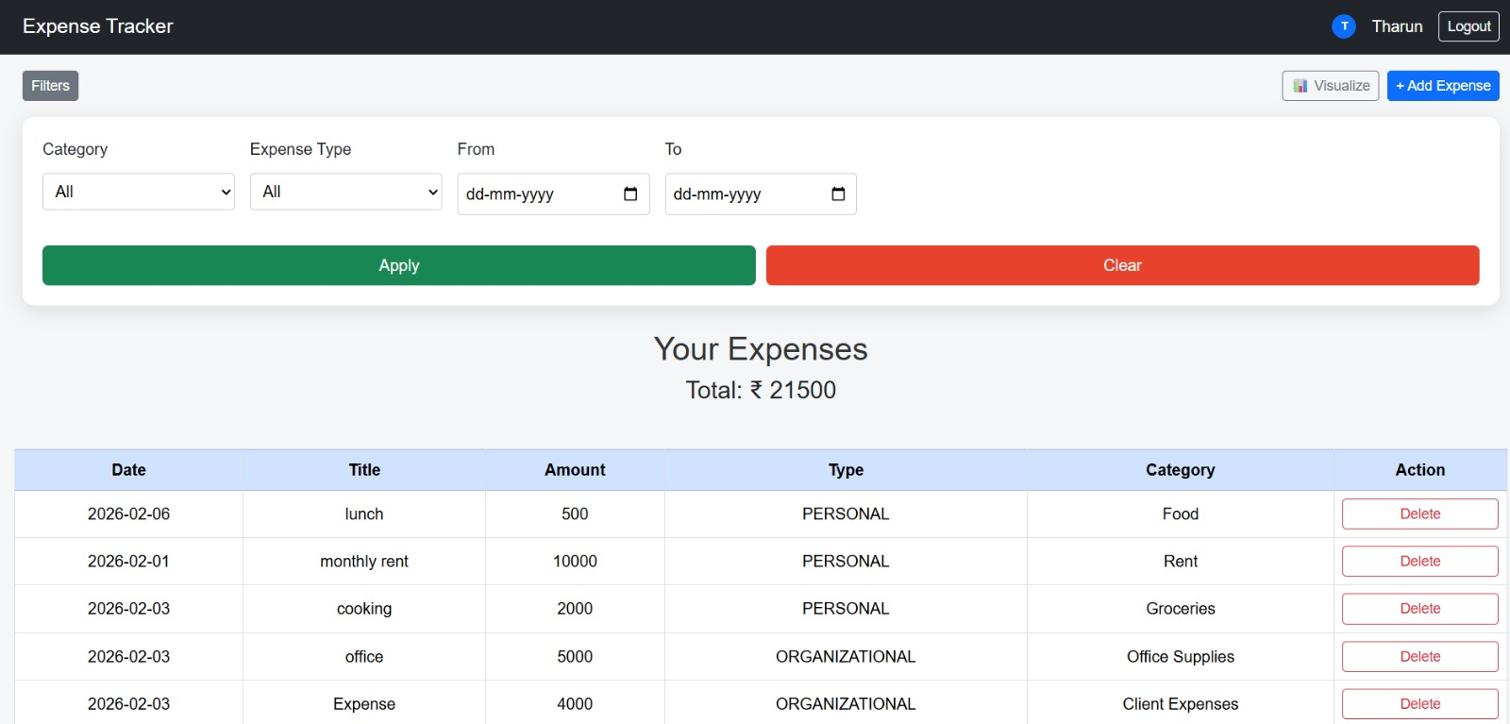
Expense Tracker Application
Dashboard Filter Tab
2024 - RPS Consulting all rights reserved

Slide 19
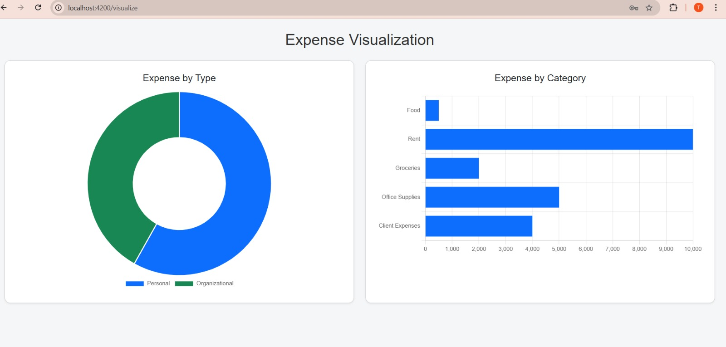
Expense Tracker Application
Expense Visualization Page
2024 - RPS Consulting all rights reserved

Slide 20
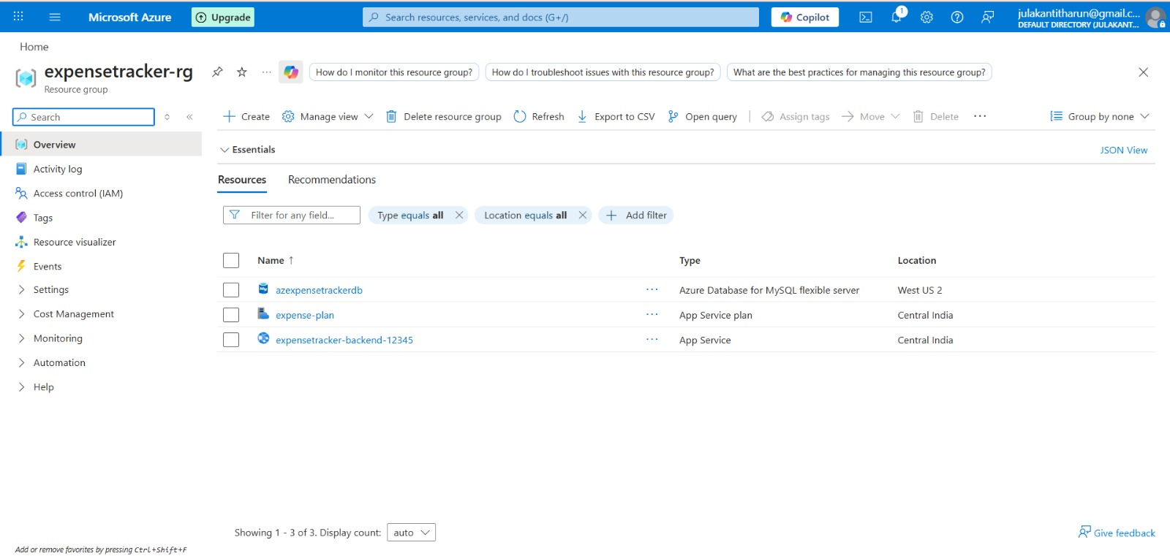
Expense Tracker Application
Azure Deployment
2024 - RPS Consulting all rights reserved

Slide 21
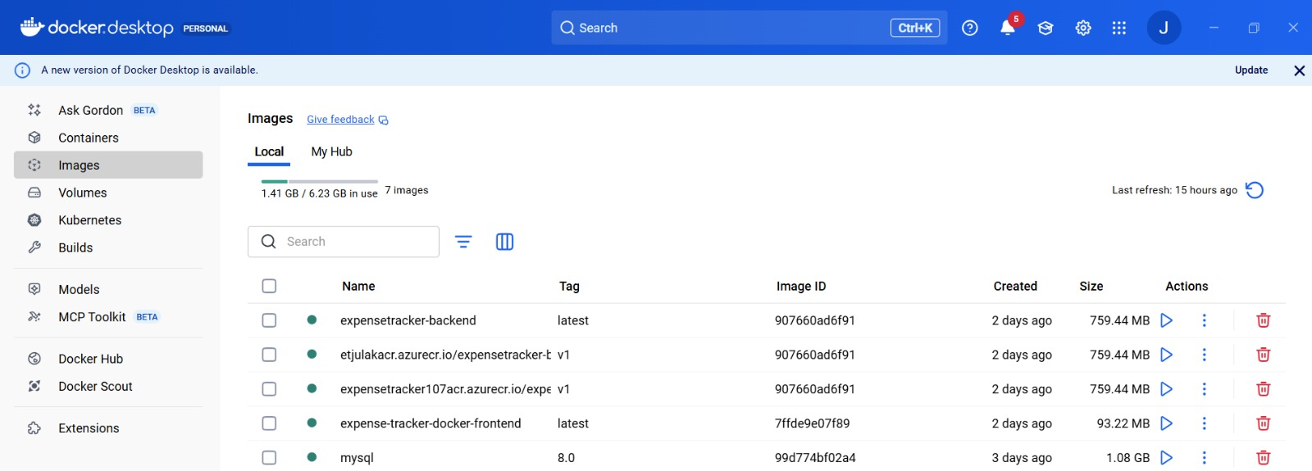
Expense Tracker Application
Azure Deployment
2024 - RPS Consulting all rights reserved

Slide 22
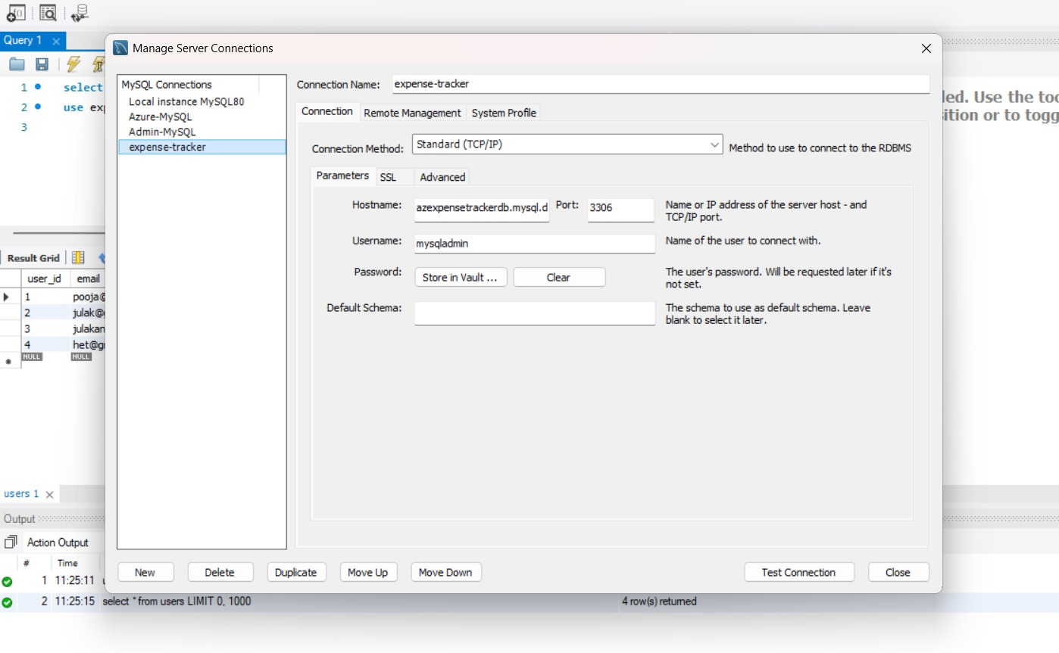
Expense Tracker Application
Azure App Services
2024 - RPS Consulting all rights reserved

Slide 23
Expense Tracker Application
Conclusion :
This Expense Tracker Application is our full-stack web application that helps users track and manage expenses effectively.
It provides:
--Easy expense entry
--Categorization
--Reports and summaries
--Cloud deployment
At last our Capstone project demonstrates practical implementation of modern web technologies.
2024 - RPS Consulting all rights reserved

