Slide 1
Russian Equipment & Personnel Losses
(24.02.2022 – 22.04.2022)

Slide 2
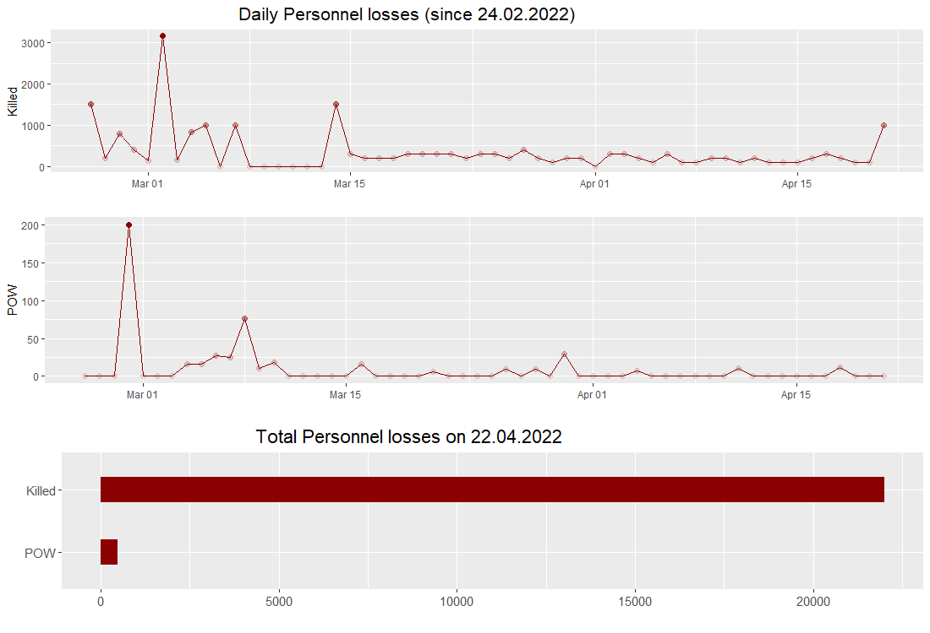
1. The highest daily personnel losses in the first 3 weeks of the invasion. 2. Losses stabilized 2 weeks prior to the Russian withdrawal from the Northern direction on the 2nd of April. 3. POW capture follows the same trend.

Slide 3
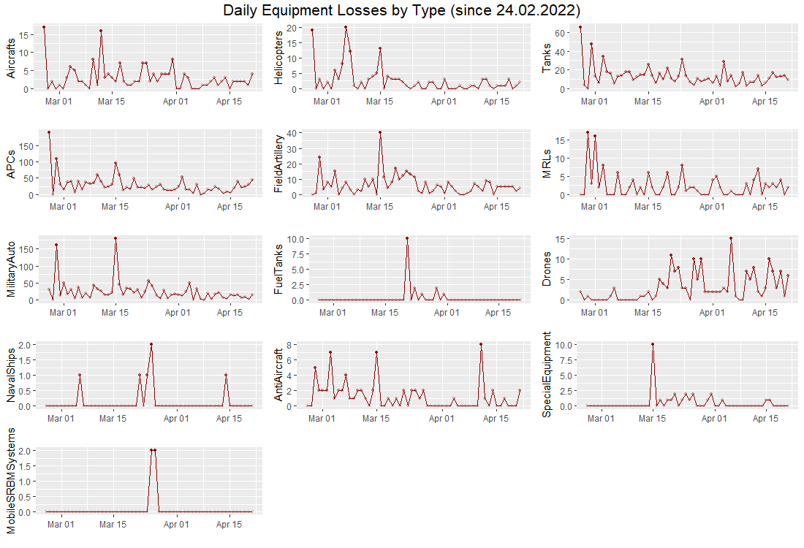
1. Similarly to the losses of personnel, losses of aircrafts, helicopters, tanks, military auto, APCs and MRLs stabilized after March 15th. 2. Losses of drones, fuel tanks and special equipment appeared in the second phase of the invasion. 3. Destruction of ships, anti-aircraft and SRBM systems does not follow previous trends.

Slide 4
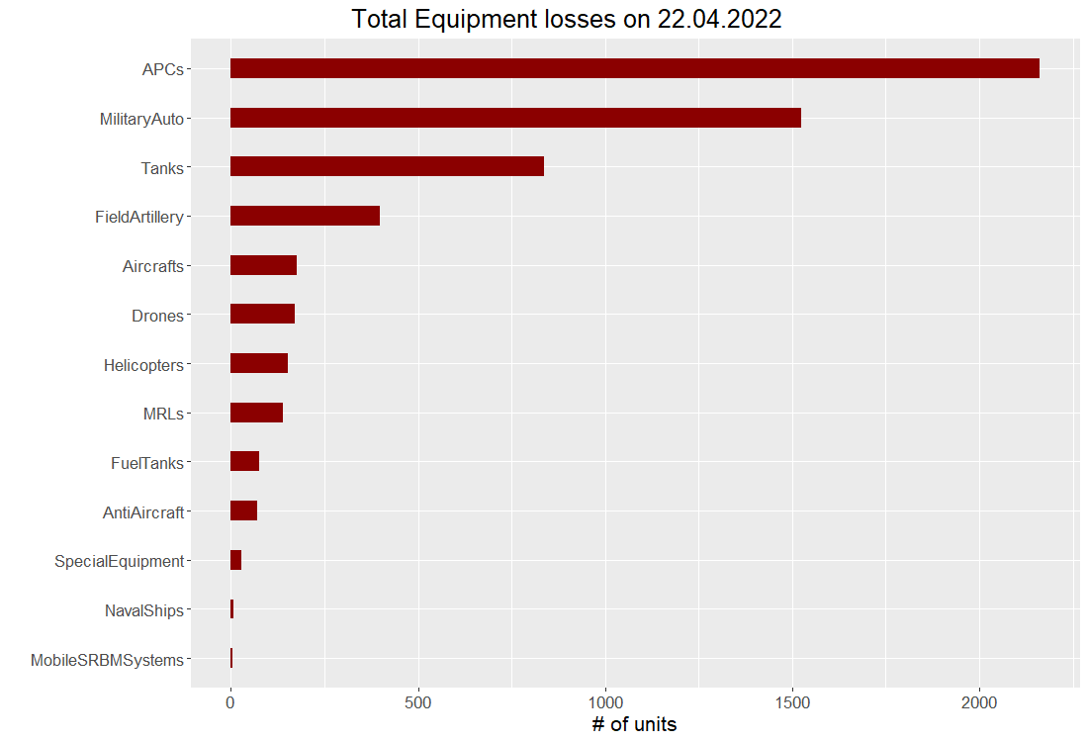

Slide 5
Conclusions
The pattern of losses changed after March 15th, which suggests the breaking point for the Northern direction around that time.
Further losses shift to surveillance operations (drones) and logistics (fuel tanks).
More insights can be drawn with information on the geographical distribution of losses, as well as comparing losses with the total forces used in the region.

