Slide 1
Pathology diagnosis using machine learning methods, TCGA
Thesis proposal
Dávid Hrabovszki

Slide 2
The aim is to classify two different types of brain tumor from Whole Slide histology images using Deep Learning.
Supervisor: Anders Eklund
Additional supervisor / customer: Neda Haj Hosseini
Department: Biomedical Engineering (IMT), US Campus

Slide 3
Background
Pathology: branch of medical science primarily concerning the cause, origin and nature of disease
Histology: branch of biology which studies the microscopic anatomy of biological tissues
Whole Slide Images (WSI): digitized tissue slides under a microscope
Brain tumor grades according to WHO increase in malignancy:
I
II
III
IV
Binary classification (expert task, that can be helped with DL)
Lower Grade Glioma (LGG)
Glioblastoma Multiforme (GBM)

Slide 4
Data
The Cancer Genome Atlas (TCGA) https://portal.gdc.cancer.gov
1900 Whole Slide Images, on average 200 MB each
e.g. 20,000 x 15,000 pixels
Some WSIs will be excluded (out of focus, marker, low quality, >90% normal cells)
WSIs can be opened in different resolutions / magnification levels
2 classes: GBM (1193 WSIs) – LGG (707 WSIs)
Images need to be divided into patches to feed to CNN
WSIs are labeled per image -> no labels at pixel / patch level
Patches with white background (no tissue) will be excluded
Might not use all data, if training takes too long

Slide 5
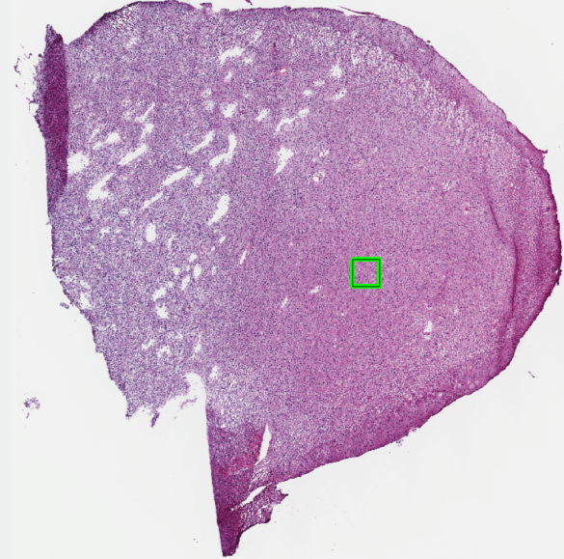
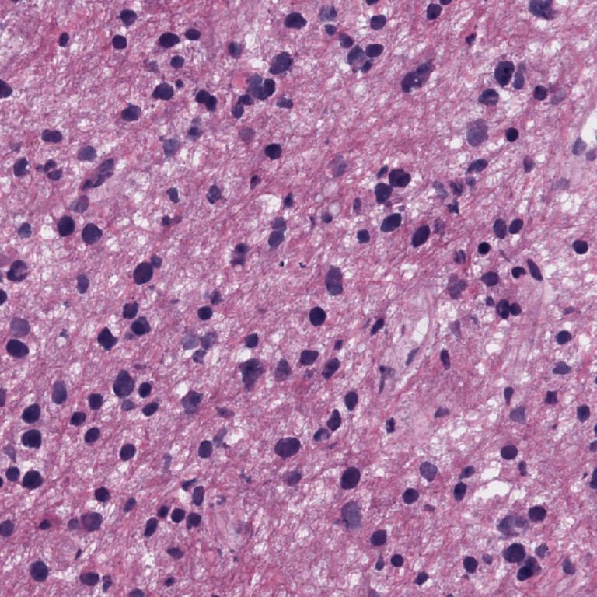
Example – Whole Slide Image (LGG class)
Patch extraction

Slide 6
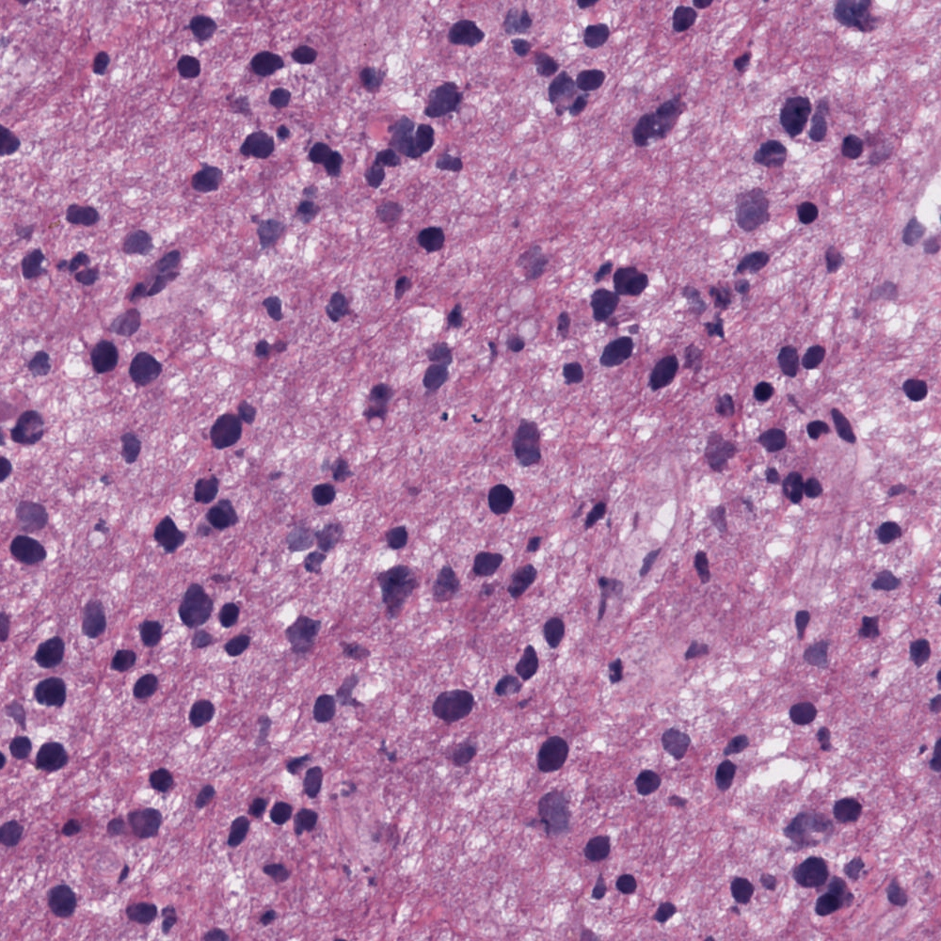
Example – One patch with visible cells and structures at 20x magnification (LGG class)

Slide 7
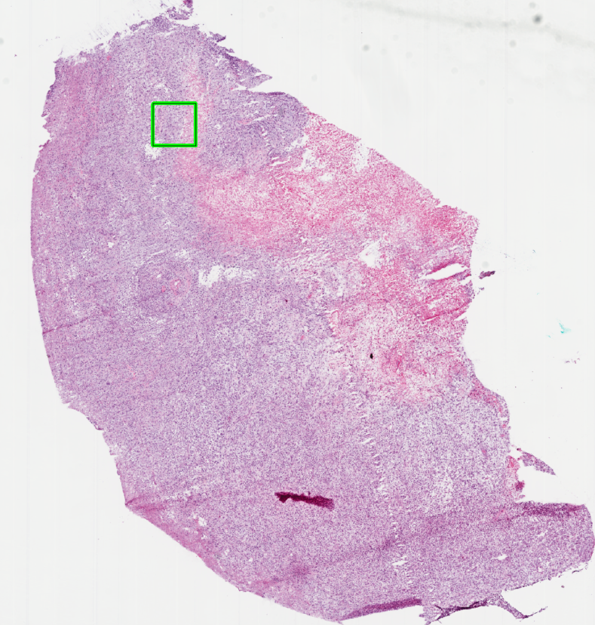
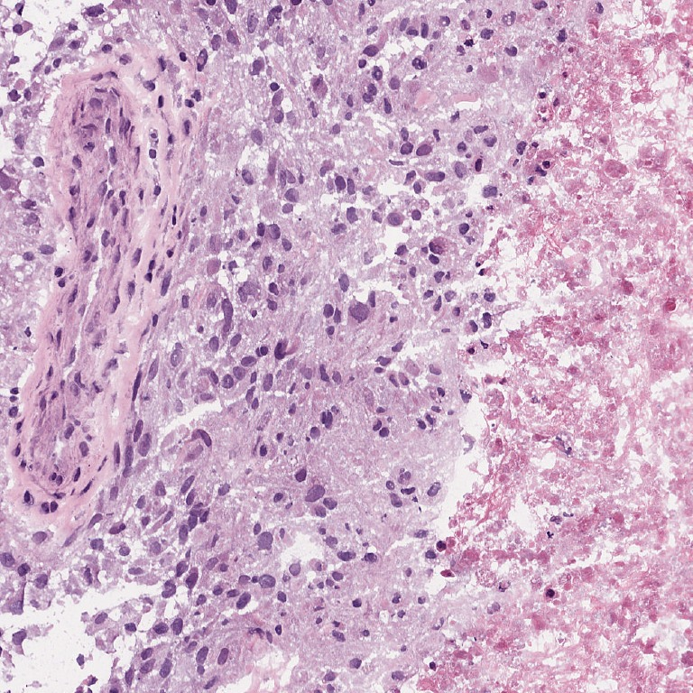
Example – Whole Slide Image (GBM class)
Patch extraction

Slide 8

Example – One patch with visible cells and structures at 20x magnification (GBM class)

Slide 9
Research question
What is the best approach with Deep Learning for GBM vs LGG classification using histology images without pixel level annotation?
Challenges:
No pixel level labeling (patches in a slide might be cancer-free)
Large images (need to create patches)
Slides come from different sources -> need to be normalized
Possible extensions:
Further classify LGG into grade II and III
Classify no-cancer from cancer (based on limited number of non-cancer WSIs)
Find the best solution by comparing evaluation metrics statistically:
Accuracy, Precision, Recall, F-score
AUC, ROC curve

Slide 10
Proposed method (may not have time for all)
Use CNN to classify images and experiment with different setups
Preprocessing (patch size, magnification level, down sampling, background filtering, color normalization, outlier removal)
Network architecture
Pretrained network vs starting from scratch
Data augmentation methods (mirroring, rotation)
Combining patches into slide level prediction:
Uncertainty from Monte Carlo dropout are the weights of patches
Simple max pooling (positive, if at least one patch is positive)
Majority voting
Spatial correlation between patches (patches that are closer to each other might have the same class)

Slide 11
Report outline
Introduction: challenges, medical and statistical background
Data: data description
Methods:
Preprocessing
CNN modelling
Data augmentation
Spatial correlation analysis
Combining patch predictions to WSI level prediction
Results: statistically compare approaches using evaluation metrics
Discussion
Conclusion

Slide 12
Literature review
DL for histology images (feature extraction, classification or regression for survival years; same dataset or similar; accuracy measures can be compared)
doi: 10.3389/fnins.2020.00027
doi: 10.1007/978-3-030-11723-8_41
doi: 10.1007/978-3-030-11723-8_42
doi: 10.4103/2153-3539.186902
doi: 10.1186/s12859-017-1685-x
doi: 10.1109/ICASSP.2015.7178109
doi: 10.1007/s11517-020-02147-3
arXiv:2011.05410
doi: 10.1016/j.jocn.2019.05.019
Other ML methods for histology images (need for hand-crafted features)
doi: 10.1016/j.media.2015.12.002
doi:10.3390/cancers12030578

Slide 13
Literature review
Other ML methods for histology images (need for hand-crafted features)
doi: 10.1016/j.media.2015.12.002
doi:10.3390/cancers12030578
Methods for slide color normalization (for preprocessing)
doi: 10.1007/978-3-030-46640-4_5
doi: 10.3389/fmed.2019.00193
AI in pathology (challenges, opportunities)
doi: 10.4103/jpi.jpi_53_18
doi: 10.1038/s41571-019-0252-y
doi: 10.1038/s41698-017-0022-1
5. Aggregating patch predictions to slide level
doi: 10.1038/s41591-019-0508-1
6. Brain tumor grading (medical background)
doi: 10.1007/s00401-016-1545-1

Slide 14
Literature review
DL for histology images (feature extraction, classification or regression for survival years; same dataset or similar; accuracy measures can be compared)
Segmentation and Classification in Digital Pathology for Glioma Research: Challenges and Deep Learning Approaches (Kurc et al., 2020)
Dropout-Enabled Ensemble Learning for Multi-scale Biomedical Data (Momeni et al., 2019)
A Combined Radio-Histological Approach for Classification of Low Grade Gliomas (Bagari et al., 2019)
Deep learning for digital pathology image analysis: A comprehensive tutorial with selected use cases (Janowczyk et al., 2016)
Large scale tissue histopathology image classification, segmentation, and visualization via deep convolutional activation features (Xu et al., 2017)
Deep convolutional activation features for large scale Brain Tumor histopathology image classification and segmentation (Xu et al., 2015)
DeepSurvNet: deep survival convolutional network for brain cancer survival rate classification based on histopathological images (Shirazi et al., 2020)
Glioma Classification Using Multimodal Radiology and Histology Data (Hamidinekoo et al., 2020)
Automated brain histology classification using machine learning (Ker et al., 2019)

Slide 15
Literature review
Other ML methods for histology images (need for hand-crafted features)
Automated classification of brain tumor type in whole-slide digital pathology images using local representative tiles (Barker et al., 2016)
Glioma Grading via Analysis of Digital Pathology Images Using Machine Learning (Rathore et al., 2020)
Methods for slide color normalization (for preprocessing)
Towards Population-Based Histologic Stain Normalization of Glioblastoma (Grenko et al., 2020)
A High-Performance System for Robust Stain Normalization of Whole-Slide Images in Histopathology (Anghel et al., 2019)
AI in pathology (challenges, opportunities)
Artificial Intelligence and Digital Pathology: Challenges and Opportunities (Tizhoosh et al., 2018)
Artificial intelligence in digital pathology — new tools for diagnosis and precision oncology (Bera et al., 2019)
Precision histology: how deep learning is poised to revitalize histomorphology for personalized cancer care. (Djuric et al., 2017)
5. Aggregating patch predictions to slide level
Clinical-grade computational pathology using weakly supervised deep learning on whole slide images (Campanella et al., 2019)
6. Brain tumor grading (medical background)
The 2016 World Health Organization Classification of Tumors of the Central Nervous System: a summary (Louis et al., 2016)

Slide 16
Literature review
Lessons learnt
There are many different ways to preprocess the images
Pretraining the model might help
GoogleNet, AlexNet, etc. are useful for this task, but perform differently
Different patch sizes result in different performance
Color normalization is important, there are many options
Combining patch predictions is a challenge
New in my study
Spatial correlation analysis
Monte Carlo dropout for uncertainty of patches
Statistical comparison between different setups

Slide 17
Thank you!

