Slide 1
Database
Management
System
Lab Project
Developing By
Habibur Rahman (011 161 081)
Saifullah Sajib (011 161 185)

Slide 2
Online Auction System
$
$
Target Feature:
Tracking Auction Time
Finding Highest Bidder

Slide 3
Start Page
NAME login signup
search
City
Category
Bid Now!
image
Item1
Place
Start price
status
item2
item3
Category
item4
item5
item6

Slide 4
Page 2
NAME login signup
search
City
Category
Bid Now!
image
Category
Name :
Category :
Bid Starts :
Bid Ends :
Initial Bid :
Bid Status: Yet to bid

Slide 5
Page 3
NAME login signup
search
City
Category
Bid Now!
image
Top Bid
Product ID: XXX
BID!
Category
Name :
Category :
Bid Starts :
Bid Ends :
Initial Bid :
Bid Status: Ongoing
Product ID
Your Bid
Enter

Slide 6
Page 4
NAME login signup
search
City
Category
Bid Now!
image
Top Bid
Category
Name :
Category :
Bid Starts :
Bid Ends :
Initial Bid :
Bid Status: Finished

Slide 7
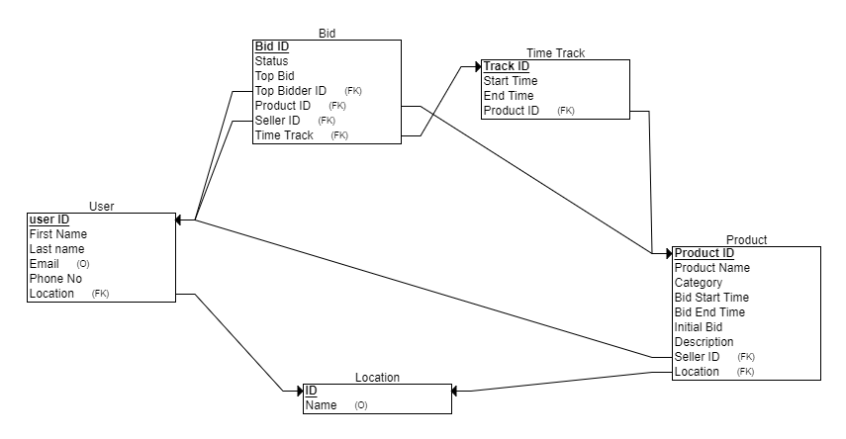
ERD Schema

