Slide 1
Verifiable Credentials and DIDs
Hubai Rajmund Szilveszter – CQKFI2

Slide 2
TODO: felvezető rész, miket csináltam
SSI, DID ki, VC marad
AOV a use case, data-veracity
Aca-py a végében, a dva ábra, amit csináltunk
Röviden a controllerekről, agentekről
Hogyan ment a flow – exchangekor, AOV
UI screenshot
Tech-stackek, identus, credo, acapy miért választottam ezt
excalidraw

Slide 3
What are Verifiable Credentials?
A digital format for securely sharing identity information, based on open standards
Issued by a trusted source (e.g. government, university) Issuer
Held by the user (in a digital wallet) Holder
Easily verifiable by third parties Verifier Used in areas like digital ID, education, healthcare, and finance to prove qualifications, status, or identity without revealing unnecessary personal data.
Cryptographically signed for authenticity

Slide 4
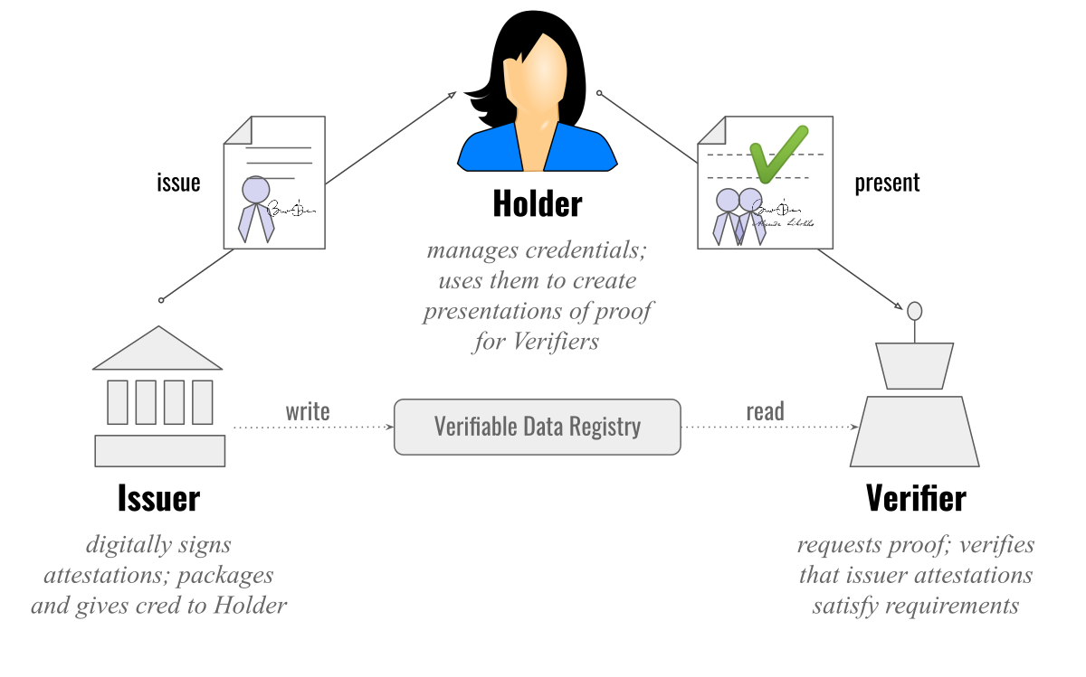
Issuer – Holder – Verifier Triangle

Slide 5
What is SSI – Self-Sovereign Identity?
A user-centric model of digital identity where individuals fully own, control, and share their personal data.
No central authority manages identity
Users store credentials in a digital wallet
Share only necessary info with full consent
Built on technologies like DIDs and Verifiable Credentials Promotes privacy, security, and portability of identity across platforms.

Slide 6
What are DIDs?
A new type of identifier used in Verifiable Credentials to enable self-sovereign identity.
Created and controlled by the user (not issued by a central authority)
Globally unique and resolvable on decentralized networks (e.g. blockchains)
Enable secure, private, and verifiable interactions
Link to public keys and metadata, allowing trusted communication without revealing personal info

Slide 7
Connection between SSI, DIDs, and VCs
How SSI, DIDs, and VCs Work Together
Self-Sovereign Identity (SSI) is the framework that empowers users to control their digital identity.
Decentralized Identifiers (DIDs) are unique IDs that users and issuers control directly—no central authority needed.
Verifiable Credentials (VCs) are the tamper-proof digital proofs (e.g., diplomas, IDs) issued to DIDs.
Together, they enable secure, private, and user-controlled digital identity.

Slide 8
Hyperledger Aries
An open-source framework for building interoperable, secure, and privacy-respecting digital identity solutions.
Works with DIDs and Verifiable Credentials
Provides tools for peer-to-peer communication, credential exchange, and identity management
Often used with Hyperledger Indy (for blockchain-based identity)
Enables wallets, agents, and secure messaging in Self-Sovereign Identity (SSI) systems

Slide 9
Aries Cloudagent Python

Slide 10
Aries Cloudagent Python

Slide 11
AOV – Attestation of Veracity

