Slide 1
Advanced Regular Expressions
By Himanshu Rana

Slide 2
What are Regular Expressions?
Everything is text.
Using symbols understanding the pattern.
They are not a programming language(no 1+1).
Check digits(phone), format(email).
Convert tab delimited files to comma delimited.
Find duplicate words.
Case-Sensitive.

Slide 3
Available Flavours
C/C++
Java
JavaScript/ECMAScript
.NET
Perl
PHP(PCRE)
Python
Ruby
Unix
Apache
MySQL

Slide 4
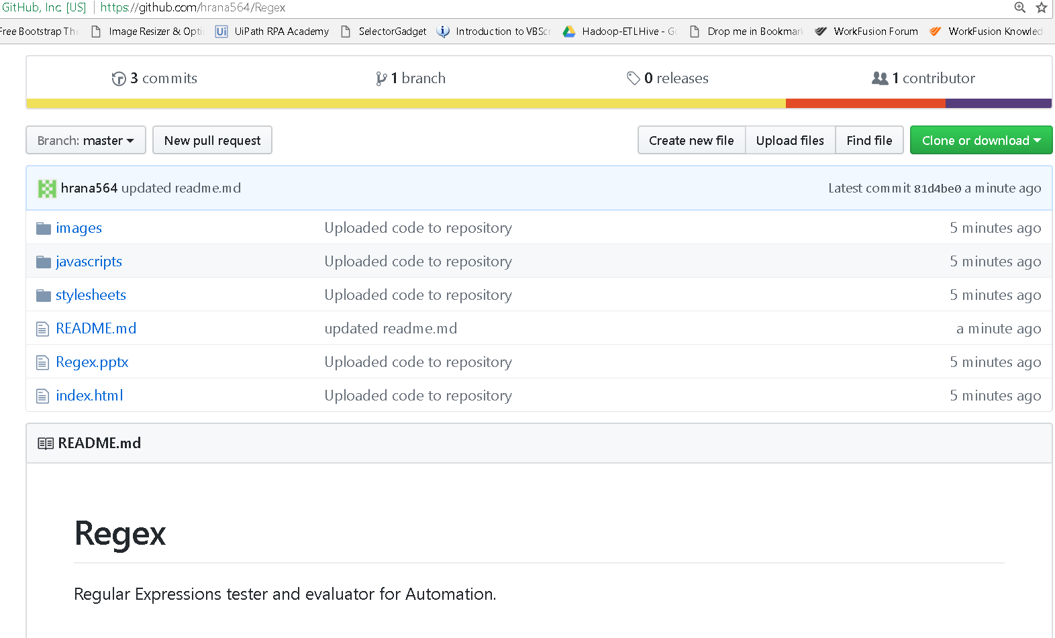
Environment Setup
https://github.com/hrana564/Regex

Slide 5
Regex Modes
Standard /cat/
Global /cat/g
Case-insensitive /cat/i
Multiline /cat/m

Slide 6
Characters
Literal Characters : Strings /car/ matches “car”, first 3 letters of “carnival”.
Backtracking in matching “cat” in “The cow, camel and cat”.
Meta characters : \ . * + - {} [] ^ $ | ? () : ! = and escaping them. Eg “resume1.txt” matches “resume11txt”.
\t->tab; \r, \n, \r\n ->line returns;
Dot wildcard matches all.

Slide 7
Range Characters
[0-9].
[a-z].
[A-Z].
[a-ek-ou-y] includes 15 characters only.
[50-99] includes numbers between 0-9.
^ -> Negative character set. See[^mn] matches seek not seem but still matches “See “.
Wild card(.) inside range losses its meaning eg “h[.]t”.
Escaping inside range e.g. ] - ^ \

Slide 8
Shorthand Character Sets
Shorthand | Meaning | Equivalent
\d | Digit | [0-9]
\w | Word Character | [a-zA-Z0-9_]
\s | Whitespace | [ \t\r\n]
\D | Not Digit | [^0-9]
\W | Not Word Character | [^a-zA-Z0-9_]
\S | non White Space | [^ \t\r\n]

Slide 9
Repetition Meta Characters
Meta Character | Meaning
* | Preceding item zero or more times
+ | Preceding item one or more times
? | Preceding item zero or one time
{min, max} | Quantified repetition meta characters. Max is optional.

Slide 10
Apples* matches Applesssssssssss, Apple and Apples.
Apples+ matches Applesssssssssss and Apples.
Apples? matches Apple and Apples.
\d\d\d\d* matches numbers with 3 digits or more.
\d\d\d\d+ matches numbers with 4 digits or more.
Colou?r matches Color and Colour
\d{4,8} matches numbers with four to eight digits.
\d{4} matches numbers with exactly four digits(min is max).
\d{4,} matches numbers with four or more digits(max is infinite).
\d{0,} = \d* and \d{1,} = \d+
\d{3}-\d{3}-\d{4} matches my phone number 855-102-6626

Slide 11
Greedy Expressions
Standard repetition quantifiers are greedy.
Expression tries to match the longest possible string.
.+\.jpg matches filename.jpg. Here + is greedy but it gives back the “.jpg” to make the match(backtracking).
Expression gives back as little as possible.
.*\d+ in page 266 the \d has only 6 for \d+.
Regex is eager to give you result and greedy for maximum match.
“?” makes the quantifiers lazy i.e. “*?”,”+?”,”{min,max}?”,”??”.

Slide 12
Grouping Metacharacters
( and ) are Grouping Metacharacters.
Allows repetition to a group instead of a single character.
Makes expression easier to read.
Captures the group for use in matching and replacing.
Cannot be used inside a character set.
Example (abc)+ matches abcabcabc
Example (in)?dependent matches dependent and independent.

Slide 13
Alteration Metacharacter
| -> Matches previous or next expression
Group alternations expression to keep them distinct.
Ordered, leftmost expression gets precedence.
Multiple choices can be daisy-chained.
Examle apples|orange matches either the word apple or backtracks and matches oranges.
Example apple(juice|sauce) is used to match both applejuice and applesauce.
W(ei|ie)rd matches both Weird and Wierd to find misspelled words.
Put simplest and most efficient expressions to the left, as regular expressions are eager and greedy.

Slide 14
Word Boundaries
They refer a position and not a character. Zero – length.
Example : \b\w+\b finds 4 matches in “This is a demo”.
Example : \b\w+\b matches all of “abc_123” but only a part of “top-notch”.
Looks for the whole word instead of partial words.
Metacharacter | Meaning
\b | Word boundary(start\end of word)
\B | Not a Word boundary.

Slide 15
Backrefences in Regex
Grouped expressions are captured in Regex.
Stores the matched portion in parentheses.
A(p{2}l)e matches apple and stores “ppl”.
\1 - \9 are used to store back references.
Can be used in the same expression as the group.
Can be accessed after the match is complete.
Example (apples) to \1 matches “apples to apples”.
Example <(i|em)>.+?</\1> matches “<em>Hello</em>” and “<i>Hi</i>” and do not match “<em>Hello</i>”.
Careful backreferences. (A?)B\1 matches B.
Find Replace using backreferences. Some programming languages use $1 instead of \1.

Slide 16
Optional Backreferecnes
\1, \2 are limited to 99 while in some programming it is limited to 99.
?: -> ? Means give this group a different meaning while : means this is a non capturing group expression.
(a)(b)(c)(d)(e)(f)(g)(h)(i)(j)(k)\1\2\3\4\5\6\7\8\9\10\11 matches abcdefghijkabcdefghijk
To skip some we make it optional.
(?:a)(b)(c)(d)(e)(f)(g)(h)(i)(j)(k)\1\2\3\4\5\6\7\8\9\10 matches abcdefghijkbcdefghijk.

Slide 17
How to use this session
Matching names.
Matching postal codes.
Matching email addresses.
Matching URL’s.
Matching Decimal Numbers/Currency.
Matching IP addresses.
Matching Dates.
Matching Times.
Matching HTML tags.
Matching Passwords/ Credit card info.

Slide 18
Questions Please
Thank You

