Slide 1
Mobile Price Prediction Project
Feature Extraction & Analysis
Your Name: Harsh Ranjan
Date : 29/3/2026

Slide 2
Predict mobile phone prices using ML models
Identify key features affecting price
Help company improve pricing strategy
Project Objective

Slide 3
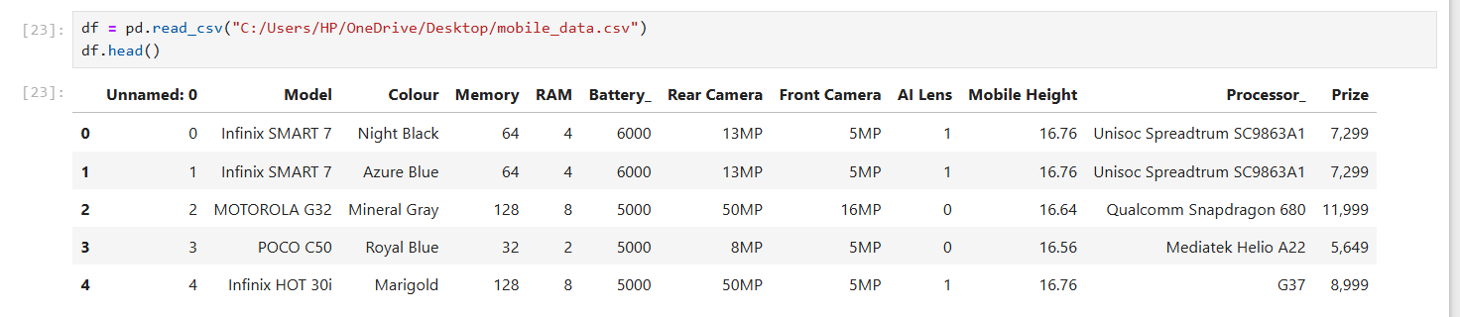
Total records: 541
Features:
RAM, Memory, Battery
Processor, AI Lens
Mobile Height
Price (Target)
Dataset Overview

Slide 4
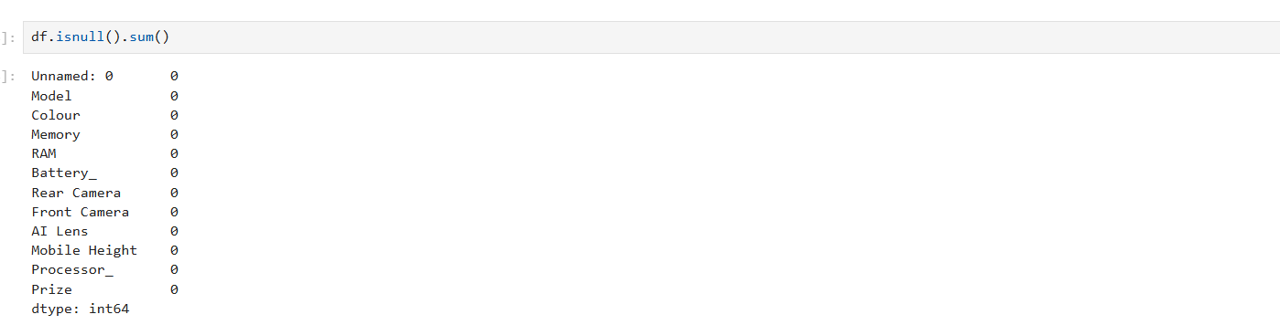
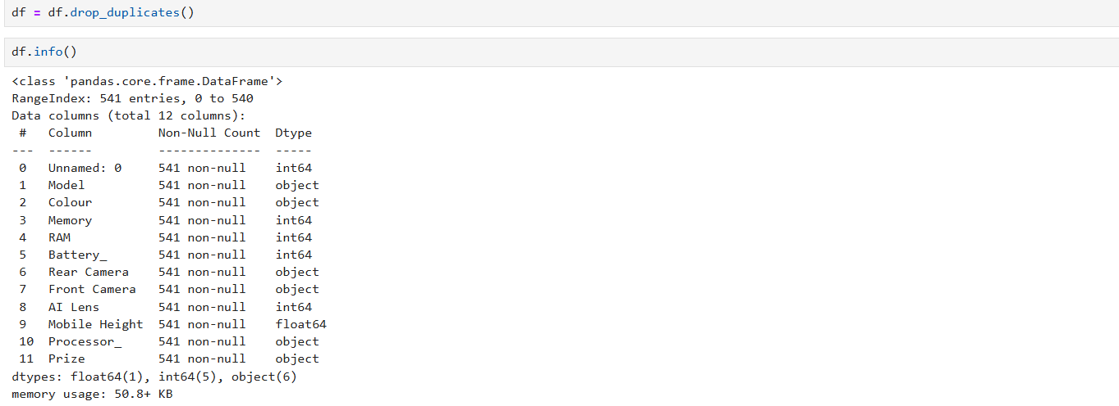
Data Exploration

Slide 5
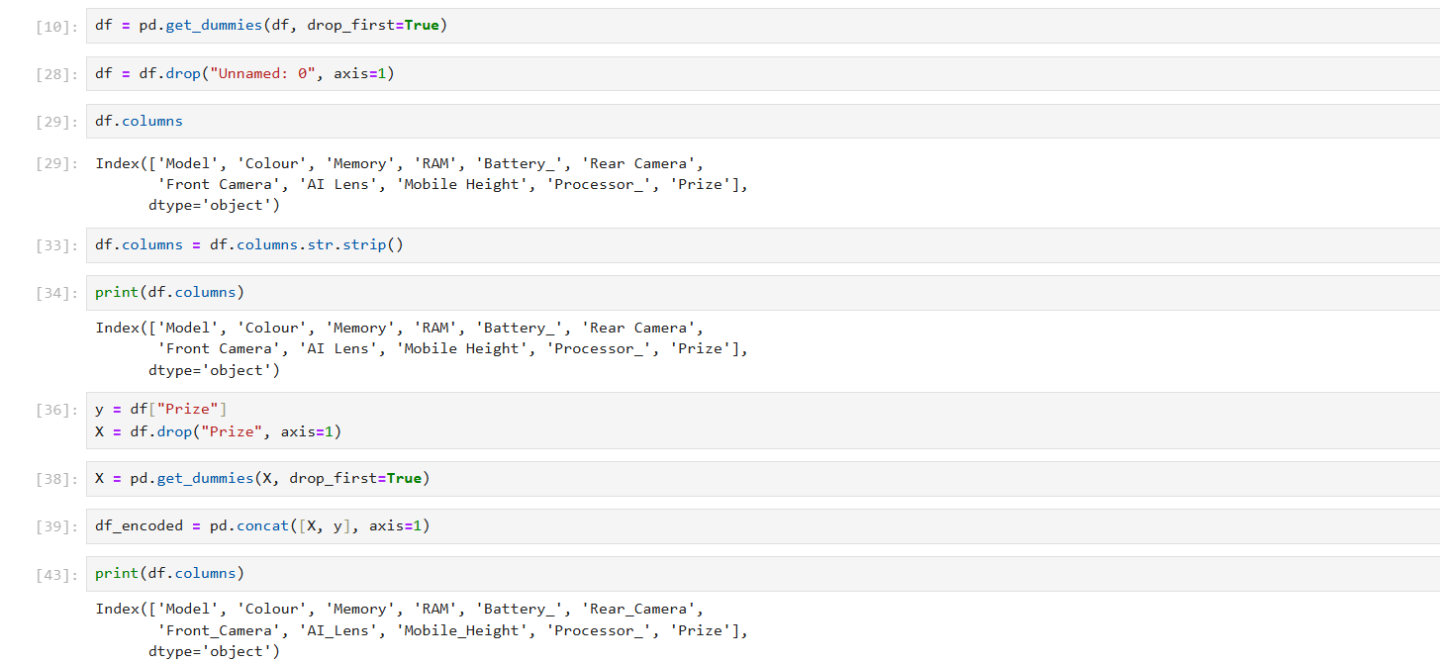
Data Preprocessing

Slide 6
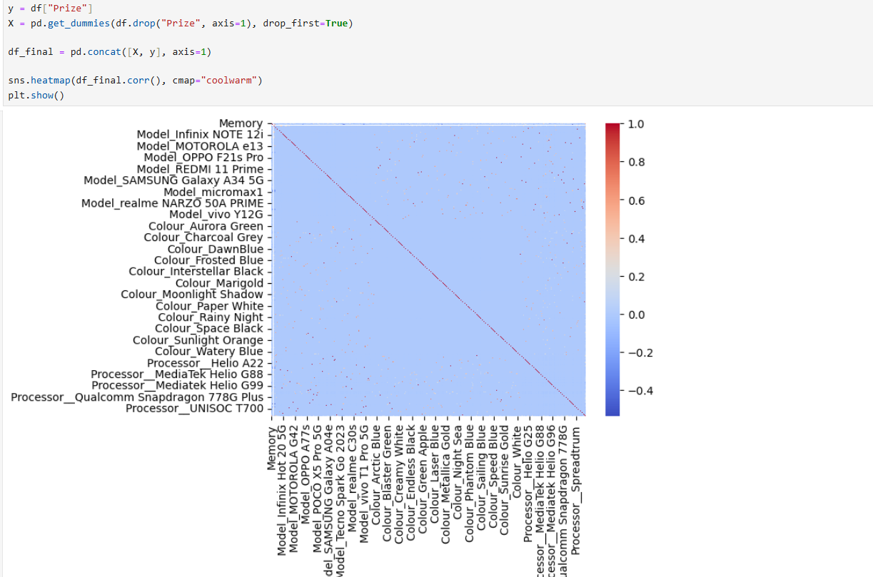
Heatmap

Slide 7
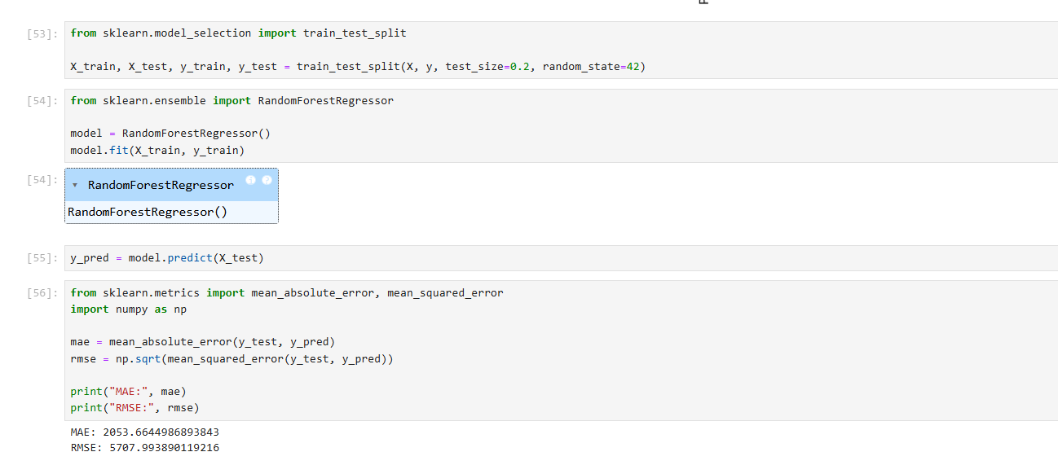
Train Test Split

Slide 8
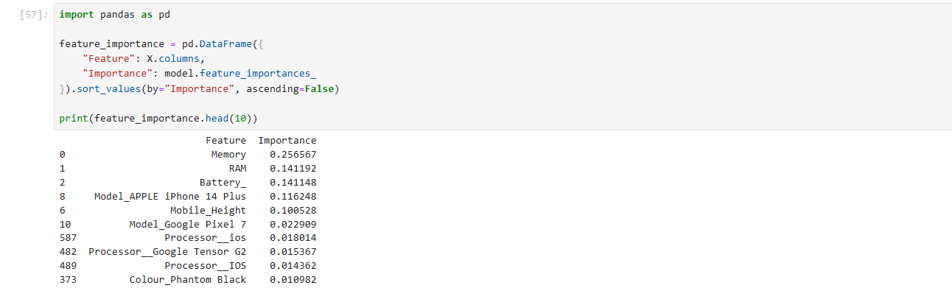
FEATURE IMPORTANCE

Slide 9
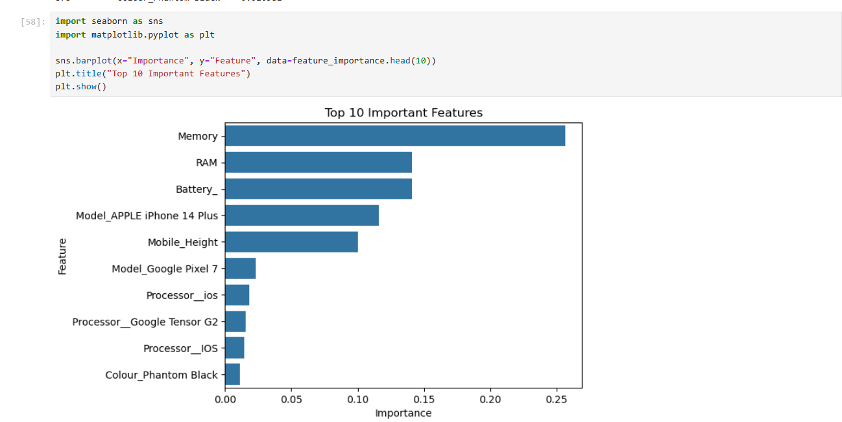
TOP 10 IMPORTANT FEATURES

Slide 10
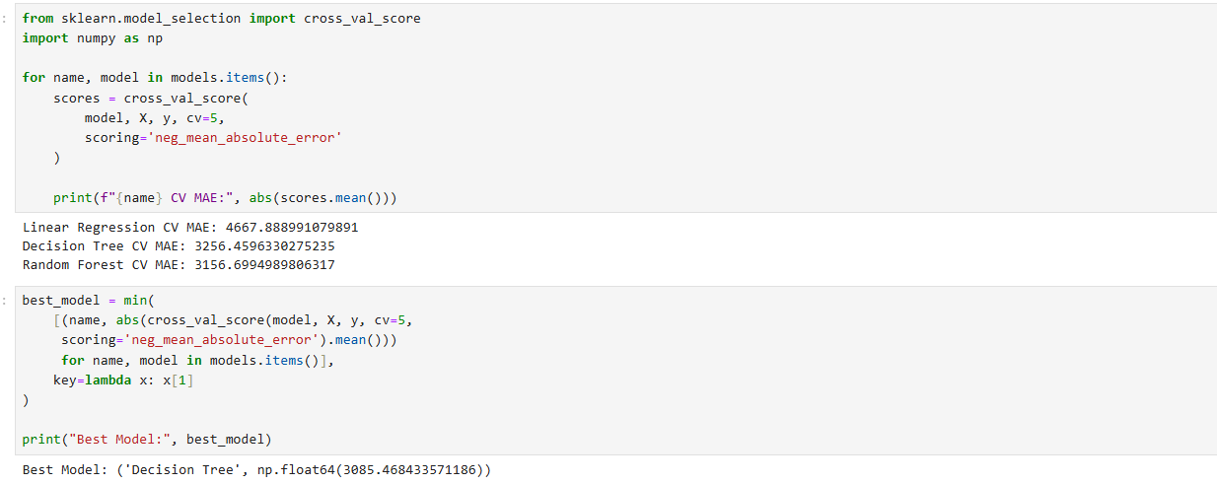
COMPARING MULTIPLE MODELS

Slide 11
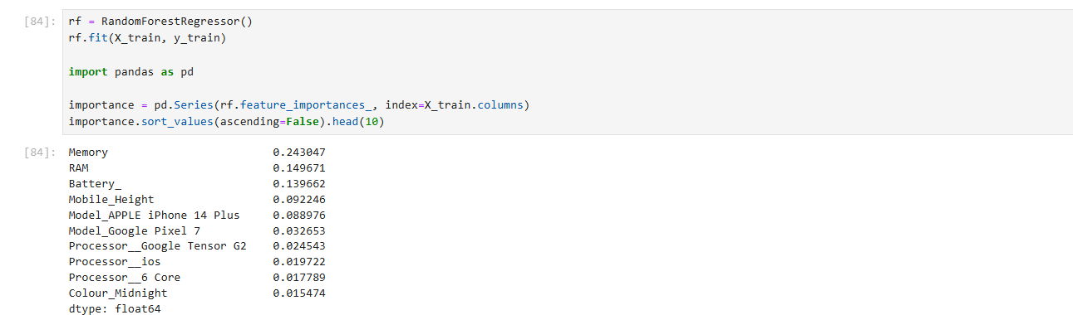
How much each feature contributes to predicting Price
Top 3 Features Responsible in Driving Price -:
1.Memory
2.RAM
3.Battery

Slide 12
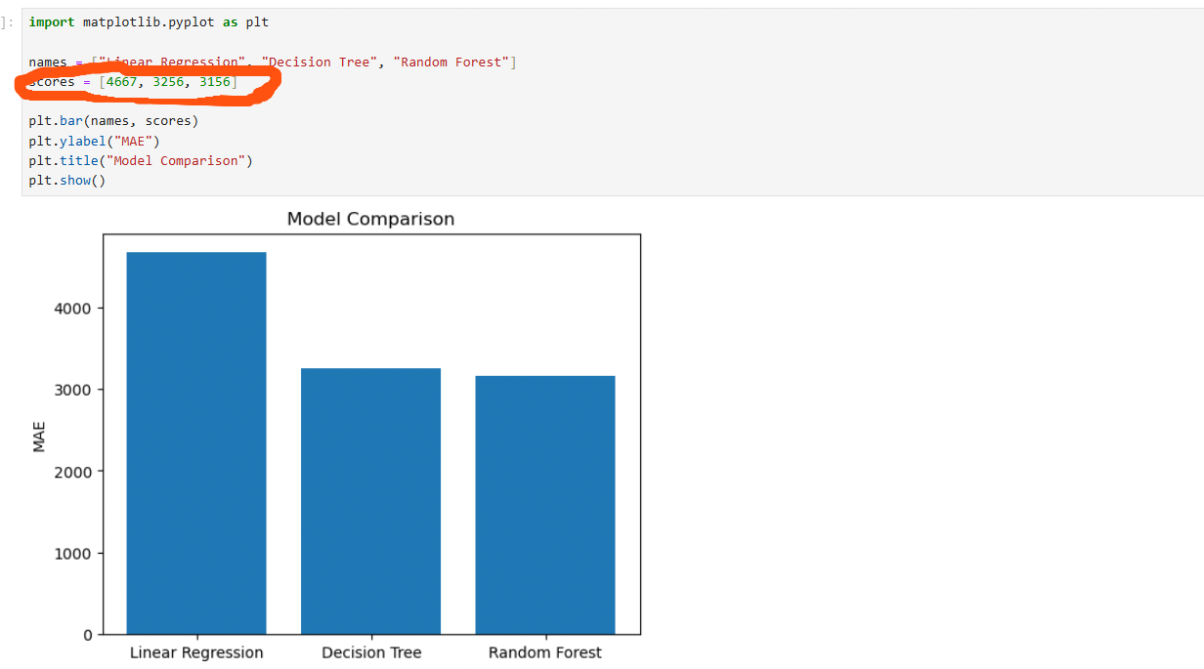
Model Performance Comparison
This slide compares the performance of different models using MAE to identify the most accurate model.

Slide 13
RECOMMENDATIONS
Increase focus on RAM & Memory in premium phones
Performance Score strongly impacts pricing
Processor type also influences price

Slide 14
This project demonstrates end-to-end machine learning pipeline including data cleaning, feature engineering, model evaluation, and business recommendations. Random Forest is the most effective model for this dataset .
CONCLUSION

Slide 15


