Slide 1

DEPARTMENT OF MATHEMATICS
Rayleigh Portfolios and Matrix Decomposition
Francois Buet-Golfouse, UCL
Hans Roggeman
Islam Utyagulov
Notes:
<number>

Slide 2
Disclaimer
This paper was prepared for informational purposes by the authors, and is not a product of any institution’s Research Department. The views expressed therein are solely those of the authors and do not reflect those of any institution or employer, past and present.
The authors make no representation and warranty whatsoever and disclaim all liability, for the completeness, accuracy or reliability of the information contained herein.
This document is not intended as investment research or investment advice, or a recommendation, offer or solicitation for the purchase or sale of any security, financial instrument, financial product or service, or to be used in any way for evaluating the merits of participating in any transaction, and shall not constitute a solicitation under any jurisdiction or to any person, if such solicitation under such jurisdiction or to such person would be unlawful.

Slide 3
Overview
Investment as balance of risk and rewards
Different approaches, from Markowitz to multi-period risk sensitive
Popular KPIs are generally in the form of ratios
Sharpe ratio
Information ratio
Maximum diversification
Minimum concentration
Etc.
Our goal
Develop a generic framework
Recast optimisation problem as a traditional ML
Design efficient algorithms

Slide 4
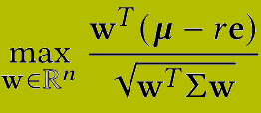
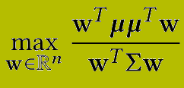
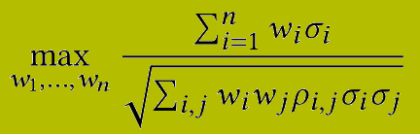
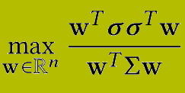
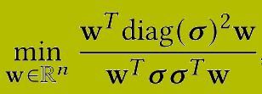
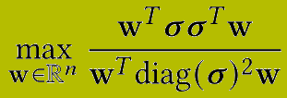
A Generic Framework
Sharpe ratio/Information ratio: (excess) return of a portfolio over portfolio standard deviation
Maximum diversification: maximize the standard deviation ratio of ρ=1 portfolio and a diversified portfolio
Minimum concentration: minimize the standard deviation ratio of ρ=0 portfolio and a ρ=1 portfolio

Slide 5
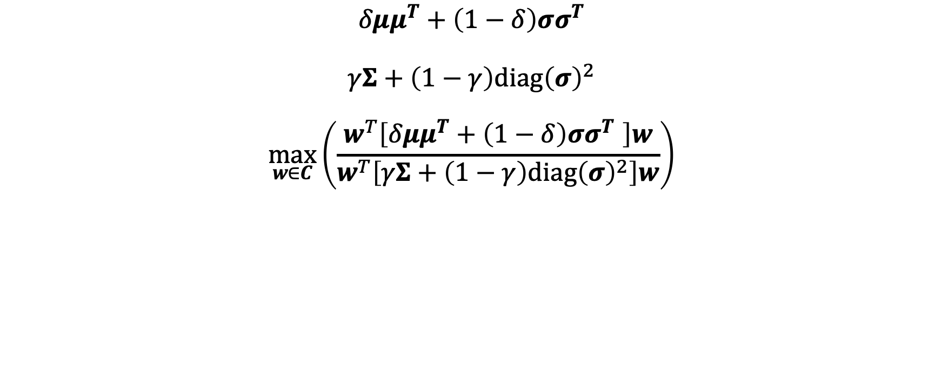
A Generic Framework

Slide 6
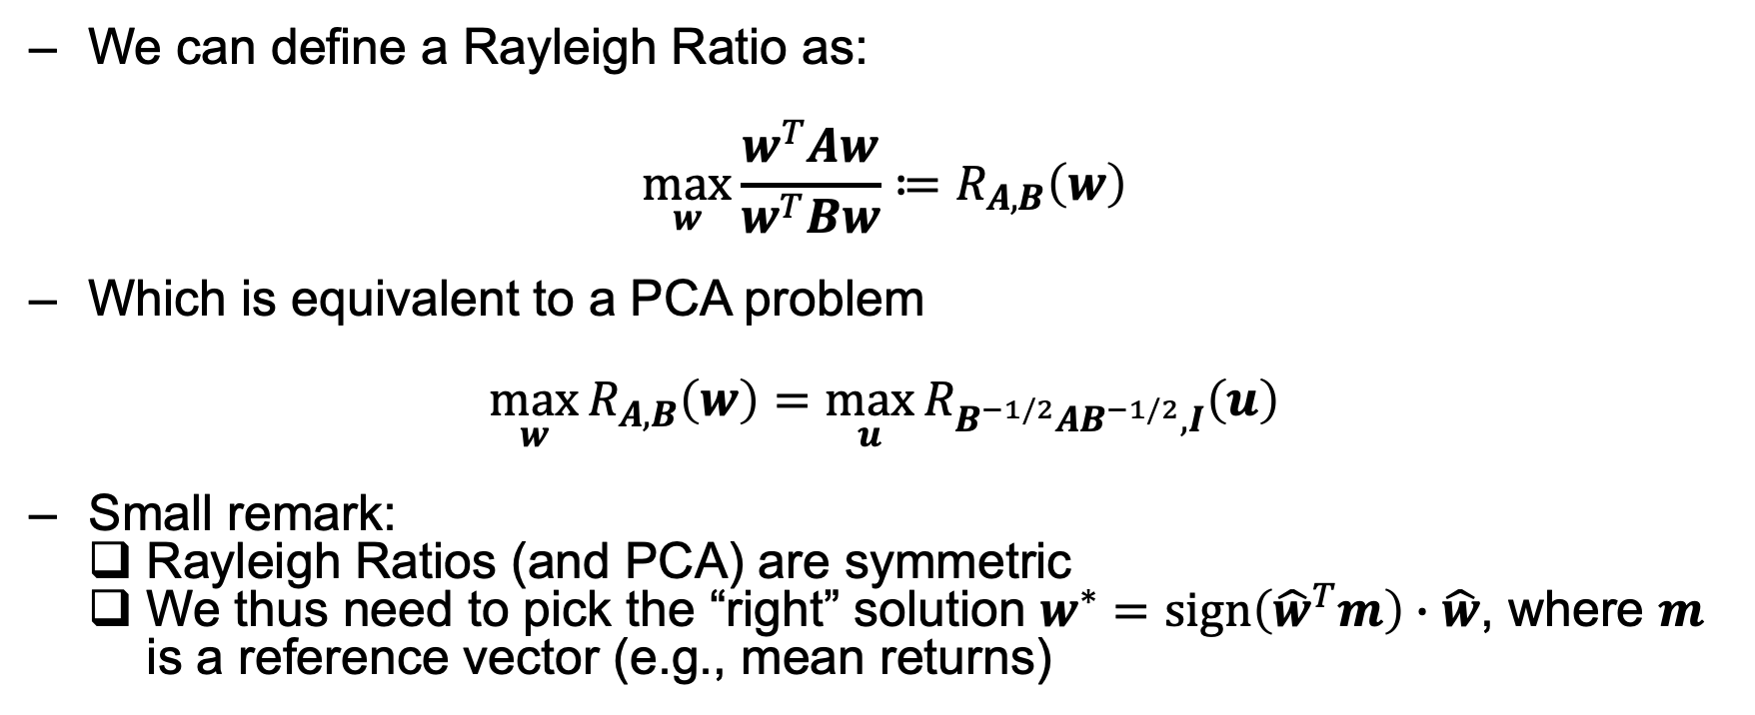
Rayleigh Quotients

Slide 7
Introducing Sparsity
Control the absolute exposure of a portfolio
Select a subset of stocks rather than the whole universe
Apply Occam’s razor
Increase out-of-sample performance (which is really what investing is after)
Sparse Rayleigh portfolios give us a way to interpolate between full diversification and stock picking.

Slide 8


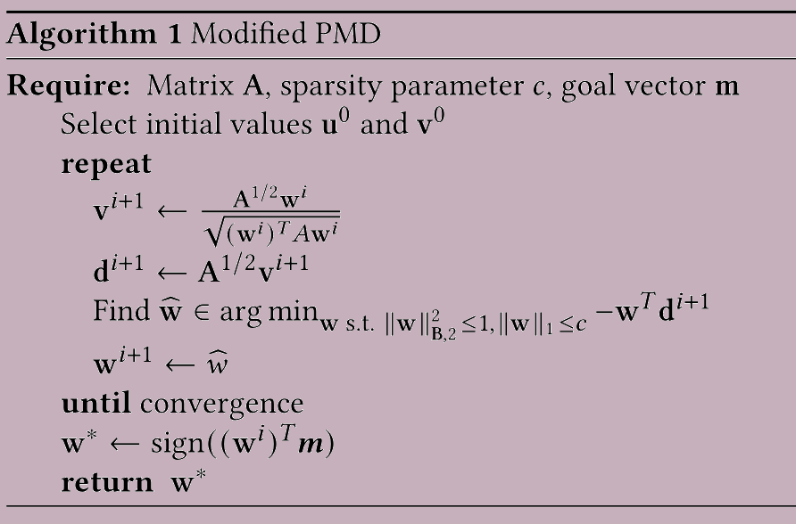
Introducing Sparsity
Rayleigh Ratio is equivalent to a bi-convex problem:
Adding Sparsity keeps it bi-convex:

Slide 9
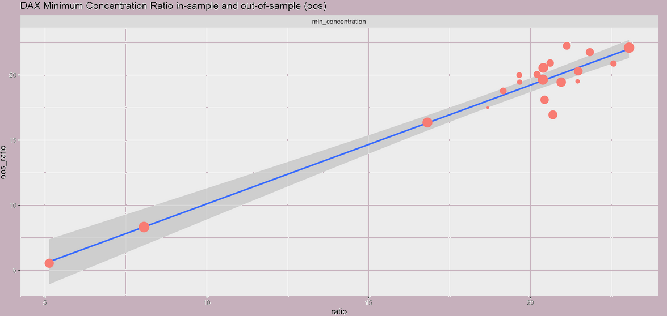
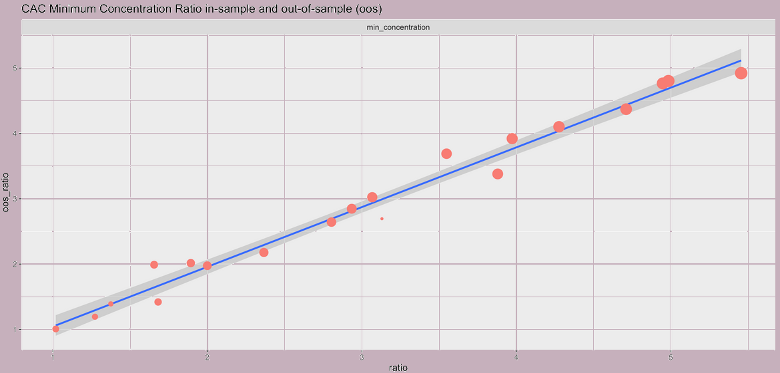
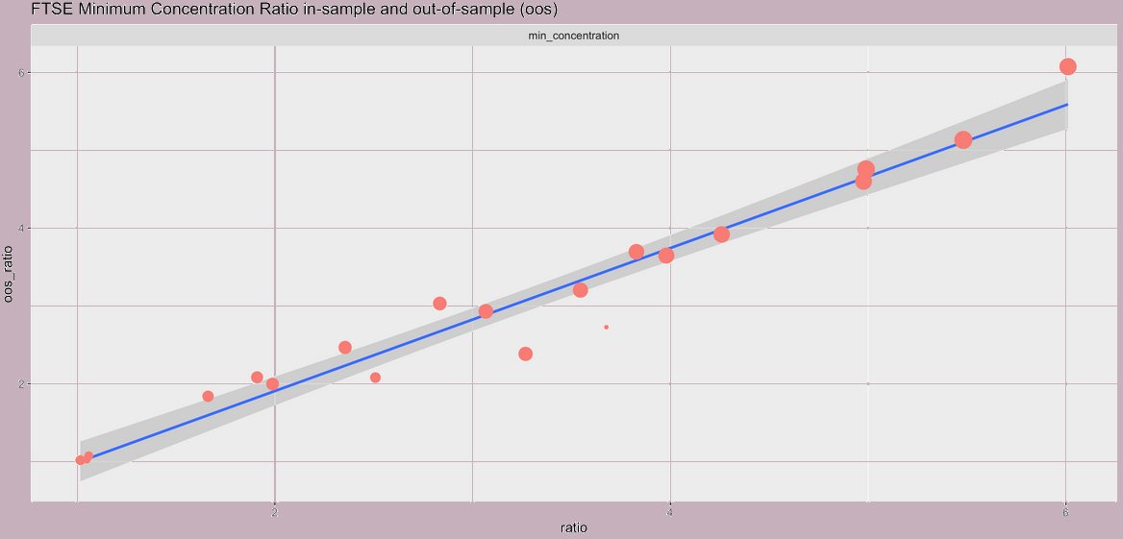
Introducing Sparsity
DAX, CAC & FTSE: daily adjusted returns for 12 years from Yahoo Finance (9.5 yrs in-sample, 2.5 yrs out-of-sample)
Minimum Concentration

Slide 10
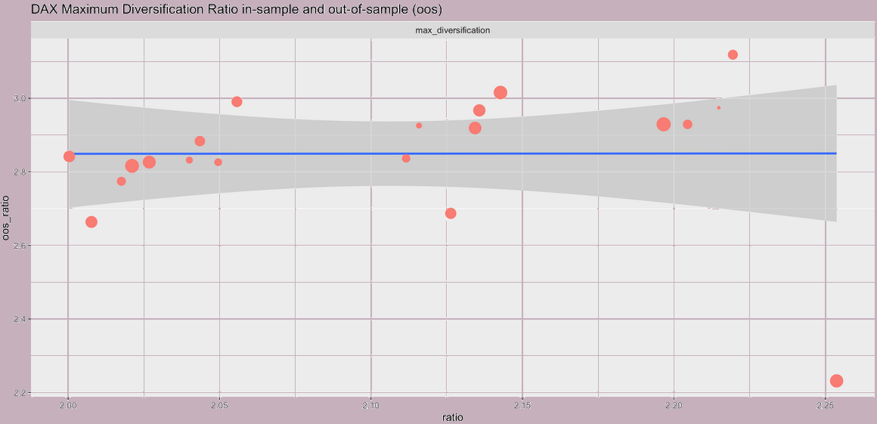
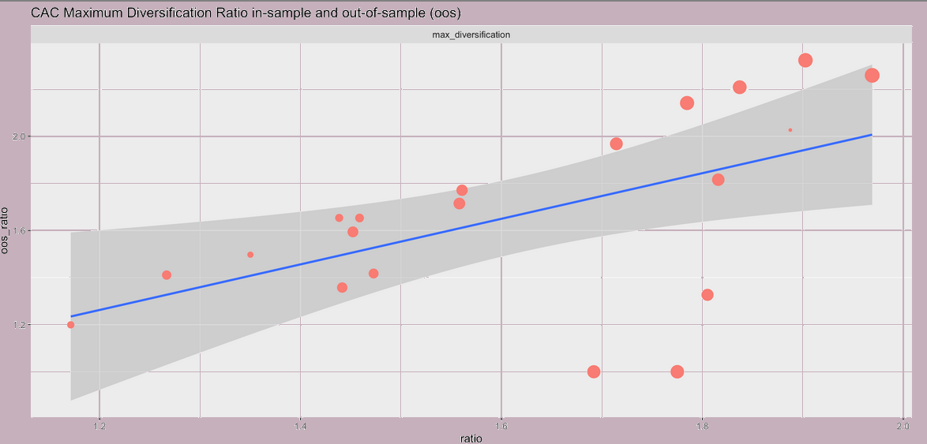
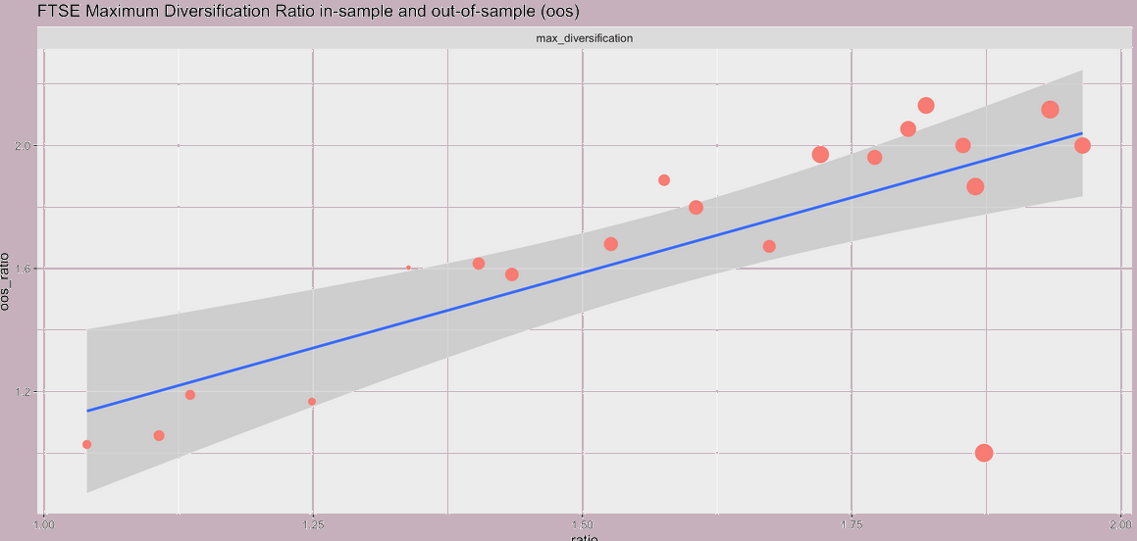
Introducing Sparsity
DAX, CAC & FTSE: daily adjusted returns for 12 years from Yahoo Finance (9.5 yrs in-sample, 2.5 yrs out-of-sample)
Maximum Diversification

