Slide 1






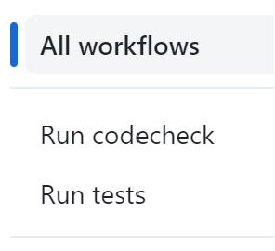


load best model
dvc pull
Developer
commit
push
User
pre-commit

Slide 2




Slide 3
load best model
dvc pull
Developer
commit
push
User
pre-commit

Slide 4
dvc pull
Developer
commit
push
User
pre-commit

