Slide 1
















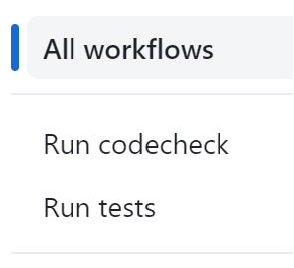
Result
Config.
Compute Engine
Storage Bucket
Container Registry
trigger image rebuild
trigger
testing
User
dvc pull
Developer
commit
push
pre-commit

Slide 2



Slide 3
Result
Config.
Compute Engine
Storage Bucket
Container Registry
trigger image rebuild
trigger
testing
User
dvc pull
Developer
commit
push
pre-commit

Slide 4
load best model
dvc pull
Developer
commit
push
User
pre-commit

Slide 5
dvc pull
Developer
commit
push
User
pre-commit

