Slide 1
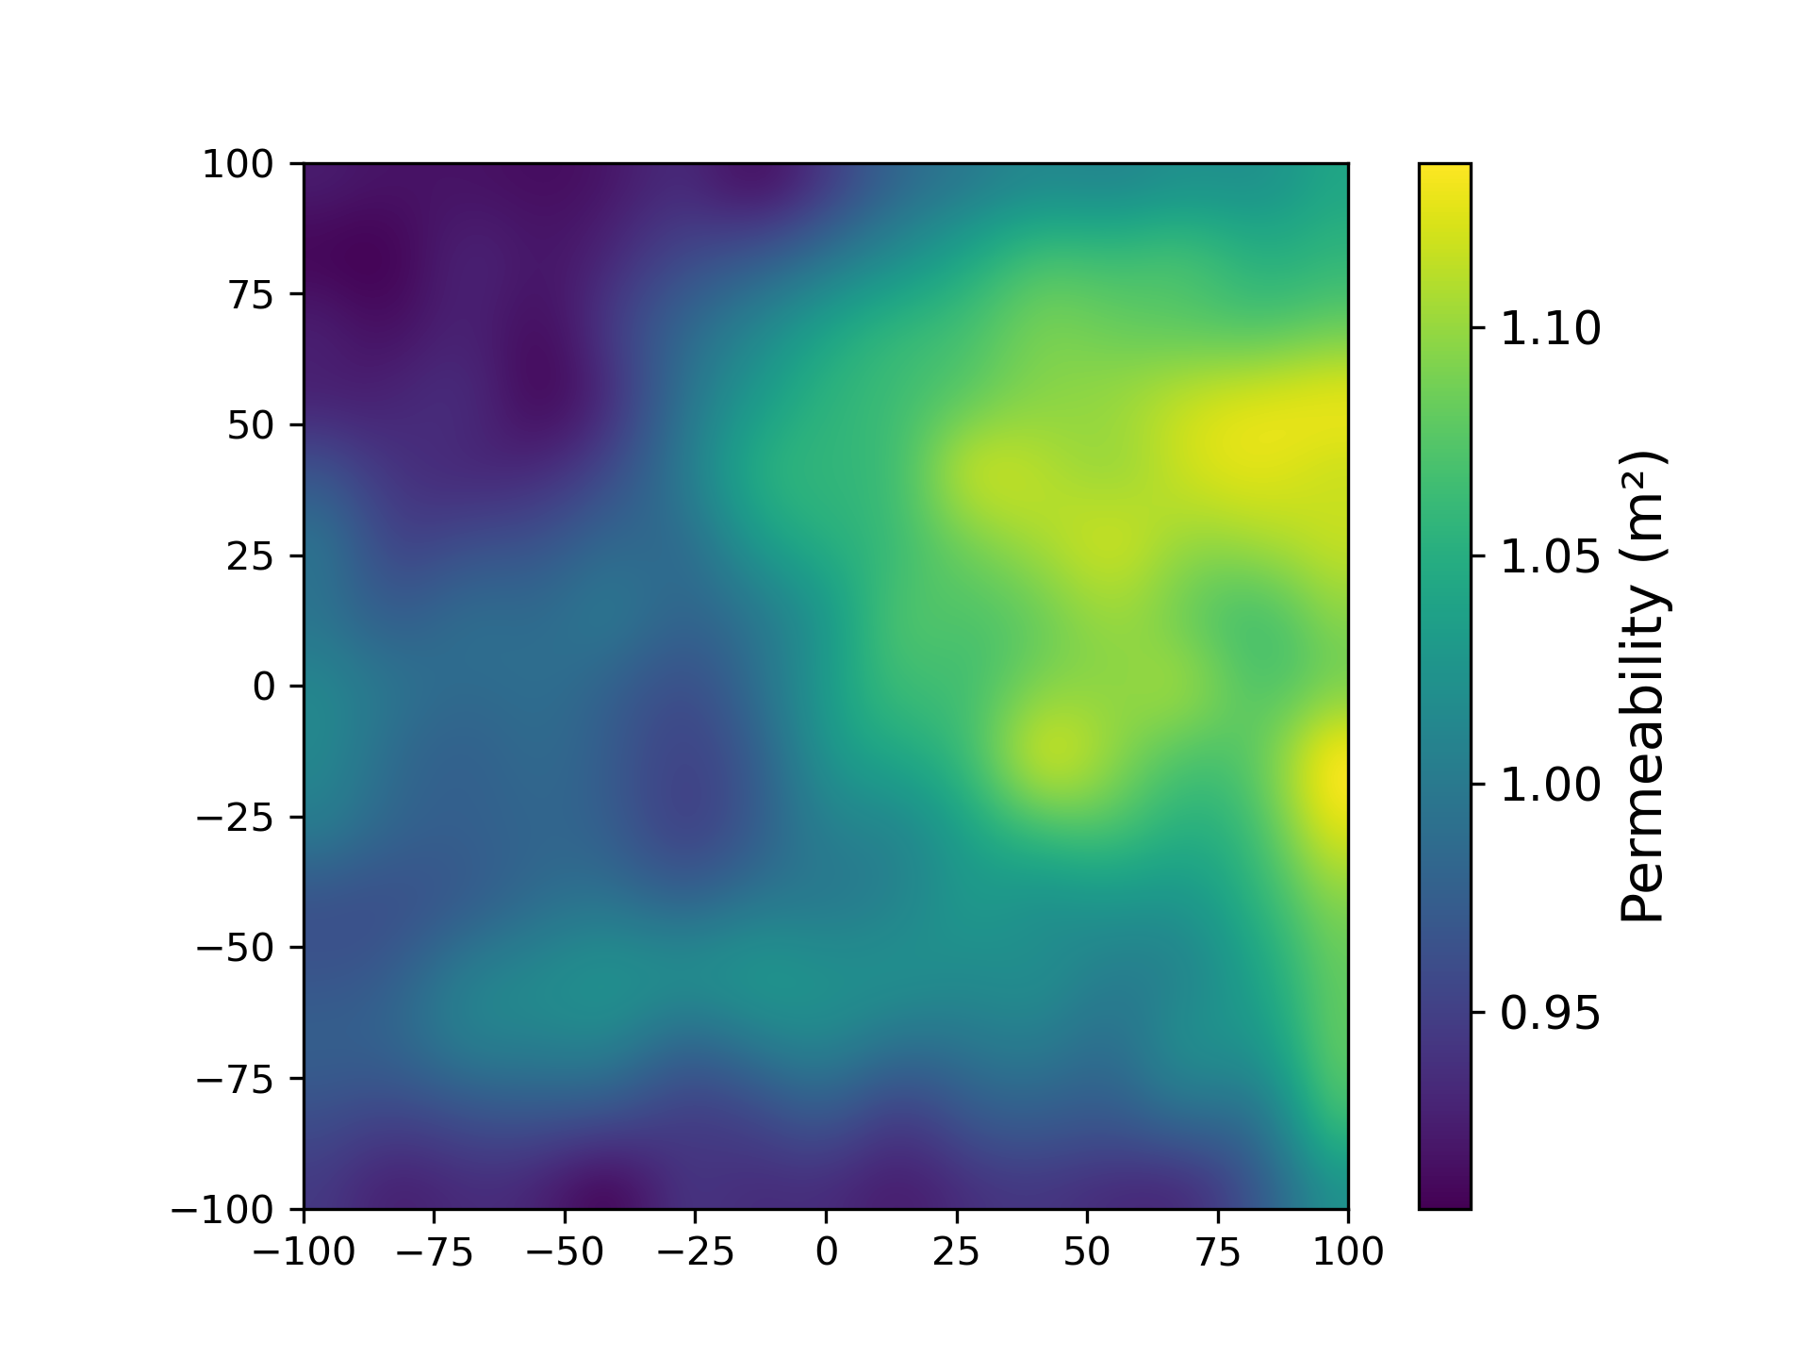
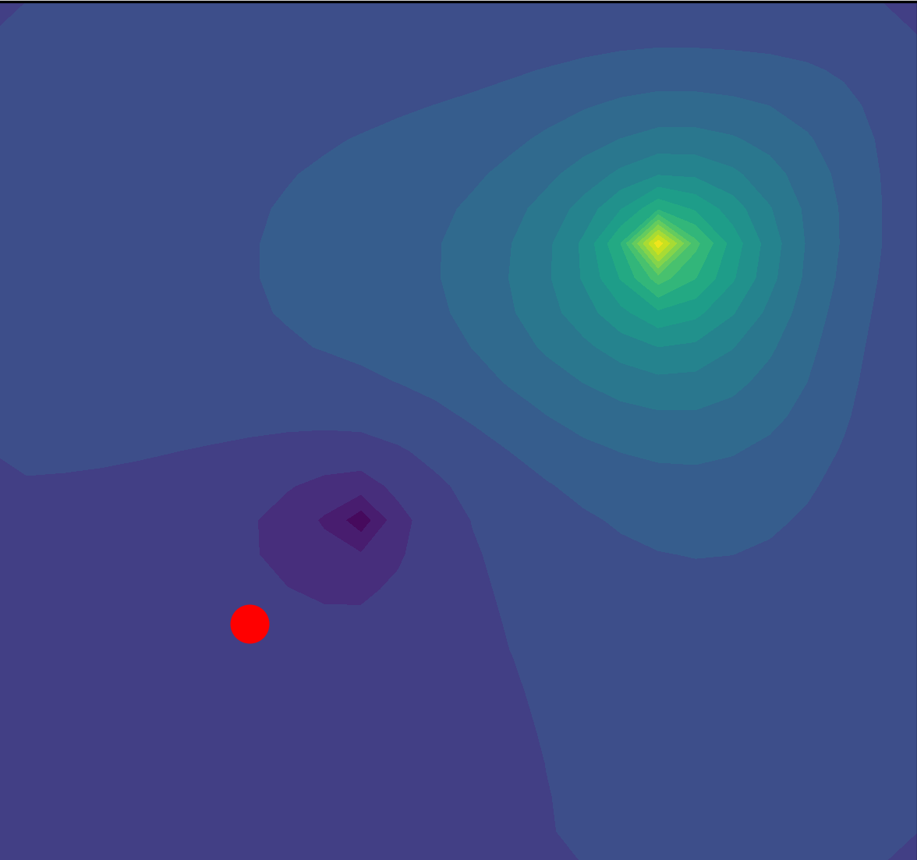
Pretraining
Finetuning
Heterogenous permeability samples
Convolutional Neural Network
Pretrained Convolutional Neural Network
Control parameters
Extraction rates
Extraction rates
Backpropagation loop
Injector
Injector
Backpropagation loop
AD Single phase
full order model
NN controlled extractor
AD Multiphase full order model
NN controlled extractor
Critical location
Critical location
Loss Function
Pressure errors at Critical locations
Pressure errors at Critical locations

