Slide 1
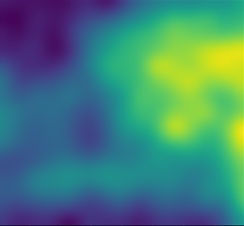
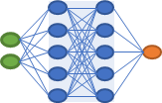
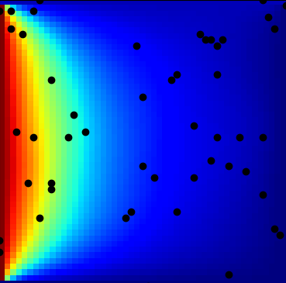
Coefficient mismatch
True KL coefficients
Inferred KL coefficients
Neural Networks
Backpropagation
Loss
Observed
pressure

Slide 2
Coefficient mismatch
True KL coefficients
Simulated
pressure
Differentiable
Simulator
Neural Networks
Inferred KL coefficients
Backpropagation
Loss
Pressure mismatch
Observed
pressure

