Slide 1
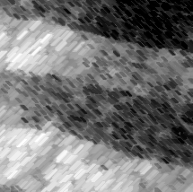
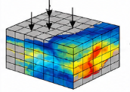

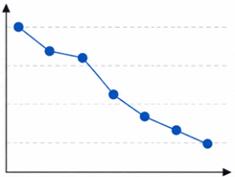

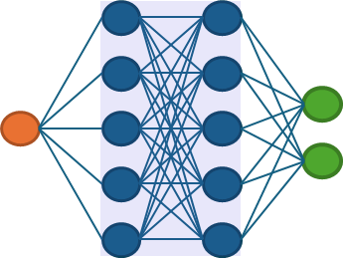
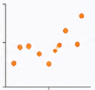
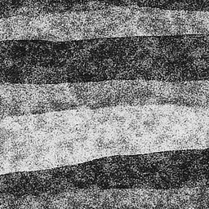
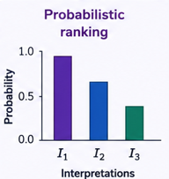
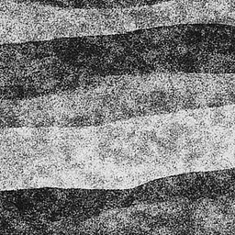

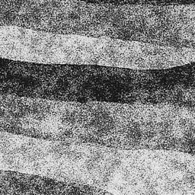
Text description
of a geology
“Fractured dolomite aquifer with a central low-permeability halite zone…. “
Inferred geology
Forward model
VAE Decoder
Foundation text to image models
Inferred pressure
Inferred latent
Learned latent
Pressure inference error
Neural networks
VAE
Encoder
Ranking
Observed pressure
Geologic images
Data generation
Prior
Inversion
Ranking

