Slide 1
Classics Library XML Catalog
Niamh Mcguigan
And
Helen Davies

Slide 2
Original Problems
Almost 4000 objects
No searchable catalog
Incomplete bibliographic data in spread sheet
Available data varies between objects
Does not conform to library standards

Slide 3
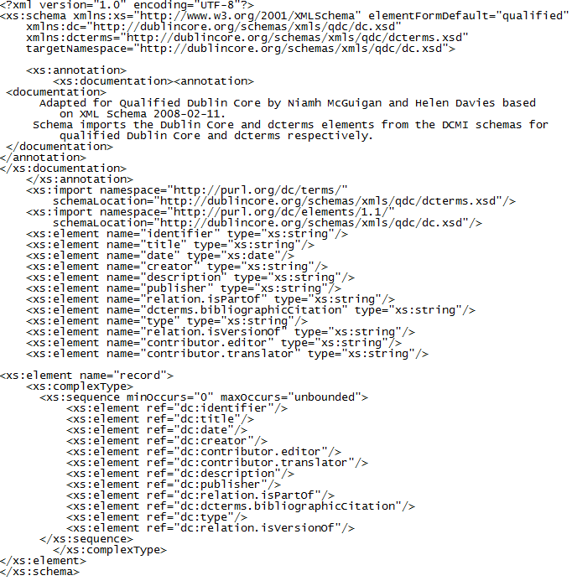
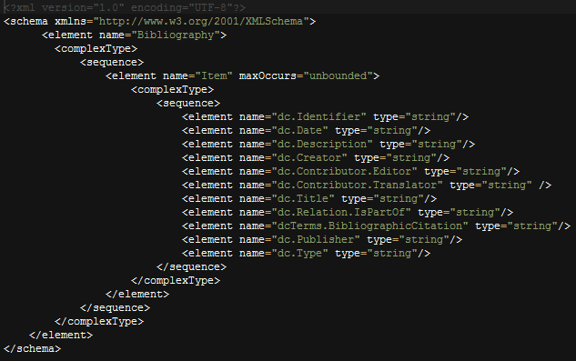
Two Different Schemas
DC Complete Schema
Functional Schema

Slide 4
Detail: DC Complete Schema

Slide 5
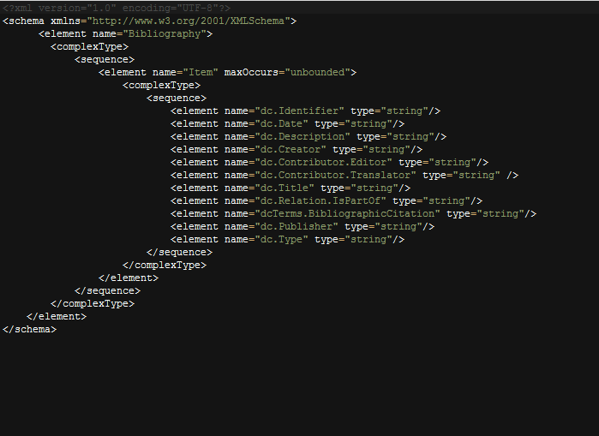
Detail: Functional Schema

Slide 6
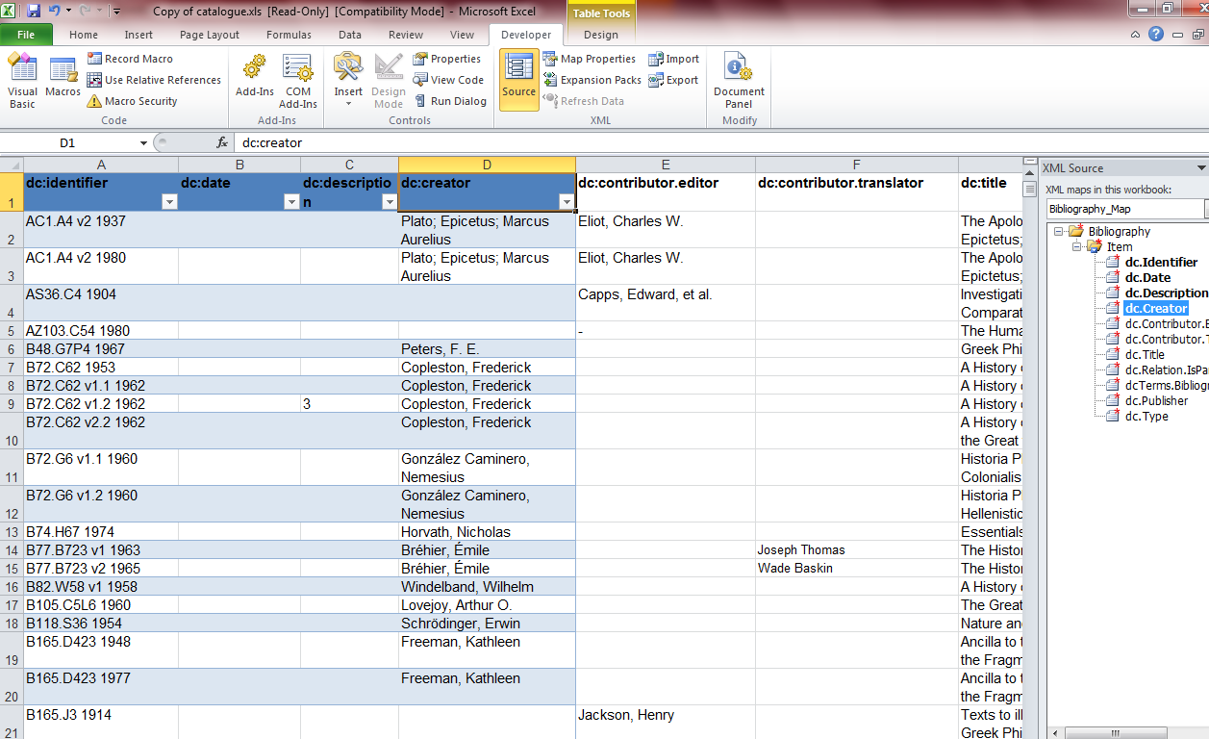
Mapping to Excel

Slide 7
Exist

Slide 8
Search Results

