Slide 1
Classics Library XML Catalog
Niamh Mcguigan
And
Helen Davies

Slide 2
Original Problems
Almost 4000 objects
No searchable catalog
Incomplete bibliographic data in spread sheet
Available data varies between objects
Does not conform to library standards

Slide 3
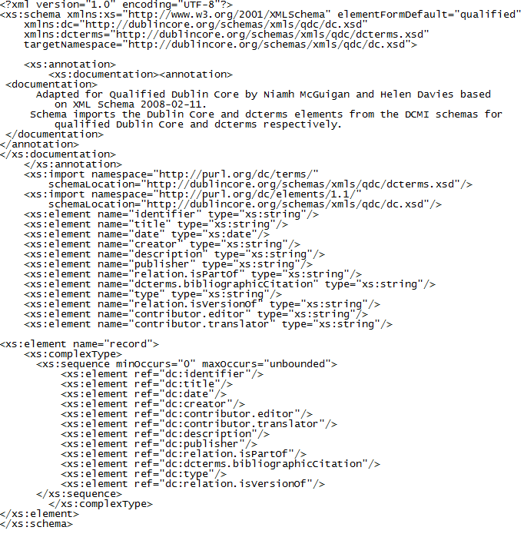
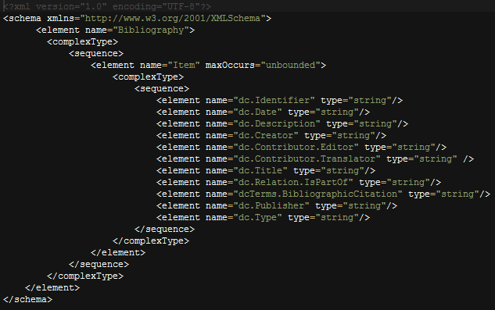
Two Different Schemas
DC Complete Schema
Functional Schema

Slide 4
Detail: DC Complete Schema

Slide 5
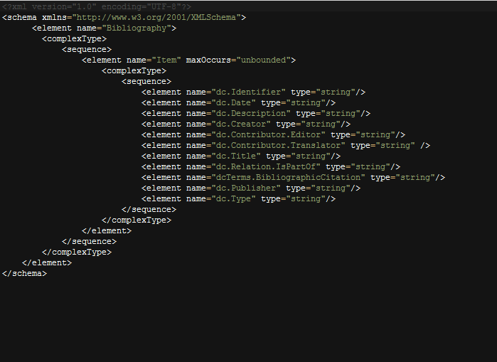
Detail: Functional Schema

Slide 6
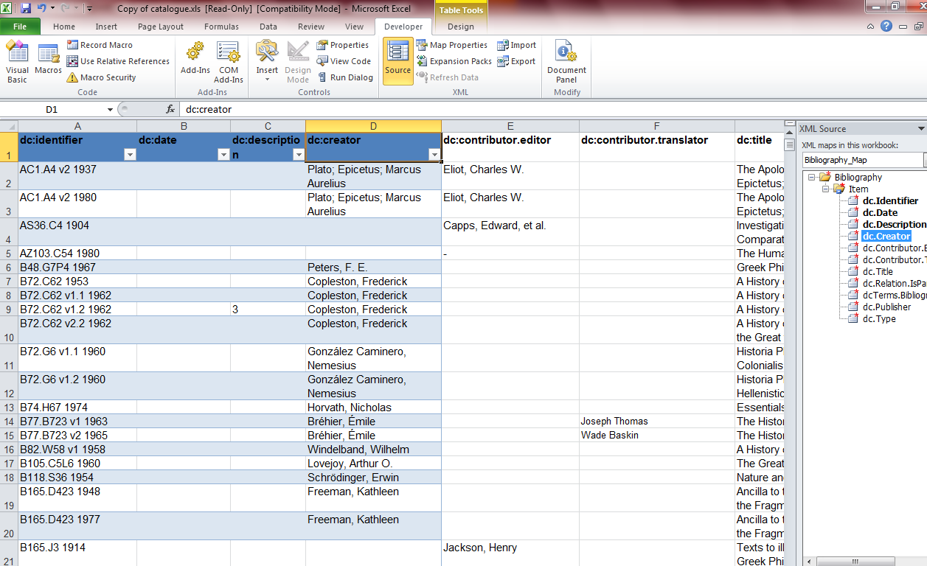
Mapping to Excel

Slide 7
Searches
Entire catalog:
doc("XMLproject.xml")/Bibliography/Item[contains(.,"Plato")]
Author:
doc("XMLproject.xml")/Bibliography/Item/dc.Creator[contains(.,"Plato")]/../.
Date:
doc("XMLproject.xml")/Bibliography/Item/dc.Description[contains(.,"Plato")]/../.
Editor:
doc("XMLproject.xml")/Bibliography/Item/dc.Contributor.Editor[contains(.,"Plato")]/../.
Translator:
doc("XMLproject.xml")/Bibliography/Item/dc.Contributor.Translator[contains(.,"Plato")]/../.
Title:
doc("XMLproject.xml")/Bibliography/Item/dc.Title[contains(.,"Plato")]/../.
Series Title:
doc("XMLproject.xml")/Bibliography/Item/dc.Relation.IsPartOf[contains(.,"Plato")]/../.
Journal Article Citation : doc("XMLproject.xml")/Bibliography/Item/dc.Terms.BibliographicCitation[contains(.,"Plato")]/../.
Publisher: doc("XMLproject.xml")/Bibliography/Item/dc.Publisher[contains(.,"Plato")]/../.
Item Type: doc("XMLproject.xml")/Bibliography/Item/dc.Type[contains(.,"Plato")]/../.

