Slide 1
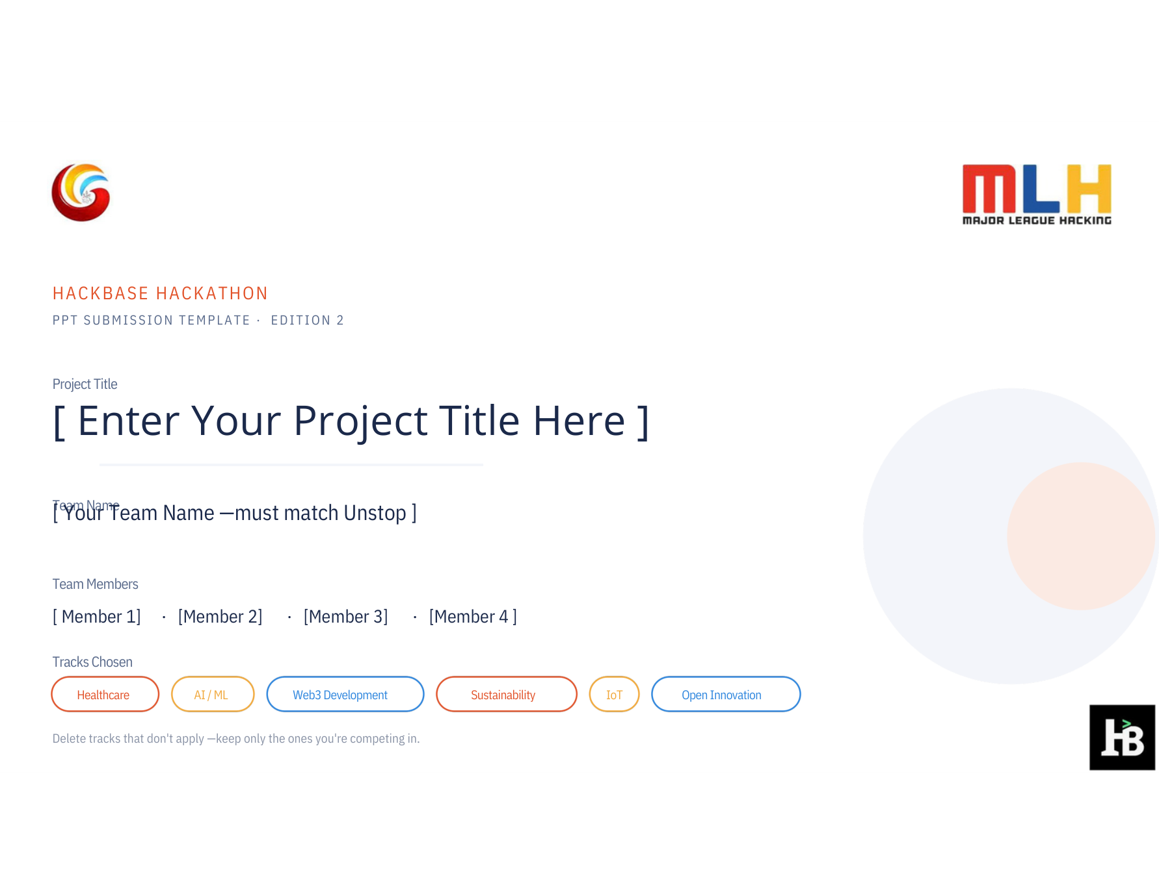
SpotStory
Gemini-assisted skin-change visit prep · not cancer detection
Team Name
[TEAM NAME — exact Unstop name]
[Member 1] · [Member 2] · [Member 3] · [Member 4]
Healthcare
AI / ML
Open Innovation
A conversation-prep prototype: visual notes, personal timeline, clinician handoff.

Slide 2
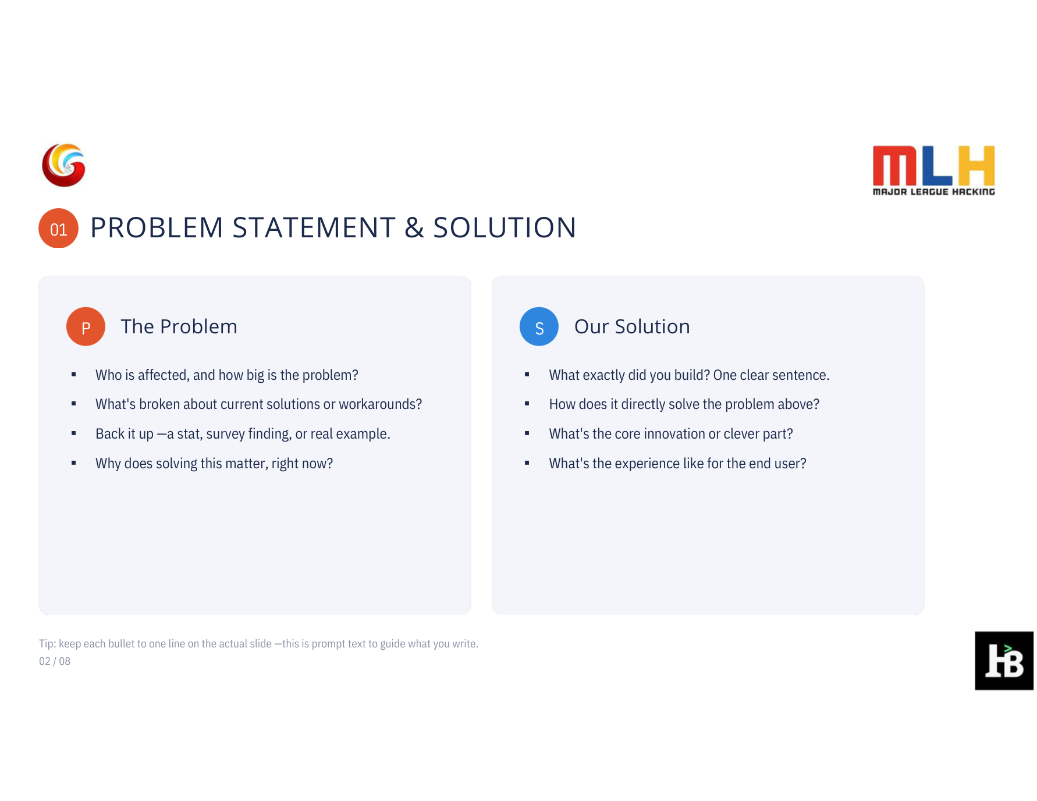
P
The Problem
S
Our Solution
• A single phone photo loses the timeline: when a spot appeared and how it changed.
• An unvalidated “AI cancer score” can overclaim what a camera image proves.
• ACS flags new/evolving spots; AAD includes all skin tones, palms, soles and nails.
• Need: an accessible bridge from “I noticed this” to a clearer care conversation.
• SpotStory pairs a person’s own timeline with optional Gemini photo notes.
• Gemini describes visible cues only — no cancer label, probability, or “all clear.”
• The browser turns selected facts into an editable, visit-ready note.
• Static, sourced guidance supports clinician follow-up; no diagnosis or urgency score.
Sources: American Cancer Society · American Academy of Dermatology | Prototype, not clinically validated.

Slide 3
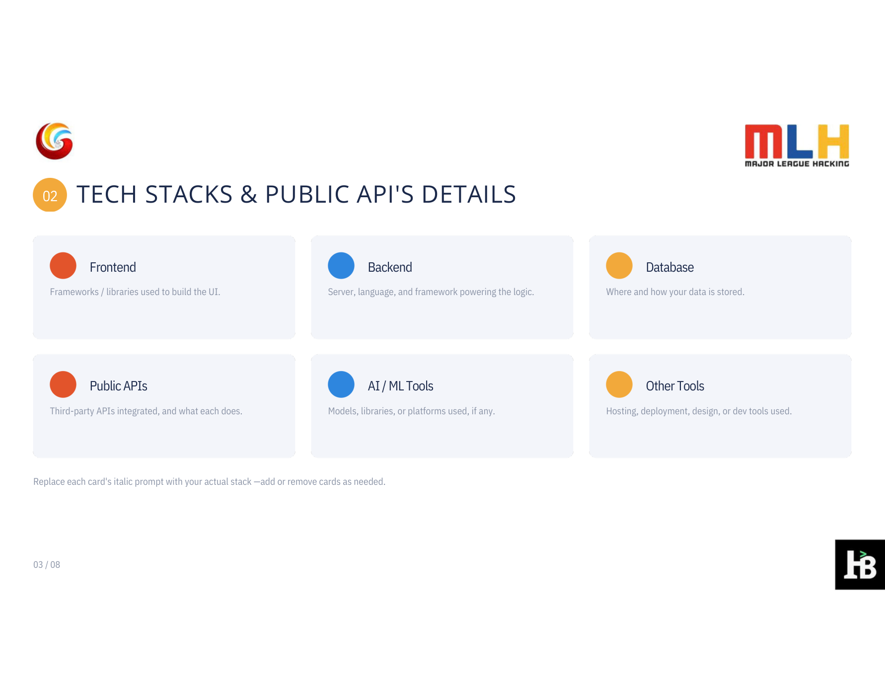
Frontend
Backend
Data
Vanilla HTML / CSS / JS
Responsive, accessible UI
Local image preview + resize
Node.js 18 · built-in HTTP
Same-origin Gemini proxy
Input validation + rate limit
No database
No image written to disk
Timeline remains in browser
Public API
AI / ML
Other Tools
Google Gemini API
`generateContent` image input
Server-to-server request
Gemini 3.5 Flash
Structured JSON visual notes
No diagnosis or risk score
Google AI Studio key
`.env.local` server secret
Synthetic/static demo mode
Live request sends only the resized image and selected output language; user timeline stays client-side.

Slide 4
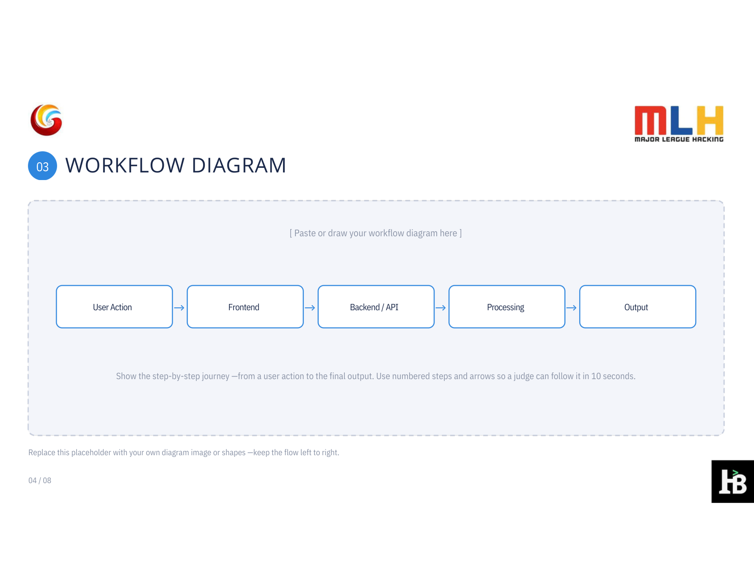
LIVE FLOW · EXPLICIT CONSENT · NO PERSISTENT IMAGE STORE
01 · PERSON
→
02 · BROWSER
→
03 · NODE
→
04 · GEMINI
→
05 · HANDOFF
Selects own
spot history
Previews +
resizes photo
Checks file;
hides API key
Returns JSON
visual notes
Local visit
prep note
Only the photo + language reach Gemini
Timeline + optional note stay in browser
No diagnosis, probability, or urgency
The photo is not written to disk by this prototype. Live Gemini requests are subject to Google API terms.

Slide 5
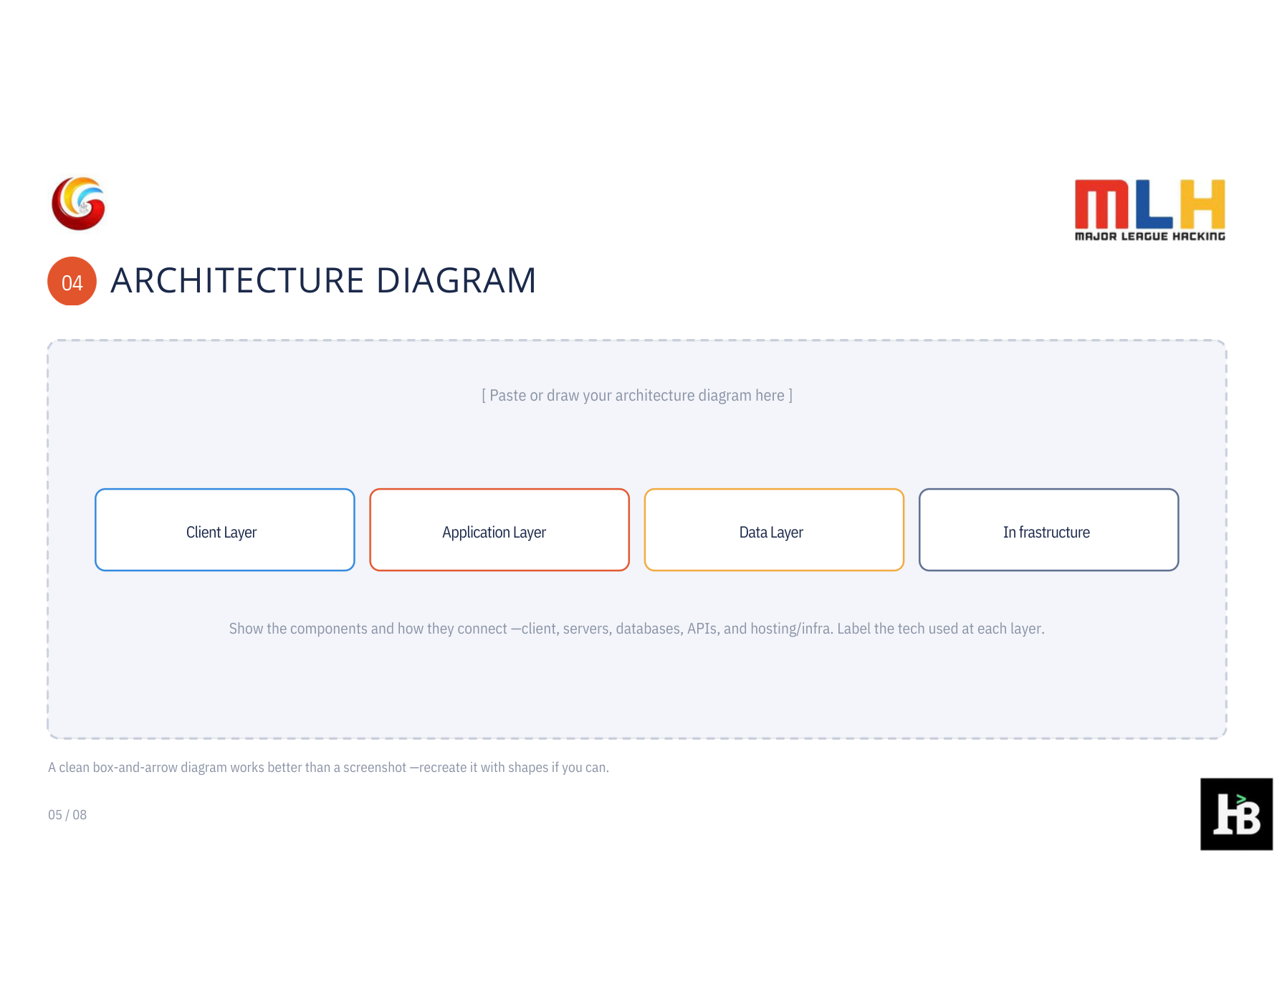
NO DATABASE · SAME-ORIGIN API · SECRET NEVER ENTERS THE BROWSER
CLIENT
APPLICATION
AI API
DATA / INFRA
Browser UI
Node.js server
Gemini API
No DB
→
→
→
Vanilla JS
Story + consent
Image resized locally
MIME / size check
Rate-limited proxy
Output safety filter
Image input only
Constrained JSON
Key in server header
No file persistence
Secret in .env.local
Usage-based API
Returned notes + locally composed story → editable visit brief
Future deployment would add identity, encryption, consent governance, clinical review, and privacy/regulatory assessment.

Slide 6
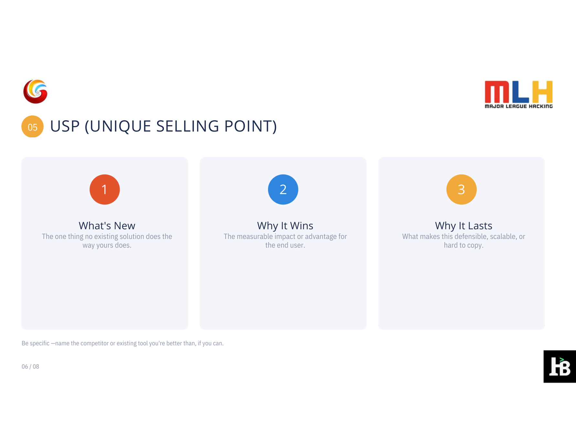
1
2
3
Pixels → a visit brief
A different lane
A testable hypothesis
Gemini notes visible cues; the person supplies the timeline. The handoff — not a cancer score — is the product.
Miiskin maps and compares photos; SkinVision offers risk indications. SpotStory explores a no-score, editable clinician brief.
Bilingual, privacy-light, human-led. Clinician co-design and measured user value must prove it can stand out.
Landscape scan: Miiskin (photo tracking) · SkinVision (risk indication). Novelty is unproven; validate this no-score handoff with users.

Slide 7
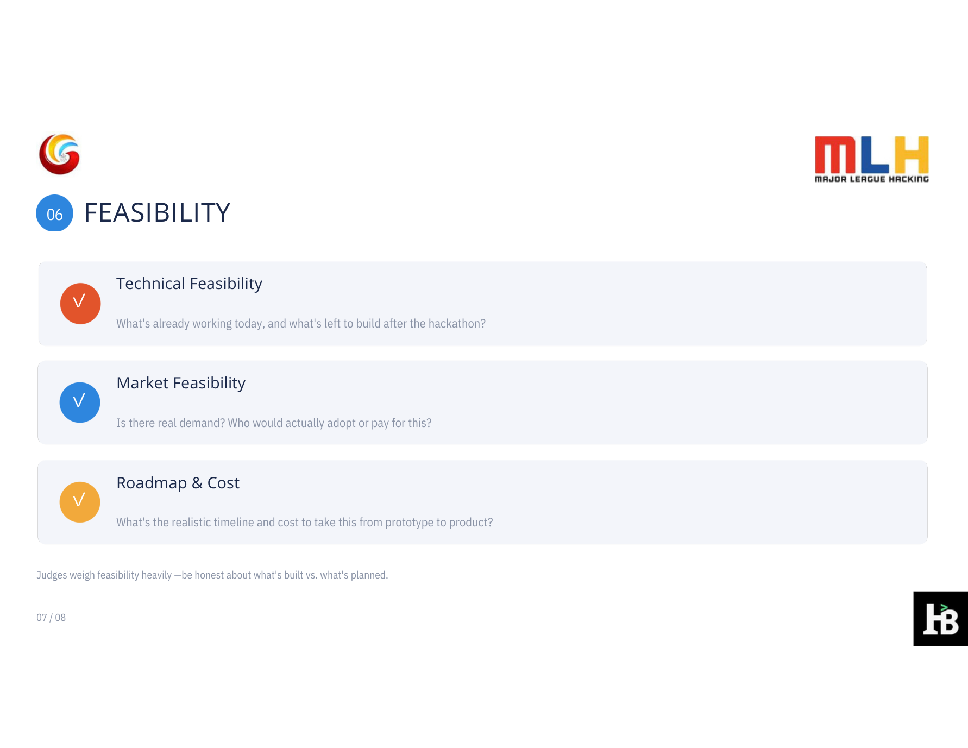
✓
Technical Feasibility
Built: responsive UI, synthetic-image demo, server-side Gemini JSON endpoint, response filter, 10 safety/API stub tests, and local note builder.
Not built: clinical validation, authentication, or production data controls.
✓
Market Feasibility
Product hypothesis: people tracking a changing spot may value a clearer visit note; clinicians may value concise patient context.
Next: interview patients and dermatology/primary-care professionals; quantify willingness to adopt.
✓
Roadmap & Cost
0–4 weeks: co-design + privacy/risk review. 1–3 months: usability + representative image testing. 3–6 months: supervised pilot only if approved.
Prototype API spend: usage-based with a quota cap; production budget and regulatory path TBD.
No patient-facing diagnostic use until expert review, representative validation, privacy/security work, and appropriate regulatory assessment.

