Slide 1
GEO SPACIAL DEV
Hariprakash Reddy
Notes from book: Python Geospatial Development - Third Edition

Slide 2

GIS
The term GIS generally refers to geographic information systems, which are complex computer systems for storing, manipulating, and displaying geospatial data
The central GIS concepts you will have to become familiar with: location, distance, units, projections, datums, coordinate systems, and shapes
geodetic location:A latitude and longitude value refers to what is called a geodetic location

Slide 3
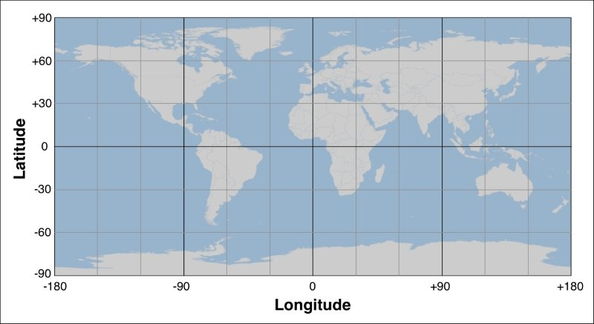
Latitude , longitude

Slide 4
Distance
Angular distance: this is the angle between two rays going out from the center of the Earth through two points. Angular distances are commonly used in seismology
Linear distance: this is what people typically mean when they talk of distance—how far apart two points on the Earth's surface are. This is often described as an "as the crow flies" distance.
Traveling distance: linear ("as the crow flies") distances are all very well, but very few people can fly like crows. Another useful way of measuring distance is to measure how far you would actually have to travel to get from one point to another, typically following a road or other obvious route.
Because we are working with distances between points on the Earth's surface rather than points on a flat surface, we are actually using what is called the great-circle distance. The great-circle distance is the length of a semicircle going between two points on the surface of the Earth, where the semicircle is centered around the middle of the Earth:haversine formula is often used for this.

Slide 5
units
Millimeters
Centimeters
Inches
International feet
U.S. survey feet
Meters
Yards
Kilometers
International miles
U.S. survey (statute) miles
Nautical miles

Slide 6
Projections
A projection is a mathematical transformation that "unwraps" the three-dimensional shape of the Earth and places it onto a two-dimensional plane.
Cylindrical projections: An easy way to understand cylindrical projections is to imagine that the Earth is like a spherical Chinese lantern with a candle in the middle:
Some of the main types of cylindrical projections include the Mercator projection, the equal-area cylindrical projection, and the universal transverse Mercator projection.
Conic projections: A conic projection is obtained by projecting the Earth's surface onto a cone:
Azimuthal projections:An azimuthal projection involves projecting the Earth's surface directly onto a flat surface

Slide 7
Coordinate systems
There are two types of coordinate systems you will need to be familiar with: projected coordinate systems and unprojected coordinate systems.
Datums: a datum is a mathematical model of the Earth used to describe locations on the Earth's surface.
WGS 84: This is the World Geodetic System of 1984. This is a global datum covering the entire Earth. It makes use of yet another model of the Earth's shape (the Earth Gravitational Model of 1996, EGM 96) and uses reference points based on the IERS International Reference Meridian. WGS 84 is a very popular datum. When dealing with geospatial data covering the United States, WGS 84 is essentially identical to NAD 83. WGS 84 also has the distinction of being used by Global Positioning System (GPS) satellites, so all data captured by GPS units will use this datum.

Slide 8
Definitions
A point, of course, is simply a coordinate, described by two or more numbers within a projected or unprojected coordinate system.
A path is generally described using what is called a LineString:
LineStrings are also sometimes referred to as PolyLines. Where a LineString is closed (that is, the last line segment finishes at the point where the first line segment starts), the LineString is often referred to as a linear ring.
Polygons are commonly used in geospatial data to describe the outline of countries, lakes, cities, and so on. A polygon has an exterior ring, defined by a closed LineString, and may optionally have one or more interior rings within it, each also defined by a closed LineString. The exterior ring represents the polygon's outline, while the interior rings (if any) represent "holes" within the polygon:

Slide 9
GIS format
Geospatial data describing geographical features.
Additional meta-data describing this data, including the datum and projection used, the coordinate system and units that the data is in, the date this file was last updated, and so on.
Attributes providing additional information about the geographical features that are being described. For example, a city feature may have attributes such as name, population, average temperature, and so on.
Display information, such as the color or line style to use when a feature is displayed.
There are two main types of GIS data: raster format data and vector format data. Raster formats are generally used to store bitmapped images, such as scanned paper maps or aerial photographs. Vector formats, on the other hand, represent spatial data using points, lines, and polygons. Vector formats are the most common type used by GIS applications as the data is smaller and easier to manipulate

Slide 10
Raster format
Digital Raster Graphic (DRG): This format is used to store digital scans of paper maps
Digital Elevation Model (DEM): This is used to record elevation data
Band Interleaved by Line (BIL), Band Interleaved by Pixel (BIP), Band Sequential (BSQ): These data formats are typically used by remote sensing systems

Slide 11
Vector Format
Shapefile: This is an open specification developed by a company called the Environmental Systems Research Institute (ESRI) for storing and exchanging GIS data. A shapefile actually consists of a collection of files all with the same base name, for example, hawaii.shp, hawaii.shx, hawaii.dbf, and so on.
Simple Features: This is an OpenGIS standard for storing geographical data (points, lines, and polygons) along with associated attributes.
TIGER/Line: This is a text-based format previously used by the US Census Bureau to describe geographic features such as roads, buildings, rivers, and coastlines. More recent data comes in the Shapefile format, so the TIGER/Line format is only used for earlier Census Bureau datasets.
Coverage: This is a proprietary data format used by ESRI's ARC/INFO system.

Slide 12
microformats
Well-known Text (WKT): This is a simple text-based format for representing a single geographic feature such as a polygon or LineString
Well-known Binary (WKB): This alternative to WKT uses binary data rather than text to represent a single geographic feature
GeoJSON: This is an open format for encoding geographic data structures and is based on the JSON data interchange format
Geography Markup Language (GML): This is an XML-based open standard for exchanging GIS data

Slide 13
Reading and writing geospatial data
GDAL/OGR: Unfortunately, the naming of these two libraries is rather confusing. GDAL (short for Geospatial Data Abstraction Library), was originally just a library for working with raster-format geospatial data, while the separate OGR library was intended to work with vector-format data. However, the two libraries are now partially merged and generally downloaded and installed together under the combined name of GDAL.
A default installation of GDAL allows you to read data in 100 different raster file formats, and write data in 71 different formats. OGR, by default, supports reading data in 42 different vector file formats and writing data in 39 different formats. This makes GDAL/OGR one of the most powerful geospatial data translators available, and certainly the most useful freely-available library for reading and writing geospatial data.

Slide 14
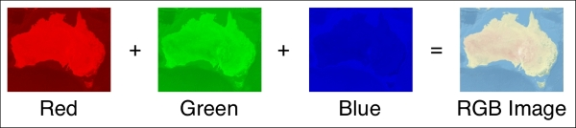
Understanding GDAL
To read and write raster-format data, the GDAL library makes use of a dataset object. The dataset object, an instance of gdal.Dataset, represents a file containing raster-format data.
Each dataset is broken down into multiple bands, where each band contains a single piece of raster data. For example, a raster dataset representing a basemap image might consist of three bands, representing the red, green, and blue color components of the overall image:

Slide 15
gdal.Band – Raster data in .tiff format
You can use the band.ReadRaster() method to read some or all of the band's data into a binary string and then use the built-in struct library to convert that string into an array of values
You can use the band.ReadArray() method to read some of the band's data, storing the cell values directly into a NumPy array object

Slide 16
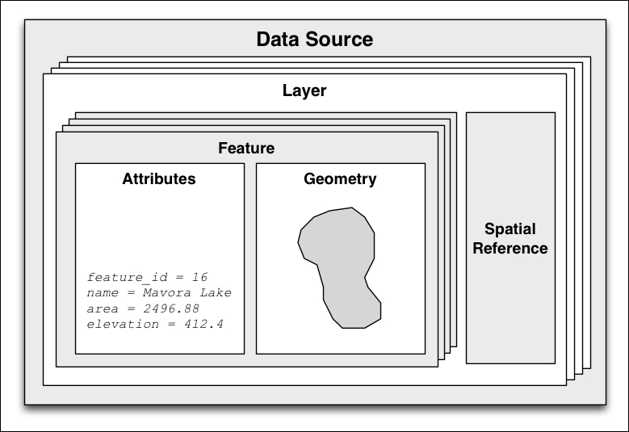
Vector Data
Understanding OGR:

Slide 17
Dealing with projections
whenever you have some geospatial data, you need to know which projection that data uses.
You also need to know the datum (model of the Earth's shape) assumed by the data.
A common challenge when dealing with geospatial data is that you have to convert data from one projection or datum to another. Fortunately, there is a Python library that makes this task easy: pyproj.
Geod is a geodetic computation class. This allows you to perform various great-circle calculations.
When you create a new Geod object, you specify the ellipsoid to use when performing the geodetic calculations.

Slide 18
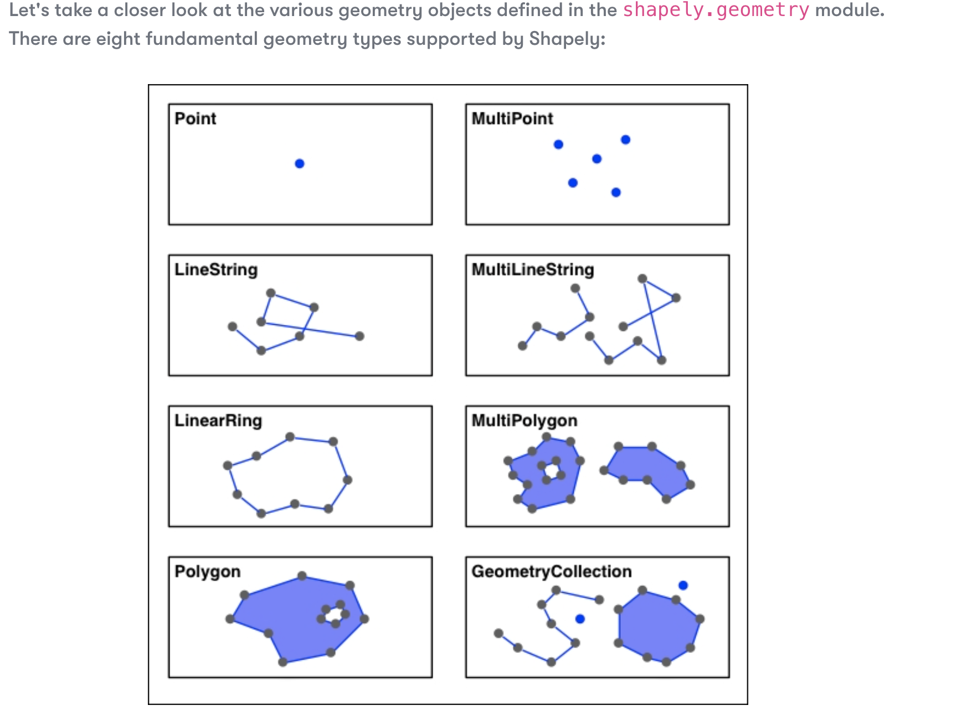
shapely

Slide 19
Visualizing geospatial data
Mapnik is a freely-available library for building mapping applications. Mapnik takes geospatial data from a PostGIS database, shapefile, or any other format supported by GDAL/OGR, and turns it into clearly-rendered, good-looking images.
The binaries have to be installed and python or javascript wrappers are available.
Python 3 support is not there. Better to use nodejs version.
npm i mapnik
Better to use libraries such as geopandas and Folium

Slide 20
Sources of Data – some of links may not work
OpenStreetMap - http://openstreetmap.org
Natural Earth - http://www.naturalearthdata.com
Shorelines - http://www.ngdc.noaa.gov/mgg/shorelines/gshhs.html
World Borders Dataset - http://thematicmapping.org/downloads/world_borders.php
Natural Earth - http://www.naturalearthdata.com
USA - https://apps.nationalmap.gov/downloader/#/

Slide 21
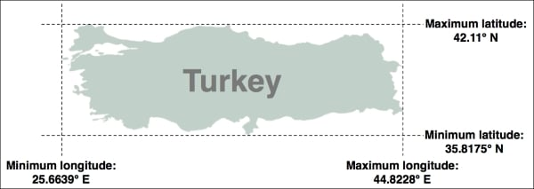
Working with geospatial data
Task – calculate the bounding box for each country in the world

Slide 22
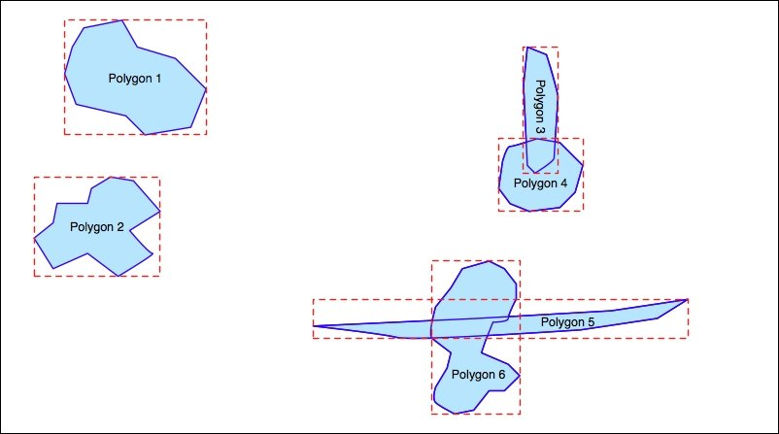
Spatial indexes
Spatial indexes are one of the most powerful features of spatial databases
(psycopg3 – upcoming with async support)
PostGIS is one of the most popular and powerful geospatial databases and has the bonus of being open source and freely available. PostGIS itself is actually an extension to the PostgreSQL relational database system—to use PostGIS from your Python programs, you first have to install and set up PostgreSQL, then install the PostGIS extension, and then finally install the psycopg2 database adapter for Python.

Slide 23
Advanced PostGIS features
On-the-fly transformations of geometries from one spatial reference to another.
The ability to edit geometries by adding, changing, and removing points and by rotating, scaling, and shifting entire geometries.
The ability to read and write geometries in GeoJSON, GML, KML, and SVG formats, in addition to WKT and WKB.
A complete range of bounding-box comparisons, including A overlaps B, A contains B, and A is to the left of B. These comparison operators make use of spatial indexes to identify matching features extremely quickly.
Proper spatial comparisons between geometries, including intersection, containment, crossing, equality, overlap, touching, and so on. These comparisons are done using the true geometry rather than just their bounding boxes.
Spatial functions to calculate information such as the area, centroid, closest point, distance, length, perimeter, shortest connecting line, and so on. These functions take into account the geometry's spatial reference, if known.
Performing calculations on unprojected coordinates takes approximately an order of magnitude longer than performing the same calculations using projected (Cartesian) coordinates
The GEOGRAPHY type only supports lat/long values on the WGS84 datum (SRID 4326)
Many of the functions available for projected coordinates are not yet supported by the GEOGRAPHY type

