Slide 1
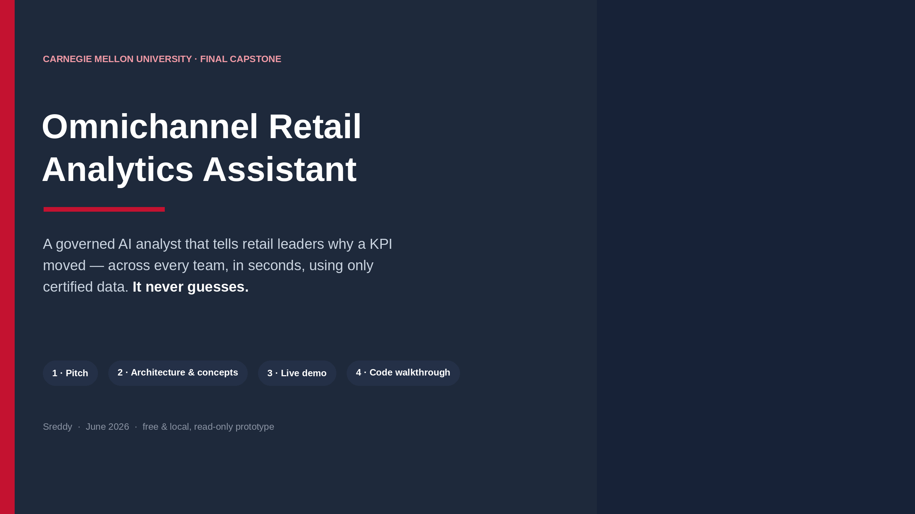
Notes:
0:00–0:35. Say the pitch verbatim (big text), then read the 4 chips as your agenda. Energy up.

Slide 2
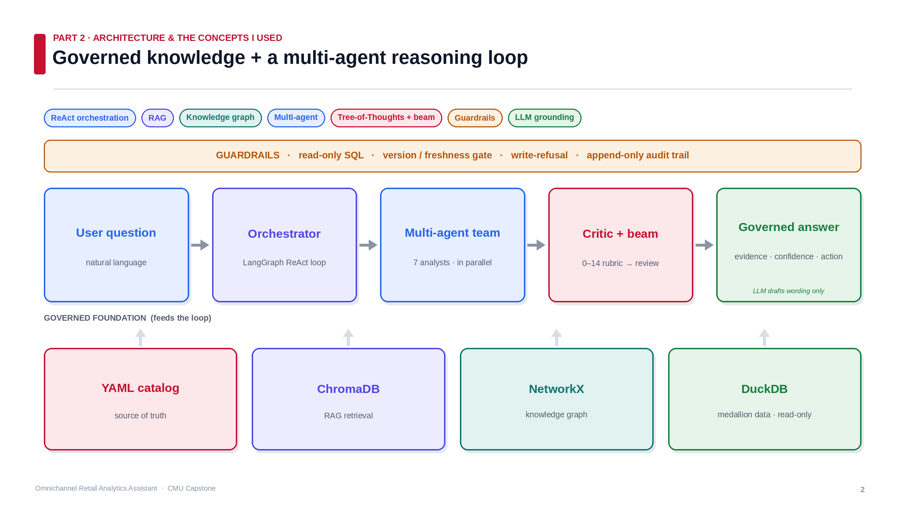
Notes:
0:35–2:35 (~2 min) — centerpiece. Trace it: a question comes in; the LangGraph ORCHESTRATOR runs a governed loop — RETRIEVES certified context (RAG/ChromaDB), VALIDATES vs the YAML catalog, RELATES metric→drivers via a NetworkX knowledge graph. It dispatches a TEAM of 7 analysts in PARALLEL; a CRITIC scores each on a 0–14 rubric, BEAM keeps the strongest, every recommendation goes to an owner for review. Two anchors: the whole loop runs inside GUARDRAILS (top band: read-only, version-gated, write-refusing, audited), fed by the GOVERNED FOUNDATION (YAML = source of truth, DuckDB read-only). Close: 'the LLM only drafts the wording — every number comes from governed SQL.' Point at each chip.

Slide 3
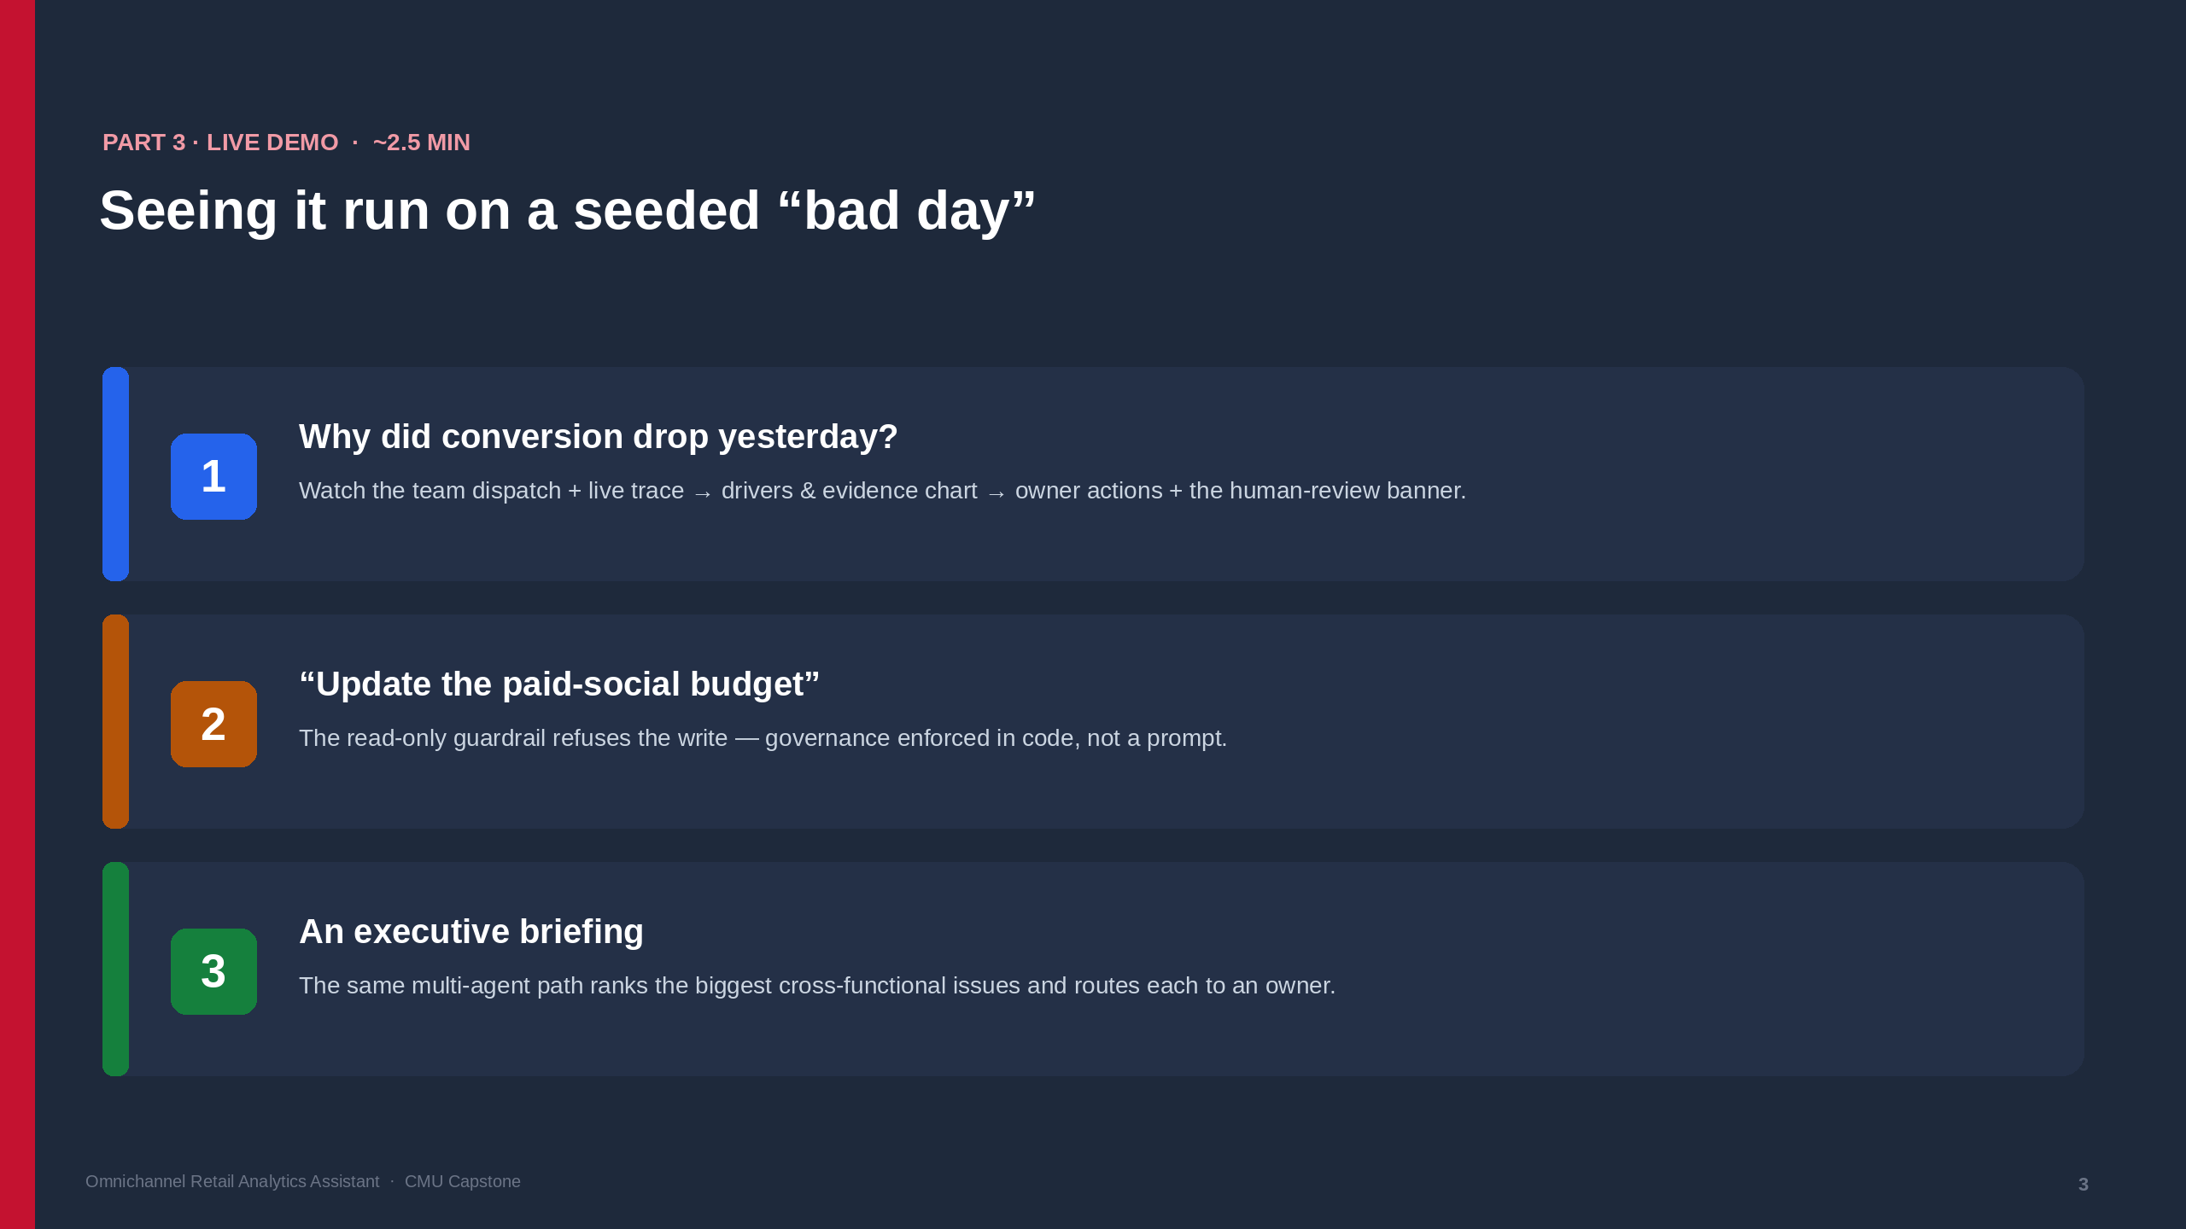
Notes:
2:35–5:00. App running and WARMED UP. (1) Run the conversion investigation; narrate the steps as the trace streams; land on Business answer → Evidence chart → owner actions + 🔴 human-review banner. (2) Type a write request → it refuses (fast, always lands). (3) One briefing. Short on time → #1 and #2 only. Keep a backup screenshot.

Slide 4
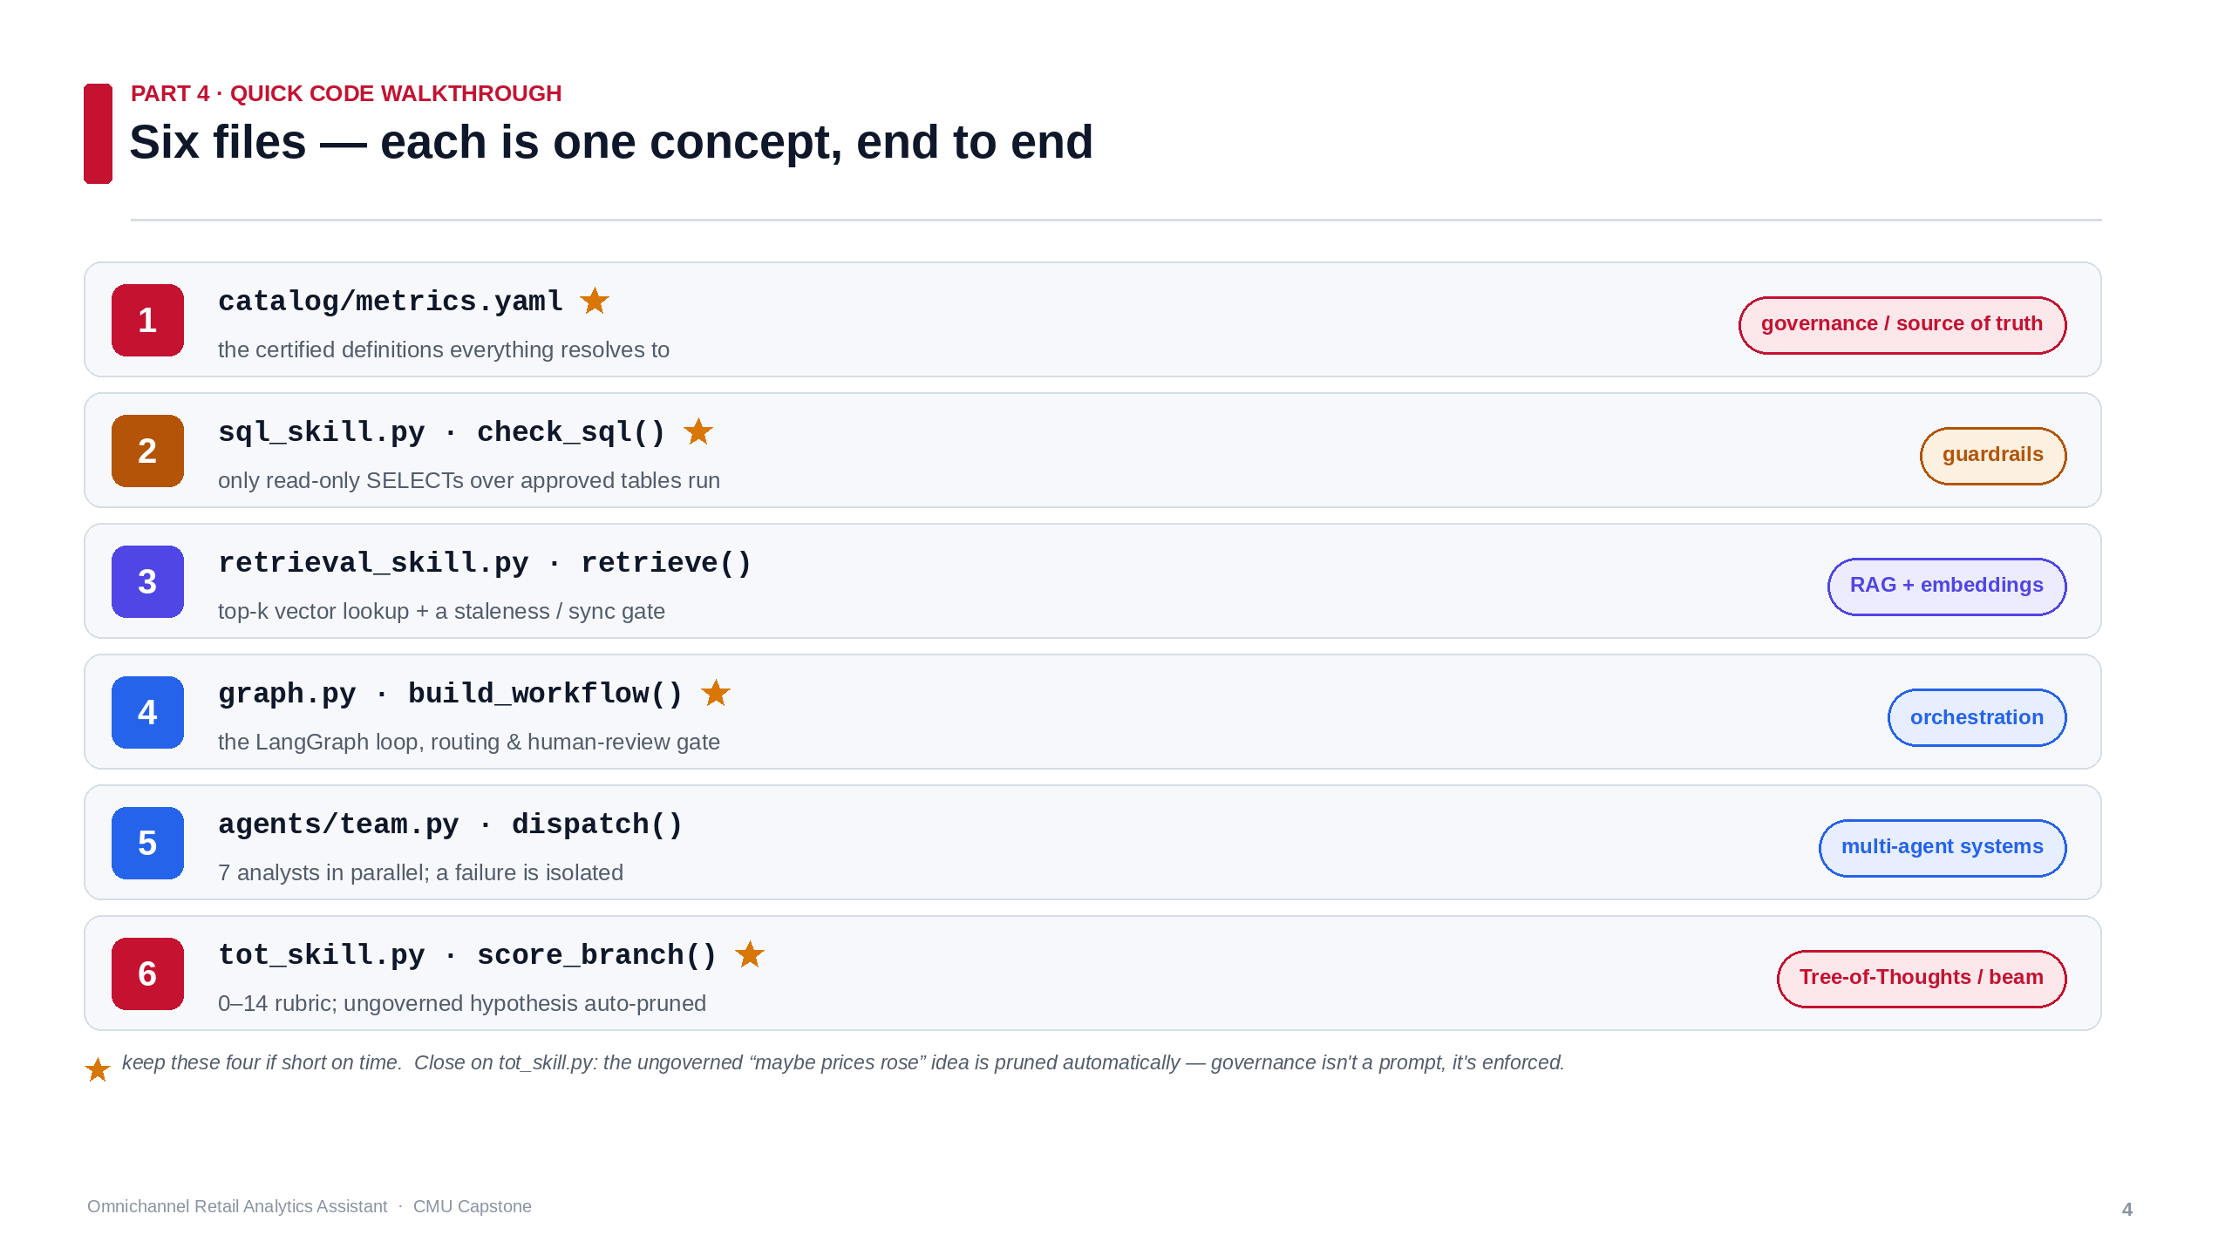
Notes:
5:00–7:30 (~2.5 min). Switch to VS Code with these SIX files PRE-OPENED as tabs. Open in order; ONE sentence each. Goal: show you understand the concepts, not read code. End on ungoverned_branch() being auto-pruned. Short on time → the four starred files. Bump editor font so it's readable on video.

Slide 5
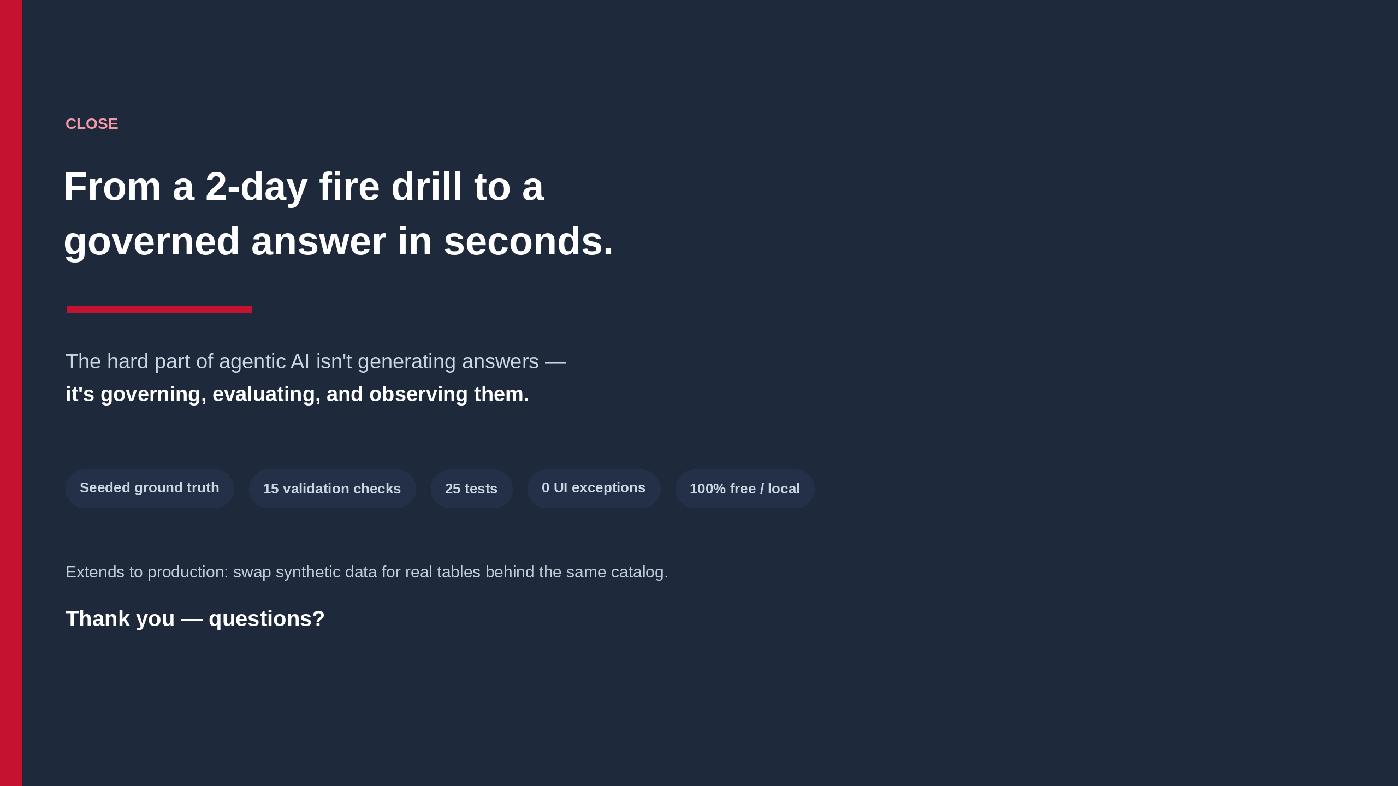
Notes:
7:30–8:00. Tie back to fast AND trustworthy. Deliver the one-sentence lesson slowly. Sweep the proof chips in one breath. One line on the production path, thank them, open Q&A.

