Slide 1


The journey to making 1-Dimensional Digital Signal Processing FAST!
4/28/2023
Author: Jeffrey Allen
Instructor: Dr. Michael Wise

Slide 2
Agenda
Introduction to Digital Signal Processing (DSP)
Convolution in 1-Dimensional Digital Signal Processing
GPU Computing Overview
Parallelization of Convolution on GPUs
Code Execution
Performance Considerations

Slide 3
First Thing: The Simple Overview
I’m going to explain the journey of creating a CUDA C++ interface that takes in an array of data, and based on the size of that data will make a decision about how to most efficiently process it

Slide 4
Introduction to Digital Signal Processing (DSP)
The world is is filled with signals (discrete-time sequences)
Images from remote space probes
Voltages generated by the heart/brain
Radar and sonar echoes
Seismic vibrations
Audio/Acoustics measurement
DSP is the science of using computers to understand these types of data. General goals can be:
Speech recognition
Filtering
Image enhancement
Neural networks
Data compression
Relies on mathematical techniques to process all this information
Notes:
Addresses #1: The theory behind the algorithms you implemented with sufficient detail so that someone who's never seen the topic before could be prepared to understand the basics of the codebase

Slide 5
Introduction to DSP (cont.)
A digital signal is a sequence of numerical values representing a continuous-time signal that has been sampled at discrete intervals (sampled and quantized)
Once in digital form, the signal can be easily processed and manipulated using digital circuits and algorithms
1
Notes:
Addresses #1: The theory behind the algorithms you implemented with sufficient detail so that someone who's never seen the topic before could be prepared to understand the basics of the codebase

Slide 6
Introduction to DSP (cont.)
DSP in Real-World Applications
Audio processing: noise reduction, equalization, and compression
Image processing: enhancement, filtering, and edge detection
Communications: channel equalization, error correction, and signal modulation/demodulation
Control systems: feedback control, adaptive filtering, and system identification
1

Slide 7
2. Convolution in 1-Dimensional DSP
Convolution is a fundamental operation in DSP
Involves combining an input signal with a filter (also known as an impulse response) to produce a modified output signal
Example 1: Edge detection for images
Example 2: Low pass filter for audio
Mathematically, convolution can be expressed as:
y[n] = Σ (x[k] * h[n - k])
where y[n] is the output signal, x[k] is the input signal, h[n] is the impulse response, and the summation runs over all possible values of k (* is the notation for convolving, not multiplication)

Slide 8
Convolution in 1-Dimensional DSP (cont.)
Convolution is a mathematical operation that combines two signals to create a third, modified signal
It is used to apply a filter to an input signal, which can be thought of as "smearing" or "blurring" one signal with another
In the context of DSP, the input signal might be an audio recording, and the filter could be designed to enhance or suppress specific frequencies
2

Slide 9
Convolution in 1-Dimensional DSP (cont.)
The impulse response (h[n]) is a representation of the filter's behavior
It describes how the filter responds to an impulse (a signal consisting of a single non-zero value followed by zeros)
By convolving the input signal with the impulse response, we apply the filter's behavior to the input signal, generating a modified output signal
2
Notes:
Addresses #1: The theory behind the algorithms you implemented with sufficient detail so that someone who's never seen the topic before could be prepared to understand the basics of the codebase

Slide 10
Convolution in 1-Dimensional DSP (cont.)
The convolution operation can be expressed as a summation:
y[n] = Σ(x[k] * h[n - k])
For each output sample (y[n]), we calculate the sum of the products of the input signal samples (x[k]) and the corresponding impulse response samples (h[n - k]).
The summation runs over all possible values of k, typically from negative infinity to positive infinity. However, in practice, the range of k is limited by the non-zero duration of the input signal and impulse response.
2
Notes:
Addresses #1: The theory behind the algorithms you implemented with sufficient detail so that someone who's never seen the topic before could be prepared to understand the basics of the codebase

Slide 11
Convolution in 1-Dimensional DSP (cont.)
Quick Example
Suppose we have
an input signal x[n] = {1, 2, 3}
an impulse response h[n] = {2, 1}
To compute the convolution, we follow these steps
Flip the impulse response: h_flipped[n] = {1, 2}.
Shift the flipped impulse response by n: h_shifted[n] = {1, 2} for n=0; h_shifted[n] = {0, 1, 2} for n=1; and so on.
Multiply and sum the corresponding samples
y[0] = (1*1) + (2*0) = 1;
y[1] = (1*2) + (2*1) = 4;
y[2] = (1*3) + (2*2) = 7;
y[3] = (2*3) = 6;
The output signal (convolution result) is y[n] = {1, 4, 7, 6}.
2

Slide 12
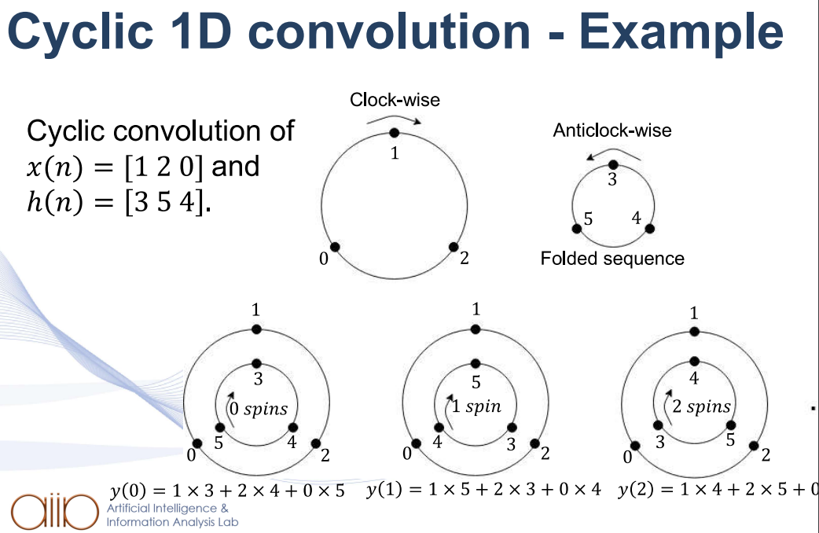
Convolution in 1-Dimensional DSP (cont.)
Quick Example
Thank you P. Giannakeris, P. Bassia, N. Kilis, R.T. Chadoulis Prof. Ioannis Pitas Aristotle University of Thessaloniki pitas@csd.auth.gr www.aiia.csd.auth.gr for the amazing visualization
2

Slide 13
Convolution in 1-Dimensional DSP (cont.)
Reference Implementation
To begin this project, I created a 1D Convolution reference implementation in python, leveraging the Numpy library
Why it can be trusted
I have done the convolution process by hand hundreds of times
I have read peer reviewed literature on how others do the process
I have translated the convolution algorithm in the BASIC programming language to python from The Engineering Guide to DSP
Testing process
“Gold standard” data was setup in the beginning of the project
The output of each convolution run is compared to the gold standard and compares to within 1/100th accuracy
Further development was conducted with APOD Cycle
Assess the issue
Parallelize the portions I could
Optimize parallelization
Deploy it to production codebase
2
Notes:
Addresses #3: A detailed explanation of your reference implementation, how you developed it, and why it can be trusted as accurate, Addresses #4: A detailed explanation of your reference implementation, how you developed it, and why it can be trusted as accurate, Addresses #4: A detailed description of your comparison testing structure, justifying how your tests maintained accuracy at each stage of your development process

Slide 14
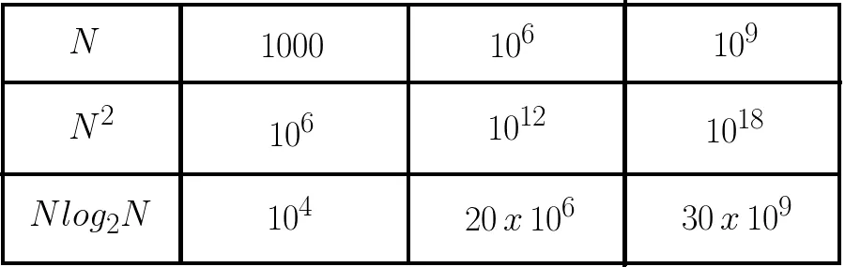
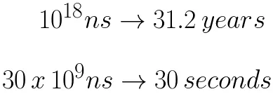
Convolution in 1-Dimensional DSP (cont.)
There is a mathematical trick though which speeds up the convolution process by great orders of magnitude…
Fast Fourier Transforms
Essentially, we convert the time-based values to the frequency spectrum where it is trivial to multiply each array element-wise, greatly improving the efficiency of obtaining the desired results. The runtime of time-based convolution is O(n²) while using a DFT is O(n log n)
2
Notes:
Addresses #1: The theory behind the algorithms you implemented with sufficient detail so that someone who's never seen the topic before could be prepared to understand the basics of the codebase

Slide 15
Convolution in 1-Dimensional DSP (cont.)
How it works
Basic 1D time convolution involves directly applying the convolution sum formula in the time domain
For each output sample, the input signal and impulse response are multiplied element-wise, and the products are summed to obtain the convolution result
Basic time convolution has a higher computational complexity than FFT convolution, with a complexity of O(n*m), where n is the length of the input signal, and m is the length of the impulse response
Time convolution does not require any additional overhead, such as the FFT and IFFT operations, making it more suitable for small input signals and impulse responses
2
Notes:
Addresses #1: The theory behind the algorithms you implemented with sufficient detail so that someone who's never seen the topic before could be prepared to understand the basics of the codebase

Slide 16
Convolution in 1-Dimensional DSP (cont.)
FFT and how it works
FFT convolution is based on the Convolution Theorem, which states that convolution in the time domain is equivalent to multiplication in the frequency domain
Both the input signal and the filter are transformed into the frequency domain using the Fast Fourier Transform. Then, the two frequency-domain signals are multiplied element-wise, and the Inverse Fast Fourier Transform (IFFT) is applied to the product to obtain the convolution result in the time domain
FFT convolution has a lower computational complexity than basic time convolution for large input signals and impulse responses
The downside for smaller input is FFT convolution introduces some overhead due to the forward and inverse FFT operations
2
Notes:
Addresses #1: The theory behind the algorithms you implemented with sufficient detail so that someone who's never seen the topic before could be prepared to understand the basics of the codebase

Slide 17
Convolution in 1-Dimensional DSP (cont.)
Ultimate motivation: Take the best parts of both worlds
Build a processor that produces an accurate result based on the size of the input
If the input is smaller, <= 500 elements, use time based, everything greater, use FFT based convolution
2
Notes:
Addresses #1: The theory behind the algorithms you implemented with sufficient detail so that someone who's never seen the topic before could be prepared to understand the basics of the codebase

Slide 18
3. GPU Computing Overview
GPUs are well-suited for parallel tasks, such as DSP operations
NVIDIA's CUDA is a popular platform for general-purpose GPU computing
CUDA allows developers to write C/C++ code that runs on NVIDIA GPUs
GPUs consist of thousands of small cores that can handle many threads simultaneously

Slide 19
GPU Computing Overview
GPUs (Graphics Processing Units) were initially designed for rendering graphics, but they have evolved to support general-purpose computing
They feature a highly parallel architecture, with many small cores that can execute instructions concurrently
This parallelism makes GPUs well-suited for tasks that can be broken down into smaller, independent sub-tasks, such as DSP operations
3

Slide 20
GPU Computing Overview
CUDA (Compute Unified Device Architecture) is a parallel computing platform and programming model developed by NVIDIA
It allows developers to leverage NVIDIA GPUs for general-purpose computing tasks
CUDA provides a C/C++ API, enabling developers to write GPU-accelerated code with familiar programming languages
3

Slide 21
GPU Computing Overview
CUDA code is organized into functions called "kernels," which are executed by multiple threads in parallel on the GPU
Threads are grouped into blocks, and blocks are organized into a grid
The programmer specifies the number of threads per block and the number of blocks in the grid
Each thread has a unique ID within its block, and each block has a unique ID within the grid
3

Slide 22
GPU Computing Overview
GPUs have a hierarchical memory structure
Global memory accessible by all threads and has the highest capacity but the slowest access time
Shared memory shared by all threads in a block, allowing for efficient data exchange between threads. It has lower capacity than global memory but faster access time
Local memory private to each thread and used for local variables or temporary data storage
Constant and texture memory read-only memory optimized for specific access patterns
3

Slide 23
4. Parallelization of Convolution on GPUs
Convolution can be parallelized by dividing the the work needed to be done to convolve the signals
Each thread on the GPU computes the convolution for a subset of the output signal
Threads access shared memory to read input signal and filter coefficients
Results are written back to memory after all threads complete their tasks

Slide 24
Parallelization of Convolution on GPUs
GPUs excel at parallel tasks, while CPUs (Central Processing Units) are better suited for serial tasks
GPUs have more cores and can execute more threads simultaneously than CPUs, enabling them to process large amounts of data in parallel
CPUs have fewer cores but feature more complex control logic and larger caches, making them better suited for tasks that require sophisticated branching and decision-making
4

Slide 25
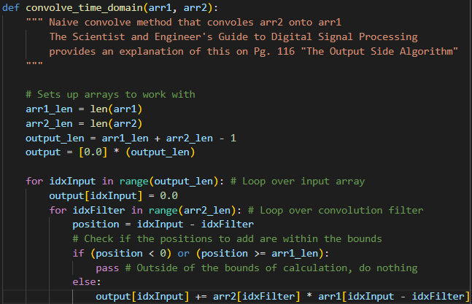
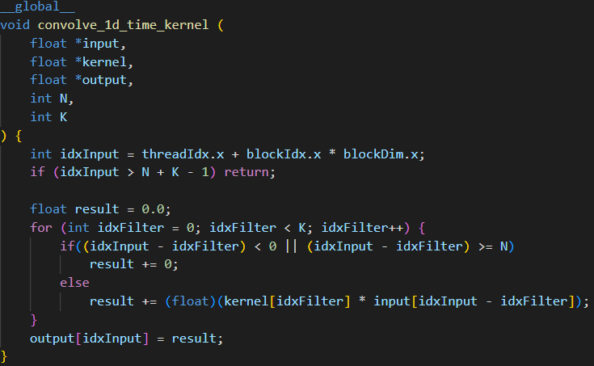
Parallelization of Convolution on GPUs
Naive GPU Implementation
4

Slide 26
Parallelization of Convolution on GPUs
Naive GPU Implementation
Python CPU Method
Read the input elements in it's neighbourhood
Read the convolutional filter
Perform the convolution computation
Write the result of the computation to it's index in the output array
CUDA GPU Method
Same as above, but exploiting the fact each element in the output array can be computed independently
Have one thread per output index which is responsible for its computation
4

Slide 27
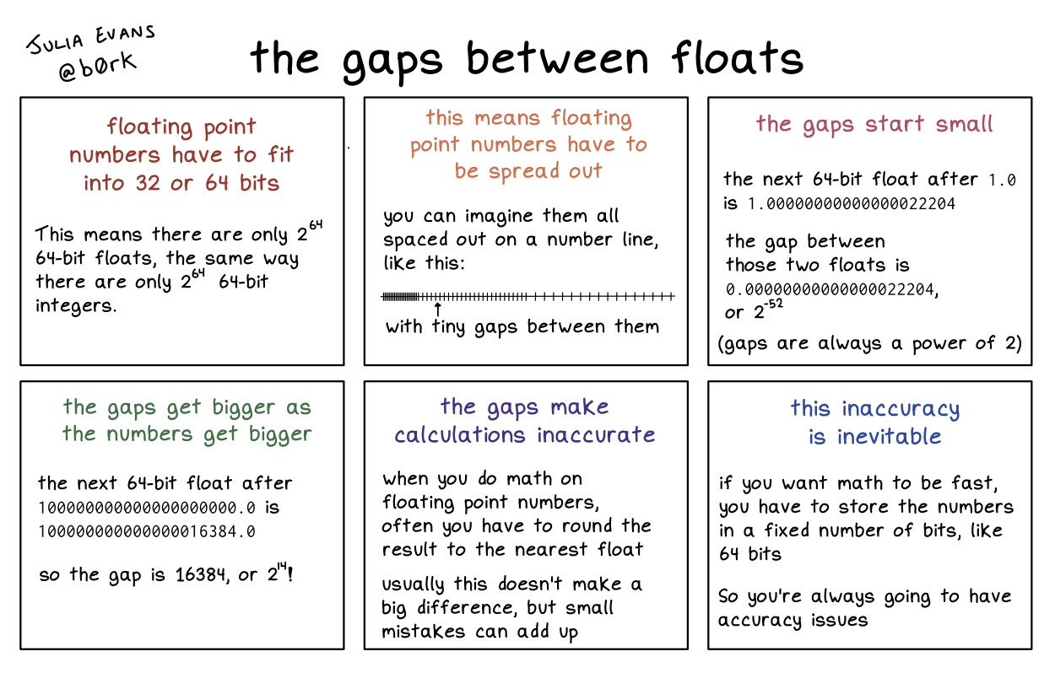
Parallelization of Convolution on GPUs
Testing
I’ve written a result_checker.py which reads in files and compares outputs element-wise
The main portion of the checker leverages the Numpy allclose() method
The method returns True if two arrays are element-wise equal within a tolerance
There needs to be room for tolerance when dealing with floating point values because →
4

Slide 28
Parallelization of Convolution on GPUs
Optimization Opportunity
In the naive implementation, there are two calls to global memory which is not as efficient as it could be
The filter doesn’t change during runtime, so we have the opportunity to put that into constant memory (beware though, constant memory is typically small, 64KB, so it only holds ~8192 float2 elements)

Slide 29
5. Code Execution with DFT
Let’s compare!
Convolving a signal consisting of 8,192 elements with a filter of 8,912 elements
5

Slide 30
5. Code Execution
Versus
5

Slide 31
6. Performance Considerations
Thread organization (number of threads per block, number of blocks)
Efficient use of shared memory
Minimizing global memory access latency
Coalescing memory accesses

Slide 32
Performance Considerations
Choosing the right thread organization is crucial for optimizing performance
The number of threads per block should be a multiple of the warp size (typically 32) to ensure full utilization of GPU cores
The number of blocks should be large enough to utilize all available streaming multiprocessors (SMs) on the GPU
Experimenting with different thread organizations can help find the optimal configuration for a specific problem
6

Slide 33
Performance Considerations
NVIDIA generates whitepapers and blogs with all the information needed for a developer to maximize performance. Some examples include:
https://developer.nvidia.com/blog/nvidia-ampere-architecture-in-depth/
https://images.nvidia.com/aem-dam/en-zz/Solutions/data-center/nvidia-ampere-architecture-whitepaper.pdf
6

Slide 34
Performance Considerations
Shared memory is faster than global memory but has limited capacity
Allocating too much shared memory per block can reduce the number of concurrent blocks that can be executed on an SM, leading to underutilization
Organizing data in shared memory to minimize bank conflicts (simultaneous access to the same memory bank) can improve performance
Using shared memory efficiently is key to achieving high performance in GPU-accelerated applications
6

Slide 35
Performance Considerations
Global memory access is slow compared to shared memory and register access
Minimizing the number of global memory accesses by using shared memory, registers, or local memory can improve performance
When accessing global memory, try to read or write contiguous memory locations to take advantage of the GPU's memory coalescing capabilities
6

Slide 36
Performance Considerations
Coalesced memory accesses occur when threads within a warp access contiguous memory locations
Coalesced accesses can be combined into a single transaction, reducing memory access latency and improving performance
To maximize coalescing, organize data structures and memory access patterns so that threads within a warp access consecutive memory addresses
6

Slide 37
Performance Considerations
When parallelizing convolution, boundary conditions must be considered to ensure accurate results.
For example, when a thread calculates convolution at the edges of the input signal, it might need to access data outside its assigned segment.
In these cases, data can be padded or handled with customized strategies, such as zero-padding, boundary extension, or periodic boundary conditions.
Properly handling boundary conditions is essential for correct convolution results and optimal performance.
6

Slide 38
Conclusion
1-Dimensional Digital Signal Processing is crucial in many applications
Convolution is a key operation in DSP
GPU computing with CUDA can accelerate DSP tasks, including convolution
Proper optimization techniques are essential for efficient GPU performance
Next steps
Include option for increasing batch size
Implement callbacks

Slide 39
Q&A

Slide 40
References
NVIDIA documentation
The Scientist and Engineer’s Guide to Digital Signal Processing
Programming Massively Parallel Processors
Fast 1D Convolution Algorithms from Aristotle University of Thessaloniki
WolfSound
Python Numpy and Matlab Documentation
3Blue1Brown
Julia Evans

