Slide 1
Background
Computer System Architectures
Computer System Software

Slide 2

Computer System Architectures
Centralized (Tightly Coupled)
Distributed (Loosely Coupled)

Slide 3


Centralized v Distributed
Centralized systems consist of a
single computer
  Possibly multiple processors
  Shared memory
A distributed system consists of multiple independent computers that “appear to its user as a single coherent system” Tanenbaum, p. 2
  Defer discussion of distributed systems

Slide 4
Centralized Architectures with Multiple Processors
(Tightly Coupled)
All processors share same physical memory.
Processes (or threads) running on separate processors can communicate and synchronize by reading and writing variables in the shared memory.
SMP: shared memory multiprocessor/ symmetric multiprocessor

Slide 5
Symmetric Multiprocessor (SMP)
A stand-alone computer system with the following characteristics:
  two or more similar processors of comparable capability
  processors share the same main memory and are interconnected by a bus or other internal connection scheme
  processors share access to I/O devices
  all processors can perform the same functions
  the system is controlled by an integrated operating system that supports interaction between processors and their programs

Slide 6
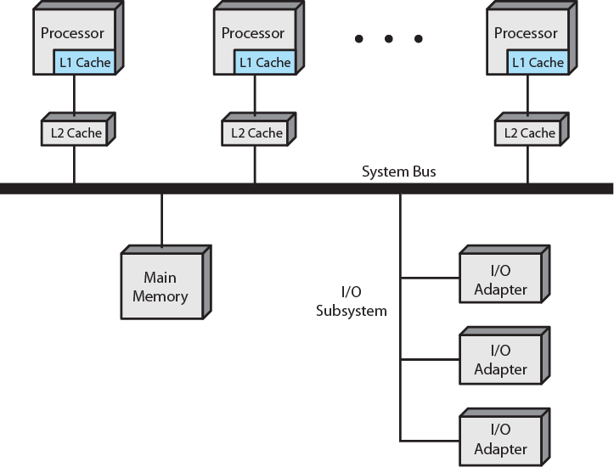
Organization of a Symmetric Multiprocessor
Operating Systems, Internals and Design Principles – William Stallings

Slide 7
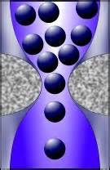
Drawbacks
Scalability based on adding
processors.
Memory and interconnection network become bottlenecks.
Caching improves access times (latency) up to a point but introduces consistency problems.
Shared memory multiprocessors are not practical if large numbers of processors are desired.

Slide 8
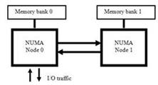
UMA: Uniform Memory Access
One physical address space
All processors can directly access any address in the same amount of time.
Symmetric Multiprocessors are examples of UMA machines.
NUMA: Non-Uniform Memory Access
One physical address space
Each memory module is attached to a specific CPU (or small set of CPUs) = node
All processors can directly access any memory location, but each can access its own local memory faster.(than non local)
NUMA machines help address the scalability issues of SMPs
Compare to organization of SMP.

Slide 9
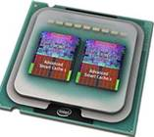
Multicore Computers
Similar to SMP in that all processors share a single memory, but …
Multicore combine two or more complete processors (cores) on a single piece of silicon (die)
Faster, require less power than SMP with processors on separate chips.
In December, 2009 Intel introduced a 48-core processor which it calls a "single-chip cloud computer" (SCC)
http://www.dailytech.com/article.aspx?newsid=16951

Slide 10
Computer System Software
Operating Systems
Middleware

Slide 11
System Software
The operating system itself
Compilers, interpreters, language run-time systems, various utilities
Middleware (Distributed Systems)
  Runs on top of the OS
  Connects applications running on separate machines
  Communication packages, web services, …

Slide 12

Operating Systems
General purpose operating systems
Real time operating systems
Embedded systems

Slide 13
General Purpose Operating Systems
Manage a diverse set of applications with varying and unpredictable requirements
Implement resource-sharing policies for CPU time, memory, disk storage, and other system resources
Provide high-level abstractions of system resources; e.g., virtual memory, files

Slide 14
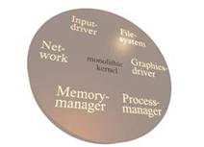
Kernel
The part of the OS that is always in memory
Monolithic kernels versus microkernels
  Monolithic: virtually all OS code is in a single program, which is the kernel.
  Microkernels: kernel contains minimal functionality; other functions are provided by server processes executing in user space
Hybrid kernels: a mixture of the two approaches

Slide 15
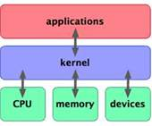
Kernel Architectures
Traditional: UNIX/Linux, Windows, Mac …
  Typically monolithic
Non-traditional:
  Pure microkernels
  Extensible operating systems
  Virtual machine monitors
Non-traditional kernel architectures experiment with various approaches to improving the performance of traditional systems.

Slide 16
Computer Architecture & the OS
Multiple processor/shared memory systems increase OS complexity
  Master-slave operating systems
  SMP operating systems
Distributed systems run a local OS on each individual processor and various kinds of middleware to support distributed applications

Slide 17
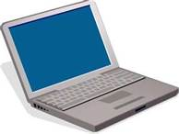
Effect of Architecture on OS
SMP
Multicore
Distributed system

Slide 18
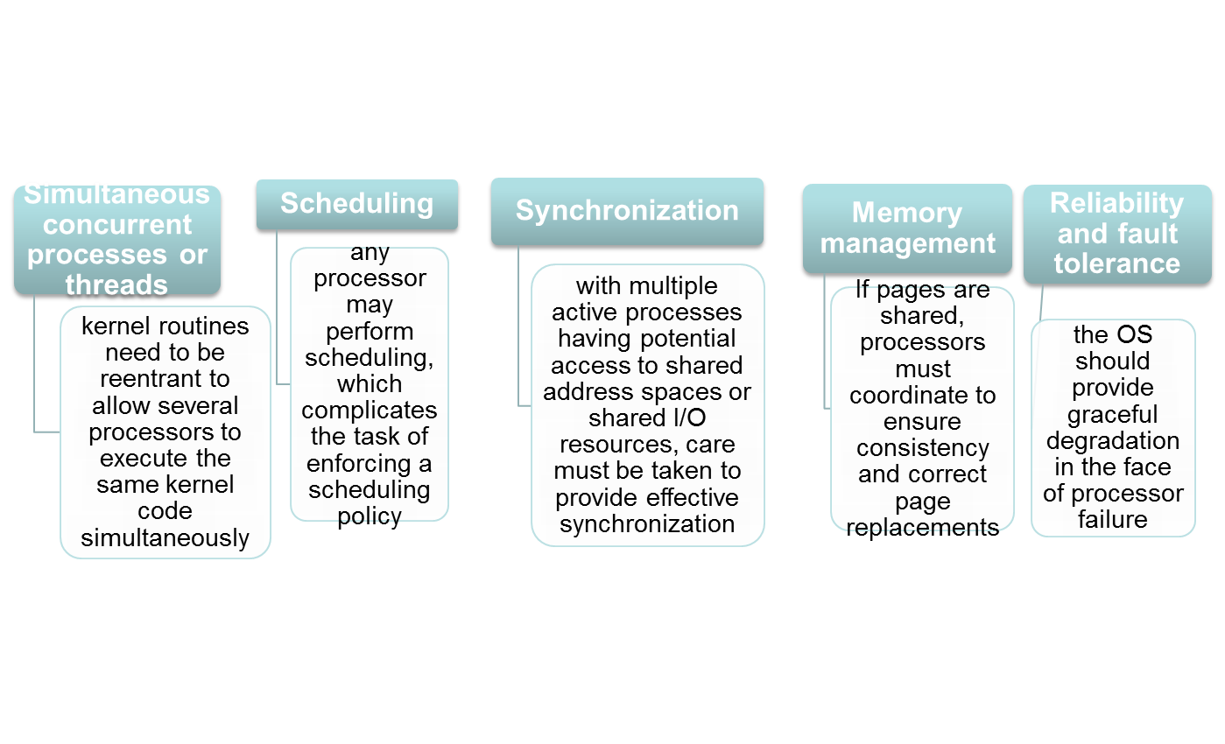
Symmetric Multiprocessor OS
A multiprocessor OS must provide all the functionality of a multiprogramming system for multiple processors, not just one.
Key design issues: (not all are unique to multiprocessors)

Slide 19
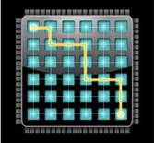
Multicore Issues
Multicore issues echo those of SMP
A high degree of parallelism will be available even in small devices.
To use effectively consider various kinds of parallelism
  Instruction level parallelism
  Support for multiprogramming on each core (?)
  Users must be able to parallelize programs (multithreading) & OS must be able to schedule related threads in an intelligent manner.

Slide 20
Amdahl’s Law
Speedup = time to run on 1 processor
time on N parallel processors
= 1
(1-f) + f / N
where f is the amount of code that can
be parallelized, with no overhead
Not all code benefits from parallelization but certain categories of applications; e.g., games, database apps, JVM (it’s multithreaded); can take advantage of multiple processors.

Slide 21

Distributed Systems
Distributed systems don’t have shared memory; communication is via messages.
A distributed operating system (if one existed) would manage all computers in the network as if they were individual processors in a SMP
  i.e., user would be able to run parallelized programs without significant modification
There’s no general purpose distributed OS – instead, middleware supports various distributed applications.

Slide 22
Sources for Next Lecture
http://zoo.cs.yale.edu/classes/cs422/2010/bib/liedtke95micro.pdf
“On Micro-kernel Construction” Jochen Liedtke, Proc. 15th ACM Symposium on Operating System Principles (SOSP), December 1995
https://pdos.csail.mit.edu/6.828/2008/readings/engler95exokernel.pdf
”Exokernel: An Operating System Architecture for Application-Level Resource Management” by Dawson R. Engler, M. Frans Kaashoek, and James O’Toole jr; Proceedings of the 15th ACM Symposium on Operating Systems Principles (SOSP ’95), Copper Mountain Resort, Colorado, December 1995, pages 251-266.
http://www.cs.columbia.edu/~nieh/teaching/e6118_s00/papers/p267-bershad.pdf
“Extensibility, Safety and Performance in the Spin Operating System”, by Brian N. Bershad, Stefan Savage, Przemyslaw Pardyak, Emin Gun Sirer, Mar E. Fiuczynski, David Becker, Craig Chambers, Susan Eggers, Proceedings of the 15th ACM Symposium on Operating Systems Principles (SOSP ’95), Copper Mountain Resort, Colorado, December 1995, pages 267-284.

