Slide 1
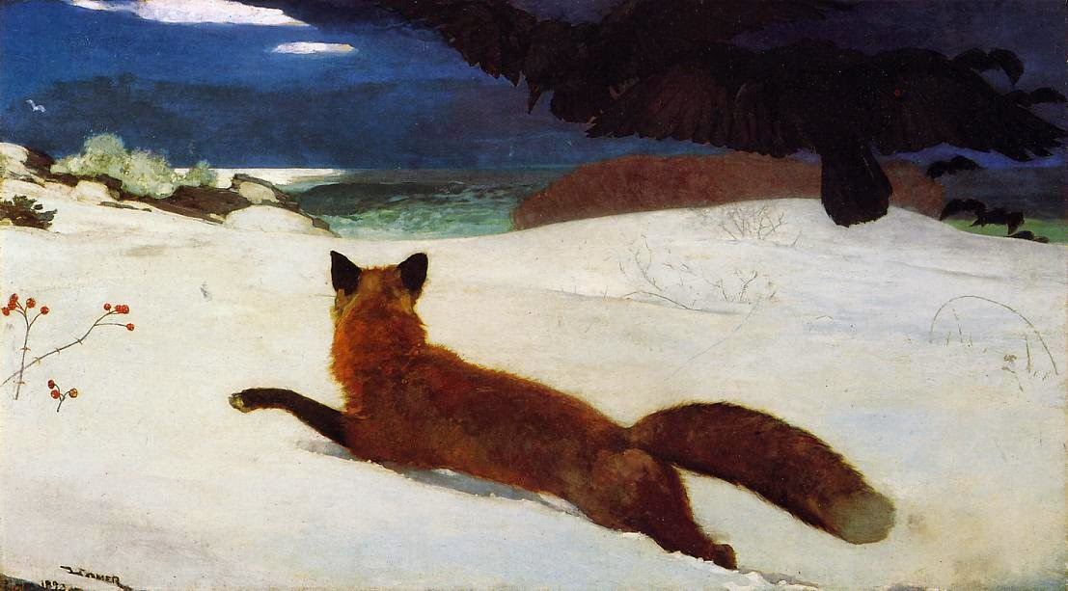
FOX path …
… navigation of physical,
virtual and literal file systems
Hans-Jürgen Rennau, Traveltainment GmbH
Presented at xmlprague 2017, February 11, 2016
Notes:
The primary purpose of XPath is to navigate through the contents of XML documents, finding elements and attributes of interest. FOXpath is an extended version of XPath, supporting a navigation of the file system which looks and feels like the navigation of XML data. Today I will talk about a generalization of FOXpath, adding support for logical file systems like archives, repositories or databases.

Slide 2
Trees! Trees! Trees!
Tree-structured information is ubiquitous.
Resource contents
(XML, HTML, JSON, CSV, .properties, ...)
Resource systems
(file systems, .jar, .zip, SVN, ...)
Notes:
Tree-structured information is ubiquitous. Tree structure organizes the contents of many resources (XML, HTML, JSON, …) as well as the contents of many resource systems (file systems, archives, version control repositories, …). How do we use these trees, how do we find in them what we need?

Slide 3
XPath!
Expression language
Powerful, readable, elegant ...
File content navigation (XML, JSON, ...)
//route/arrival[airport = 'JFK']
/../departure[@t > '18:00']/airport
Notes:
Dealing with XML documents, we have XPath, an expression language for navigating content trees. An example demonstrates the power and elegance of XPath. We get the airports of all evening flights to New York City. Remember that XPath is not restricted to XML documents. Many data formats can be parsed into node trees – e.g. HTML, JSON and CSV, which are accessible to XPath.

Slide 4
FOXpath!
Expression language
Powerful, readable, elegant ...
File system navigation
File content navigation (XML, JSON, ...)
/projects/air
//route*.xml[not(ancestor~::blacklisted)]
\\route\arrival[airport = 'JFK']
\..\departure[@t > '18:00']\airport
https://github.com/hrennau/foxpath
Notes:
But how about the file system? No expression language, only APIs! This situation motivated me to create FOXpath, an expression language enabling XPath-like navigation of the file system. An example demonstrates the similarity. But FOXpath also supports navigation of node trees, and the seamless combination of both kinds of navigation. The extended example first traverses the file system, then drills down into the documents found. Note that the path operator of XPath is represented by a backslash; the slash is used for the new URI path operator.

Slide 5
FOXpath = superset( XPath 3.0 )
XPath 3.0 + URI navigation + Etc
URI navigation ::=
URI axis step UriAxis~::Name[Expr]
URI path operator Expr1 / Expr2
Etc
Semantic extensions (values instead of errors)
Global and external variables
Namespace declarations
Simple FLWOR (any mixture of let and for)
Notes:
FOXpath is a superset of XPath 3.0 which supports file system navigation. It adds a new expression kind, the URI axis step consisting of a URI axis, a URI name test and optional predicates. And it adds the URI path operator, which combines URI navigation steps into a URI navigation path. Semantic extensions ensure seamless integration of file system and node tree navigation. These extensions define a successful evaluation in particular cases where XPath semantics raise an error. Besides, FOXpath borrows a few extensions from XQuery: support for global and external variables, namespace declarations and a simple FLWOR expression consisting of multiple for and/or let clauses.

Slide 6
FOXpath examples
/github/oxygenxml/userguide//*.dita => count()
1984
/github/oxygenxml/userguide
//*.dita[not(ancestor~::not_used)] => count()
1746
/github/oxygenxml/userguide
//*.dita[not(ancestor~::not_used)]
\*\local-name() => frequencies(15)
concept (53)
glossentry (9)
task (160)
topic (1524)
Notes:
To get a feeling for FOXpath, let‘s look at a few examples.

Slide 7
FOXpath examples
let $names :=
/github/oxygenxml/userguide
//*.dita[not(ancestor~::not_used)]
/file-name(.)
let $refNames :=
/github/oxygenxml/userguide
//(*.dita, *.ditamap)
\\@href\replace(., '.*/|#.*', '')
return
count($names except $refNames)
43
Notes:
Yet another example.

Slide 8
Generalization: challenge
Physical FS navigation (2016)
Logical FS navigation (2017)
„To build a conceptual framework relating the
abstract URI navigation defined by the FOXpath
language to an implementation-defined set of
logical file system types.“
Notes:
FOXpath adds to XPath file system navigation, but it is not really aware of the file system: it just deals with URIs and their relationships, relationships as they are found in physical file systems as well as in virtual file systems like archives, SVN repositories or github projects. Can FOXpath support navigation of such virtual file systems, too? We need a conceptual framework relating the abstract URI navigation defined by the FOXpath language to an implementation-defined set of actual logical file system types.

Slide 9
Generalization: key concepts
Logical file system
URI relationships
URI operations
URI dispatchal
Notes:
A good starting point is a generalized concept of file systems – a logical file system. It‘s based on URI relationships, which deserve to be treated as a concept in its own right. From a practical point of view, the key abstractions are URI operations and URI dispatchal. URI operations are building blocks of functionality from which navigation can be constructed. These building blocks are generic, and URI dispatchal connects them to specific implementations.

Slide 10
Logical file system
Physical file systems (OS-defined)
Virtual file systems
Archives (zip, jar, ...)
Document databases (BaseX, ...)
Version control repositories (SVN, ...)
Github project repository (https://github.com)
Literal file systems
UTREE
UGRAPH
Notes:
Loosely speaking, a logical file system is a tree of URIs, whose leaf URIs can be resolved to a chunk of content (sequence of characters or bytes) and whose inner URIs cannot be resolved to content, but are perceived as container of other URIs. The generalized notions of files and folders are thus the outer and inner nodes of such a tree of URIs. Real systems matching this model are physical file systems, as well as virtual file systems like archives, SVN repositories or github projects. Later I will introduce a third type of logical file system which represents each folder and file by a distinct unit of information. Due to this direct correspondence between resource and resource description, I use the term literal file systems.

Slide 11
URI relationships
URI: foo://a/b/c
Child URI: foo://a/b/c/d
Parent URI: foo://a/b
URI tree
(collection of path-structured URIs
with common prefix) URI axes
(child, descendant, parent, ancestor, self, ...)
URI
relationships
a
..b
....c
......d
..u
....v
....w
..m
....n
......p
......q
......r
Notes:
But what‘s a tree of URIs? A tree is based on two relationships – child and parent. Assuming path-structured URIs, a child URI is a URI obtained by appending one further step, and a parent URI is the URI obtained by removing the final step. These trivial relationships suffice to define the concept of a URI tree: a collection of path-structured URIs with a common prefix. They also imply the existence of URI axes: child, descendant, parent, ancestor, self etc.

Slide 12
URI operations
Impl(navigation) constructed from building blocks:
Traversal URI => URI*
Inspection URI => resource properties
Retrieval URI => file content
abstraction
URI operations
Navigation =
complex functionality
composed of URI operations
Notes:
What do we expect from a URI tree navigator? Traversal, inspection of basic resource properties (like size) and resource content retrieval. The complete functionality can be decomposed into small building blocks all of which amount to mapping a given URI to some piece of information. Such mappings I call URI operations.

Slide 13
URI operations and URI processor
file contents
navigation primitives
file-text
file-binary
file-doc
file-json-doc
child-uris
descendant-uris
URI
resource properties
kind
name
size
date
Notes:
This slide summarizes the URI operations. First, we have navigation primitives, mapping a URI to its child URIs and to its descendant URIs, respectively. Then we have operations mapping a URI to file content, either unstructured content (sequence of characters or bytes), or structured content represented by a node tree. Finally, we have operations mapping the URI to resource properties like kind (file or folder), name, file size and date of last modification. For each supported type of file system, there is a specific set of implementations. Such a set I call a URI processor.

Slide 14
URI navigation – backing APIs
File system type | Backing APIs
Physical file system | XQuery module: file (EXPath)
Archives | XQuery module: file (EXPath) XQuery module: archive (BaseX)
SVN | SVN Command Line Interface XQuery module: proc (BaseX)
Github projects | Github REST API XQuery module: http (EXPath) XQuery module: convert (BaseX)
BaseX databases | XQuery module: db (BaseX)
Notes:
A URI processor depends on backing APIs. This slide gives you an impression of the more important backing APIs and their usage in dependence of the file system type at hand.

Slide 15
URI operations = layer of abstraction
/a//b/c*/d
/foo.zip/#archive#/a//b/c*/d
https://github.com/myorg/myproj/a//b/c*/d
Invocation:
uri: /a//b
name: c*
kind: ()
Invocation:
uri: /a//b
name: c*
kind: ()
Invocation:
uri: /a//b
name: c*
kind: ()
child-uris($uri, $name, $kind)
child-uris
child-uris
child-uris
Notes:
URI operations provide functional building blocks from which to compose complex behaviour. At the same time they provide a layer of abstraction, which hides the specific nature of a logical file system. The slide shows three FOXpath expressions traversing different types of file systems: the physical file system, a zip archive and a github project. The expressions happen to use the same step, a URI axis step using the child axis and the name test c*. Generic code translates the navigation step into the invocation of a generic URI operation. This operation delegates the actual processing to an implementation selected according to the file system type at hand, which is recognized by inspecting the input URI.

Slide 16
Think of URI operations as a generic interface
exposed by a logical file system of any type.
URI dispatchal binds the generic interface to
a specific implementation.

Slide 17
URI dispatchal
dispatchal rules
URI
URI domain
URI processor rr
implementation(URI operations)
Notes:
URI dispatchal is based on dispatchal rules. They map the URI to a URI domain, which identifies the file system type and, by implication, the URI processor to be used.

Slide 18
URI dispatchal rules
URI matches ... | URI domain
.../#archive#/... | ARCHIVE
(one of a set of configured URI prefixes) | UGRAPH
(one of a set of configured URI prefixes) | UTREE
basex://... | BASEX
svn-... | SVN
https://github.com/... | GITHUB
file://... | FILE
/... | FILE
* | NONE
Notes:
Dispatchal rules are checked in order, and the first matching rule identifies the URI domain. If, for example, the URI contains a step /#archive#/, the URI domain is ARCHIVE, and the URI processor responsible for dealing with archive contents is invoked.

Slide 19
Examples: navigation of virtual file systems
/downloads/userguide.zip/#archive#
//*.jar/#archive#
//*.xsl
\\@match => distinct-values() => sort()
*:emph
*:title
*|text()|@*
sch:pattern[@abstract='true']
sch:schema
text()
svn-https://svn.apache.org/repos/asf/xalan
/java/trunk//*.xsl
\*\@version => frequencies(10)
1.0 (53)
Notes:
A couple of examples demonstrates the navigation of virtual file systems – here, archives and SVN repositories.

Slide 20

Literal file systems
Collection of resources described by a collection of resource descriptors
UTREE description = XML document
UGRAPH description = RDF graph
Resource
descriptors
Resources
Notes:
An interesting extension of our notion of file systems consists in literal file systems. A literal file system is a collection of resources – files and folders – each one of which is described by a distinct entity of information, called a resource descriptor. A descriptor associates its resource with a navigation URI, and, taken together, these navigation URIs arrange the resources into a single, logical tree of folders and files – ready for navigation. I defined two data formats for creating literal file systems: UTREE – XML-based, UGRAPH – RDF-based.

Slide 21
Resource descriptor
Represents a single folder or file
Information conveyed:
Navigation URI
Retrieval URI
Date of last modification (optional)
Size (optional)
Logical structure
!=
physical structure
Notes:
The key properties are a navigation URI and a retrieval URI: they may, but need not be the same. Therefore it is possible to impose a logical structure which is independent of any physical structures. The resources of a literal file system may belong to a single physical or virtual file system, but they may also stem from different systems, or even not belong to any file system at all. A literal file system may, for example, organize a large collection of unrelated internet resources into a neat tree structure – ready for navigation.

Slide 22
Resource descriptor: UGRAPH
fs:file15549 a fs:file ;
fs:navURI "https://github.com/
marklogic/marklogic-jena/README.md" ;
fs:accessURI "https://api.github.com/repos/
marklogic/marklogic-jena/git/blobs/
21c55a33...3189aae5572a409ebae6ba" ;
fs:parentDir fs:dir15495 ;
fs:name "README.md";
fs:lastModified "2016-03-25T23:07:55Z" ;
fs:fileSize "2401" .
/>
RDF triples
Notes:
This slide shows an RDF-based resource desciptor. Note that navigation and retrieval URI are different. The navigation URI expresses the location in a github project tree. The retrieval URI is used for retrieval via github REST API.

Slide 23
lifis tool
Create UTREE
lifis "github?org=oxygenxml,format=utree"
> /utree/oxygenxml/utree-oxygenxml.xml
Create UGRAPH
lifis "github?org=oxygenxml,format=ugraph"
> /ugraph/oxygenxml/ugraph-oxygenxml.ttl
Notes:
As a rule, literal file systems are created by tools. The FOXpath implementation ships with a tool for creating UTREEs and UGRAPHs describing github projects or SVN repositories. Such literal file systems offer the benefit of good performance, at least as long as resource contents are not retrieved.

Slide 24
Prepare UGRAPH endpoint
Load UGRAPH into RDF database
tdbloader --loc=/tdb/ugraph-oxygenxml
/ugraph/oxygenxml/ugraph-oxygenxml.ttl
Launch UGRAPH endpoint
fuseki-server --loc=/tdb/ugraph-oxygenxml
/oxygenxml
Notes:
A UGRAPH must be loaded into a triple store, and the triple store must be published as a SPARQL endpoint. All this can be achieved by two simple command line calls.

Slide 25
Navigate github via UTREE / UGRAPH
Use UTREE
fox -t /utree/github/ml
"https://github.com/oxygenxml//*.xsd
\*\@targetNamespace => frequencies(30)"
Use UGRAPH
fox -g http://localhost:3030/marklogic
"https://github.com/oxygenxml//*.xsd
\*\@targetNamespace => frequencies(30)"
UTREE folder
UGRAPH endpoint
Notes:
Having created a UTREE or UGRAPH literal file system, we can navigate it as if the resources which it describes were contained by the local file system. Note the options –t and –g, which pass crucial information about the literal file systems to the URI dispatcher.

Slide 26
Examples: github navigation (via UTREE | UGRAPH)
https://github.com/oxygenxml//*.xsl
/file-lines() => count()
83540
https://github.com/oxygenxml/*[.//*.xsl]
=> count()
15
https://github.com/oxygenxml/*
[.//*.xsl\*\@version\xs:decimal(.) > 2]
/file-name()
dita-css
dita-glass
Notes:
A couple of examples demonstrate the flexibility attained.

Slide 27
Goliath @ github
let $projs := https://github.com/google/*
return (
'#projects: ' || $projs => count() => lpad(9),
'#files: ' || $projs//*[is-file()] => count() => lpad(9),
'#xml: ' || $projs//*.xml => count() => lpad(9),
'#xsd: ' || $projs//*.xsd* => count() => lpad(9),
'#xsl: ' || $projs//*.xsl* => count() => lpad(9),
'xsl versions:',
$projs//*.xsl*\child::*\@version => frequencies(8)
)
#projects: 910
#files: 568358
#xml: 8484
#xsd: 80
#xsl: 44
xsl versions:
1.0 (42)

Slide 28
FOXpath – URI navigation scope
Physical file system
Virtual file systems
Archives (.zip, .jar, .docx, .epub, ...)
SVN repo
BaseX databases
github project repo (via UTREE or UGRAPH)
Literal file systems
UTREE
UGRAPH
https://github.com/hrennau/foxpath
Notes:
Let me summarize the current scope of navigation support, as offered by my FOXpath implementation.

Slide 29
FOXpath 2017 - take away
A single navigation model covering
* URI navigation
* Node navigation
Seamless integration of U+N navigation
URI navigation is based on URI operations and URI dispatchal
Scope of supported file system types
implementation-defined and easily extensible
Notes:
So what are the main points of this talk?

Slide 30
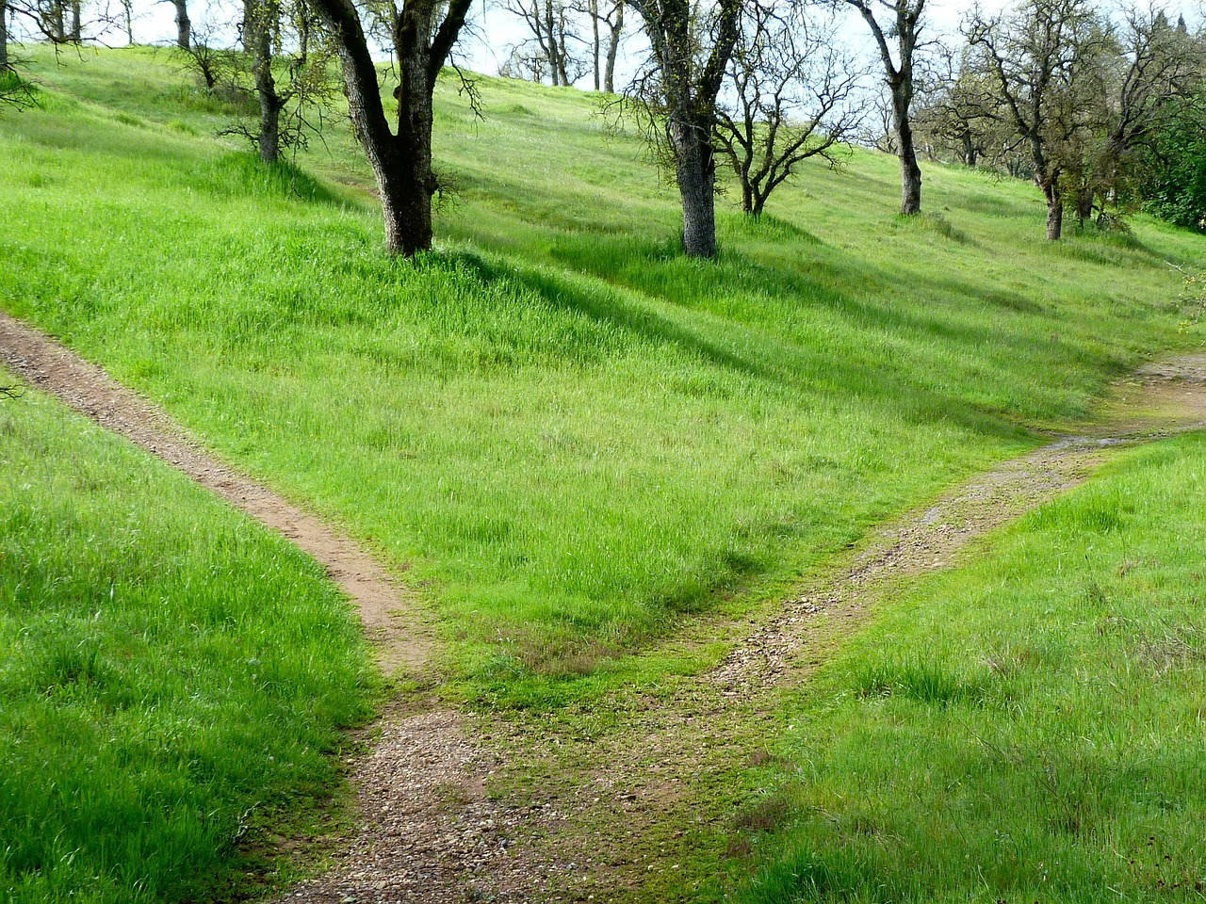
Thank you!
Notes:
Thank you for your interest!

