Slide 1

FOX path
An expression language for selecting files and folders
Hans-Jürgen Rennau, Traveltainment GmbH
Presented at Balisage 2016, August 3, 2016
Notes:
XPath is an expression language for navigating the contents of XML documents. Using XPath, we can select contents in an elegant, concise and very intuitive way. What is more: XPath is not a loose collection of expressions and rules, but a complete and fully composable expression language. Therefore there is virtually no limit to the selectiveness we may achieve, constructing XPath expressions. XML documents and a file system have much in common – they both expose a tree-structured collection of names. So – should we not have something like „XPath for files and folders“ – FOXpath for short? This presentation reports my efforts to design and implement such an expression language.

Slide 2
Outline
XPath – a model for file system navigation?
FOXpath 1.0 – an expression language
for navigating the file system
FOXpath 3.0 – FOXpath merged into XPath
Beyond the file system ...
Notes:
First, we check the basic assumption that XPath is an adequate model for file system navigation. Then we explore FOXpath, a new expression language for navigating the file system. We shall see that this first version of FOXpath is a modified copy of XPath. But then we merge FOXpath back into XPath, obtaining an extended version of XPath supporting file system navigation. And finally we shall see that FOXpath is not restricted to physical file systems, but can navigate logical file systems as well, as for example used to organize the contents of a NOSQL database, version control repositories or the URI collection exposed by REST-ful web services.

Slide 3



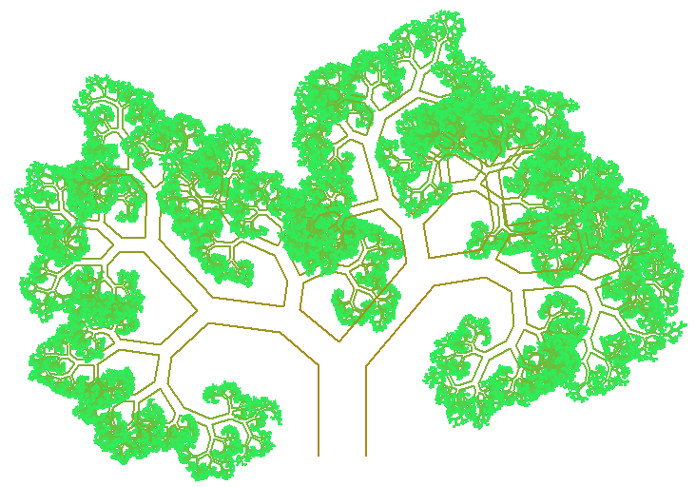
XPath – a model for file system investigation?
XPath!
XPath
?
tree
XML
file system
Notes:
XPath îs a device for exploring and navigating XML documents. A closer look at XPath reveals core concepts not based on XML, but on the general notion of a tree-structured collection of names. XML is a particular instance of that notion, and the file system is another instance. We conclude that it should be possible to design an expression language which is similar to XPath, but deals with files and folders, rather than XML nodes.

Slide 4
Goal: examples
/xsdbase/niem-3.0/descendant~::*iso*.xsd/parent~::*
/xsdbase/niem-3.0//(*.xlsx, *.txt, *.xml)
/xsdbase/niem-3.0//*[is-dir()][not(*)]
sort(distinct-values(/xsdbase/niem-3.0//*.xml/xroot()))
/xsdbase/niem-3.0//*.xsd/file-name() except
/xsdbase/niem-2.1//*.xsd/file-name()
Notes:
Let us start with a few examples illustrating the desired expression language. They look like XPath, and they are as powerful as XPath expressions.

Slide 5

The AFFe principle
XPath:
within-tree direction
Axis
Filter expressions
A F Fe
XPath:
effective boolean value of arbitrary expression
XPath:
name test | kind test
Filter
descendant::employees [address/city eq 'NewYork']
ancestor::element() [metaData]
Notes:
If we want to use XPath beyond XML, we must understand the core principles of XPath in an abstract way, which is independent of XML. „Affe“ is the German word for monkey, and most monkeys love to traverse trees. It‘s natural to summarize the core principles of XPath under the term AFFe. It‘s an acronym referring to the building blocks of selection: axis + filter + filter expression. The axis collects everything visited when traversing the tree in a particular direction (children, descendants, parent, ancestors, and so forth). Collected items are submitted to a simple filter, which in the case of XPath is either a name test or a kind test. If this filtering is still too crude, further filtering of unlimited selectiveness can be achieved by adding filter expressions.

Slide 6
FOXpath 1.0 = modified copy of XPath 3.0
Expression language
Data model = XPath data model
Grammar = XPath grammar
Semantics = XPath semantics
- PathExpr
+ FoxpathExpr
- semantics (PathExpr)
+ semantics (FoxpathExpr)
Notes:
XPath is a masterly elaboration of the AFFe principle. I never cease to marvel at the expressiveness achieved by uncomprising rigour and consistency. Aspiring to a new „XPath for files and folders“, what would be more promising than to stick as closely to XPath as possible?

Slide 7
fox path expression - example
/xsdbase/
niem-3.0/
descendant~::*.xsd
[xpath('not(//xs:documentation)')]/
file-info(., 'n40. d')
conformanceTargets.xsd .. 2013-10-18T14:19:18Z
de.xsd .................. 2013-10-18T14:19:20Z
gml.xsd ................. 2013-10-18T14:19:20Z
localTerminology.xsd .... 2013-10-18T14:19:22Z
Notes:
So the fox path expression is the only difference between XPath and FOXpath! Before becoming formal, let us look at an illustrative example. The expression reports all Niem XSDs without documentation. Ignoring the tilde and the use of wildcards within names, this could be an XPath expression.

Slide 8
fox path expression - grammar
fox path expression :
one or more steps
step :
postfix expression | fox axis step
postfix expression : e.g. function call, ...
concat(file-name(.), ' ', file-date(.))
fox axis step :
fox axis + fox name test [+ predicates]
descendant~::.xsd[matches-xpath(...)]
Notes:
That‘s because the grammar of the fox path expression is just a modified copy of the grammar of the path expression.

Slide 9
fox axis step –vs– axis step
FOXPath
folder navigation engine
fox axis step
fox axis + fox name test [+ predicates]
axis + name test [+ predicates]
axis step
node navigation engine
XPath
Notes:
So the core functionality of folder nagivation, which is the fox axis step, is a modified copy of the axis step of XPath, which is the core functionality of node navigation..

Slide 10
fox axis step
axis + name test
default axis: child
child~::foo
foo
descendant~::zoo*bar
descendant-or-self~::zoo?bar
parent~::`foo bar`
ancestor~::`.git`
ancestor-or-self~::`2016`
following-sibling~::`201601??-*`
preceding-sibling~::foo
self~::foo
Notes:
FOXpath supports most of the axes supported by XPath, excepting of course the attribute axis, as well as the preceding and following axis, which are not believed to be useful when navigating a file system. As in XPath, the child axis is the default axis.

Slide 11
fox name test
Name pattern = characters and wildcards (*, ?)
Canonical syntax (string in backquotes)
Abbreviated syntax (without backquotes)
Escape certain characters by preceding ~
Escape always: ~ [ ] \ / < > ( ) += ! | , WHITESPACE
Escape if first character: . ` DIGIT
Canon.: `foo` `foo*` `foo(1)` `foo bar` `2016`
Abbrev.: foo foo* foo~(1~) foo~ bar ~2016
Notes:
The fox name test filters by file or folder name. In contrast to the node name test of XPath, name patterns with inserted wildcards are supported. As file names can be almost arbitrary strings – not only NCNames – the syntax of a name test must make sure to avoid parsing ambiguity.

Slide 12
foxpath operator ( / )
Example expression:
xsdbase / niem-3.0
E1 / E2
evaluate E1
atomize result
for every item P: evaluate E2, using P as context item
concat, remove duplicates, sort lexicographically
Notes:
In XPath, the steps of a path expression are combined by the path operator, represented by a slash. In FOXpath, steps are combined by the foxpath operator, also a slash. The semantics are very similar to the path operator, but there is a key difference: what is pumped from left to right are URIs, not nodes.

Slide 13
Extended semantics – examples
/xsdbase//*[*.xsd]
/xsdbase/niem-3.0//*.xsd/file-name()
except
/xsdbase/niem-2.1//*.xsd/file-name()
Notes:
As we want FOXpath expressions to be just as elegant and concise as XPath expressions, we are motivated to introduce a slight extension to the expression semantics of XPath. Consider these examples, which look elegant and intuitive, yet would produce type errors if we retained XPath semantics without any changes.

Slide 14
Extended semantics – definition
Definition Extended semantics:
Evaluation as XPath yields a value =>
evaluation as FOXpath yields the same value
Evaluation as XPath yields a type error yet
evaluation as FOXpath yields a value
Notes:
Extended semantics are defined in terms of a comparison between the outcomes of evaluating the expression as an XPath or as a FOXpath expression.

Slide 15
Extended semantics – rules
Effective boolean value
Case: value(E) = sequence of >1 atomic items
XPath: EBV(E) raises type error
FOXpath: EBV(E) = EBV(E[1])
E1 or E2 contains atomic item =>
E1 union E2 = distinct-values ((E1, E2))
E1 except E2 = distinct-values (E1[not(. = E2)])
E1 intersect E2 = distinct-values (E1[. = E2])
Notes:
FOXpath defines four semantic extensions.

Slide 16
Function library
All XPath 3.0 functions
Plus ...
is-dir(), is-file()
file-name(), file-date(), file-size(), file-info() ...
grep()
xpath()
xatt, xelem, xroot()
rpad(), lpad()
Notes:
The power of XPath relies on a standard ibrary of built-in functions. FOXpath supports all XPath functions, plus a few additional functions believed to be especially useful when navigating and reporting file system contents.

Slide 17
Using functions ...
count(/xsdbase/niem-3.0//*.xsd)
/xsdbase/niem-3.0//*.xsd
[xatt('attributeFormDefault' , 'qualified')]
/file-info('n40. s10 d')“
/sort(distinct-values(
/xsdbase/niem-3.0//*[is-file()]
/replace(file-name(),'.*\.', '')
), lower-case#1)
Notes:
A few examples illustrate the use of XPath as well as FOXpath functions.

Slide 18
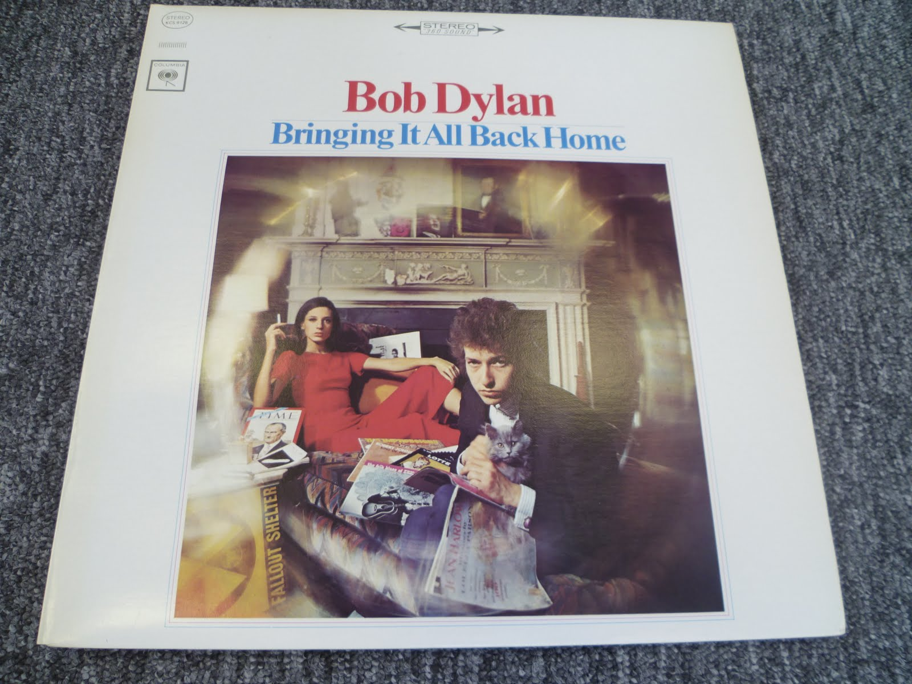
Bringing It All Back Home
Notes:
If FOXpath is almost identical to XPath, it is natural to ask if we cannot merge FOXpath back into XPath, obtaining an extended version of XPath, rather than a modified copy..

Slide 19
FOXpath 3.0 – foxpath merged into XPath
Concept
Do not replace path expression by fox path expr
Extend path expression:
Step: postfix expr | axis step | fox axis step
Operator: path operator | fox path operator
Syntax changes
fox path operator: \ (not /)
fox name test: constrain use of abbreviated syntax
(HelloWorld – an axis step or a fox axis step ?)
Notes:
Indeed – it‘s possible! This new version of FOXpath is called FOXpath 3.0, as it is an extended version of XPath 3.0.

Slide 20
Mixing axis & fox axis steps
sort(distinct-values(
\projects\xsd\niem*\\*.xsd\doc(.)
//xs:element/@name
), lower-case#1)
fox axis steps
axis steps
path expression
Notes:
With FOXpath 3.0, you can not only use fox axis steps, you can also mix axis and fox axis steps within a single path expression. This enables expressions accomplishing a two-phase navigation: initial steps select resources, following steps navigate into their contents.

Slide 21
Mixing axis & fox axis steps 2
\projects\xsd\niem*\\*.xsd
[not(doc(.)//xs:documentation)]
fox axis steps
predicate: axis steps
path expression
Notes:
Another example of mixing is the use of fox axis steps with predicates containing axis steps, which means resource selection based on resource contents.

Slide 22
FOXpath 3.0 - implementation
Reference implementation:
written in XQuery 3.1 (5331 LOC)
Dependency on XQuery processor
Currently: BaseX 8.5 or greater
https://github-com/hrennau/foxpath
Notes:
A reference implementation of FOXpath 3.0 is available.

Slide 23
for $d in /xsdbase/niem-3.0//*[is-dir()] return
concat(
for $i in 1 to (count($d/ancestor~::*) - 2) return '. ',
file-name($d))
. niem
. . adapters
. . . edxl-cap
. . . . 3.0
. . . edxl-de
. . . . 3.0
. . . edxl-have
. . . . 3.0
. . . geospatial
. . . . 3.0
. . appinfores
. . . 3.0
. . codes
. . . ansi_d20
. . . . 3.0
Notes:
The implementation in action – a complex expression producing a tree representation of the folder tree found under the niem-3.0 folder.

Slide 24
Moving beyond the file system
File system – tree of resource URIs
Other types of resource trees:
Resource URIs exposed by a REST-ful web service
URIs of documents stored in a NOSQL database
URIs of resources managed by version control
...
Folder navigation defined by FOXpath –
not restricted to the file system!
Notes:
The folder navigation supported by FOXpath is not restricted to physical file systems – it can also deal with other kinds of resource trees, which may be regarded as logical file systems.

Slide 25

Folder navigation
Basic building block of folder navigation:
fox axis step
Notes:
It is important to recognize the basic building block of folder navigation – which is the fox axis step. The question arises whether the fox axis step can deal with logical file systems as well.

Slide 26
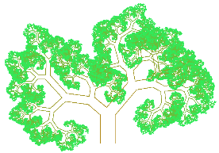

fox axis step: implementation
tree interface
fox axis step
fox:child-uri-collection($uri, $name) as xs:anyURI*
fox:descendant-uri-collection($uri, $name) as xs:anyURI*
fox:root-uri($uri) as xs:anyURI?
Notes:
As you remember, the fox axis step combines a fox axis with a fox name test. A complete implementation can be built upon navigation primitives, three functions mapping an input URI to output URIs – root, child and descendant URIs. The functions constitute a sufficient interface to the tree, as far as navigation is concerned. This interface completely hides the nature of the resource tree – physical file system, SVN repository, etc. In principle, FOXpath can navigate any type of resource tree, for which implementations of these three navigation primitives are available.

Slide 27
Parallel support for multiple resource tree types
URI => ResourceTreeType
RTType1
fox axis step
RTType2
RTType3
Notes:
What is more: FOXpath can support in parallel any number of resource tree types. This presupposes that for a given URI, the type of containing resource tree can be determined. If this is the case, for a given context URI, the appropriate instances of the navigation primitives can be selected and the fox axis step can be executed.

Slide 28
Formal integration
Problem: set of navigation-supported resource tree types is implementation-defined!
Solution: New component of the dynamic context:
[Definition: Available navigation primitives. This is a mapping of strings to function items representing the three navigation primitives.]
Notes:
Support for various resource tree types will certainly be implementation dependent. How to integrate this variability cleanly into the highly standardized XPath language?

Slide 29
FOXpath – an afterthought
Nested forest:
outer forest = resource trees
inner forest = node trees
Seamless navigation of the nested forest
Emerges:
a continuous space of information
(the info space)
Notes:
An afterthought: FOXpath complements tree navigation of resource contents with tree navigation of resource collections. FOXpath encourages us to perceive a nested forest of information: an outer forest consisting of resource trees, an inner forest consisting of the node trees corresponding to leaves of the resource trees. FOXpath enables us to navigate the complete structure in a seamless way, and therefore we may experience this nested forest as a single, continuous space – the info space.

Slide 30
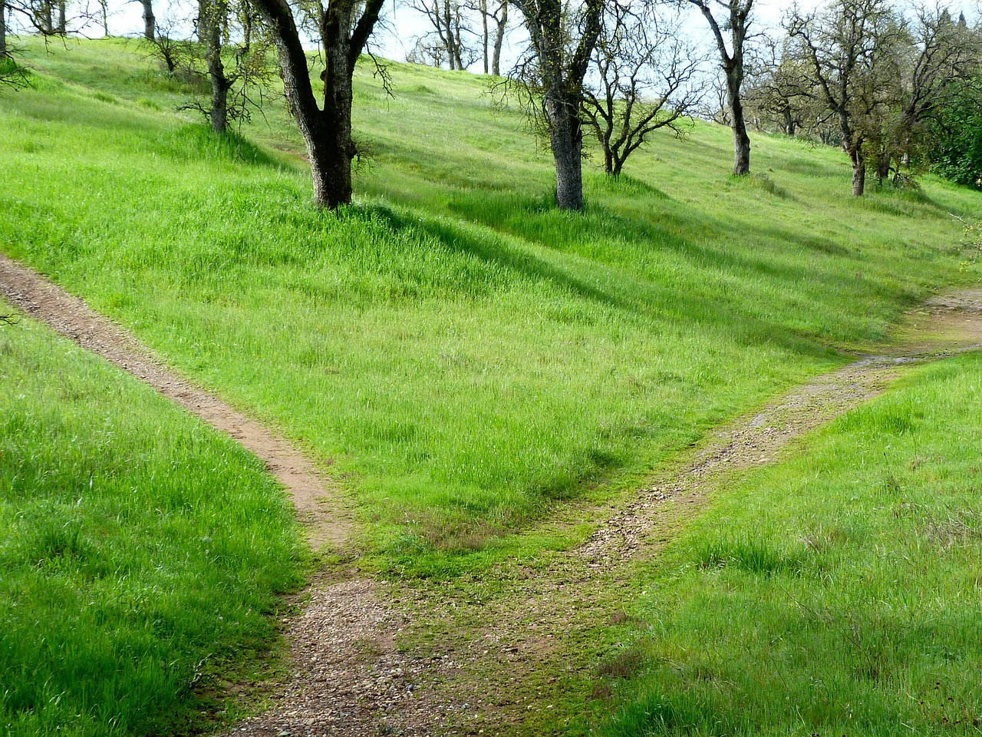
The end! (The end?)
Notes:
There is a choice to be made: either XPath remains an ingenious tool for navigating XML documents, or it will be extended to become the engine of the info space.

