Slide 1

An introduction to Greenfox
A schema language describing
file system contents -
hands-on & brainfriendly
Hans-Jürgen Rennau, parsQube GmbH
Presented at Declarative Amsterdam 2020, October 8, 2020
Notes:
This is an introduction to greenfox, a schema language for validating file systems.

Slide 2
File system tree validation
File system tree =
a selected folder
+ all folders/files directly or indirectly contained
Validation =
check conformance to a set of constraints („schema“)
Validation result =
the outcome of one check:
single resource checked against a single constraint
Validation report =
collected validation results,
mapped to something palatable

Slide 3
Why might you care?
What we are used to:
declarative validation of single files against schemas
(XSD, RelaxNG, JSON Schema, CSV Schema, SHACL, …)
Real interest: validity of systems, not individual files
Single file: a tiny jigsaw piece in the picture of system validity
File system trees are simply larger parts of the picture
Examples:
A product to be shipped
A set of applications in use
Critical components of infrastructure
Data sources and assets
Complex test results
SAMPLE WORRIES
No file forgotten?
File versions correct?
Log files removed?
Documentation complete?
All translations included?
All links updated? Etc. etc.

Slide 4
Outline
Getting started - hands-on impressions
Big Picture - concepts
Overview - available constraint types

Slide 5
Part 1: Getting started …
A guided tour:
„A trivial file system tree
Validated against a
non-trivial schema
Developed in seven steps
Source of all airport data: https://openflights.org/data.html

Slide 6
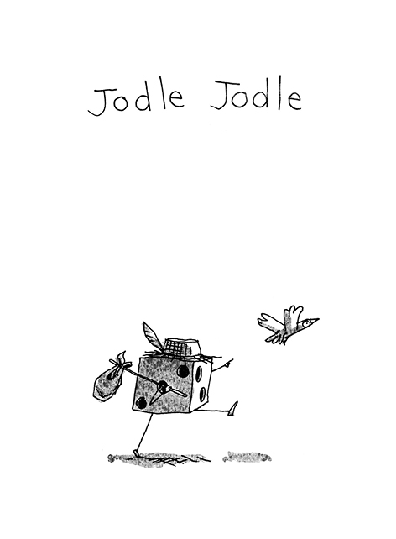
(having made up his mind to participate
In the Greenfox tutorial at Decl. Amst. 2020)
(Jodle will join us, coming straight from the pencil of Cédric Philippe)
http://cedricphilippe.com/section_me.html

Slide 7
Part 2: Big picture
The key to understanding Greenfox is knowing
SEVEN CONCEPTS

Slide 8
SEVEN CONCEPTS
Resources
Constraints
Shapes
Target declarations
Link definitions
Results
Reports

Slide 9
1. Resources
Resources = files & folders
Now that was easy!

Slide 10

2. Constraints
A constraint is a function:
Selection of the resource is not part of the constraint –
that‘s the business of the containing shape
Schema representation: XML element + attributes + children
Maps a resource to a validation result
= (1) pass|failure (2) details

Slide 11
2. Constraints - type + facet
Type, parameters, facet
The type is identified by the XML element name
The parameters are provided by attributes / child elements
The facet depends on a key parameter
Example: Constraint #1
Type: Value
Parameters: exprXP, minCount, minCountMsg
Key parameter: minCount
Facet: ValueMinCount

Slide 12
2. Constraints - example
Example: Constraint #2
Type: Value
Parameters: exprXP, distinct, distinctMsg
Key parameter: distinct
Facet: ValueDistinct

Slide 13
2. Constraints - categorization
Categorization:
Unary - targets single resource
e.g. <value>, <valuePair>, <docTree>
Binary - targets a pair of resources
e.g. <valueCompared>, <docSimilar>, <folderSimilar>
Categorization:
Closed - excludes impact from other resources
e.g. <value>, <valueCompared>
Open - allows impact from other resources
e.g. <foxvalue>, <foxvaluePair>, <links>

Slide 14
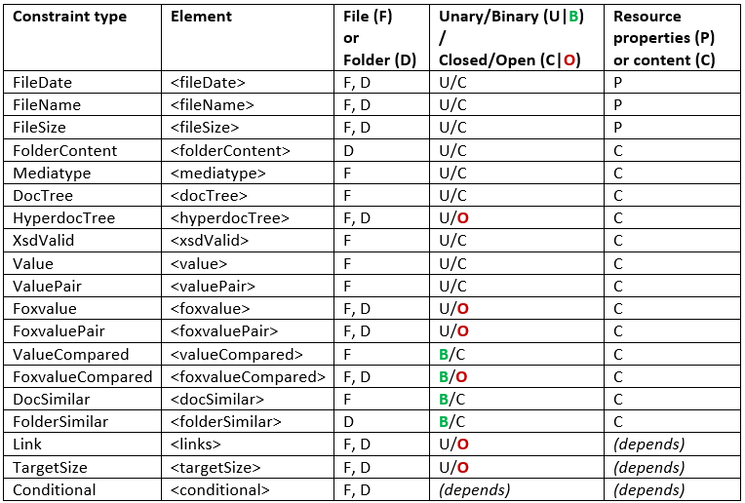
2. Constraints - constraint types

Slide 15
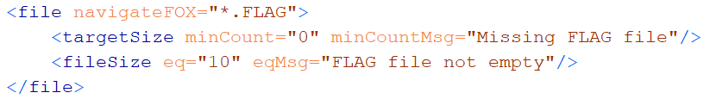
3. Shapes
Shape is two things:
Set of constraints
Target declaration
Target declaration:
„The constraints apply to these resources: (a selector)“
Schema representation of a shape: <file>, <folder>
Element name: the kind of resources
Attributes: target declaration
Child elements: constraints

Slide 16
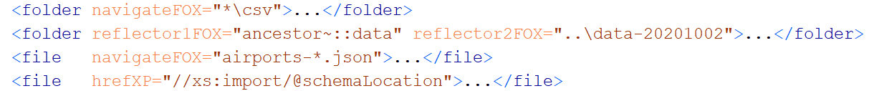
4. Target declaration
A target declaration is a function:
Schema representation: attributes of <file> or <folder>
Maps a resource to a set of resources
* Input resource =
a resource from the target of the parent shape
* Output resources =
contribution to the target of this shape

Slide 17
5. Link definition
A Link Definition is a function:
Schema representation:
Either: <linkDef> element
Or: Attributes and child elements of a „link using element“
Link using elements:
Shapes <file>, <folder>
Links constraint <links>
Binary constraints <valueCompared>, <docSimilar>, <folderSimilar> …
Hyperdoc constraint <hyperdocTree>
Maps a resource to a set of resources

Slide 18
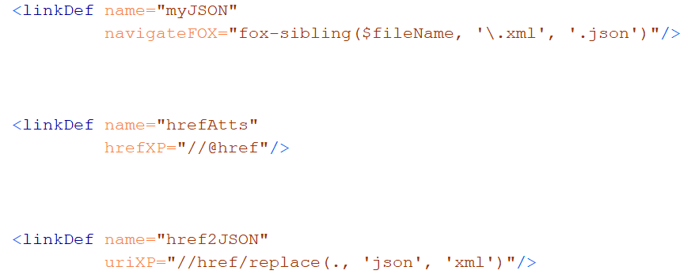
5. Link definition - connectors
Connector: foxpath
Connector: href-expression
Connector: URI-expression

Slide 19

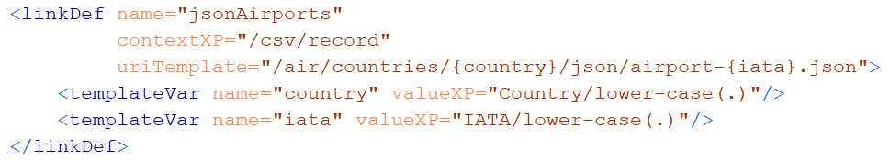
5. Link definition - more connectors
Connector: mirror
Connector: URI-template

Slide 20
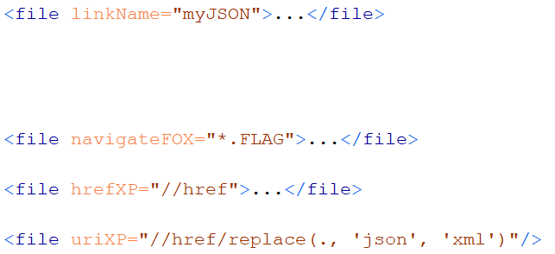
5. Link definition - used by target declarations
Link Definition referenced (@linkName)
Link Definition local (@navigateFOX, @hrefXP, @uriXP, …)

Slide 21
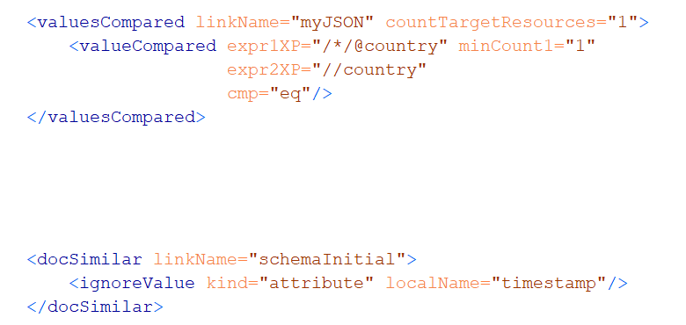
5. Link definition - used by binary constraints
ValueCompared
DocSimilar

Slide 22
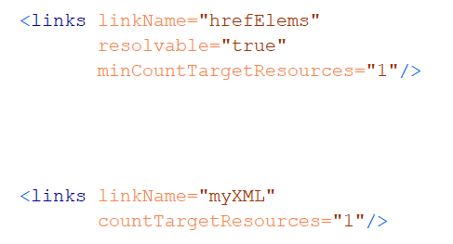
5. Link definition - constraints
Links resolvable and yield at least one link target resource
Exactly one link target resource

Slide 23
Intermezzo (interfoxo)
Note the the amazing fox – look at …
$greenfox/declarative-amsterdam-2020/the-amazing-fox/the-amazing-fox.txt
$greenfox/declarative-amsterdam-2020/tutorial-foxpath/tutorial-foxpath.txt
For example, node tree and file system navigation can be freely mixed, e.g.
fox "ancestor~::decl*//*.gfox.xml[\\*:docSimilar]"
selects files based on their structured XML content. Or
fox "ancestor~::decl*//airport-*.json/jdoc(.)[\\iata eq 'WAT']"
selects files based on their structured JSON content.
NOTE: In Greenfox, the roles of / and \ are reversed. If you use fox with option –b, it behaves like Greenfox.

Slide 24
6. Results
Validation result =
Outcome of checking a single resource against a single constraint
XML element <red>, <green>
Attributes and child elements …
Identify the resource
Identify the constraint type and facet
Constraint location in the schema
Constraint parameters
Observations

Slide 25
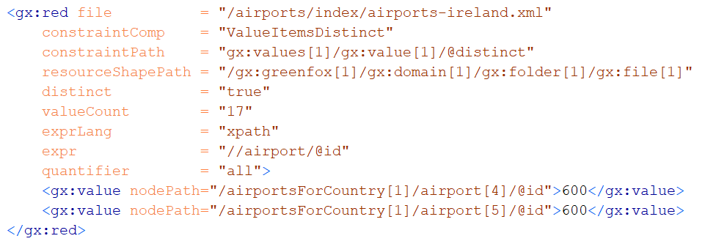
6. Result - example

Slide 26
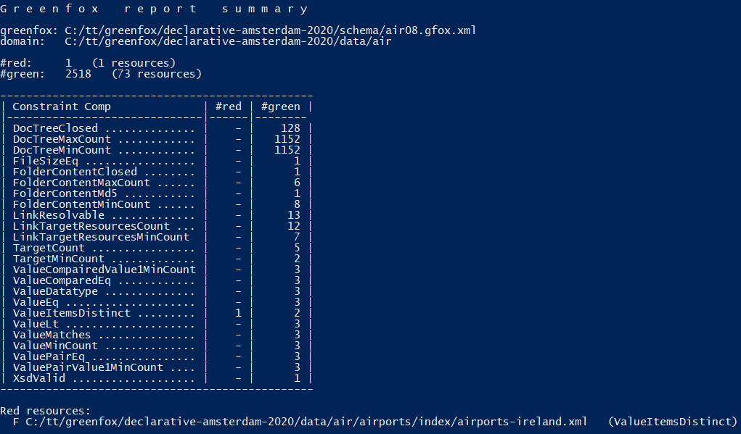
7. Report - example

Slide 27
Part 3: Constraint types
Now you are ready to familiarize yourself with
CONSTRAINT TYPES

Slide 28
Constraint types

Slide 29
Important, but only mentioned
<focusNode> - changing evaluation context
Variable bindings in XPath and Foxpath (e.g. $fileName)
Dealing with archives
JSON, CSV, HTML, .txt (see also demo-mediatype)
Schema context & schema parameters

Slide 30
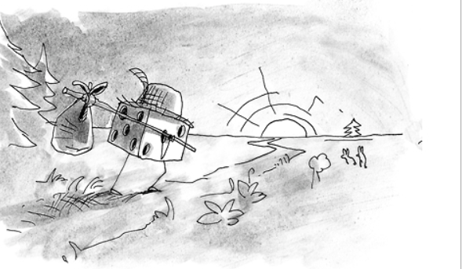
Thank you, Jodle and all others, for your kind attention!
(Jodle returning to Prague, straight to the pencil of Cédric Philippe)
http://cedricphilippe.com/section_me.html

