Slide 1



Industry Apprenticeship Report
Name: Gohel Harsh
Enrollment. No.:1C2300204011003
Guided Name: Dr. Dikshan Shah

Slide 2
Internship Overview
Organization: Sahana System Limited
Role: AI/ML Data Annotation Intern
Industry-oriented apprenticeship program
Academic Year: 2025–2026

Slide 3
Introduction
AI & ML systems depend on high-quality data
Data annotation is the foundation of ML models
Internship focused on real-world document annotation workflows

Slide 4
Internship Objectives
Understand data annotation lifecycle
Work with real industry datasets
Learn professional AI tools and SOPs
Improve technical and professional skills

Slide 5
Internship Role
Downloading and managing raw data
Uploading documents for annotation
Manual data annotation
Verification and quality checking

Slide 6
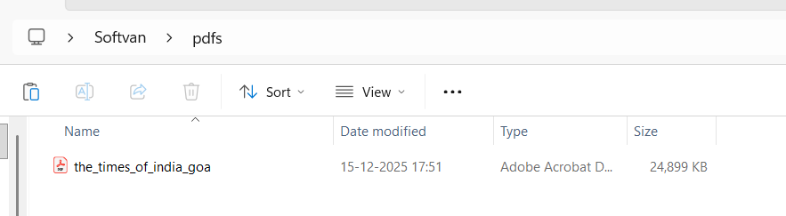
Managing Raw Data
Handling raw PDF documents
Quality and clarity checks
Identifying missing or corrupted files
Organizing data using folder structure

Slide 7
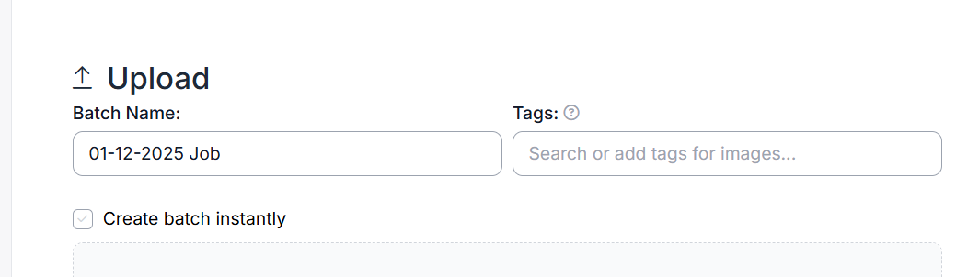
Uploading Documents
Uploading PDFs to internal tools
Converting PDFs to images
Splitting multi-page documents
Updating task status

Slide 8
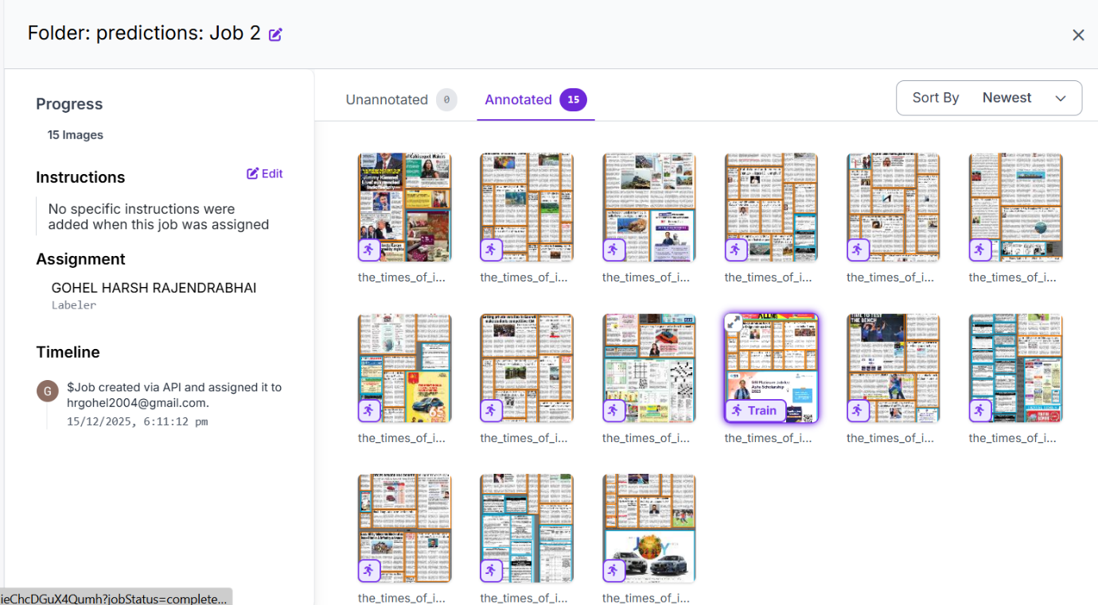
Manual Data Annotation
Drawing bounding boxes
Labeling text, tables, headings, fields
Document classification
Following SOP guidelines

Slide 9
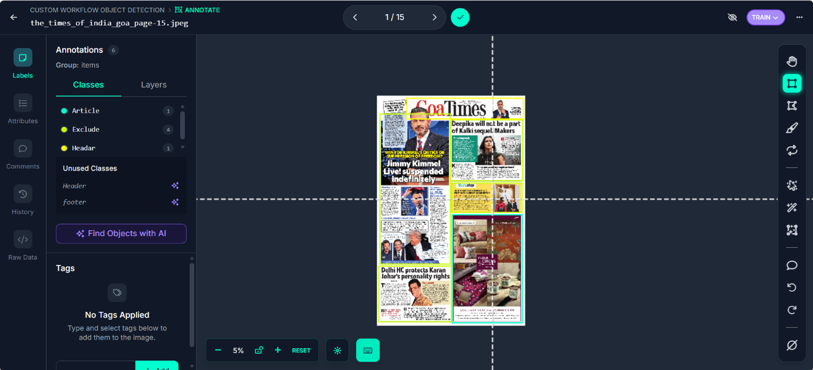
Annotation Verification
Checking label accuracy
Correcting annotation errors
Removing overlaps
Improving dataset quality

Slide 10
Using Roboflow
Dataset management
Manual & AI-assisted annotation
Version control
Exporting datasets (YOLO, COCO, CSV)

Slide 11
Tools & Technologies Used
Roboflow
Adobe Acrobat & PDF tools
Python (basic automation)
Google Drive, OneDrive

Slide 12
Skills Learned
Technical Skills
Data annotation workflow
Dataset preparation
Data verification
Soft Skills
Time management
Attention to detail
Team communication

Slide 13
Challenges Faced
Low-quality documents
Large data volumes
Learning new tools
Maintaining speed with accuracy

Slide 14
Conclusion
Gained real-world AI/ML exposure
Understood importance of data quality
Improved technical and professional skills
Strong foundation for future career

Slide 15
Thank you
-Gohel Harsh R

