Slide 1
Predicting Charlotte Traffic Stop Outcomes
Based on Driver and Officer Demographic Information
Group 3
Mitchell Jones, Harley Grafton, Jordan Register, Srikar Vavilala, Marianna Shaver

Slide 2
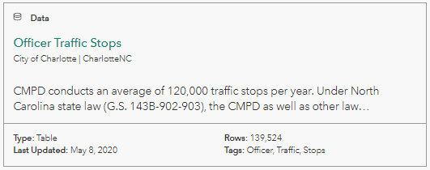
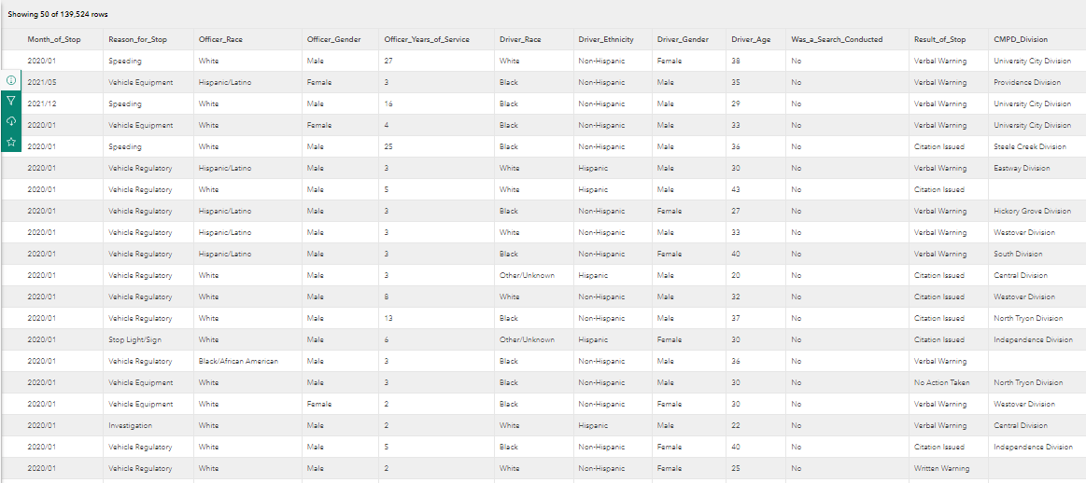
Snapshot of the Data
Charlotte Officer Traffic Stops
Charlotte Open Data Portal

Slide 3
Understanding the Problem

Slide 4
Questions we set out to answer
How can Machine Learning techniques be used with sociopolitical data?
More specifically: are any protected attributes like race or gender significant for predicting traffic stop outcomes?
This would imply potential discrimination in traffic policing.
If so, what characteristics help predict the outcomes of traffic stops?
What does this say about the criminal justice system?

Slide 5
Review of Literature
Novel Idea - Using ML to attack injustice
Applying machine learning methods to critique and dismantle sociopolitical injustices is an uncommon application of ML.
Combining machine learning methods with a focus on racial disparities among police traffic stops has been attempted, however, prior research efforts have either:
Focused primarily on a descriptive/statistical analysis of the data (e.g., Pierson et al., 2020).
Did not apply ML methods (e.g., Pierson et al., 2020).
Explored national data, requiring that they had to make subjective decisions when joining differentially labeled data across states (e.g., Pierson et al., 2020).
Did not explore racial disparities (e.g., Hamada et al., 2018)
Did not explore traffic stops (rather stop and frisk) (e.g., Kumar et al., 2018).
Few studies have attempted to develop a predictive model from the traffic stop data, likely due to its inherent unfairness.
Thus we set out to build “fairness” and equal opportunity into the model
Notes:
Jordan

Slide 6
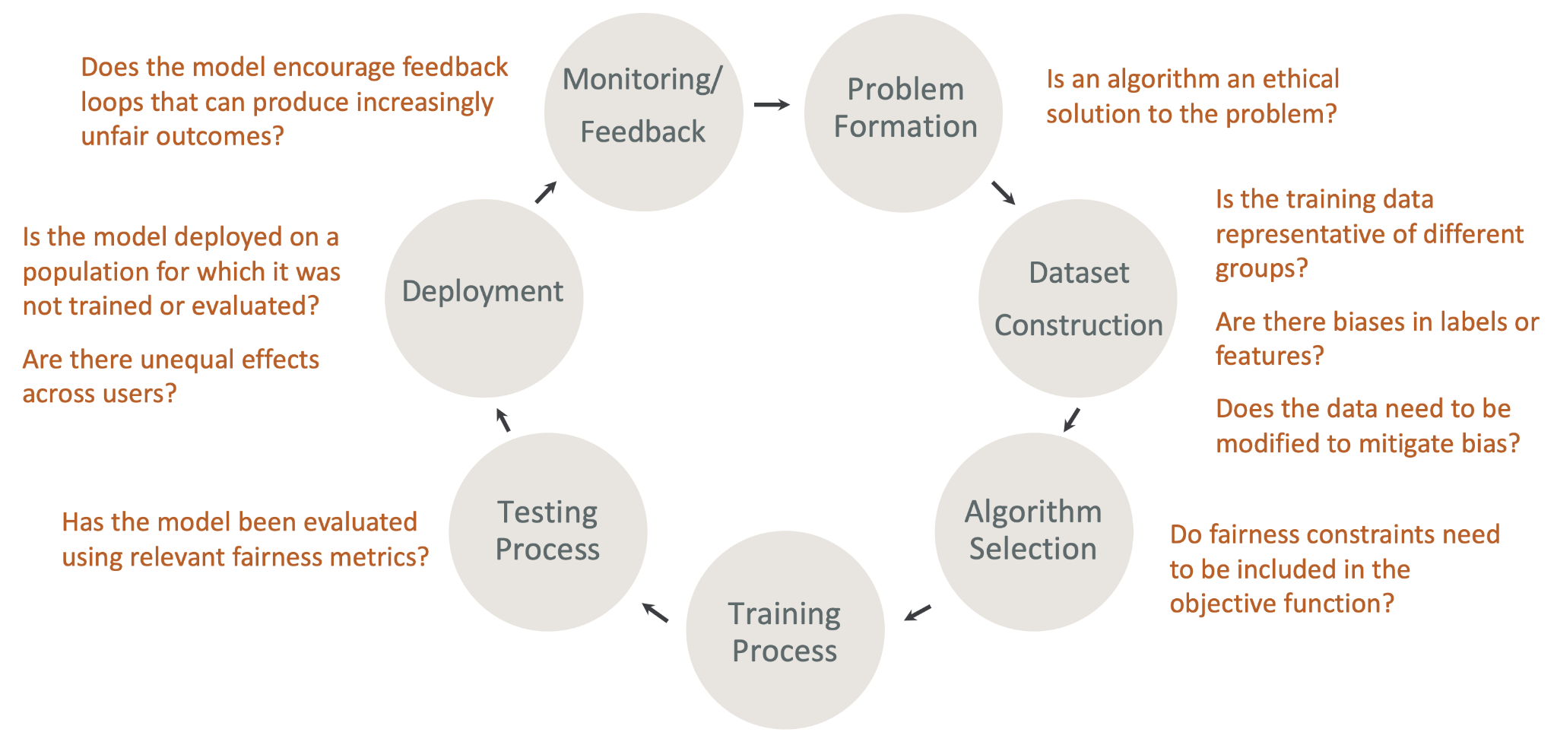
Why a fair model is important
According to Hardt et al., (2016)
“Despite the demand, a vetted methodology for avoiding discrimination against protected attributes in machine learning is lacking.
A naïve approach is often used where the developed algorithm ignores all protected attributes such as race, color, religion, gender, disability, or family status.
However, this idea of “fairness through unawareness” is ineffective due to the existence of redundant encodings (i.e. “ways of predicting protected attributes from other features”) (p. 1).
Source:
What Is Fairness and Model Explainability for Machine Learning Predictions? - Amazon SageMaker
Notes:
Jordan and Mitchell

Slide 7
Important Note
We realize that by analyzing this dataset, we could shed light on a potentially controversial topic.
Note that none of our findings should be considered causal. Rather they shed light on correlations in the data that may be used to dismantle bias in policing.

Slide 8
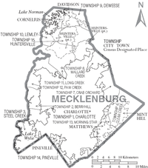
Steps and Approaches
Preprocessing: Clean the dataset
Check for missing values
Consistency (spelling, etc.)
Skewness → normalization
EDA: Identify variables to be used
Modelling:
Identify most appropriate models to use.
Binary. Search conducted or not
Sklearn fairness metrics
Fine tune models
Analysis: Visualize/Understand output
Create Streamlit
Findings: Write report

Slide 9
Preprocessing

Slide 10
Preprocessing
Drop non-informative variables
Check for missing values and spelling consistency
Filtered for logical consistency
Created new variables from references original variables
Changed variable data types
Scaled skewed variables
Notes:
Drop non-informative variables (GlobalID, ObjectID)
Check for missing values (removed NA from CMPD_Division)
Consistency (spelling, etc.)
Filtered for logical consistency (Driver Age > 14)
Set 2-category variables to binary format
Created new variables based on initial variables.
Re-grouped Outcome_of_Stop into 3 consolidated outcomes instead of 5.
Binary “Arrest” column
Re-phrased/grouped Officer_Race to match designation options of Driver_Race
Created binary Racial_Match column if Driver and (new) Officer Race matched
Skewness → normalization of Officer_Years_of_Service

Slide 11
Exploratory Data Analysis (EDA)
Streamlit Interactive EDA

Slide 12
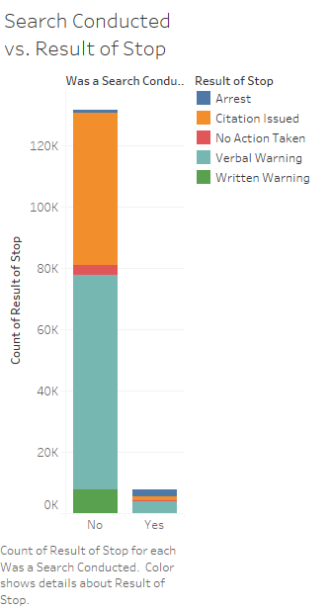
EDA: Reducing our target variables → RQ Modifications
Our EDA illuminated that a conducted search typically results in more serious consequences → Warning, Citation, Arrest.
Thus, (for feasibility) we chose “Was a Search Conducted” as our target variable.
Our research questions moving forward became:
RQ#1
RQ#3
RQ#2
What driver attributes (race, ethnicity, gender, age) correlate the most with the most with whether a search was conducted.
What officer attributes (race, gender, years of service) correlate the most with the most with whether a search was conducted.
What general attributes correlate the most with whether a search was conducted.

Slide 13
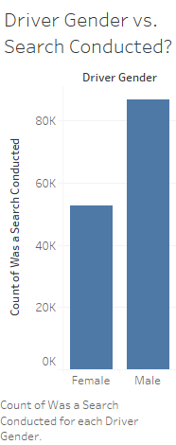
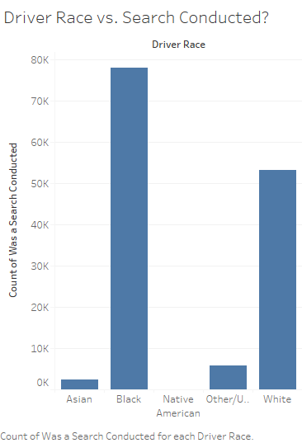
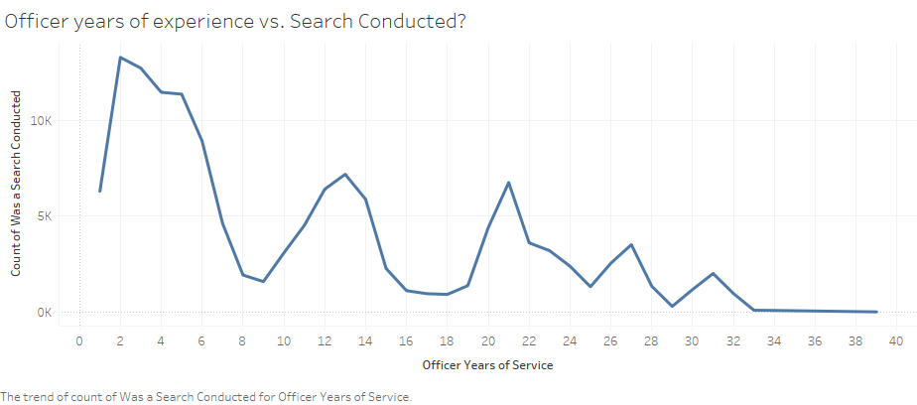
EDA Findings
Men are typically searched more than women
Men are also pulled over more than women
Black and White people are searched more than people of other races
White: 49%, Black: 35% of CLT population (then why are Black people searched at a higher rate?)
Officers with more years of experience typically search people less
Could be due to less officers with more years of experience being on traffic duty
Thus, we anticipated that:
Driver gender, driver race, and officer experience are the most significant predictors of whether a search is conducted in a CLT traffic stop.

Slide 14
Modelling

Slide 15
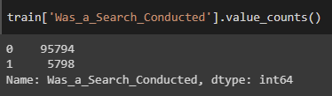
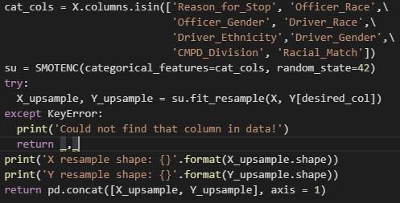
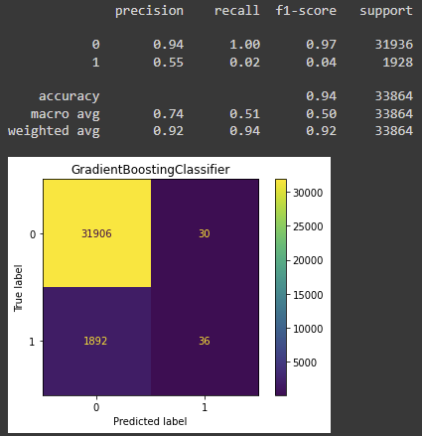
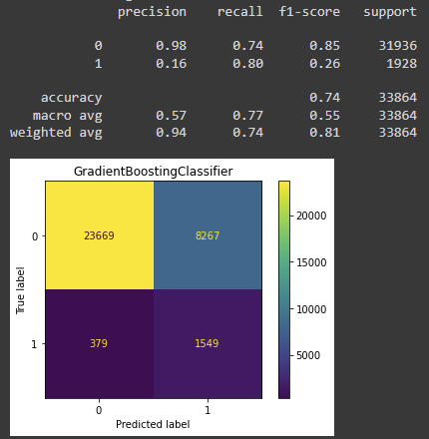
Upsampling is Key to Minority Class Detection

Slide 16
Relevant Variables for Predictions
Filter-Based Feature Selection
Chi^2
Mutual Information
Wrapper Based Feature Selection
Sequential Feature Selection (Forward)

Slide 17
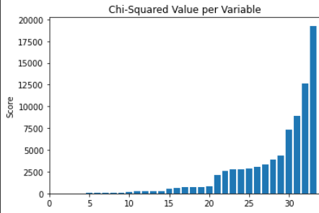
Chi-Squared Implementation
The 5 most relevant features were deemed to be:
Officer_Years of Service
Reason_for_Stop_Speeding
CMPD_Division_Metro Division
CMPD_Division_Providence Division
Driver_Gender
Driver_Race had the 12th highest value.
Reason_for_Stop_Speeding
CMPD_Division_Metro_Division
CMPD_Division_Providence Division
Officer_Years_of_Service
Driver_Gender
Driver_Race
Notes:
The chi-square test is a statistical test of independence to determine the dependency of two variables. Simply put, for features that have higher Chi-Square values are the ones that are more dependent on the response and it can be selected for model training.
Among Officer, Driver, Reason for Stop, and CMPD Division variables, the 5 most relevant features were deemed to be Officer_Years of Service, Reason_for_Stop_Speeding, CMPD_Division_Metro Division, CMPD_Division_Providence Division, and Driver_Gender.
With regards to score, Driver_Race was the 12th most relevant variable.

Slide 18
Chi-Squared Implementation Cont.
Model | Train Accuracy | Test Accuracy | Class | Precision | Recall
Gaussian Naive-Bayes | 0.76 | 0.67 | 0 | 0.98 | 0.66
 |  |  | 1 | 0.13 | 0.81
Gradient Boosting | 0.80 | 0.74 | 0 | 0.98 | 0.74
 |  |  | 1 | 0.15 | 0.80
Notes:
Based on this metric, the lowest 7 of the 34 total features were dropped, and the models were rerun. Shown here are the 2 models that performed the best based on Accuracy and Recall.
The metrics for the GNB model after dropping the features, when compared to those from the baseline upsampled GNB model, are 4% lower in terms of Test Accuracy and 5% lower for Recall. However, the Recall value for the positive class increased by 8%.
Furthermore, for the Gradient Boosting model, the model performed 7% worse with regards to accuracy metrics and had 9% worse recall for the negative class. That being said, it performed 4% better better with regards to precision for the positive class and 17% better for positive class recall.

Slide 19
Forward Feature Selection Implementation
Interesting dropped features include:
Officer_Race_White
CMPD_Division_University City Division
Driver_Race and Driver_Gender were deemed to be relevant.
The metrics for the chosen models were the exact same as with the chi^2 implementation.
Notes:
This Forward Sequential Feature Selector adds features to greedily form a feature subset. At each stage, this estimator chooses the best feature to add or remove based on the cross-validation score of a given estimator. In this implementation,
Among the dropped features, it was interesting to see that Officer_Race_White and the university city division of the PD were dropped as being irrelevant.
Yet again however, Driver_Race and Driver_Gender were included as being relevant.
As for the metrics, the Gradient Boosting and Gaussian NB model performed pretty much exactly the same as with the chi-squared implementation.

Slide 20
Is Driver Race Significant in Predictive Modelling?
Good
Race actually isn’t important / isn’t a huge predictor of traffic stop searches. Overall, this is a good thing, since we don’t want Driver Race to be significant in predicting Traffic Stop outcome.
Bad
Makes it more difficult to form a “fair” model by comparison. However, we still found some success in this, due to Driver Race not being completely irrelevant in the decision making process.

Slide 21
Fairness and Equal Opportunity Metrics
Two novel metrics are available:
Fairness Metric - measures disparate impact. This is a measure of how the rate at which an unprivileged group receives a certain outcome compares with the rate at which a privileged group receives that same outcome.
Equal Opportunity Classifier - Assuming data about the predictor, target, and membership in the protected group are available, EOC attempts to optimally adjust any learned predictor so as to remove discrimination.
Probability of the target variable occurring without considering the protected attribute is the same as the probability of the target variable while considering the protected attribute.
Ex: Is the probability of someone being searched the same as the probability of being searched if they are Black? Female? Etc.
Protected attribute
Target

Slide 22
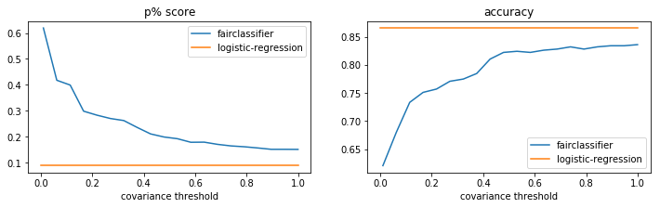
P% Tradeoff (Ideal)

Slide 23
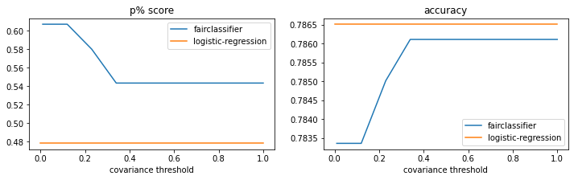
Driver Race and P% Tradeoff

Slide 24
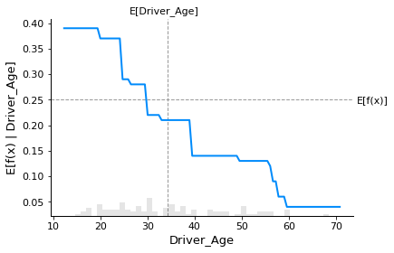
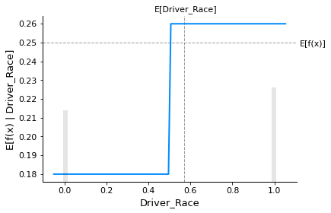
A few Partial Dependence Plots
“What is Partial Dependence?”

Slide 25
Findings

Slide 26
Major Findings
Most important Predictors
Driver_Race*, Driver_Gender, Officer_Years of Experience
Effect of Fairness Metric
Minor positive effect on model performance (%)
Potentially: Black drivers are overrepresented in the dataset in every category (though Driver_Race was not a significantly predictive attribute in our modeling and analysis.)
Discrimination in Traffic Searches
Notes:
(harley) Predictive power of Driver_Race may be reduced due to Selection Bias with the dataset we have to train, vs the reality of Charlotte resident demographics. Black drivers are over-represented in the dataset to begin with but this weighting is not factored in to model.

Slide 27





The Team
Jordan Register
Marianna Shaver
PhD Candidate, Mathematics Education;
Data Science Grad Cert.
Chemist
Data Science
Grad Student
Srikar Vavilala
Harley Grafton
Data Scientist @ Electric Power Research Institute
Business Solutions Engineer @ Charter-Spectrum
Mitchell Jones
Data Analyst @ Visual Risk IQ

Slide 28


