Slide 2
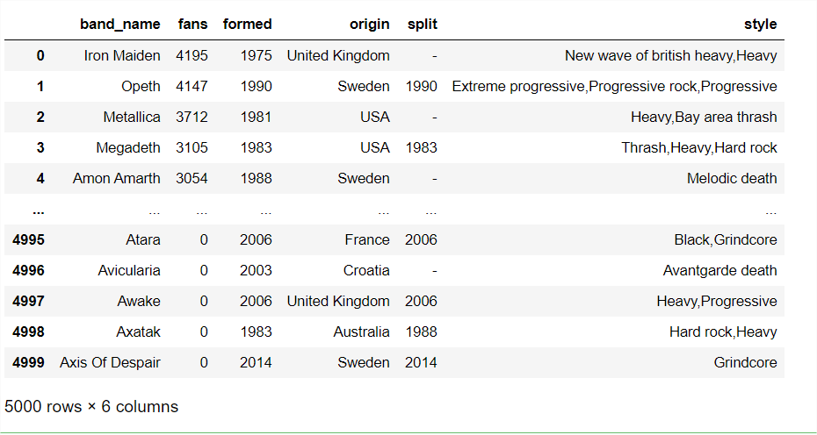
for i,j in data.iterrows():
print (i)
print(j)

