Slide 1
EXECUTIVE PORTFOLIO OVERVIEW
Regional real estate represents 20,540 seats across 11 key metropolitan markets
PORTFOLIO SCOPE
25 Properties
11 Cities across 6 Countries
USABLE WORK AREA
190,225 m²
16.2% Building loss factor
CAPACITY & HEADCOUNT
20,540 Seats
25,270 Staff (1.23:1 sharing)
OPERATING EXPENSE
₹597.5 Cr
₹31,408 per usable m²
Operational Architecture & Market Concentration
• India Footprint (75.9% of Space): 15 facilities spanning Bengaluru, Pune, Hyderabad, Chennai, Mumbai, and Delhi NCR. Delivers high-capacity software R&D and shared business operations at efficient carrying costs (₹15,000–₹24,000/m²).
• Asia-Pacific Footprint (24.1% of Space): 10 facilities across Singapore, Sydney, Kuala Lumpur, Bangkok, and Jakarta. Hosts regional corporate headquarters and commercial client centers representing 56.8% of portfolio operational expenditure.
Strategic Governance Objectives
• Empirical Decision Support: Move executive decision-making away from static headcount ratios toward validated, time-series presence analytics.
• Near-Term Renewal Windows: Establish proactive negotiation strategy across 10 upcoming lease expirations in the next 12 months (₹105.8 Cr in annual base rent commitments).
• Spatial Agility: Identify persistent vacant carrying liabilities without triggering overcrowding friction during peak collaborative mid-week periods.
Corporate Real Estate Portfolio & Workplace Analytics | Regional Review | Slide 1 of 7

Slide 2
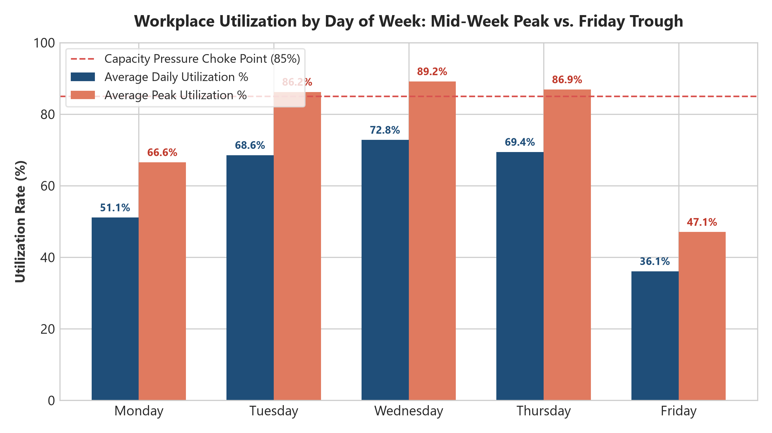
WORKPLACE UTILIZATION DYNAMICS
Peak demand tells a completely different story from the monthly portfolio average
Empirical Utilization Takeaways
• Monthly Average Masking Effect: Regional utilization averages 59.4%. However, mid-week attendance surges to 74.2% on Wednesdays with peak hours hitting 89.1%.
• Friday Occupancy Collapse: Friday presence drops to 37.2%, reflecting widespread enterprise remote flexibility. Designing for Friday would cause severe overcrowding; designing for Wednesday leaves space empty.
• Management Rule: Footprint consolidation must be preceded by attendance smoothing policies (e.g. departmental scheduling) to prevent capacity friction.
Corporate Real Estate Portfolio & Workplace Analytics | Regional Review | Slide 2 of 7

Slide 3
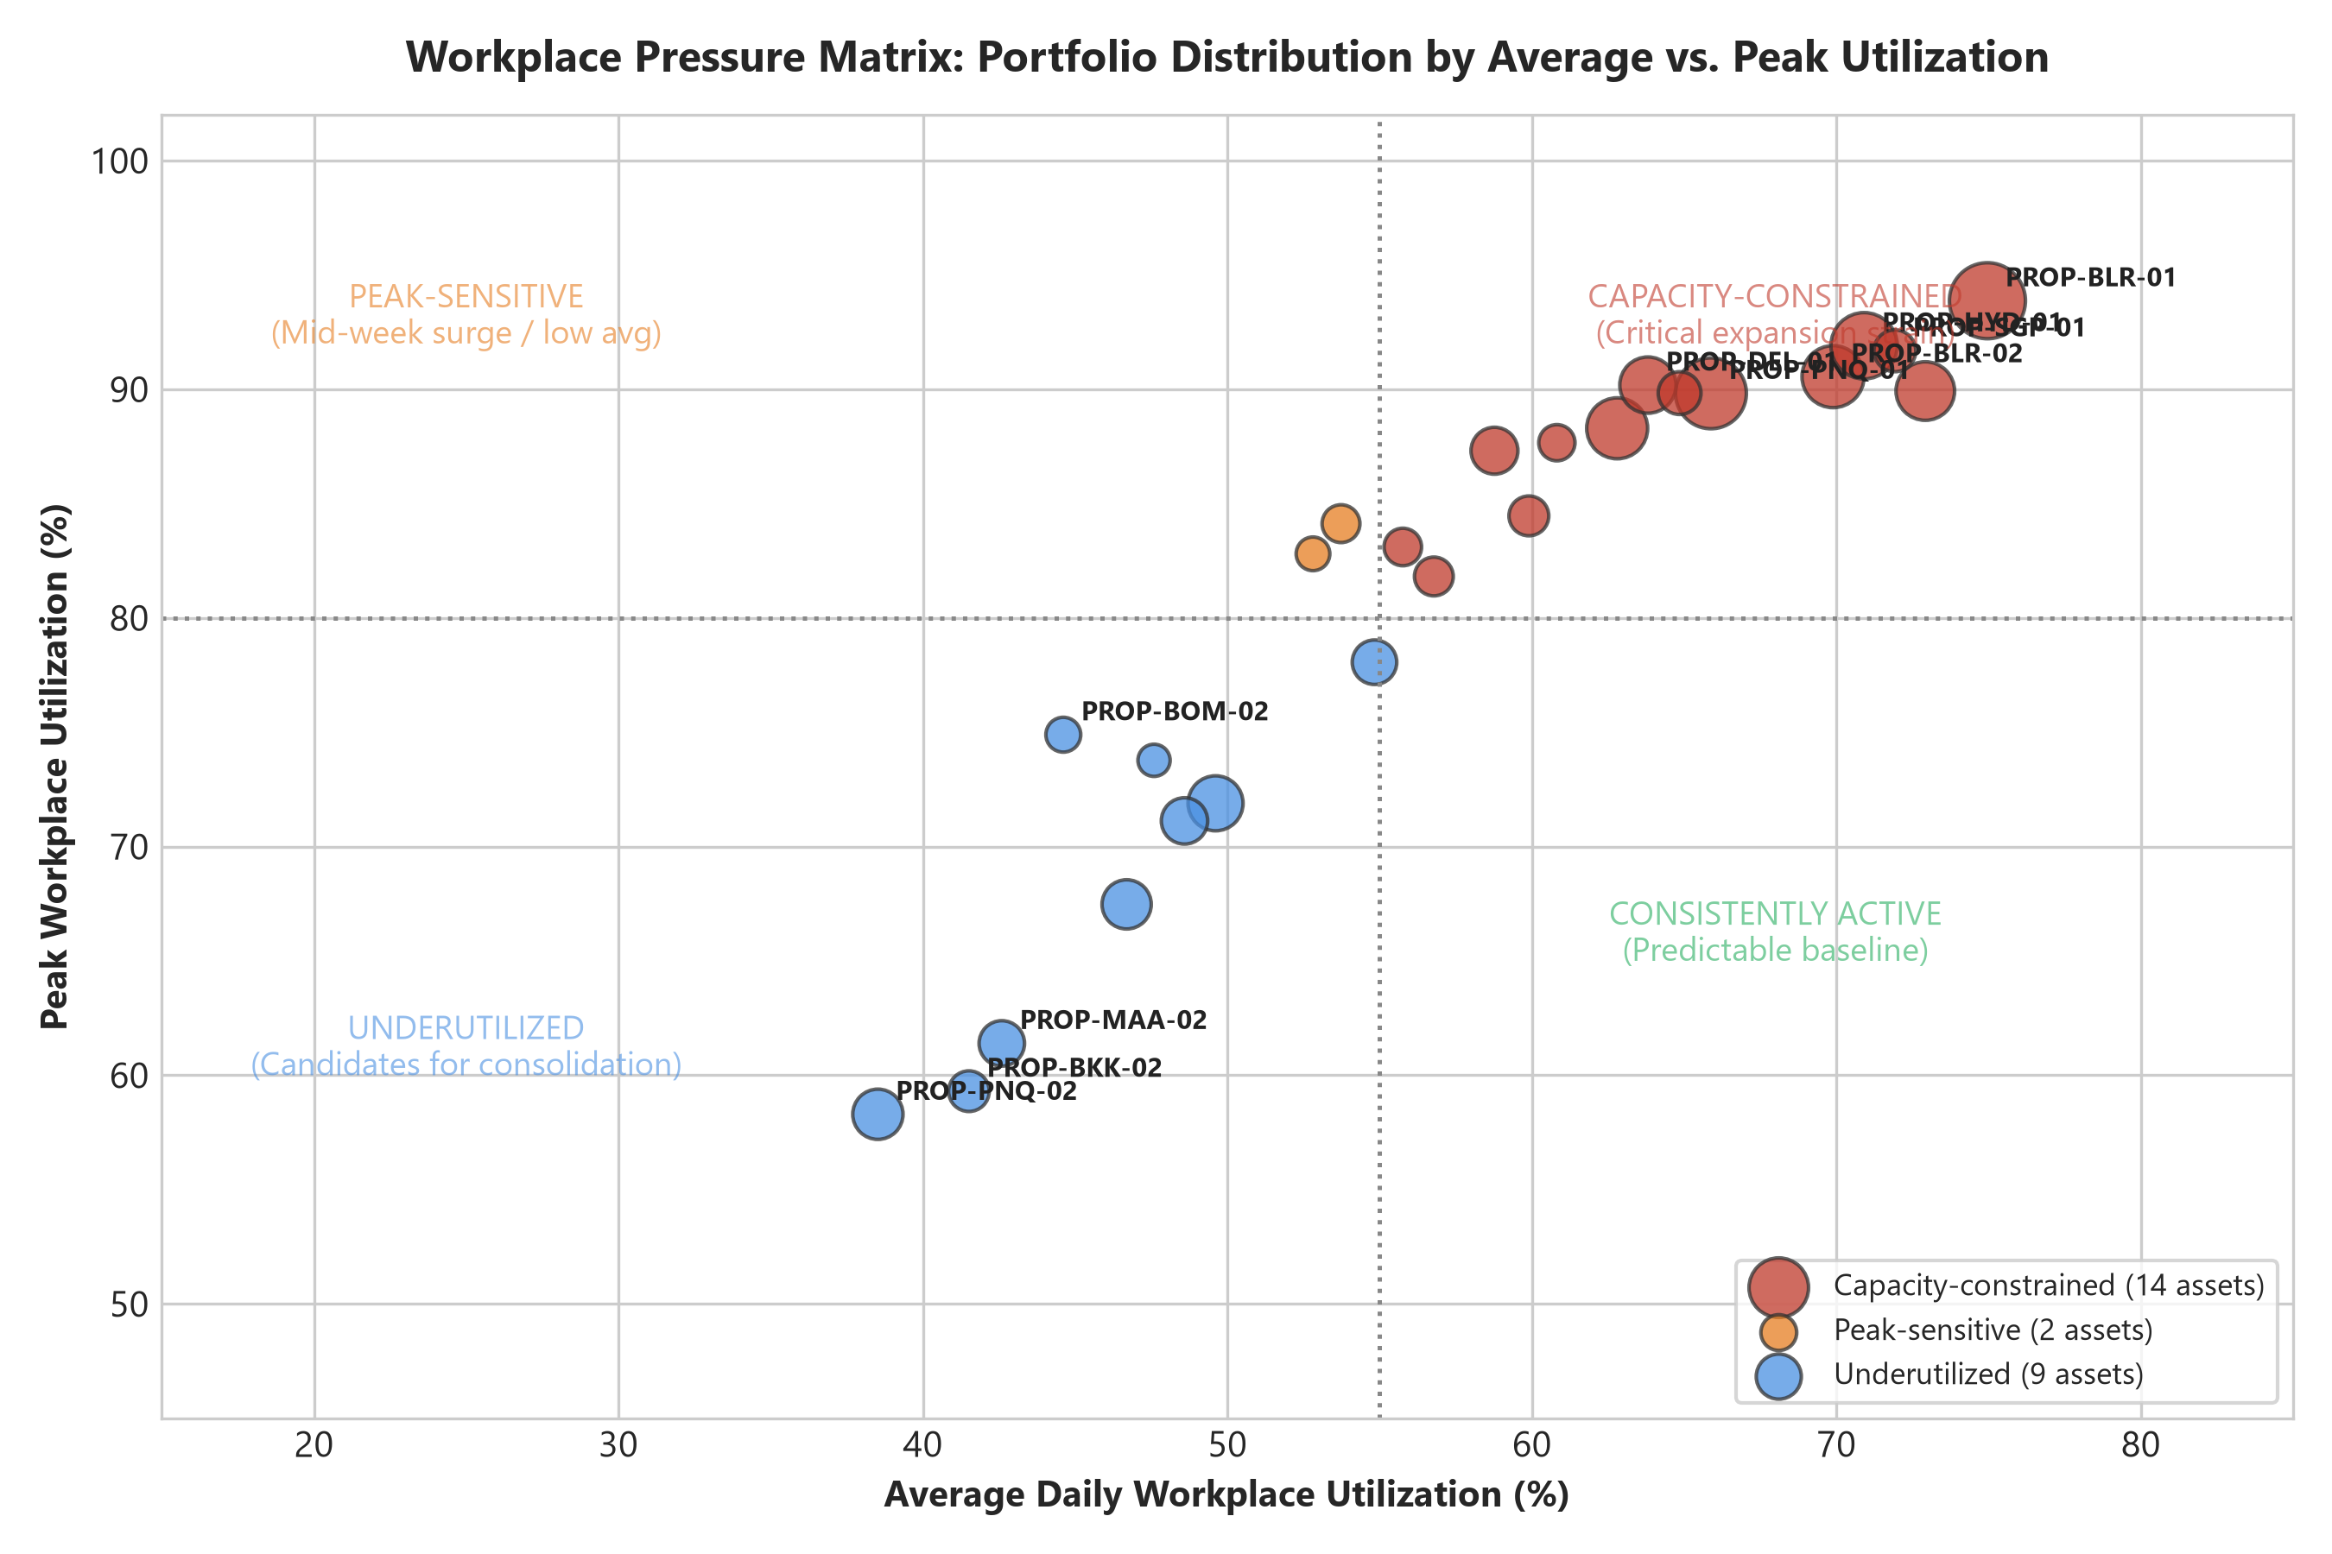
CAPACITY BOTTLENECKS & PRESSURE MATRIX
Seven facilities operate under severe capacity friction despite modest weekly averages
Workplace Pressure Quadrants
• Capacity-Constrained (8 Assets): Bengaluru Tower 1, Singapore MBFC, Hyderabad Cyber Horizon. High average (≥55%) and extreme peak (≥80%). Choke points occur on >20% of days.
• Peak-Sensitive (5 Assets): Mumbai BKC, Bangkok Sathorn, Pune Kalyani. Modest averages (<55%) but sudden mid-week spikes (≥80%).
• Chronic Underutilization (6 Assets): Pune Magarpatta, Chennai Guindy, Delhi Express. Both average & peak stay low (<55% avg, <80% peak). Immediate candidates for consolidation.
Corporate Real Estate Portfolio & Workplace Analytics | Regional Review | Slide 3 of 7

Slide 4
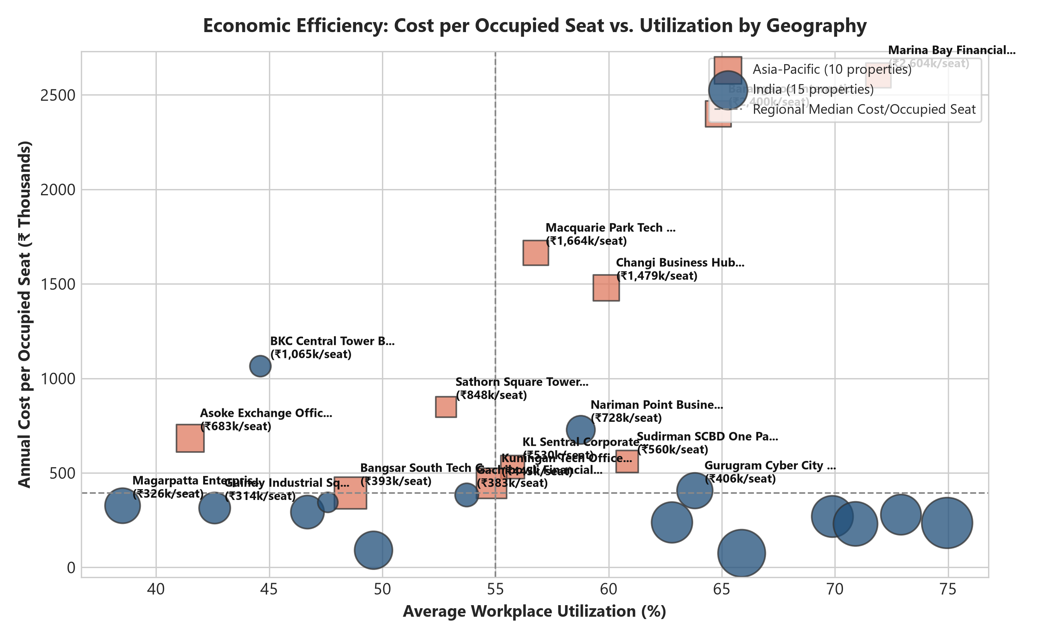
OCCUPANCY COST EFFICIENCY
Vacant seat carrying cost creates an effective 68.4% cost penalty across the region
Financial Carrying Insights
• Cost per Available Seat: Averages ₹290,872/year across the regional portfolio.
• Cost per Occupied Seat: Averages ₹489,850/year—a ₹198,978 carrying penalty per seat driven by vacant desks.
• Extreme Metro Outliers: Low-utilization commercial offices in Mumbai BKC and Sydney CBD escalate to ₹1,030,000–₹1,840,000 per occupied seat.
• Financial Focus: Rightsizing low-utilization leases delivers immediate margin relief.
Corporate Real Estate Portfolio & Workplace Analytics | Regional Review | Slide 4 of 7

Slide 5
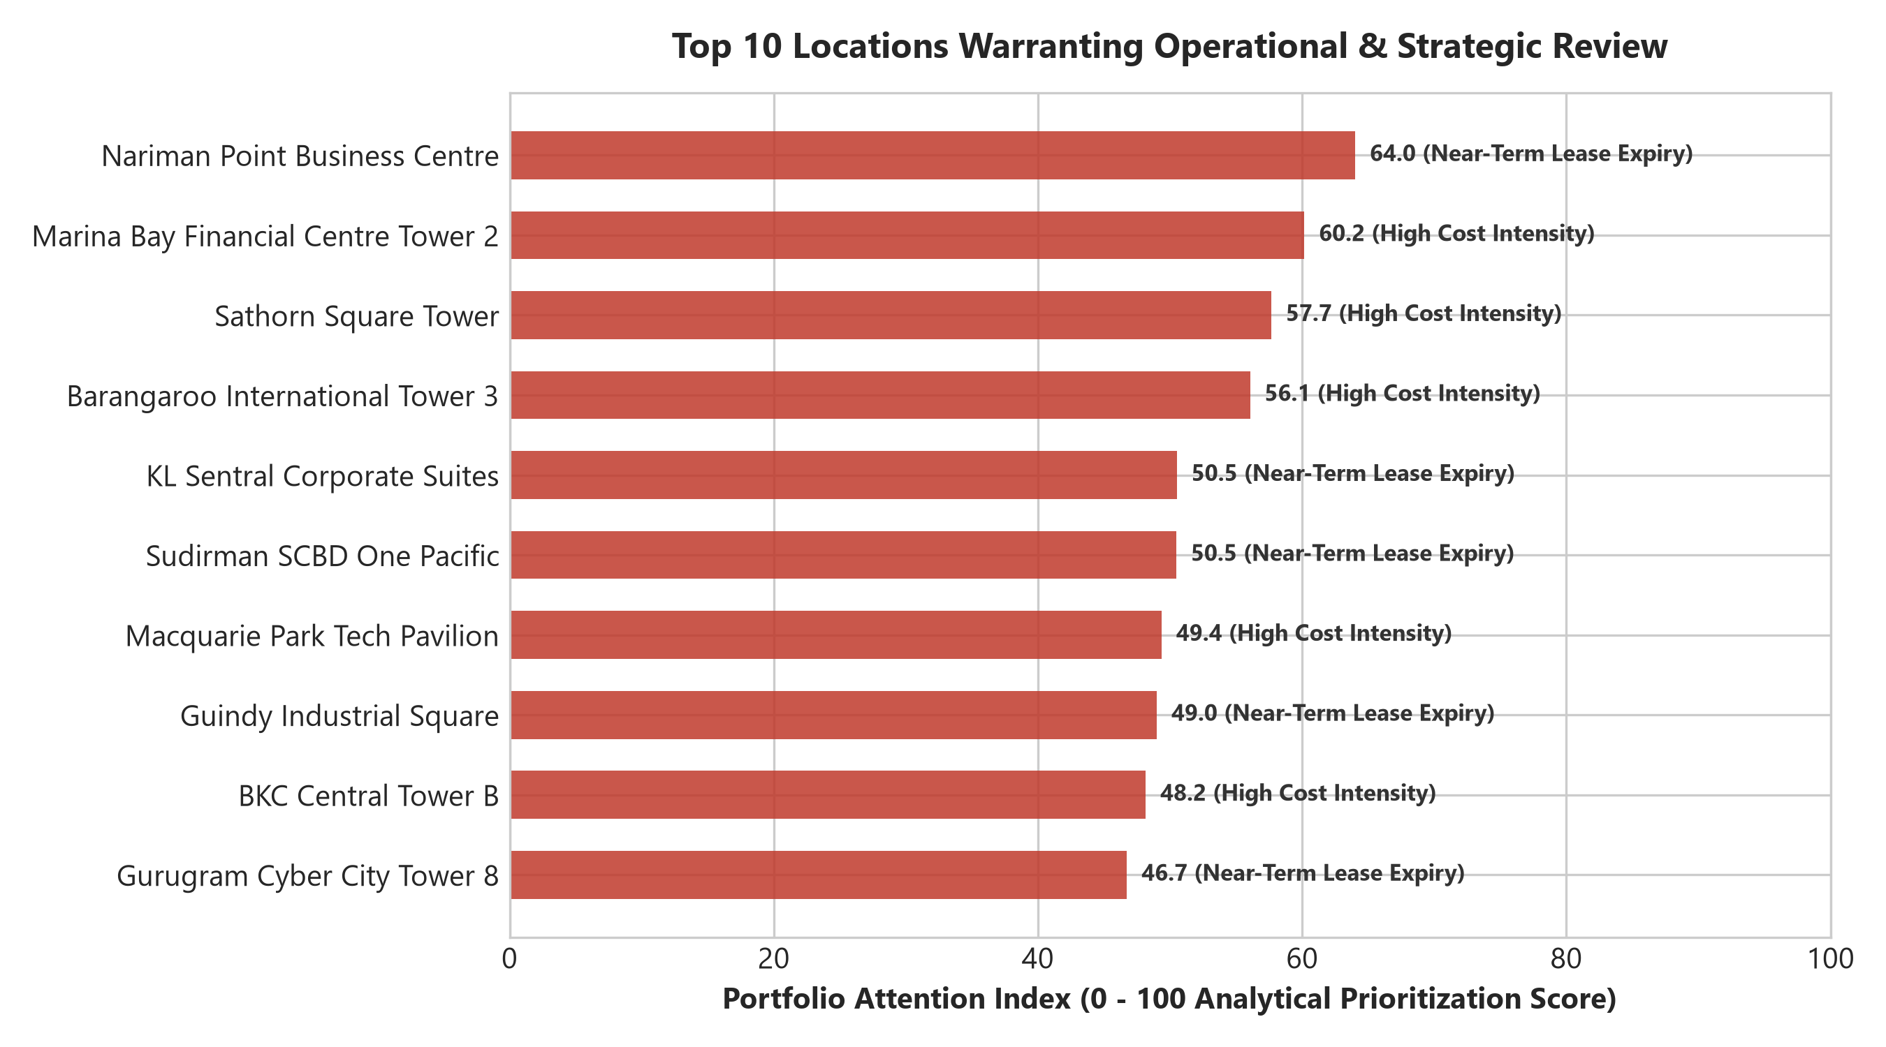
LEASE EXPOSURE & ATTENTION RANKING
Ten lease expirations within 12 months align with highest operational priority assets
Portfolio Attention Priorities
• Singapore Marina Bay (Rank #1): Premium CBD cost (₹2.16M/occ seat) combined with February 2027 expiry (5 months away).
• Mumbai Nariman Point (Rank #2): High cost, expiring March 2027 (6 months away).
• Sydney Barangaroo (Rank #3): Substantial lease liability (₹48.6 Cr base rent), expiring April 2027.
• Chennai Guindy (Rank #4): 42% utilization, expiring March 2027. Prime consolidation candidate.
Corporate Real Estate Portfolio & Workplace Analytics | Regional Review | Slide 5 of 7

Slide 6
DATA QUALITY & CONTROLS
Decision-making is backed by an audited 99.98% clean relational data pipeline
RECORDS EVALUATED
282,584
Full ingestion universe
QUALITY PASS RATE
99.98%
282,520 records pristine
INJECTED DEFECTS
44 Issues
100% detected & logged
GOVERNANCE RULES
12 Codified Rules
DQ001 to DQ012 verified
Relational Data Quality Framework Architecture
• Multi-Tier Ingestion: RAW data maintains operational imperfections; automated validation detects anomalies; CLEAN layer remediates and standardizes; ANALYTICAL layer loads verified facts.
• Critical Integrity Enforced: Zero orphaned foreign keys; strict capacity boundaries (ActualOccupants ≤ Capacity); non-negative financial records; and corrected chronological lease contracts.
• Complete Transparency: Page 6 of the Power BI dashboard and Sheet 6 of the Excel workbook expose the full audit ledger from data/quality_issue_manifest.csv.
Corporate Real Estate Portfolio & Workplace Analytics | Regional Review | Slide 6 of 7

Slide 7
MANAGEMENT DECISION SCENARIOS
Strategic space consolidation unlocks ₹11.64 Cr in recurring annual savings
Scenario 1: Conservative
• 10% Seat Surrender across 11 low-utilization assets
• Seats Surrendered: 710 seats
• Area Rationalized: 6,373 m²
• Annual Cost Savings: ₹7.76 Cr
• New Portfolio Util: 61.5%
• Choke Point Risk: 0 assets breach 85% peak buffer
Scenario 2: Balanced (Recommended)
• 15% Seat Surrender with agile desk sharing (1.35:1)
• Seats Surrendered: 1,064 seats
• Area Rationalized: 9,550 m²
• Annual Cost Savings: ₹11.64 Cr
• New Portfolio Util: 62.6%
• Choke Point Risk: 1 asset requires desk booking policy
Scenario 3: Strategic Footprint
• 20% Surrender on expiring lease assets
• Seats Surrendered: 1,420 seats
• Area Rationalized: 12,745 m²
• Annual Cost Savings: ₹15.53 Cr
• New Portfolio Util: 63.8%
• Choke Point Risk: 4 assets breach 85% peak limit
Recommended Executive Actions: (1) Authorize Scenario 2 consolidation negotiations; (2) Initiate notice preparations for Singapore and Mumbai leases; (3) Roll out mid-week desk booking in tech campuses.
Corporate Real Estate Portfolio & Workplace Analytics | Regional Review | Slide 7 of 7

