Slide 1
Data Visualization of Smartphone Usage And Addiction Behavior
Presented By:
Arpita Teli
Kalyani Nair
Vishakha Deshmane
Hridaya Adep
Saloni Warang
Soham Wankhede

Slide 2
Dataset Overview
Domain: DIGITAL BEHAVIOR/ SMARTPHONE USAGE ANALYTICS
Objective:
Analyze how users spend time on their smartphones.
Study relationship between screen time and smartphone addiction.
Identify behavioral patterns.
Dataset Size:
7500 users
16 variables
Mix of numerical and categorical data

Slide 3
Types of Data Used
Nominal Data (Categories without order)
gender
transaction_id
user_id
Ordinal Data (Categories with order)
addiction_level
stress_level
academic_work_impact
Numerical Data (Quantitative)
age
daily_screen_time_hours
social_media_hours
gaming_hours
sleep_hours
notifications_per_day
app_opens_per_day
weekend_screen_time
addicted_label

Slide 4
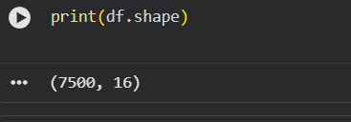
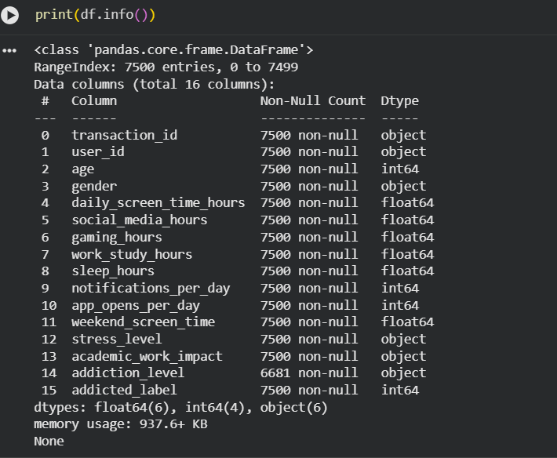
Dataset Information and Structure

Slide 5
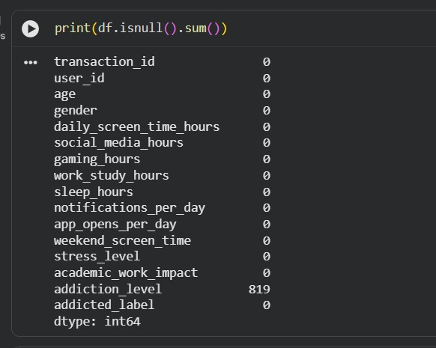
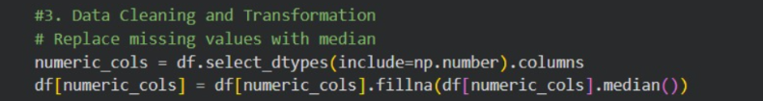
Data Cleaning
Step 1: Handling Missing Values: Missing values were identified and replaced with median

Slide 6
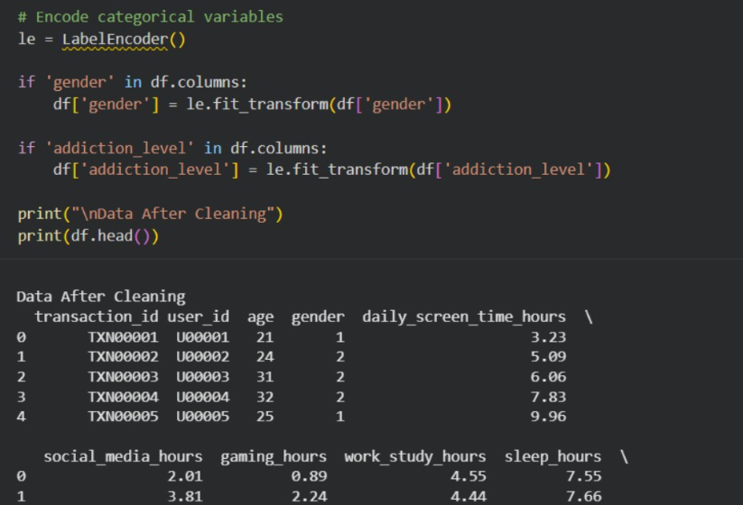
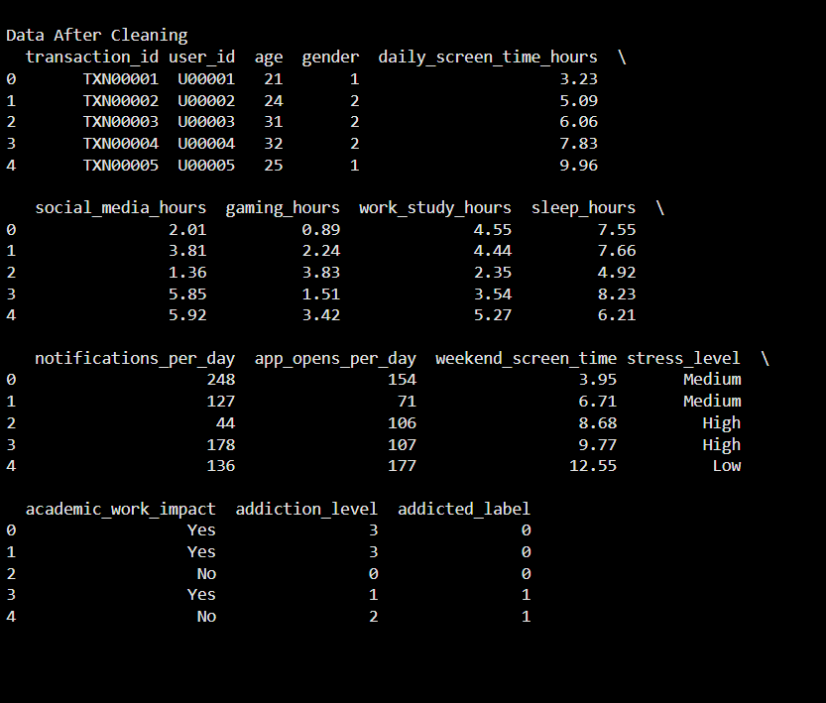
Data Cleaning
Step 2: Encoding Categorical Data: Categorial variables were converted into numerical form

Slide 7
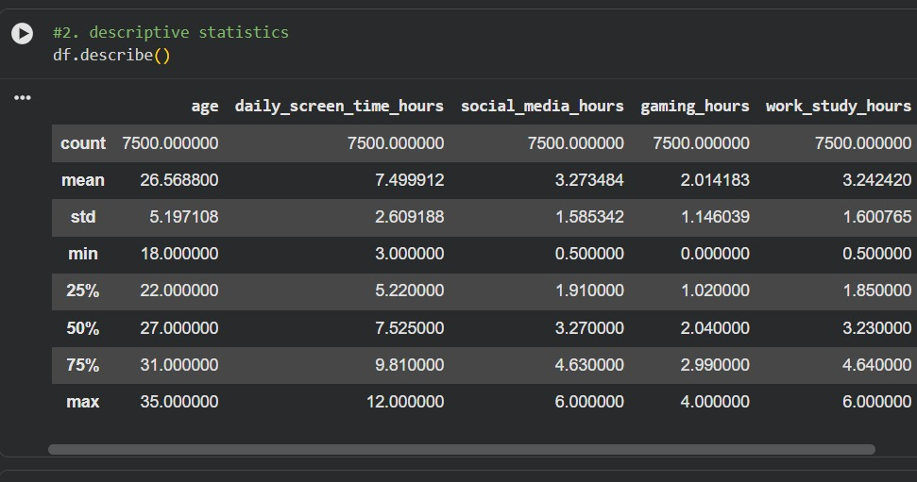
Descriptive Statistics

Slide 8
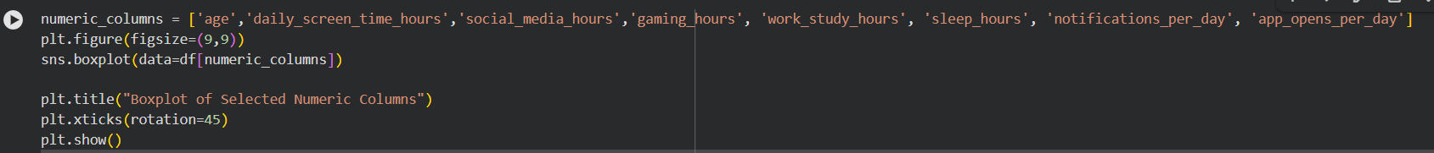
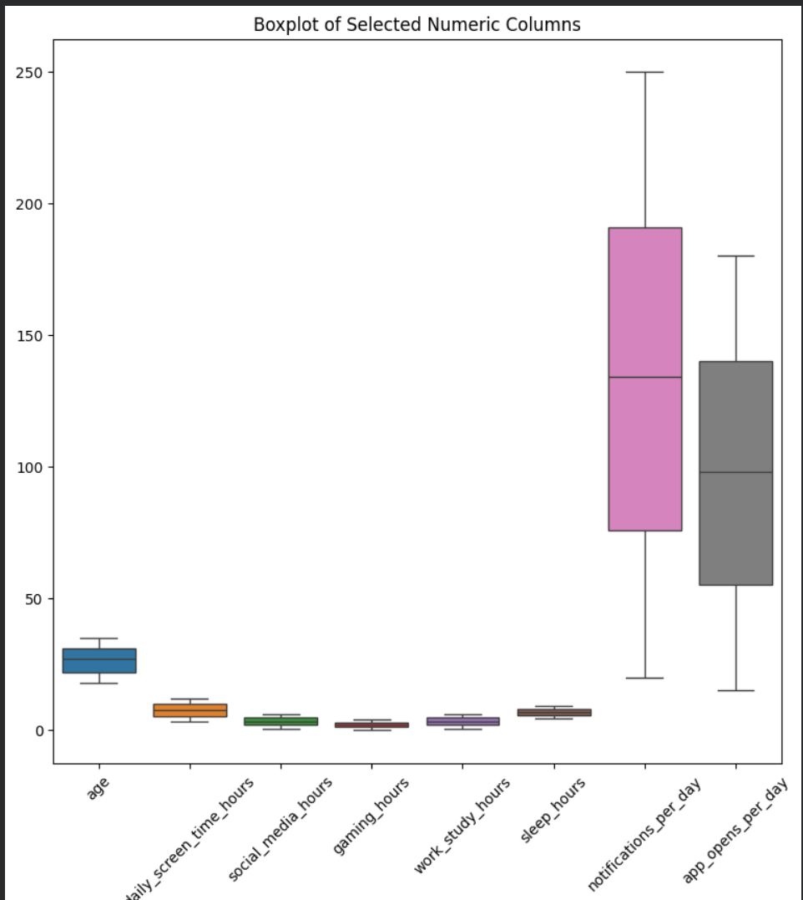
Box Plot (Outlier Detection)

Slide 9
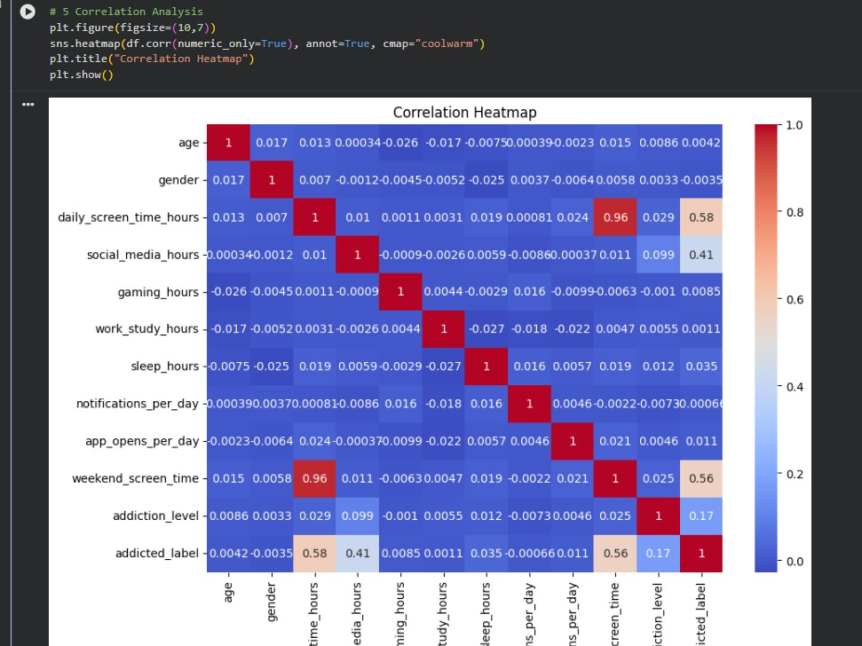
Correlation Heatmap

Slide 10
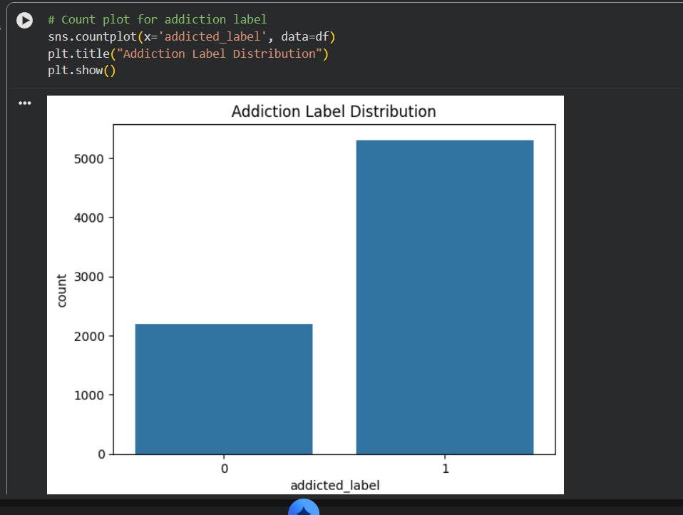
Addiction Label Distribution

Slide 11
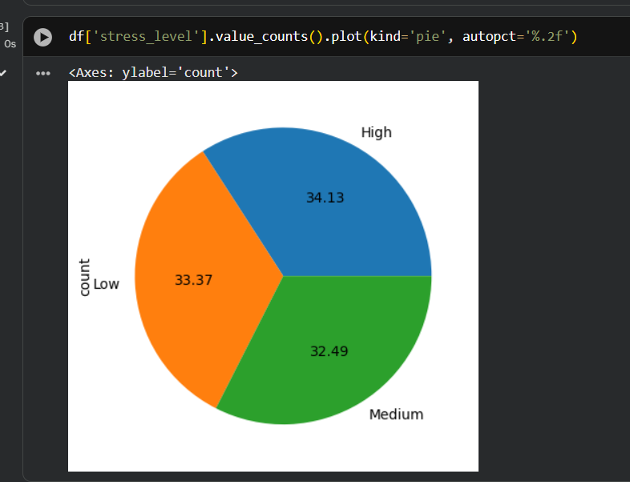
Pie chart for Stress level

Slide 12
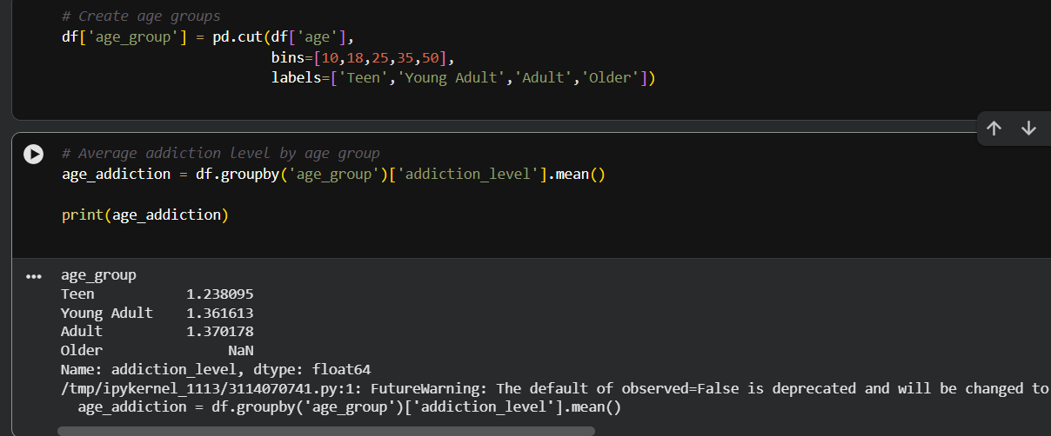
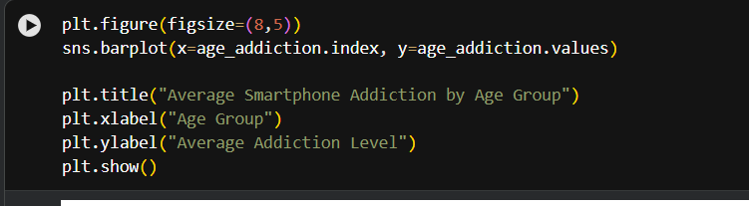
Age Group vs Addiction Analysis

Slide 13
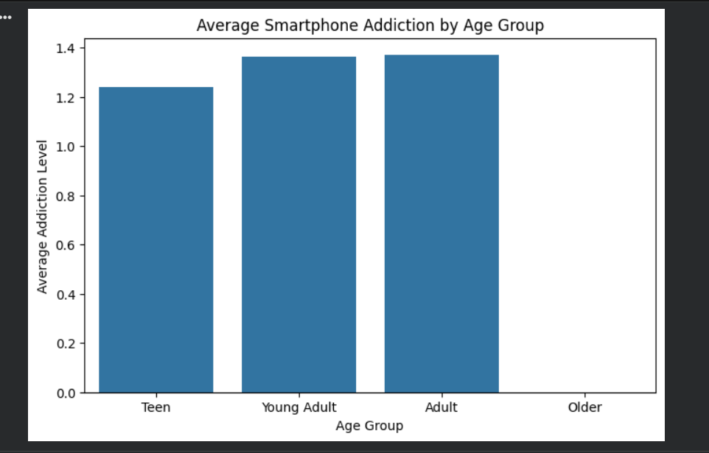
Age Group vs Addiction Analysis

Slide 14
Recommendations
Improve data preprocessing Encode categorical variables properly before applying machine learning models.
Use feature engineering Create new features such as total_screen_time = social_media_hours + gaming_hours + studying_hours.
Apply machine learning models Use classification models like Logistic Regression, Decision Tree, or SVM.
Normalize or scale numeric data StandardScaler or MinMaxScaler can improve model performance.
Perform feature selection Use correlation analysis to remove irrelevant variables and keep only important features affecting addiction levels.

Slide 15
Benefits
Better data understanding EDA helps understand data distribution, patterns, and relationships between variables.
Better predictive modeling Clean and processed data improves the accuracy of machine learning models.
Efficient decision making Technical analysis helps researchers and developers build systems to monitor and reduce smartphone addiction.

Slide 16
Conclusion
Through Exploratory Data Analysis (EDA), data cleaning, descriptive statistics, visualization, and correlation analysis, the dataset was examined to understand user behavior and identify important factors influencing smartphone addiction.
The visualizations such as histograms, boxplots, and heatmaps helped in identifying data distribution, outliers, and relationships between different variables.
Overall, the analysis highlights that excessive smartphone usage can negatively affect lifestyle habits such as sleep and stress management. These insights can help researchers, educators, and users understand smartphone usage patterns and encourage healthier digital habits. The findings can also support the development of tools and strategies to monitor and reduce smartphone addiction.

Slide 17
THANK YOU !

