Slide 1
Steps to Running a Servlet
Create a directory structure under Tomcat for your application.
Write the servlet source code.
Compile your source code.
Deploy the servlet
Run Tomcat
Call your servlet from a web browser

Slide 2
Write the Servlet Code
Servlets implement the javax.servlet.Servlet interface.
Because most servlets extend web servers that use the HTTP protocol to interact with clients, the most common way to develop servlets is by specializing the javax.servlet.http.HttpServlet class.
The HttpServlet class implements the Servlet interface by extending the GenericServlet base class, and provides a framework for handling the HTTP protocol.
Its service() method supports standard HTTP requests by dispatching each request to a method designed to handle it.
In myApp/src, create a file called TestingServlet.java

Slide 3
Servlet Example
1: import java.io.*;
2: import javax.servlet.*;
3: import javax.servlet.http.*;
4:
5: public class MyServlet extends HttpServlet
6: {
7: protected void doGet(HttpServletRequest req,
8: HttpServletResponse res)
9: {
10: res.setContentType("text/html");
11: PrintWriter out = res.getWriter();
12: out.println( "<HTML><HEAD><TITLE> Hello You!” +
13: “</Title></HEAD>” +
14: “<Body> HelloYou!!!</BODY></HTML>“ );
14: out.close();
16: }
17: }

Slide 4

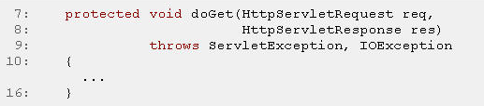
An Example of Servlet (I)
Lines 1 to 3 import some packages which contain many classes which are used by the Servlet (almost every Servlet needs classes from these packages).
The Servlet class is declared in line 5. Our Servlet extends javax.servlet.http.HttpServlet, the standard base class for HTTP Servlets.
In lines 7 through 16 HttpServlet's doGet method is getting overridden

Slide 5
An Example of Servlet (II)
In line 11 we use a method of the HttpServletResponse object to set the content type of the response that we are going to send. All response headers must be set before a PrintWriter or ServletOutputStream is requested to write body data to the response.
In line 12 we request a PrintWriter object to write text to the response message.
In lines 13 and 14 we use the PrintWriter to write the text of type text/html (as specified through the content type).

Slide 6

An Example of Servlet (III)
The PrintWriter gets closed in line 15 when we are finished writing to it.
In lines 18 through 21 we override the getServletInfo() method which is supposed to return information about the Servlet, e.g. the Servlet name, version, author and copyright notice. This is not required for the function of the HelloClientServlet but can provide valuable information to the user of a Servlet who sees the returned text in the administration tool of the Web Server.

Slide 7
Compile the Servlet
Compile the Servlet class
The resulting TestingServlet.class file should go under myApp/WEB-INF/classes

Slide 8
Deploy the Servlet
In the Servlet container each application is represented by a servlet context
Each servlet context is identified by a unique path prefix called context path
  For example our application is identified by /myApp which is a directory under webapps.
The remaining path is used in the selected context to find the specific Servlet to run, following the rules specified in the deployment descriptor.

Slide 9
Deployment Descriptor
The deployment descriptor is a XML file called web.xml that resides in the WEB-INF directory within an application.
<web-app xmlns=http://java.sun.com/xml/ns/j2ee……>
<display-name>test</display-name>
<description>test example</description>
<servlet>
<servlet-name>Testing</servlet-name>
<servlet-class>TestingServlet</servlet-class>
</servlet>
<servlet-mapping>
<servlet-name>Testing</servlet-name>
<url-pattern>/servlet/TestingServlet</url-pattern>
</servlet-mapping>
</web-app>

Slide 10
Run the Servlet
To execute your Servlet, type the following URL in the Browser’s address field:
http://localhost/myApp/servlet/myServlet

Slide 11
Running service() on a single thread
By default, servlets written by specializing the HttpServlet class can have multiple threads concurrently running its service() method.
If you would like to have only a single thread running a service method at a time, then your servlet should also implement the SingleThreadModel interface.
  This does not involve writing any extra methods, merely declaring that the servlet implements the interface.

Slide 12
Example
public class SurveyServlet extends HttpServlet implements SingleThreadModel
{
/* typical servlet code, with no threading concerns
* in the service method. No extra code for the
* SingleThreadModel interface. */
...
}

Slide 13
The Servlet Interfaces – 5 Interfaces

Slide 14
All servlets must implement the servlet interface. It declares the init(),service(),and destroy() methods that are called by the server during lifecycle of a servlet. A method is also provided that allows a servlet to obtain any initialization parameters.
The init(), service(), and destroy() methods are the life cycle methods of the servlet. These are invoked by the server. The getServletconfig() method is called by the servlet to obtain initialization parameters.

Slide 15
The ServletConfig Interface
The ServletConfig interface is implemented by the server. It allows a servlet to obtain configuration data when it is loaded.
The ServletContext Interface
The ServletContext Interface is implemented by the server. It enables servlets to obtain information about their environment.
The ServletRequest Interface
The ServletRequest Interface is implemented by the server. It enables a servlet to obtain information about a client request.

Slide 16
The ServletResponse interface
TheServletResponse Interface is implemented by the server . It enables a server to formulate a response for a client
The SingleThreadModel Interface
This interface is used to indicate that only a single thread will execute the service() method of a servlet at a given time. It defines no constants and declares no methods. If a servlet implements this interface, the server has two options . First, it can create several instances of the servlet. When a client request arrives, it is sent to an available instance of the servlet. Second, it can synchronize access to the servlet.

Slide 17
The Servlet Classes – 4 Classes

Slide 18
The GenericServlet Class
The GenericServlet Class provides implementations of the basic life cycle methods for a servlet and its typically sub classed by servlet developers. GenericServlet implements the servlet and ServletConfig interfaces. In addition, a method to append a string to the servlet log file is available. The signatures of this method are shown here:
void log(String s)
void log(String s, throwable e)
Here,s is the string to be appended to the log, and e is an exception that occurred.

Slide 19
The ServletInputStream Class
The ServletInputStream Class extends InputStream. It is implemented by the server and provides an input stream that a servlet developer can use to read the data from a client request. It defines the default constructor. It addition, a method is provided to read bytes from the stream. Its signature is shown here:
int readLine(byte[]buffer, int offset, int size)
throws IOException
Here, buffer is the array into which size bytes are placed starting at offset. The method returns the actual number of bytes read or -1 if an end-of-stream condition is encountered.

Slide 20
The ServletOutputStream Class
The ServletOutputStream class extends OutputStream. It is implemented by the server and provides an output stream that a servlet developer can use to write data to a client response. A default constructor is defined. It also defines the print() and println() methods, which output data to the stream.
The Servlet Exception Classes
javax.servlet defines two exceptions. The first is ServletException, which indicates that a servlet problem has occured . The second is unavailable Exception, which extends servletException. It indicates that a servlet is unavailable.

Slide 21
javax.servlet.http Package

Slide 22
The Servlet Interfaces

Slide 23
HttpServletRequest - Extends the ServletRequest interface to provide additional functionality for the request object that is passed to an HTTP servlet.
HttpServletResponse - Defines an HTTP servlet response that a servlet running on a Web server sends to a client using HTTP.
HttpSession - Provides a way to identify a user across more than one page request or visit to a Web site
HttpSessionBindingListener - Causes an object to be notified when it is bound to or unbound from a session.

Slide 24
The Servlet Classes

Slide 25
Cookie - Creates a cookie, a small amount of information sent by a servlet to a Web browser, saved by the browser, and later sent back to the server when the client accesses the same Web page.
HttpServlet - Provides an abstract class that you can subclass to create an HTTP servlet, which receives requests from and sends responses to a Web site.
HttpSessionBindingEvent - Sent by a session to an object that implements HttpSessionBindingListener when the object is bound to or unbound from the session.
HttpUtils - Provides a collection of methods that are useful in writing HTTP servlets.

Slide 26
HTTP GET AND POST METHODS
A Web browser client communicates with the server typically using one of two HTTP methods—GET or POST. Typically, these methods are used as follows:
GET is used to request information from the server.
POST is used to send data to the server.
The GET method can also be used to pass information in the form of a query string in the URL
POST can be used for requests.

Slide 27
An Example
The following URL with a query string (the data following the ?) is passed by the GET method and sets a parameter called day to the value 12
http://localhost:8000/j2ee?day=12

Slide 28
Interpretation of the code
Because the query string is added to the end of the URL, information that is sent as part of a GET request is visible to the client. examples of this type are seen many times when browsing the Web, especially when using search engines.
Because a URL can be read and bookmarked, sensitive information (such as a password, personal details, or credit card numbers) should not be passed this way.

Slide 29
POST Method
In contrast, the POST method sends its data directly after the HTTP header, in the body of the message, and does not append data to the URL. For this reason, it is safer to send sensitive information using POST.
In all other respects, the GET and POST methods can be thought of as the same.

Slide 30
GET and POST Methods
They both interact with the server and can be used to update or change the current Web page and change server-side properties.
In fact, POST methods are often used to send long query strings that would otherwise overflow the maximum size for a URL.
As a servlet developer, whether to use GET or POST can become a matter of personal choice, as long as one remembers that GET should never be used where the information being sent may be used to compromise someone’s security or privacy.

Slide 31
Other HTTP Methods
Other HTTP Methods
The following HTTP methods are used less often:
HEAD - This method can be used if the client wants information about a document but does not want the document to be returned. Following a HEAD request, the server responds with the HTTP headers only; no HTTP body is sent.
PUT - Requests the server to store the body of the request at a specified URL.

Slide 32
Other HTTP Methods
DELETE - Requests the removal of data at a URL.
OPTIONS - Requests information about the communications options available.
TRACE - Used for debugging. The HTTP body is simply returned by the server.

Slide 33
HTTP Status Code Groups
100-199 - Information indicating that the request has been received and is being processed.
200-299 - Request was successful.
300-399 - Further action is required.
400-499 - Request is incomplete.
500-599 - Server error has occurred.
Most browsers will deal with most of these status codes silently. The handling of status codes is browser specific

Slide 34
HTTP Status Codes
400 Bad Request - The server detected a syntax error in the request.
401 Unauthorized - The request did not have the correct authorization.
403 Forbidden - The request was denied, reason unknown.
404 Not Found - The document was not found.
500 Internal Server Error - Usually indicates that part of the server (probably your servlet) has crashed.
501 Not Implemented - The server cannot perform the requested action.

Slide 35
Content Type Headers
As part of the response headers, a content type field is used to indicate the format of the data that is being sent in the response. The value for this field is in Multipurpose Internet
Mail Extensions (MIME)—also used when attaching documents to e-mail.
Some self-explanatory MIME content types are as follows:
text/html
text/plain
image/gif
application/pdf
The browser can also specify in the request header the MIME types that it will accept.

Slide 36
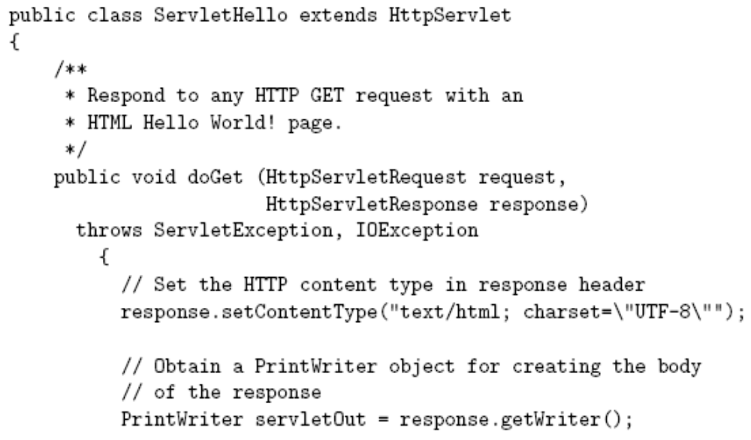
Hello World! Servlet

Slide 37
Hello World! Servlet
All servlets we will write
are subclasses of
HttpServlet

Slide 38
Hello World! Servlet
Server calls doGet() in response to GET request

Slide 39
Hello World! Servlet
Interfaces implemented by request/response objects

Slide 40
Hello World! Servlet
Production servlet should
catch these exceptions

Slide 41
Hello World! Servlet
JWSDP Tomcat server exception handling:
  Writing a trace for the exception in logs/jwsdp_log.*.txt log file
  Returning HTML page to client that may (or may not) contain partial exception trace
If servlet prints a stack trace itself by calling printStackTrace(), or if it writes debugging output to System.out or System.err, this output will be appended to the file logs/launcher.server.log

Slide 42
Hello World! Servlet
First two
things done
by typical servlet;
must be in this
order

Slide 43
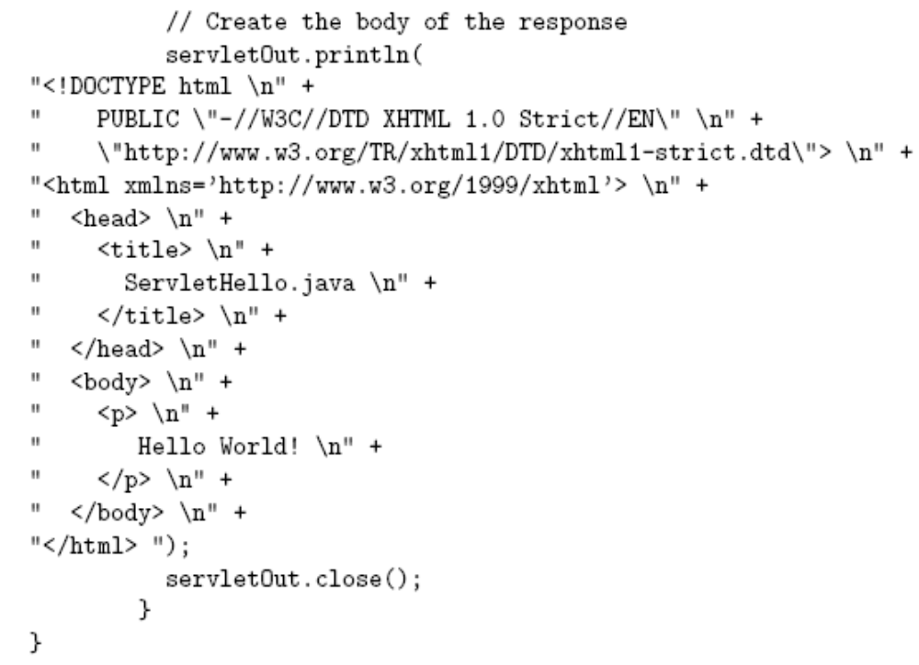
Hello World! Servlet

Slide 44
Hello World! Servlet
HTML generated by calling print() or
println() on the servlet’s
PrintWriter object

Slide 45
Hello World! Servlet
Good practice to explicitly close
the PrintWriter when done

Slide 46
Next Session: Cookies and Session Tracking

