Slide 1
Cloud for customer service integration Internship Project Phase 2 review 2, May 2022
Done at:
Project Advisor (External): Krishna vihar sathish babu - VP, Engineering
Project Advisor (Internal): Dr Bhagavathi Sivakumar – Associate professor
S.No | Reg.No | Name of the Student | Section
1 | CB.EN.U4CSE18502 | Hridhi sethi | CSE A

Slide 2
Problem formation and understanding
To maintain and enhance the current stack including software's like C4C, CPI and FSM, along with testing the new stack features being added.

Slide 3
Motivation
Cloud platform integration is a middleware between C4C(Cloud for customers) and FSM (field service management) software.
It helps companies help their customers by providing solutions to their problems either through online help (c4c) or on field (FSM)
In order to maintain the data properly between these 2 interactive platforms CPI came into picture.

Slide 4
Demonstration of tools/Softwares
Here the tools used for maintenance of current stack are C4C, CPI, FSM, SAP logon pad(backend)
For testing of the new stack features Jmeter tool was used.

Slide 5
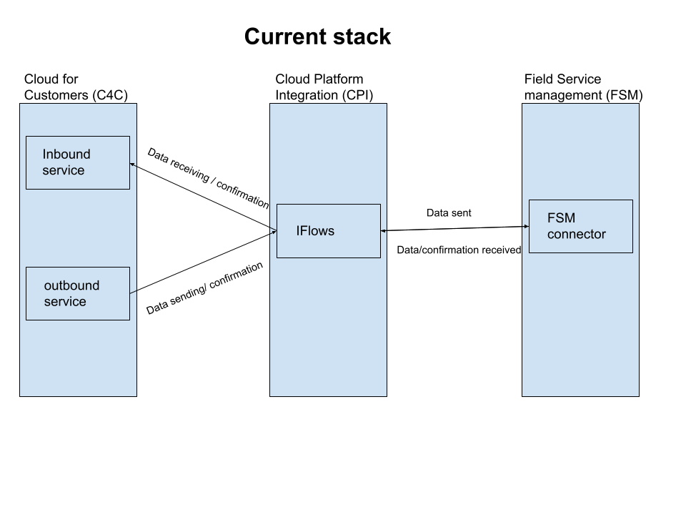
Architecture diagram

Slide 6
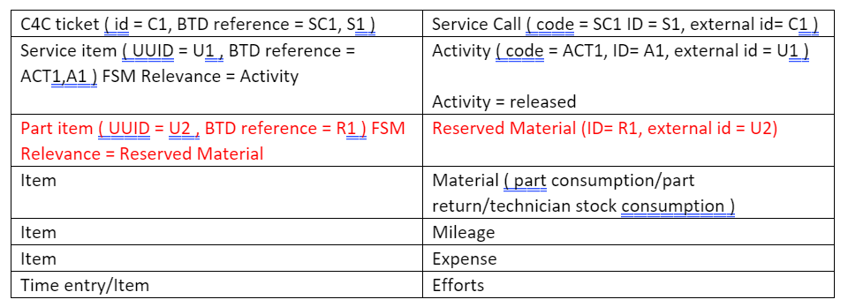
System Design
A particular scenario of replicating service call from FSM to C4C

Slide 7
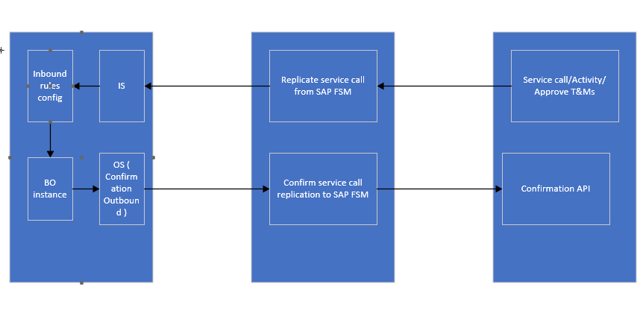
Data flow diagram for service call

Slide 8
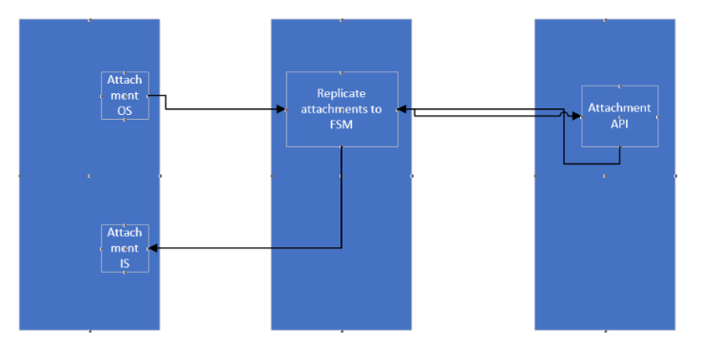
Data flow diagram for attachments

Slide 9
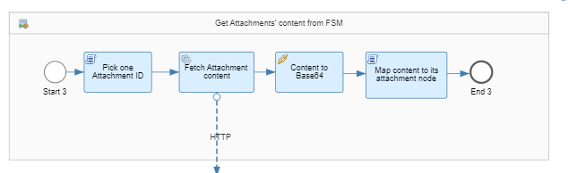
Implementation
Helped in designing and implementation of integration flows. For example for replication of attachments from FSM to C4C

Slide 10
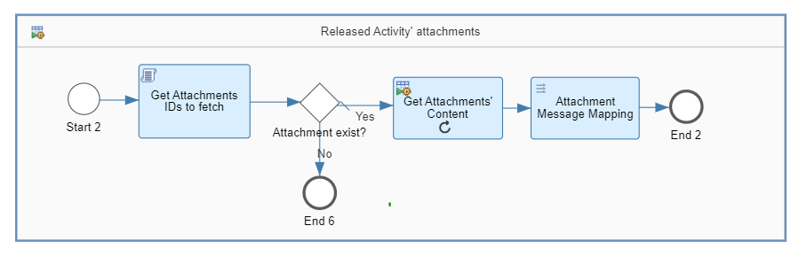
Also implemented the flow of replication when a released activity is being replicated

Slide 11
Testing and validation
As new stack is under development, its modules namely case and template were tested using Jmeter scripts.
Case module is equivalent to tickets in current stack. Tickets are used to track the customer issues and solutions proposed to them.
Template module is often used to speed up the process of order by automating tasks that occur frequently

Slide 12
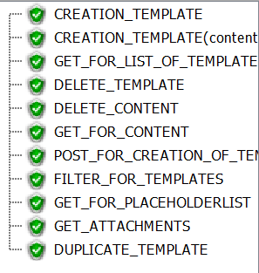
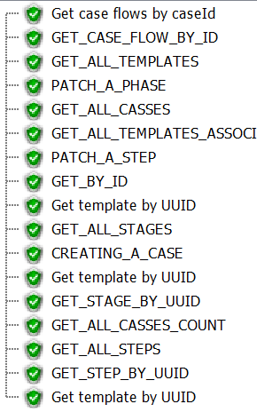
Template module test cases with validation
Case module test cases with validation

Slide 13
Demonstration and Discussion
Maintenance and enhancement of features like deletion will be developed in upcoming future for the current stack.
Development of new stack is under progress. Q1 was completed with a focus on case and template API
In new stack Q2 phase is under progress with its focus on CPI

Slide 14
References
SAP C4C system : Logon (sapbydesign.com)
SAP CPI system : Cloud Integration (ondemand.com)
SAP FSM system : http://qt.coresystems.net/

Slide 15
Thank You

