Slide 1
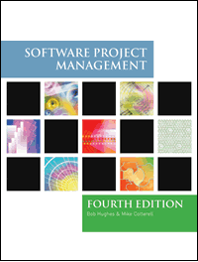
Software Project Management
5th Edition
Chapter 2
Programme management and project evaluation
Notes:
This talk provides an overview of the basic steps needed to produce a project plan. The framework provided should allow students to identify where some of the particular issues discussed in other chapters are applied to the planning process. As the focus is on project planning, techniques to do with project control are not explicitly described. However, in practice, one element of project planning will be to decide what project control procedures need to be in place.

Slide 2
Main topics to be covered
Programme management
Benefits management
Project evaluation
  Cost benefit analysis
  Cash flow forecasting
Project risk evaluation

Slide 3
Programme management
One definition:
‘a group of projects that are managed in a co-ordinated way to gain benefits that would not be possible were the projects to be managed independently’ Ferns
Notes:
The quotation is from a paper that appeared in the International Journal of Project Management August 1991

Slide 4
Programmes may be
Strategic
Business cycle programmes
Infrastructure programmes
Research and development programmes
Innovative partnerships
Notes:
Strategic
Several projects together implement a single strategy. For example, merging two organizations will involve many different activities e.g. physical re-organization of offices, redesigning the corporate image, merging ICT systems etc. Each of these activities could be project within an overarching programme.
Business cycle programmes
A portfolio of project that are to take place within a certain time frame e.g. the next financial year
Infrastructure programmes
In an organization there may be many different ICT-based applications which share the same hardware/software infrastructure
Research and development programmes
In a very innovative environment where new products are being developed, a range of products could be developed some of which are very speculative and high-risk but potentially very profitable and some will have a lower risk but will return a lower profit. Getting the right balance would be key to the organization’s long term success
Innovative partnerships
e.g. pre-competitive co-operation to develop new technologies that could be exploited by a whole range of companies

Slide 5
Programme managers versus project managers
Programme manager
  Many simultaneous projects
  Personal relationship with skilled resources
  Optimization of resource use
  Projects tend to be seen as similar
Project manager
  One project at a time
  Impersonal relationship with resources
  Minimization of demand for resources
  Projects tend to be seen as unique
Notes:
The programme manager may well have a pool of staff upon which to call. He/she will be concerned with ensuring the best use of staff e.g ensuring that staff have regular work with no periods of enforced idleness between project tasks. The project leader would think in terms of ‘I need a Java programmer for four weeks’ without being concerned which specific person it is (beyond obvious concerns that they are fully capable).

Slide 6
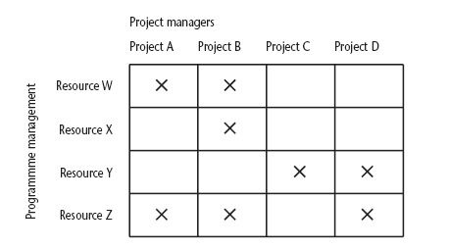
Projects sharing resources
Notes:
During the resource allocation phase of project planning – see chapter/lecture 8 on resource allocation – some project activities could be delayed while waiting for a resource to become available.

Slide 7
Strategic programmes
Based on OGC approach
Initial planning document is the Programme Mandate describing
  The new services/capabilities that the programme should deliver
  How an organization will be improved
  Fit with existing organizational goals
A programme director appointed a champion for the scheme
Notes:
The material here is based on the UK government’s Office of Government Commerce (OGC) approach which is described in detail in their publication Managing successful programmes.
The programme director should be someone who is in a prominent position in the organization so that the seriousness and commitment of the organization to the programme are made clear.
An example of what might be a programme is given in Section 3.4 in the text. It might be found at the IOE company that the customers’ experience of the organization can be very variable and inconsistent. The employee who records the customer’s requirements is different from the people who actually carry out the work and different again from the clerk who deals with accounts. Different maintenance engineers deal with different types of equipment. A business objective might be to present a consistent and uniform interface to the client. This objective might need changes to a number of different systems which until now have been largely self-contained. The work to reorganize each individual area might be treated as separate projects, co-ordinated at a higher level as a programme.

Slide 8
Next stages/documents
The programme brief – equivalent of a feasibility study: emphasis on costs and benefits
The vision statement – explains the new capability that the organization will have
The blueprint – explains the changes to be made to obtain the new capability
Notes:
The programme brief – is it worth it?
The vision statement – the ‘what’
The blueprint – the ‘how’

Slide 9
Benefits management
developers
users
organization
use
for
the
application
benefits
build
to deliver
Providing an organization with a capability does not guarantee that this will provide benefits envisaged – need for benefits management
This has to be outside the project – project will have been completed
Therefore done at programme level

Slide 10
Benefits management
To carry this out, you must:
Define expected benefits
Analyse balance between costs and benefits
Plan how benefits will be achieved
Allocate responsibilities for their achievement
Monitor achievement of benefits
Notes:
Benefit profiles can be produced that document when and how it is planned that the benefits will be experienced.
As different components of the new capability are developed, a series of tranches of projects (projects grouped in different steps of the programme) may be completed, each with a set of associated benefits.
The achievement of benefits might be made the responsibility of staff who are designated as business change managers.

Slide 11
Benefits
These might include:
Mandatory requirement
Improved quality of service
Increased productivity
More motivated workforce
Internal management benefits
Notes:
You could argue that as you have to comply with a mandatory requirement, the question of benefits is irrelevant in this case. However as failure to comply will a negative outcome (e.g. not being able to trade), avoiding that negative outcome is clearly a benefit which could be costed.
‘Internal management benefits’ includes things like better decision-making. In the case of an insurance company a deeper analysis of insurance claims might help identify types of business that are most risky and allow the company to adjust premiums to cover these.

Slide 12
Benefits - continued
Risk reduction
Economies
Revenue enhancement/acceleration
Strategic fit
Notes:
‘Economies’ refers to cost-cutting e.g. using an automated telephone system to direct calls without human intervention could allow an organization to reduce staff.
Revenue enhancement/acceleration e.g. the sooner that bills reach the customers, the sooner they can pay them.
‘Strategic fit’ A change might not benefit any single group within an organization but might have to be made to obtain a benefit for the organization as a whole.

Slide 13
Quantifying benefits
Benefits can be:
Quantified and valued e.g. a reduction of x staff saving £y
Quantified but not valued e.g. a decrease in customer complaints by x%
Identified but not easily quantified – e.g. public approval for a organization in the locality where it is based

Slide 14
Cost benefit analysis (CBA)
You need to:
Identify all the costs which could be:
  Development costs
  Set-up
  Operational costs
Identify the value of benefits
Check benefits are greater than costs
Notes:
Section 3.10 of the text expands this material.
Exercise 3.1 requires students to identify the potential costs and benefits of the Brightmouth College payroll application.

Slide 15
Net profit
Year | Cash-flow
0 | -100,000
1 | 10,000
2 | 10,000
3 | 10,000
4 | 20,000
5 | 100,000
Net profit | 50,000
‘Year 0’ represents all the costs before system is operation
‘Cash-flow’ is value of income less outgoing
Net profit value of all the cash-flows for the lifetime of the application
Notes:
See Section 3.12 for further details. Exercise 3.2 is applicable here

Slide 16
Pay back period
This is the time it takes to start generating a surplus of income over outgoings. What would it be below?
Year | Cash-flow | Accumulated
0 | -100,000 | -100,000
1 | 10,000 | -90,000
2 | 10,000 | -80,000
3 | 10,000 | -70,000
4 | 20,000 | -50,000
5 | 100,000 | 50,000
Notes:
The payback period would be about 4.5 years.
Exercise 3.3. in the text is relevant hee.

Slide 17
Return on investment (ROI)
ROI =
Average annual profit
Total investment
X 100
In the previous example
average annual profit
= 50,000/5
= 10,000
ROI = 10,000/100,000 X 100 = 10%
Notes:
Exercise 3.4. gives further practice is calculating ROI.

Slide 18
Net present value
Would you rather I gave you £100 today or in 12 months time?
If I gave you £100 now you could put it in savings account and get interest on it.
If the interest rate was 10% how much would I have to invest now to get £100 in a year’s time?
This figure is the net present value of £100 in one year’s time
Notes:
If you invested £91 now you would get £9.10 in interest which would give you £100.10 in 12 months

Slide 19
Discount factor
Discount factor = 1/(1+r)^{t}
  r is the interest rate (e.g. 10% is 0.10)
  t is the number of years
In the case of 10% rate and one year
Discount factor = 1/(1+0.10) = 0.9091
In the case of 10% rate and two years
Discount factor = 1/(1.10 x 1.10) =0.8294

Slide 20
Applying discount factors
Year | Cash-flow | Discount factor | Discounted cash flow
0 | -100,000 | 1.0000 | -100,000
1 | 10,000 | 0.9091 | 9,091
2 | 10,000 | 0.8264 | 8,264
3 | 10,000 | 0.7513 | 7,513
4 | 20,000 | 0.6830 | 13,660
5 | 100,000 | 0.6209 | 62,090
 |  | NPV | 618
Notes:
NPV is the sum of the discounted cash flows for all the years of the ‘project’ (note that in NPV terms the lifetime of the completed application is included in the ‘project’)
The figure of £618 means that £618 more would be made than if the money were simply invested at 10%. An NPV of £0 would be the same amount of profit would be generated as investing at 10%.

Slide 21
Internal rate of return
Internal rate of return (IRR) is the discount rate that would produce an NPV of 0 for the project
Can be used to compare different investment opportunities
There is a Microsoft Excel function which can be used to calculate
Notes:
A quite detailed discussion of IRR features in the text in Section 3.12

Slide 22
Dealing with uncertainty: Risk evaluation
project A might appear to give a better return than B but could be riskier
Could draw up draw a project risk matrix for each project to assess risks – see next overhead
For riskier projects could use higher discount rates

Slide 23
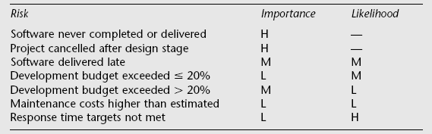
Example of a project risk matrix
Notes:
In the table ‘Importance’ relates to the cost of the damage if the risk were to materialize and ‘likelihood’ to the probability that the risk will actual occur. ‘H’ indicates ‘High’, ‘M’ indicates ‘medium’ and ‘L’ indicates ‘low’. The issues of risk analysis are explored in much more depth in lecture/chapter 7.

Slide 24
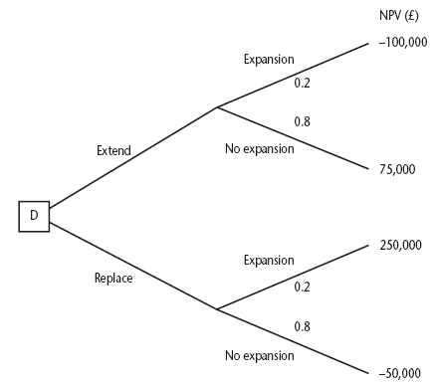
Decision trees
Notes:
The diagram here is figure 3.8 in the text.
This illustrates a scenario relating to the IOE case study. Amanda is responsible for extending the invoicing system. An alternative would be to replace the whole of the system. The decision is influenced by the likelihood of IOE expanding their market. There is a strong rumour that they could benefit from their main competitor going out of business: in this case they could pick up a huge amount of new business, but the invoicing system could not cope. However replacing the system immediately would mean other important projects would have to be delayed.
The NPV of extending the invoicing system is assessed as £75,000 if there is no sudden expansion. If there were a sudden expansion then there would be a loss of £100,000. If the whole system were replaced and there was a large expansion there would be a NPV of £250,000 due to the benefits of being able to handle increased sales. If sales did not increase then the NPV would be -£50,000.
The decision tree shows these possible outcomes and also shows the estimated probability of each outcome.
The value of each outcome is the NPV multiplied by the probability of its occurring. The value of a path that springs from a particular decision is the sum of the values of the possible outcomes from that decision. If it is decided to extend the system the sum of the values of the outcomes is £40,000 (75,000 x 0.8 – 100,000 x 0.2) while for replacement it would be £10,000 (250,000 x 0.2 – 50,000 x 0.80). Extending the system therefore seems to be the best bet (but it is still a bet!).

Slide 25
Remember!
A project may fail not through poor management but because it should never have been started
A project may make a profit, but it may be possible to do something else that makes even more profit
A real problem is that it is often not possible to express benefits in accurate financial terms
Projects with the highest potential returns are often the most risky

