Slide 1

Software Project Management
4th Edition
Chapter 6
Activity planning
Notes:
This talk provides an overview of the basic steps needed to produce a project plan. The framework provided should allow students to identify where some of the particular issues discussed in other chapters are applied to the planning process. As the focus is on project planning, techniques to do with project control are not explicitly described. However, in practice, one element of project planning will be to decide what project control procedures need to be in place.

Slide 2
Scheduling
‘Time is nature’s way of stopping everything happening at once’
Having
  worked out a method of doing the project
  identified the tasks to be carried
  assessed the time needed to do each task
need to allocate dates/times for the start and end of each activity
Notes:
Point out to students (if you are in the United Kingdom at least) that the UK English pronunciation of schedule is ‘shedule’ and that ‘skedule’ is the US pronunciation!

Slide 3
Activity networks
These help us to:
Assess the feasibility of the planned project completion date
Identify when resources will need to be deployed to activities
Calculate when costs will be incurred
This helps the co-ordination and motivation of the project team
Notes:
Section 6.2 of the textbook discusses this

Slide 4
Identifying activities
Work-based: draw-up a Work Breakdown Structure listing the work items needed
Product-based approach
  list the deliverable and intermediate products of project – product breakdown structure (PBS)
  Identify the order in which products have to be created
  work out the activities needed to create the products
Notes:
Section 6.5 of the textbook provides more details are examples

Slide 5
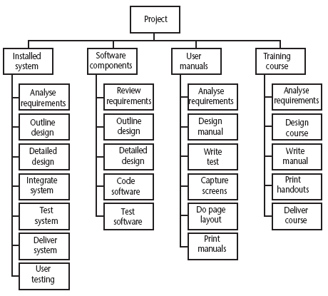
Hybrid approach
A Work Breakdown Structure based on deliverables
Notes:
The IBM MITP approach suggested the following 5 levels
Level 1: Project
Level 2: Deliverables
Level 3: Components – which are key work items needed to produce the deliverables
Level 4: Work packages: groups of tasks needed to produce the components
Level 5: Tasks

Slide 6
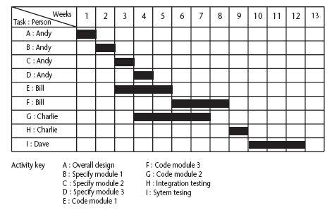
The final outcome of the planning process
A project plan as a bar chart
Notes:
The chart tells us who is doing what and when.

Slide 7
PERT vs CPM
Do B
PERT
Do A
Do D
Do C
CPM
Do B
Do A
Do D
Do C
Notes:
PERT was devised to support the development of the Polaris missile in the late 1950’s. CPM was developed by Du Pont Chemical Company who published the method in 1958.
PERT is an activity-on-node notation – the ‘nodes’ are the boxes which represent activities
CPM uses an activity-on-arrow notation where the arrows are the activities.
The approached described here is based on PERT but the other approach is described in the textbook as well – see Section 6.16

Slide 8
Drawing up a PERT diagram
No looping back is allowed – deal with iterations by hiding them within single activities
milestones – ‘activities’, such as the start and end of the project, which indicate transition points. They have zero duration.

Slide 9
Lagged activities
Where there is a fixed delay between activities e.g. seven days notice has to be given to users that a new release has been signed off and is to be installed
Acceptance
testing
7days
Install new
release
20 days
1day

Slide 10
Types of links between activities
Finish to start
Start to start/ Finish to finish
Software
development
Acceptance testing
Test prototype
2 days
Document
Amendments
1 day
Notes:
Finish to start: The following activity starts when the previous one has been finished
e.g. testing starts when coding has been completed
Start to start: When one activity starts another has to start as well
e.g. when prototype testing starts amendment documentation has to start as well
Finish to finish: when one activity finishes the other must finish too
e.g. when the testing of the prototype is completed so is the documentation of any amendments
You could use these with lags e.g. documentation of the changes to the prototype starts 1 day after the testing and finishes 2 days after testing has been completed

Slide 11
Types of links between activities
Start to finish
Operate temporary
system
Cutover to new
system
Acceptance test
of new system
Notes:
Start to finish – in the example when the cutover to the new system takes place, the operation of the temporary system is no longer needed. Although the cutover depends of the acceptance testing to be completed, the implication is that the cutover might not start straight after acceptance testing.

Slide 12
Start and finish times
Latest
finish
Earliest start
activity
Latest start
Earliest finish
Activity ‘write report software’
Earliest start (ES)
Earliest finish (EF) = ES + duration
Latest finish (LF) = latest task can be completed without affecting project end Latest start = LF - duration
Notes:
The time that an activity can start depends on its relationship with the other tasks in the project. The earliest start is when the earliest of the preceding activities upon which the current activity depends will be completed, so that the current one can start. If it starts at this time the earliest the current activity can finish is the earliest start plus its duration.
However, it may be that the activity, although it can start, can be delayed because later activities do not have to start right way. This gives us a latest finish date. The latest start date is the latest finish date less the duration of the activity.
When a student is given coursework to do they do not necessarily start it straight away. They might note when it has got to be handed in, work out that it will only take about three days to do - with a bit of luck - and wait until three days before the hand-in before they start.

Slide 13
Example
earliest start = day 5
latest finish = day 30
duration = 10 days
earliest finish = ?
latest start = ?
Float = LF - ES - duration
What is it in this case?
Notes:
The earliest finish (EF) would be day 5 plus 10 days i.e. day 15.
The latest start (LS) would be day 30 – 10 days i.e. day 20
The float would be 30 – 5 – 10 = 15 days
This also is the same as LF – EF or LS - ES

Slide 14
Notation
Activity description
Activity label
Duration
ES
EF
LS
LF
Activity span
Float
Notes:
The activity span is the LF -ES

Slide 15
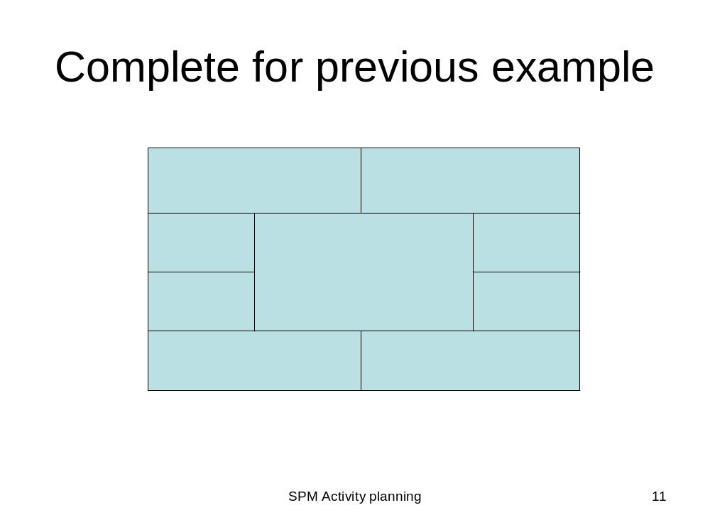
Notes:
Get students to complete the cells with the numbers from the previous example

Slide 16
Earliest start date
Earliest start date for the current activity = earliest finish date for the previous
When there is more than one previous activity, take the latest earliest finish
Note ‘day 7’ = end of work on day 7
EF = day 7
ES = day10
EF = day10

Slide 17
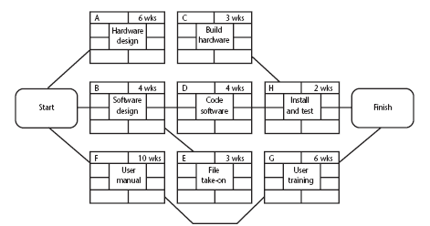
Example of an activity network
Notes:
Work out the earliest start and end dates for each activity

Slide 18
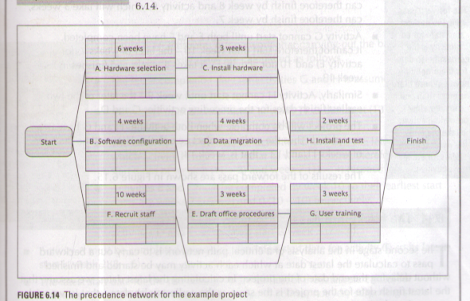

Slide 19
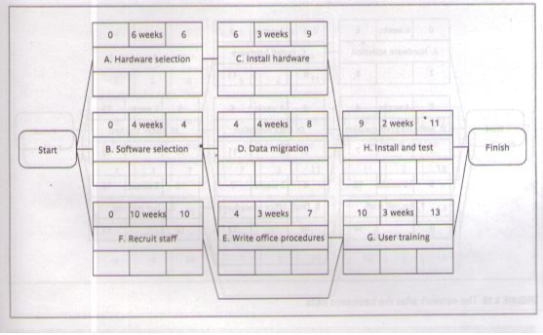

Slide 20
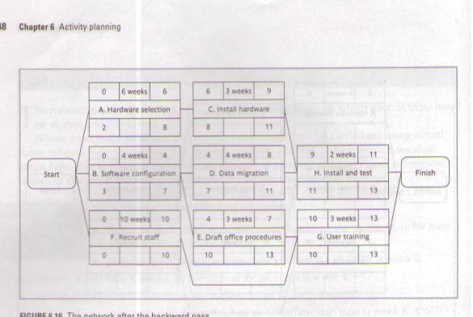

Slide 21
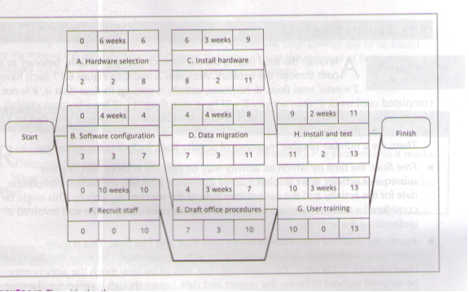

Slide 22
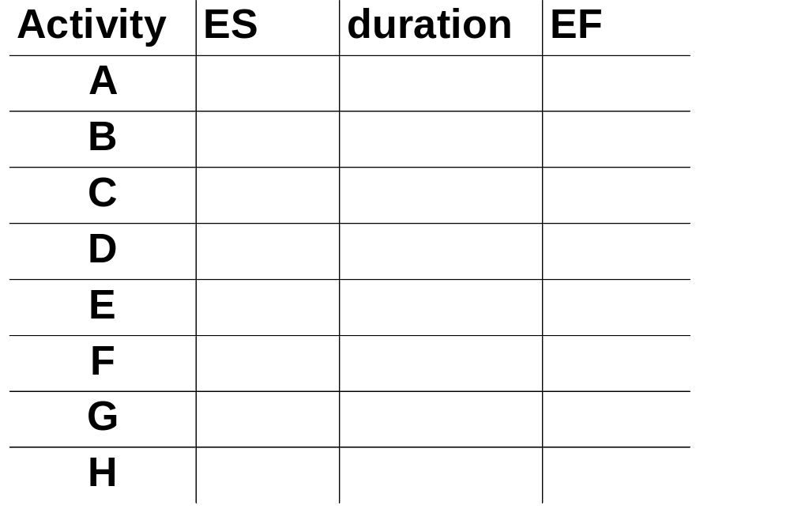
Complete the table
Notes:
Activity ES duration EF
A 0 6 6
B 0 4 4
C 6 3 9
D 4 4 8
E 4 3 7
F 0 10 10
G 10 3 14
H 9 2 11

Slide 23
Latest start dates
Start from the last activity
Latest finish (LF) for last activity = earliest finish (EF)
work backwards
Latest finish for current activity = Latest start for the following
More than one following activity - take the earliest LS
Latest start (LS) = LF for activity - duration

Slide 24
Example: LS for all activities?
Notes:
Get students to work out the latest starts and finishes for all the activities in the example

Slide 25
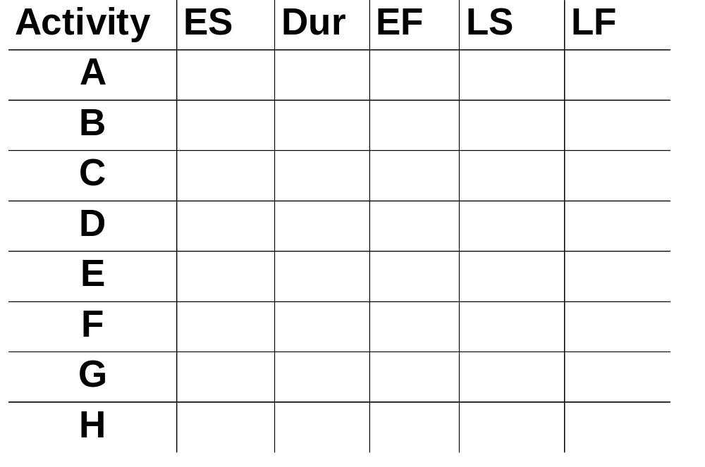
Complete the table
Notes:
Activity ES duration EF LS LF
A 0 6 6 2 8
B 0 4 4 3 7
C 6 3 9 8 11
D 4 4 8 7 11
E 4 3 7 7 10
F 0 10 10 0 10
G 10 3 14 10 13
H 9 2 11 11 13

Slide 26

Float
Float = Latest finish -
Earliest start -
Duration
FLOAT
LF
ES
activity
Latest start
Notes:
Note that Float can also be calculated as the difference between the earliest and latest start dates for an activity or the difference between the earliest and latest finish dates.

Slide 27
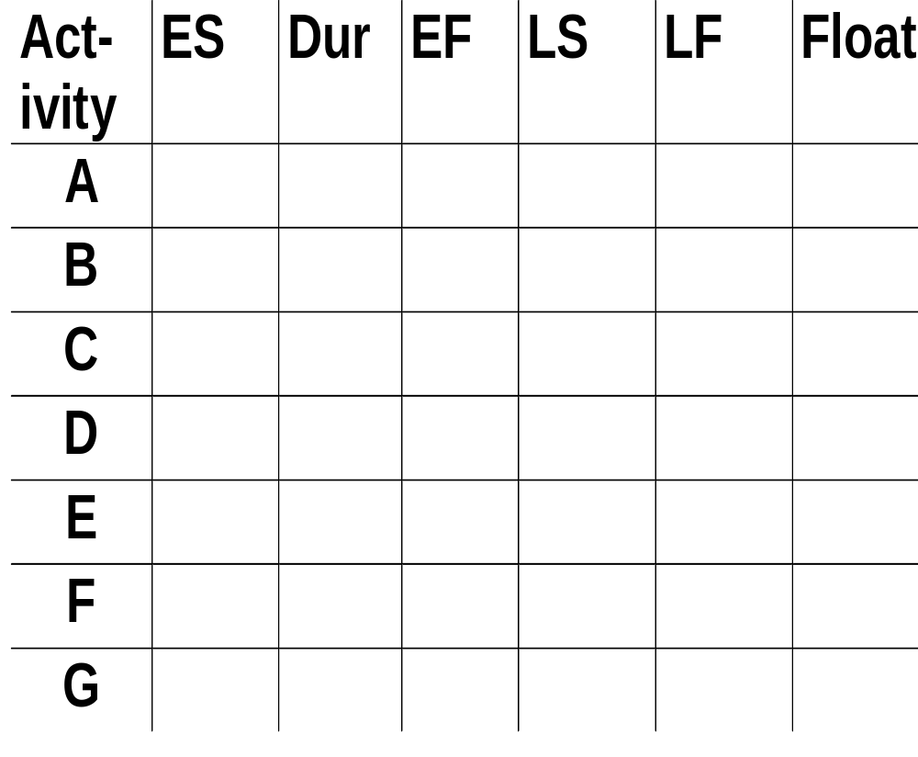
Complete the table
Notes:
A 2
B 3
C 2
D 3
E 3
F 0
G 0
H 2

Slide 28
Critical path
Note the path through network with zero floats
Critical path: any delay in an activity on this path will delay whole project
Can there be more than one critical path?
Can there be no critical path?
Sub-critical paths
Notes:
Yes, there could be more than one critical path if the two longest paths through the network were of equal length.
Where the target completion date for the project was imposed rather than calculated from the earliest finish dates, it might be later that the earliest finish date. In this case there would be no chains of activities with zero floats
The durations of activities are only estimates to start with. As the project proceeds, the estimates will be replaced by actual durations which could be different. This could change the sequence of activities identified as the critical path. Sub-critical paths are chains of activities, not on the planned critical path, but which have small floats and which could easily become the critical path as the project develops.

Slide 29
Free and interfering float
A
7w
0
B can be up to 3 days late
and not affect any
other activity = free float
7
2
9
2
B
4w
D
1w
E
2w
0
4
7
8
10
12
5
9
9
10
10
12
5
2
0
C
10w
0
10
0
10
B can be a further 2 days late – affects
D but not the project end date =
interfering float
0
Notes:
Total float = LF – ES – duration (or LS-ES or LF-EF)
Free float = ES for following activity less EF for the current
Interfering float = total float – free float

