Slide 1

Software Project Management
4th Edition
Chapter 8
Resource allocation
Notes:
This talk provides an overview of the basic steps needed to produce a project plan. The framework provided should allow students to identify where some of the particular issues discussed in other chapters are applied to the planning process. As the focus is on project planning, techniques to do with project control are not explicitly described. However, in practice, one element of project planning will be to decide what project control procedures need to be in place.

Slide 2
Schedules
Activity schedule - indicating start and completion dates for each activity
Resource schedule - indicating dates when resources needed + level of resources
Cost schedule showing accumulative expenditure
Notes:
We have already described the creation of the activity schedule in Lecture/activity 6.

Slide 3
Resources
These include
  labour
  equipment (e.g. workstations)
  materials
  space
  services
Time: elapsed time can often be reduced by adding more staff
Money: used to buy the other resources
Notes:
Section 8.2 in the main text discusses this in a little more detail.
A key point is that money (by definition) is the means by which one resource can be converted to another. However in practice this may be problematic because of resource constraints e.g. staff need time to become expert in a new technology regardless of the amount of money that might be available to buy expertise.

Slide 4
Resource allocation
Identify the resources needed for each activity
Identify resource types - individuals are interchangeable within the group (e.g. ‘VB programmers’ as opposed to ‘software developers’)
Allocate resource types to activities and examine the resource histogram
Notes:
This is covered in Section 8.3 of the text.
Note that at this point we have to assume that we are dealing with, for example, ‘standard’ software developers who have an average productivity. When we allocate actual people we may find that we have a trainee or a super-expert and this will affect productivity. A short-coming in productivity in an individual might be compensated for by a lower cost (as would be expected with trainees).
In the example in the text we start by scheduling every activity to start at the earliest possible date. However in Lecture/Chapter 7, in the section on the critical chain technique it was suggested that we plan to start activities as late as possible. Whatever the starting procedure, we then need to deal with resource clashes.

Slide 5
Resource histogram: systems analysts
5
4
STAFF REQD.
3
2
1
1
2
3
4
5
6
7
WEEK
Notes:
The resource histogram helps us identify where the demand for a resource exceeds the supply.
If we use a tool such as MS Project, the tool will generate the resource histograms for us.

Slide 6
Resource clashes
can be resolved by:
  delaying one of the activities
    taking advantage of float to change start date
    delaying start of one activity until finish of the other activity that resource is being used on - puts back project completion
  moving resource from a non-critical activity
  bringing in additional resource - increases costs
Notes:
Exercise 8.1 in the text gives some practice in the resolution of resource clashes.

Slide 7
Prioritizing activities
There are two main ways of doing this:
Total float priority – those with the smallest float have the highest priority
Ordered list priority – this takes account of the duration of the activity as well as the float – see next overhead
Notes:
Where more than one activity is competing for the same limited resource at the same time then those activities need to be prioritized.

Slide 8
Burman’s priority list
Give priority to:
Shortest critical activities
Other critical activities
Shortest non-critical activities
Non-critical activities with least float
Non-critical activities

Slide 9
Resource usage
Need to maximise %usage of resources i.e. reduce idle periods between tasks
Need to balance costs against early completion date
Need to allow for contingency

Slide 10
Critical path
Scheduling resources can create new dependencies between activities – recall critical chains
It is best not to add dependencies to the activity network to reflect resource constraints
  Makes network very messy
  A resource constraint may disappear during the project, but link remains on network
Amend dates on schedule to reflect resource constraints
Notes:
In Lecture/chapter 7 the concept of critical chains was introduced which took account of resource constraints.
The point about not adding links to the network to deal with resource constraints is not in the text, but is based on practical experience. The notation for activity networks does not tell you why one activity might be dependent on the completion of another.

Slide 11
Allocating individuals to activities
The initial ‘resource types’ for a task have to be replaced by actual individuals.
Factors to be considered:
Availability
Criticality
Risk
Training
Team building – and motivation
Notes:
Availability – who is free? Note that this will change during the course of the project as some tasks are completed earlier or later than planned
Criticality – You would want to put your more experienced, ‘safer’, staff on the critical activities
Risk – this is similar to the point above, but some activities could be off the critical path but still have risks e.g. to the quality of subsequent products
Training – despite concerns about minimizing risk, it is healthy to take some risks in order to develop staff capabilities by allocating challenging tasks to relatively inexperienced stafff
Team-building – identifying people who work well together can pay dividends; chopping and changing plans all the time may in theory optimize project performance, but can in practice be demotivating for staff

Slide 12
Cost schedules
Cost schedules can now be produced:
Costs include:
Staff costs
Overheads
Usage charges
Notes:
Section 8.9 covers this in more depth.
Staff costs – includes not just salary, but also social security contributions by the employer, holiday pay etc. Timesheets are often used to record actual hours spent on each project by an individual. One issue can be how time when a staff member is allocated and available to the project, but is not actually working on the project, is dealt with.
Overheads e.g. space rental, service charges etc. Some overheads might be directly attributable to the project; in other cases a percentage of departmental overheads may be allocated to project costs.
Usage charges – some charges can be on a ‘pay as you go’ basis e.g. telephone charges, postage, car mileage – at the planning stage an estimate of these may have to be made

Slide 13
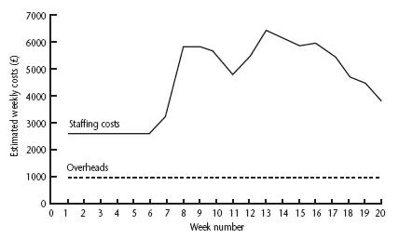
Cost profile
Notes:
This shows how much is going to be spent in each week. This could be important where an organization allocates project budgets by financial year or quarter and the project straddles more than one of these financial periods

Slide 14
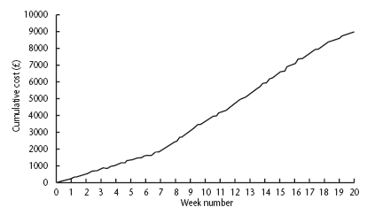
Accumulative costs
Notes:
The project manager will also be concerned about planned accumulative costs. This chart can be compared to the actual accumulative costs when controlling the project to assess whether the project is likely to meet its cost targets.

Slide 15
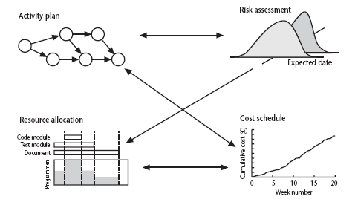
Balancing concerns
Notes:
Successful project scheduling is not a simple sequence.
Because of the inter-linking of different concerns project planning will need to be iterative. The consequences of decisions will need to carefully assessed and plans adjusted accordingly.

