Slide 2
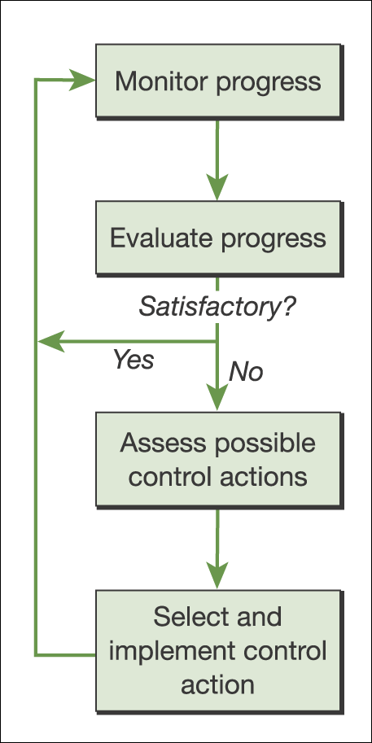
Monitoring and control cycle
Figure 12.1 Monitoring and control cycle

Slide 3
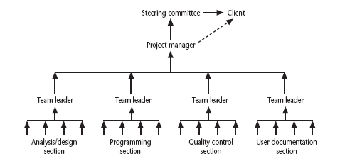
Responsibilities
Notes:
Chapter 9
The concept of a reporting hierarchy was introduced in Chapter 1.
The main lesson here is that the details relating to project progress have to originate with the people actually doing the work and have then to be fed up through the management structure. At each management level there is going to be some summarising and commentary before information is passed up to the next level. This means that there is always a danger of ‘information overload’ as information passes from the many to the few.

Slide 4
Assessing progress
Checkpoints – predetermined times when progress is checked
  Event driven: check takes place when a particular event has been achieved
  Time driven: date of the check is pre-determined
Frequency of reporting
  The higher the management level, generally, the longer the gaps between checkpoints
Notes:
Chapter 9

Slide 5
Collecting progress details
Need to collect data about:
Achievements/ Milestones
Costs
How to deal with partial completions?
99% completion syndrome
Possible solutions:
Control of products, not activities
Subdivide into lots of sub-activities
Notes:
Chapter 9
Projects have to be delivered on time and within budget, hence the concern with monitoring achievements and costs.
Partial completion is where, for example, data is being collected at the end of Week 2 of an activity that should take four weeks. We want to know if it is about 50% completed.
An example of the ’99% completion syndrome’ would be in the above case if the developer reported at the end of weeks 1,2 and 3 that the task was respectively 25%, 50% and 75% complete. However at the end of week 4 it is reported that the task is 99% complete. The same thing is reported at the end of week 5 and so on until the task is actually completed.
Control on products implies that actual examination of intermediate allows us to verify independently and objectively that sub-tasks have been completed.

Slide 6
Red/Amber/Green (RAG) reporting
Identify key tasks
Break down into sub-tasks
Assess subtasks as:
  Green – ‘on target’
  Amber – ‘not on target but recoverable’
  Red – ‘not on target and recoverable only with difficulty’
Status of ‘critical’ tasks is particularly important
Notes:
Chapter 9
RAG reporting highlights those activities which need particular attention. The status of a troubled activity might typically move from green to amber; if corrective action is possible it might go back to green, otherwise it could switch to red. If there are lots of instances where activities switch directly from green to red, this could indicate more management control.
‘Critical tasks’ would be those on the critical path and/or reliant on critical resources.

Slide 7
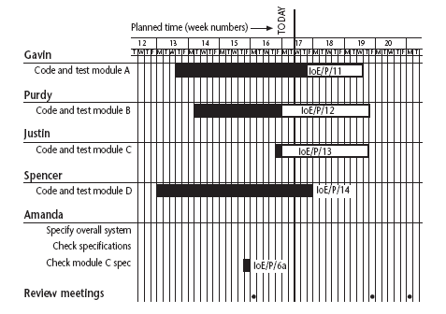
Gantt charts
Notes:
Chapter 9
Note that the Gantt chart is named after Henry Gantt (1861-1919) and so should not be written in capitals! You could ask students what they think GANTT stands for before you tell them this to impress this on them. I really find Gantt written as GANTT very, very annoying and threaten students with instant failure of the module if they do this!
The format of the Gantt chart here differs from the format used in Microsoft project as the activities for each team member are grouped together. You could input the details so that they came out in this format, but it would not occur automatically.

Slide 8
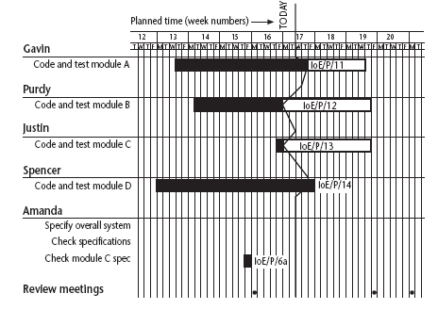
Slip charts
Notes:
Chapter 9
A slip chart is a version of the Gantt chart where a line is drawn from top to bottom. To the left of the line are all the completed activities and to the right those activities ( or parts of activities) that have not been completed.
The more jagged the line, the more it means that that there are some activities that are lagging to various degrees and some that are ahead of themselves. A very jagged line means that there is scope for re-planning to move resources from those activities that are ahead to those that are behind.

Slide 9
Ball charts
Code and test module A
10/10/05
21/10/05
23/10/05
10/10/05
Code and test module B
14/10/05
17/10/05
27/10/05
31/10/05
Code and test module C
17/10/05
17/10/05
27/10/05
27/10/05
Green: On time
Red: Missed the target
Notes:
Chapter 9
Circles, which represent the start or finish of activities, start with the initial target dates. If these are modified then the second dates are changed. When the event actually takes place, the colour of the circle is changed to green if it is on target and to red if it has missed the target.
The idea is that this chart is put on a wall in a prominent position as a constant reminder to the project team of the current situation – hence it is often referred to as ‘balls on the wall’.

Slide 10
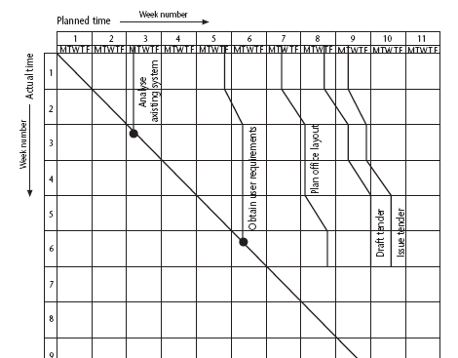
The timeline
Records the way targets have changd throughout the project
Notes:
Chapter 9
This records the way that targets have changed throughout the project.
Planned time is plotted on the horizontal axis, and actual time on the vertical axis. The bendy lines going from top to bottom represent the scheduled completion date for each activity e.g.
‘analyse existing system’ – at start this was due finish on the Monday of week 3 and it did finish then
‘obtain user requirements’ was originally planned to finish on the Thursday of week 5, but at the end of the first week it was rescheduled to finish on the Tuesday of week 6.

Slide 11
Cost monitoring
A project could be late because the staff originally committed, have not been deployed
In this case the project will be behind time but under budget
A project could be on time but only because additional resources have been added and so by over budget
Need to monitor both achievements and costs
Notes:
Chapter 9

Slide 12
Earned value analysis
Planned value (PV) or Budgeted cost of work scheduled (BCWS) – original estimate of the effort/cost to complete a task (compare with idea of a ‘price’)
Earned value (EV) or Budgeted cost of work performed (BCWP) – total of PVs for the work completed at this time
Notes:
Chapter 9

Slide 13
Earned value – an example
Tasks
  Specify module 5 days
  Code module 8 days
  Test module 6 days
At the beginning of day 20, PV = 19 days
If everything but testing completed, EV = 13 days
Schedule variance = EV-PV i.e. 13-19 = -6
Schedule performance indicator (SPI) = EV/PV
i.e 13/19 = 0.68
Notes:
Chapter 9
A negative schedule variance (SV) means that the project is behind schedule as does a SPI that is less than 1.0.

Slide 14
Earned value analysis – actual cost
Actual cost (AC) is also known as Actual cost of work performed (ACWP)
In previous example, if
  ‘Specify module’ actually took 3 days (planned 5 days)
  ‘Code module’ actually took 4 days (planned 8 days)
Actual cost = 7 days
Cost variance (CV) = EV-AC
i.e. 13-7 = 6 days
Cost performance indicator (CPI) = EV/AC
i.e = 13/7 = 1.86
Positive CV or CPI > 1.00 means project under budget or the work is completed better than planned
Notes:
Chapter 9

Slide 15
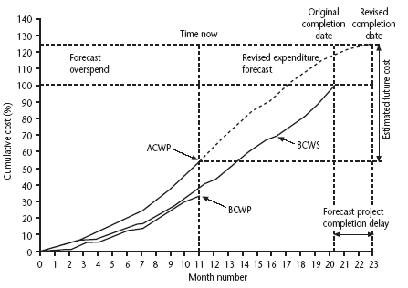
Earned value chart with revised forecasts
(AC)
(PV)
(EV)
Notes:
Chapter 9
This shows how the planned value (PV), earned value (EV) and actual cost (AC) can be tracked over the lifetime of a project.
It also shows how the graph can be used to show adjustments to the final estimated cost and duration. A revised assessment of the budget at completion (EAC estimate at completion) can be produced by dividing the original estimated budget at completion (BAC) by the current CPI.
Similarly a forecast of the actual duration of the project can be derived by dividing the original estimated duration by the SPI.

Slide 16
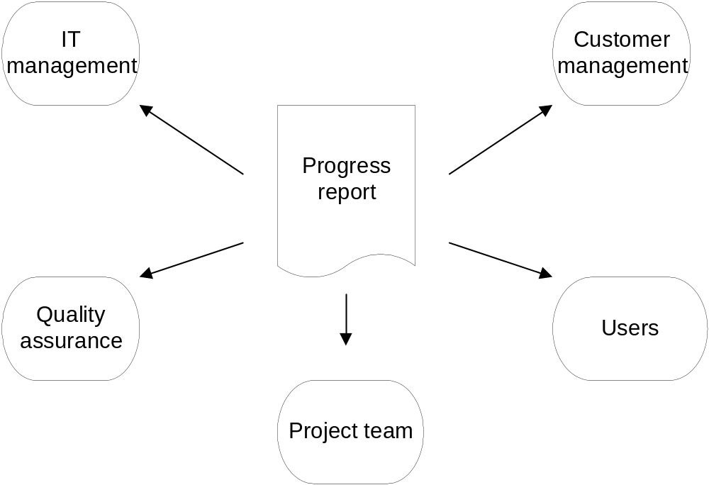
Recipients of progress reports

Slide 17
Report contents (typical)
Period covered
Narrative summary of progress
Milestones achieved/deliverables completed
Problems encountered (and solutions)
Projected completion date
Costs to date and predicted
Changes identified and implemented

Slide 18
Reporting in PRINCE2®
Project Initiation Document (PID)
End-stage assessment
Mid-stage assessment
Highlight report
Checkpoint report
Project closure report

Slide 19
Prioritizing monitoring
We might focus more on monitoring certain types of activity e.g.
Critical path activities
Activities with no free float – if delayed later dependent activities are delayed
Activities with less than a specified float
High risk activities
Activities using critical resources
Notes:
Chapter 9
Critical path activities – by definition if these are late then the project as a whole will be delayed
Activities with no free float – free float was defined in Lecture/Chapter 6. A project with no free float will delay following dependent activities, although the project end date may not be directly threatened.
Activities with less than a specified float – projects when being executed can be very dynamic: some activities will take longer than estimated others less; this could lead to the critical shifting. Activities with small floats are the most likely to find themselves turned into activities on the critical path if their floats get eroded.
High risk activities – recall the calculation of activity standard deviations in Chapter 7. If the standard deviation for an activity is large, this indicates that there is a lot of uncertainty about how long it will actually take.
Activities using critical resources – some resources may only be available for a limited period and if the activities that need the resource are delayed the resource could become unavailable.

Slide 20
Getting back on track
Renegotiate the deadline – if not possible then
Try to shorten activities on critical path e.g.
  Work overtime
  Re-allocate staff from less pressing work
  Buy in more staff
Reconsider activity dependencies
  Over-lap the activities so that the start of one activity does not have to wait for completion of another
  Split activities
Notes:
Chapter 9
Renegotiating the deadline – one way of doing this is to divide the deliverables into ‘tranches’ (see Lecture/Chapter 3), delivering the ones most valuable to the client on or before the deadline, but delaying less valuable ones.
Shortening the critical path – the idea is to try to get things done more quickly by adding more staff. Some activities lend themselves to this more readily than others – it is often quite difficult to do this with software development. It also increases costs
Reconsidering activity dependencies – allowing activities to overlap often increases the risk of quality shortfalls

Slide 21
Change control
The role of configuration librarian:
Identifying items that need to be subject to change control
Management of a central repository of the master copies of software and documentation
Administering change procedures
Maintenance of access records
Notes:
Chapter 9
Identifying items that need to be subject to change control – it is unlikely, for example, that a feasibility report would be subject to change control once agreement has been obtained to start the project
Management of a central repository of the master copies of software and documentation
Administering change procedures It is important that someone ensures that there is adherence to change control procedures.
Maintenance of access records. A situation to be avoided is where two different developers are making changes to the same software component.

Slide 22
Typical change control process
One or more users might perceive the need for a change
User management decide that the change is valid and worthwhile and pass it to development management
A developer is assigned to assess the practicality and cost of making the change
Development management report back to user management on the cost of the change; user management decide whether to go ahead
Notes:
Chapter 9
1 and 2. The user community itself must come to a consensus about whether a proposal for a change should go forward. A change deemed desirable by one part of the user community could cause opposition with other users.
2 and 3. This part of the process often involves a multipart form, initially raised by a user representative and then completed with a response by the developers.
4. There could be a change control board with user and developer representatives that oversees this decision-making process

Slide 23
Change control process contd.
One or more developers are authorized to make copies of components to be modified
Copies modified. After initial testing, a test version might be released to users for acceptance testing
When users are satisfied then operational release authorized – master configuration items updated
Notes:
Chapter 9
5. The configuration librarian would control this release
6. Note that it is a copy that is modified; the original would still exist as the current operational version
7. The previous version of the configuration items would be archived but preserved. If there are unforeseen problems with the new version when it is made operational then a fall-back to the previous version could be considered

Slide 24
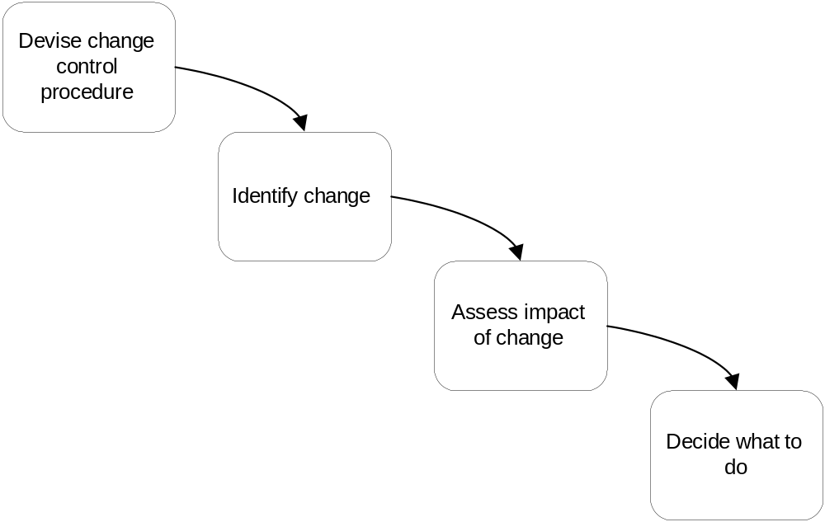
Change control

Slide 25
Change control and configuration management
Change control
  Set of procedures to ensure that changes made only after a consideration of the full impacts.
Configuration management
  Version control to ensure that all changes are properly recorded and managed – and so that knock-on effects on other projects can be identified.

