Slide 1
COOKIES

Slide 2
Cookies
A cookie is a name/value pair in the Set-Cookie header field of an HTTP response
Most (not all) clients will:
  Store each cookie received in its file system
  Send each cookie back to the server that sent it as part of the Cookie header field of subsequent HTTP requests

Slide 3
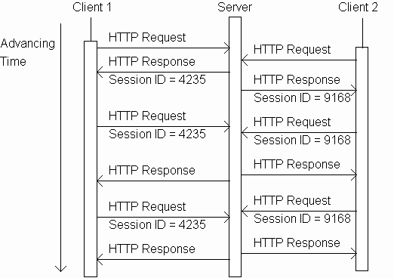
Cookies
Tomcat sends
session ID as value
of cookie named
JSESSIONID

Slide 4
Cookies
Cookie-enabled
browser returns
session ID as value
of cookie named
JSESSIONID

Slide 5
Cookies
Servlets can set cookies explicitly
  Cookie class used to represent cookies
  request.getCookies() returns an array of Cookie instances representing cookie data in HTTP request
  response.addCookie(Cookie) adds a cookie to the HTTP response

Slide 6
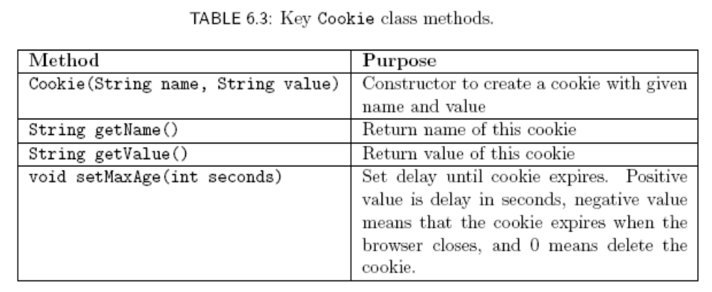
Cookies
Cookies are expired by
client (server can request
expiration date)

Slide 7
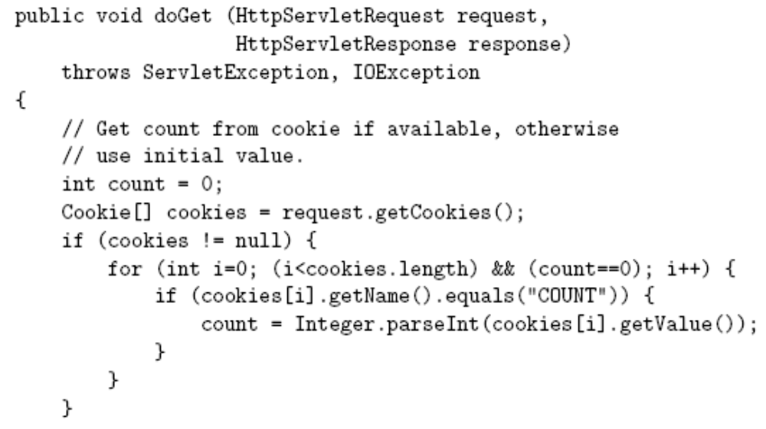
Cookies

Slide 8
Cookies
Return array of cookies
contained in HTTP request

Slide 9
Cookies
Search for
cookie
named
COUNT and
extract value
as an int

Slide 10
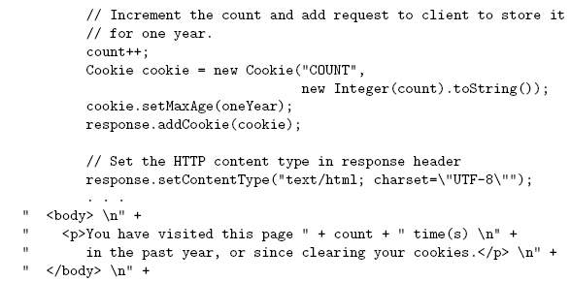
Cookies

Slide 11
Cookies
Send
replacement
cookie value
to client
(overwrites
existing cookie)

Slide 12
Cookies
Should call
addCookie()
before writing
HTML

Slide 13
Cookies
Privacy issues
HTTP request to
intended site
Web site
providing
requested
content
Client
HTTP response:
HTML document
including ad <img>
HTTP request for
ad image
Image
plus Set-Cookie
in response:
third-party cookie
Web site
providing
banner
ads

Slide 14
Cookies
Privacy issues
Second
Web site
providing
requested
content
HTTP request to 2nd
intended site
Web site
providing
requested
content
Client
HTTP response:
HTML document
including ad <img>
HTTP request for
ad image plus Cookie (identifies user)
Image
Web site
providing
banner
ads
Based on
Referer, I know two
Web sites that
this user has
visited

Slide 15
Cookies
Privacy issues
Due to privacy concerns, many users block cookies
  Blocking may be fine-tuned. Ex: Mozilla allows
    Blocking of third-party cookies
    Blocking based on on-line privacy policy
Alternative to cookies for maintaining session: URL rewriting

Slide 16
Using Cookies
The servlet is invoked when a form on web page is submitted. The example contains three files as shown
AddCookie.html – allows a user to specify a value for the cookie named MyCookie
AddCookieServlet.java – Processes the submission of AddCookie.html
GetCookiesServlet.java – Displays the cookie values

Slide 17
HTML source code for AddCookie.html
<html>
<body>
<form name=”form1” method=”post” action=http://localhost:8080/examples/servlet/AddCookieServlet>
<b>Enter a value for a cookie</b>
<input type = textbox name=”data” size=25 value=””>
<input type=submit value=”submit”>
</form>
</body>
</html>

Slide 18
AddCookie.html
This page contains a text field in which a value can be entered. There is also a Submit button on the page. When this button is pressed, the value in the text field is sent to AddCookieServlet via a HTTP POST request.

Slide 19
Source Code for AddCookieServlet.java
import java.io.*;
import javax.servlet.*;
import javax.servlet.http.*;
public class AddCookieServlet extends HttpServlet {
/*** Handle the HTTP GET method by building a simple web page.*/
public void doPost (HttpServletRequest request, HttpServletResponse response)
throws ServletException, IOException {
//get parameter from HTTP Request
String data = request.getParameter(“data”);

Slide 20
Source Code for AddCookieServlet.java
//create cookie
Cookie cookie = new Cookie(“MyCookie”,data);
//Add cookie to HTTP request
Response.addCookie(cookie);
// set content type and other response header fields first
response.setContentType("text/html");
// then write the data of the response
PrintWriter pw = response.getWriter();
pw.println(“My cookie has been set to”);
pw.println(data);
pw.close();
}
}

Slide 21
AddCookieServlet.java
It gets the value of the parameter named “data”.
It then creates a Cookie object that has the name “MyCookie” and contains the value of the “data” parameter.
The cookie is then added to the header of the HTTP response via the addCookie() method.
A feedback message is then written to the browser.

Slide 22
Source Code for GetCookiesServlet.java
import java.io.*;
import javax.servlet.*;
import javax.servlet.http.*;
public class GetCookiesServlet extends HttpServlet {
/*** Handle the HTTP GET method by building a simple web page.*/
public void doGet (HttpServletRequest request, HttpServletResponse response)
throws ServletException, IOException {
//get cookies from header of HTTP request
Cookie[] cookies = request.getCookies();
//display these cookies
response.setContentType("text/html");

Slide 23
Source Code for GetCookiesServlet.java
// then write the data of the response
PrintWriter pw = response.getWriter();
for(int i=0;i<cookies.length;i++)
{
String name = cookies[i].getName();
String value = cookies[i].getValue();
pw.println(“name=” +name+”; value= “ +value);
}
pw.close();
}
}

Slide 24
GetCookiesServlet.java
It invokes the getCookies() method to read any cookies that are included in the HTTP GET request. The names and values of these cookies are then written to the HTTP response.
Observe that the getName() and getValue() methods are called to obtain the information.

Slide 25
Compilation and Output
Compile the servlet and perform these steps:
Start Tomcat, if it is not already running
Display AddCookie.html in a browser
Enter a value for MyCookie
Submit the web page
After completing these steps you will observe that a feedback message is displayed by the browser.
Next request the following URL via a web browser:
http://localhost:8080/examples/servlet/GetCookiesServlet
Observe that the name and value of the cookie are displayed in the browser.
The cookie expires when the browser session ends.

Slide 26
SESSION TRACKING

Slide 27
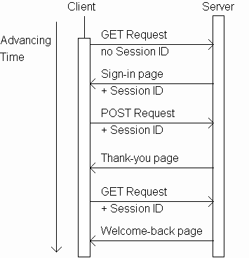
Sessions

Slide 28
Sessions

Slide 29
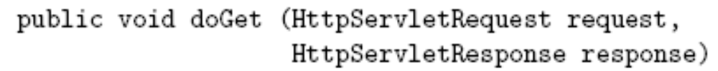
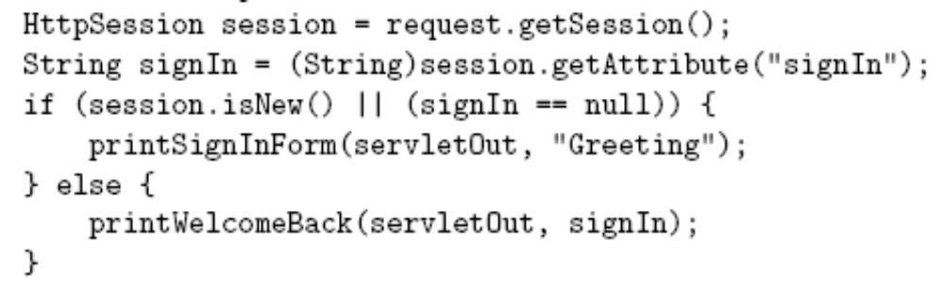
Sessions
,,,

Slide 30
Sessions
,,,
Session attribute is a
name/value pair

Slide 31
Sessions
,,,
Session attribute will
have null value until
a value is assigned

Slide 32
Sessions
,,,
Generate
sign-in form
if session is
new or
signIn
attribute has no value,
generate weclome-back page
otherwise.

Slide 33
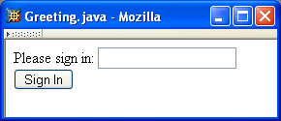
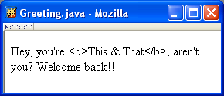
Sessions
Sign-in form
Welcome-back
page

Slide 34
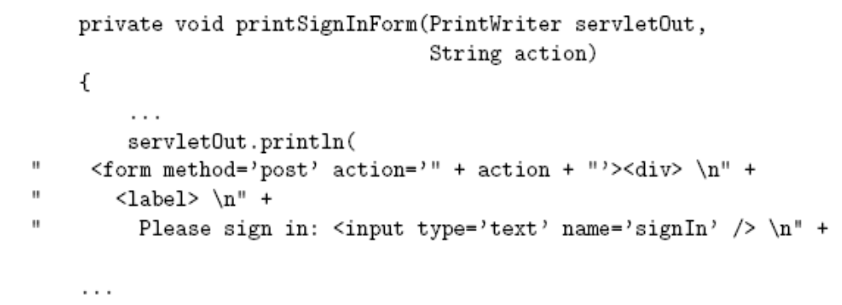
Sessions
Second argument
(“Greeting”) used as
action attribute value
(relative URL)

Slide 35
Sessions
Form will be sent using POST HTTP
Method, so doPost() method will be called

Slide 36
Sessions
Text field containing
user name is named
signIn

Slide 37
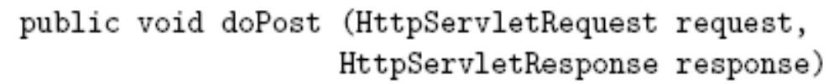
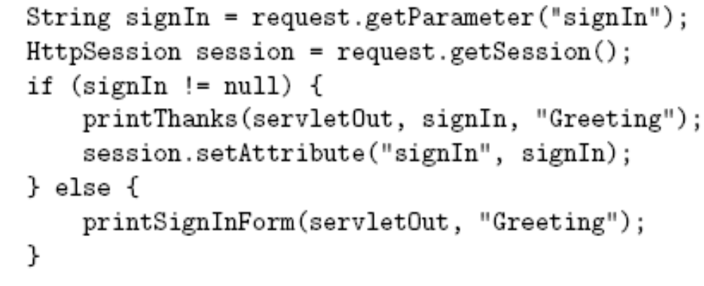
Sessions
…

Slide 38
Sessions
…
Retrieve
signIn
parameter value

Slide 39
Sessions
…
Normal
processing:
signIn
parameter
is present in
HTTP request

Slide 40
Sessions
…
Generate
HTML for
response

Slide 41
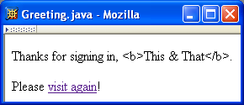
Sessions
Thank-you page
Must escape
XML special
characters in
user input

Slide 42
Sessions
…
Assign a
value to the
signIn session
attribute

Slide 43
Sessions
Session attribute methods:
  setAttribute(String name, Object value): creates a session attribute with the given name and value
  Object getAttribute(String name): returns the value of the session attribute named name, or returns null if this session does not have an attribute with this name

Slide 44
Sessions
…
Error
processing
(return user
to sign-in form)

Slide 45
Sessions
By default, each session expires if a server-determined length of time elapses between a session’s HTTP requests
  Server destroys the corresponding session object
Servlet code can:
  Terminate a session by calling invalidate() method on session object
  Set the expiration time-out duration (secs) by calling setMaxInactiveInterval(int)

Slide 46
Use of sessions
HTTP is a stateless protocol. Each request is independent of the previous one. However, in some applications, it is necessary to save state information so that information can be collected from several interactions between a browser and a server. Sessions provide such a mechanism.

Slide 47
Session – Methods and Attributes
A session can be created via the getsession() method of HttpServletRequest. A HttpSession is returned. This object can store a set of bindings that associate names with objects.
The setAttributes(), getAttribute(), getAttributenames() and removeAttribute() methods of HttpSession manage these bindings. It is important to note that session state is shared among all the servlets that are associated with a particular client.

Slide 48
Use of Session State
import java.io.*;
import java.util.*;
import javax.servlet.*;
import javax.servlet.http.*;
public class DateServlet extends HttpServlet {
/*** Handle the HTTP GET method by building a simple web page.*/
public void doGet (HttpServletRequest request, HttpServletResponse response)
throws ServletException, IOException {
HttpSession hs=request.getSession(true);
// set content type and other response header fields first
response.setContentType("text/html");

Slide 49
Use of Session State
// then write the data of the response
PrintWriter pw = response.getWriter();
Date date=(Date)hs.getAttribute(“date”);
if(date!=null)
{
pw.print(“Last access: “ +date+);
}
date=new Date();
hs.setAttribute(“date”,date);
pw.println(“current date:” +date);
}
}

Slide 50
Use of Session State
The getSession() method gets the current session. A new session is created if one does not already exist.
The getAttribute() method is called to obtain the object that is bound to the name “date”. That object is a Date object that encapsulates the date and time when this page was last accessed. A Date object encapsulating the current date and time is then created.
The setAttribute() method is called to bind the name “date” to this object.

Slide 51
Output
When you first request this servlet, the browser displays one line with the current date and time information. On subsequent invocations, two lines are displayed.
The first line shows the date and time when the servlet was last accessed.
The second line shows the date and time.

