Slide 1
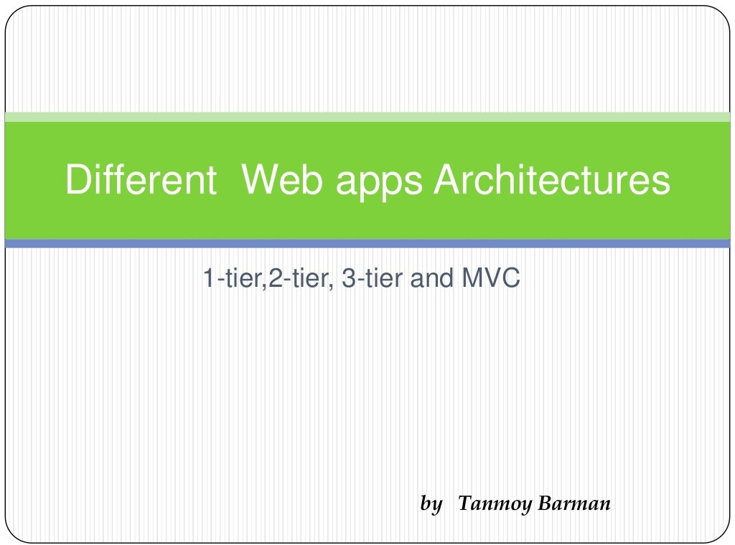

Slide 2
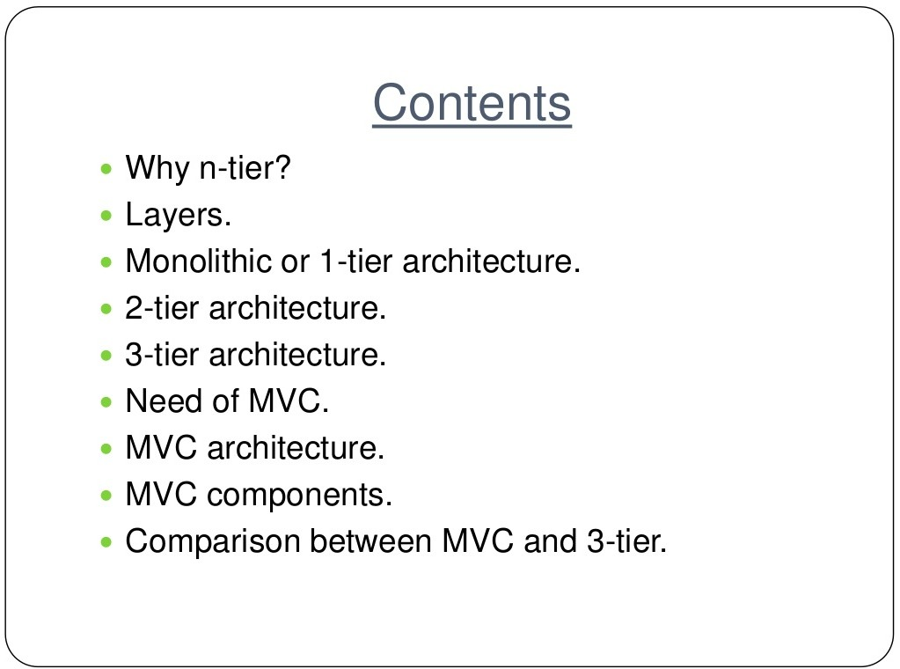

Slide 3
Internet
Internet Services
Requirements of Internet Services
Adaptability
Availability
Cost Effective
Transparency
Model : Client Server

Slide 4
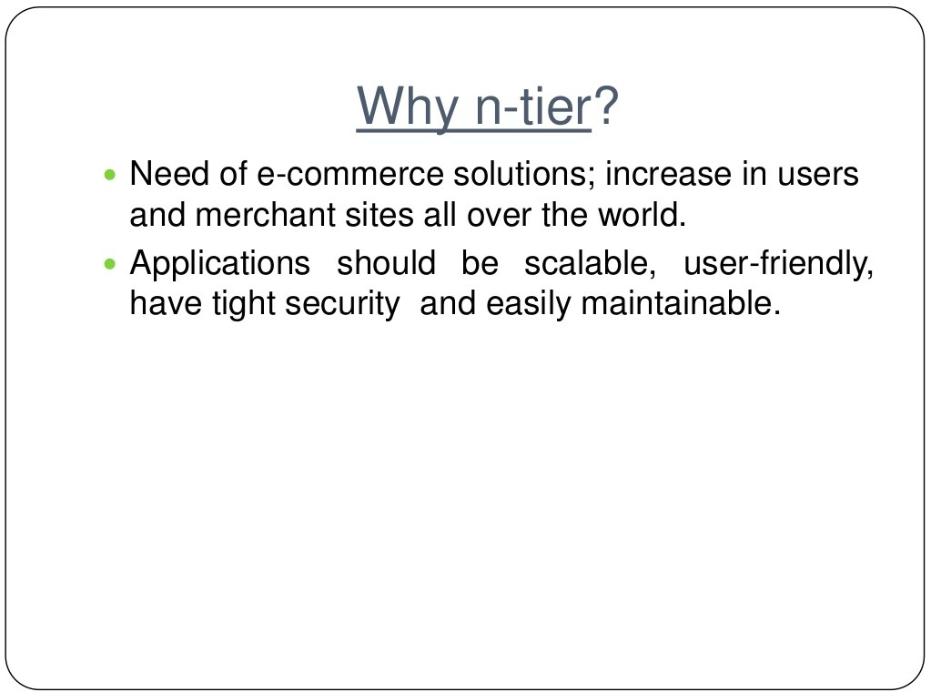

Slide 5
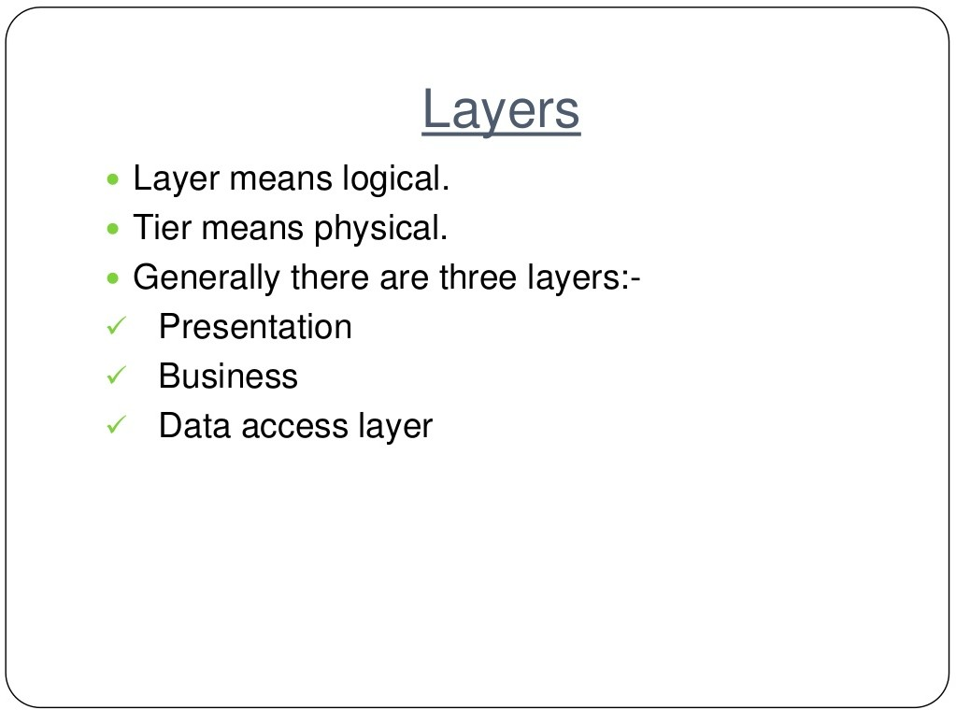

Slide 6
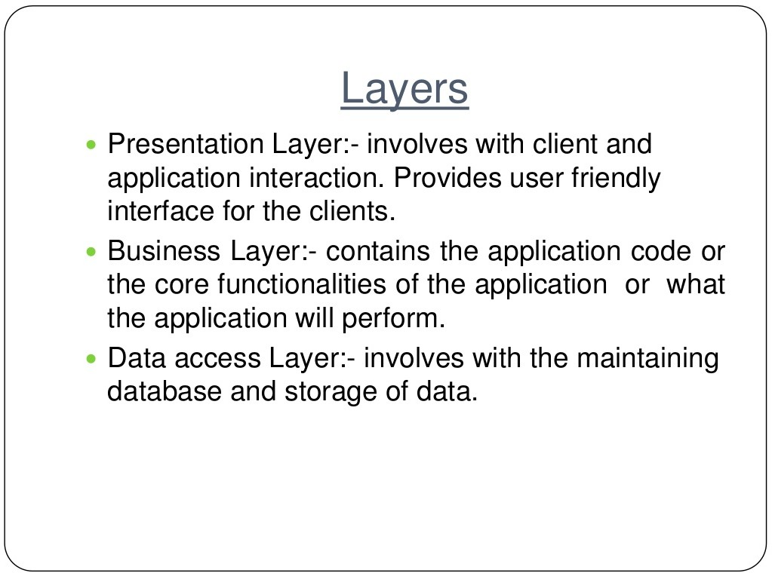

Slide 7
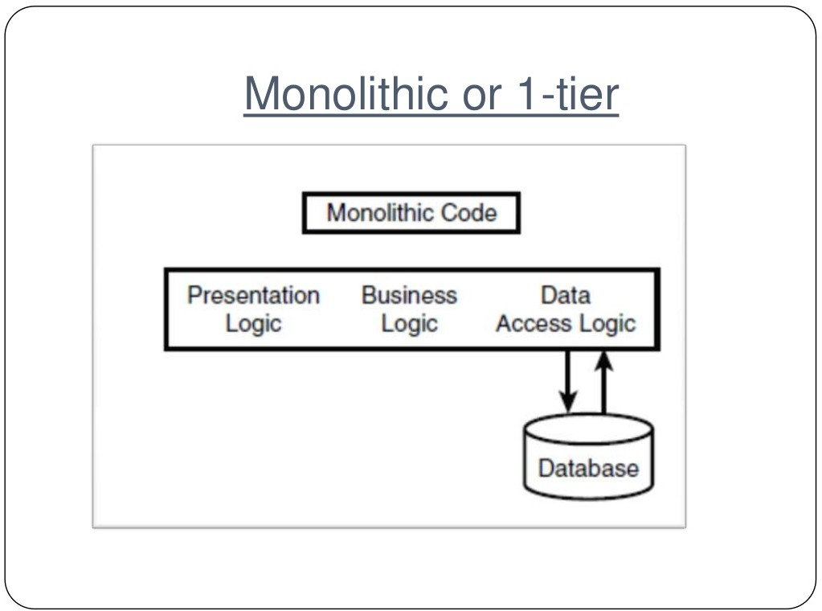

Slide 8
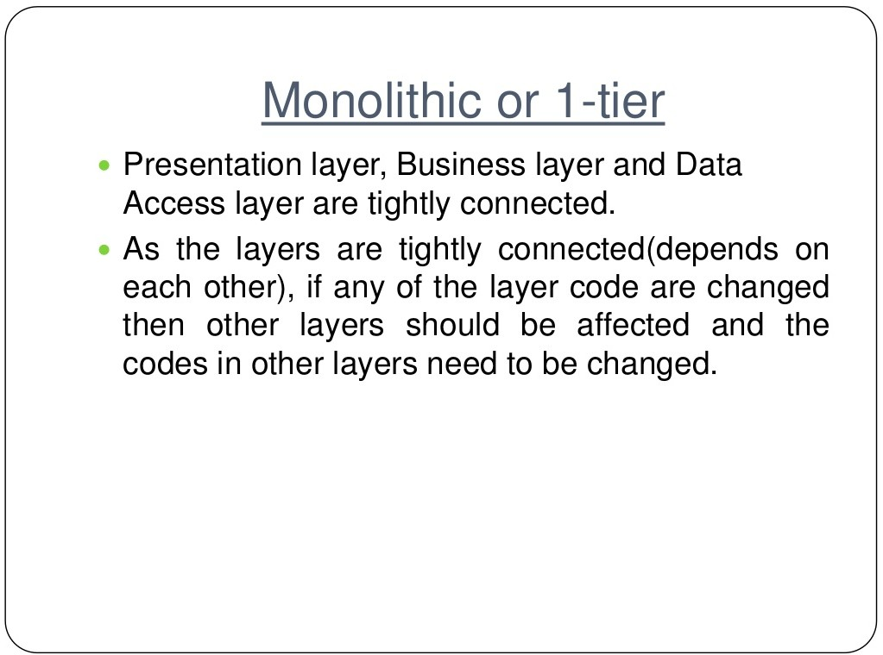

Slide 9
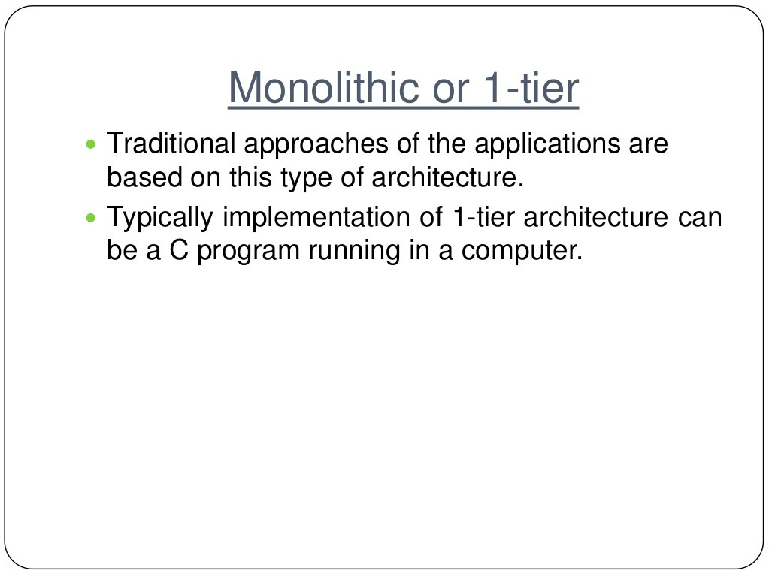

Slide 10
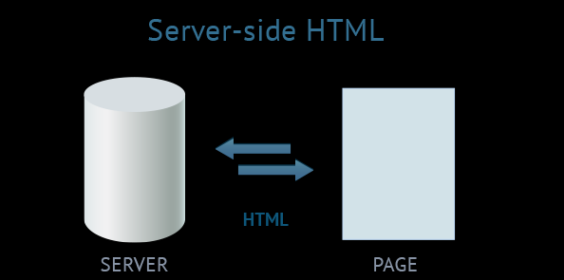
Type 1: server-side HTML web application

Slide 11
The server generates HTML content and sends it to the client as a full-fledged HTML-page.
Sometimes this architecture is called ''Web 1.0'', since it was the first to appear and currently dominates the sphere of web development.
A huge amount of data is transferred between the server and the client.
The user has to wait until the whole page reloads, responding to trivial actions, for example, when only a part of the page needs to be reloaded.
UI templates on the client depend directly on the frameworks applied on the server. Due to the limitations of mobile internet and huge amounts of transferred data, this architecture is hardly applicable in the mobile segment.
There are no means of sending instant data updates or changes in real time.

Slide 12
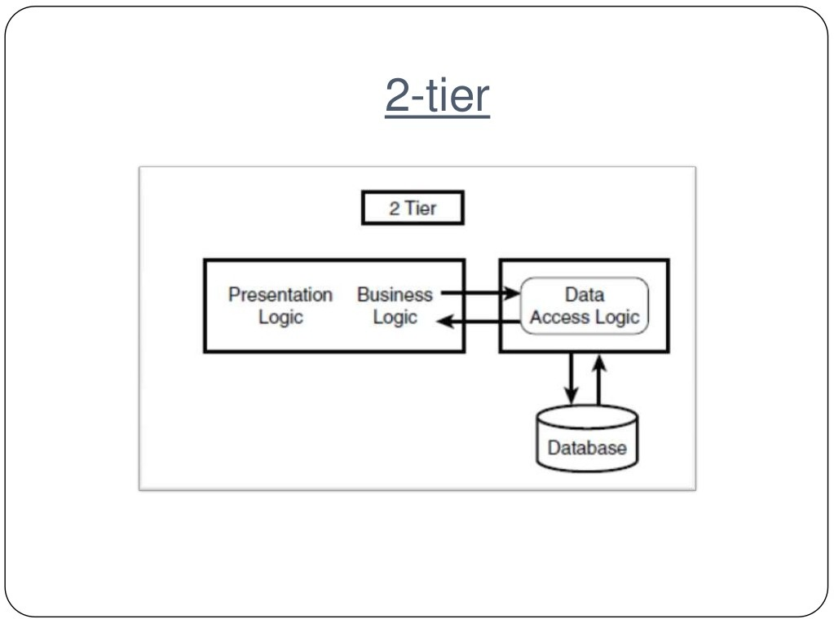

Slide 13
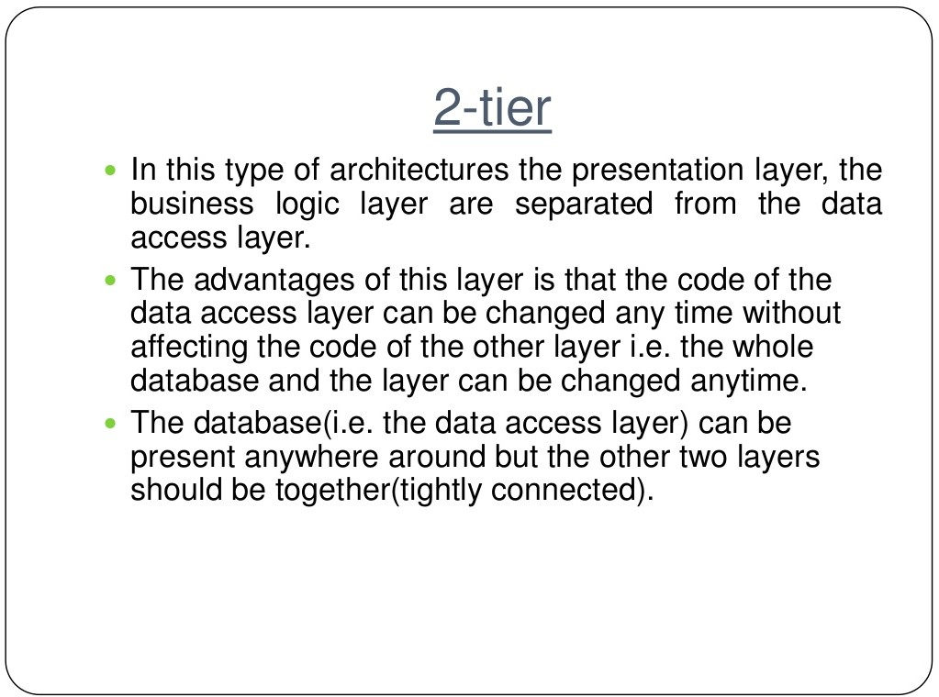

Slide 14
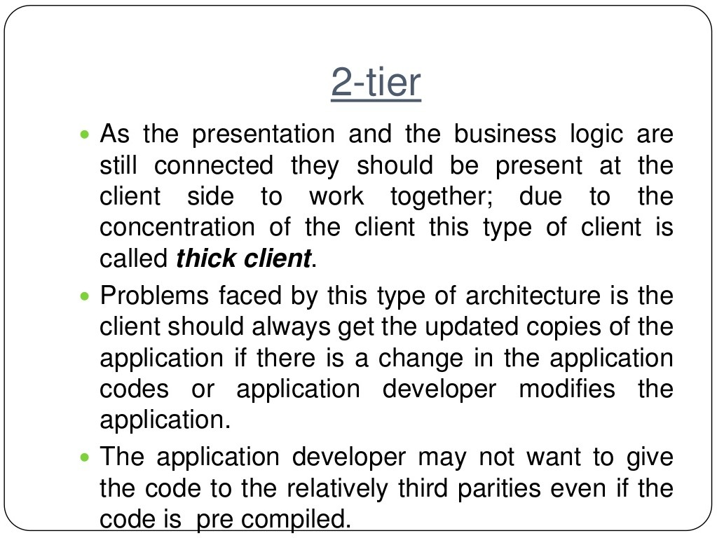

Slide 15
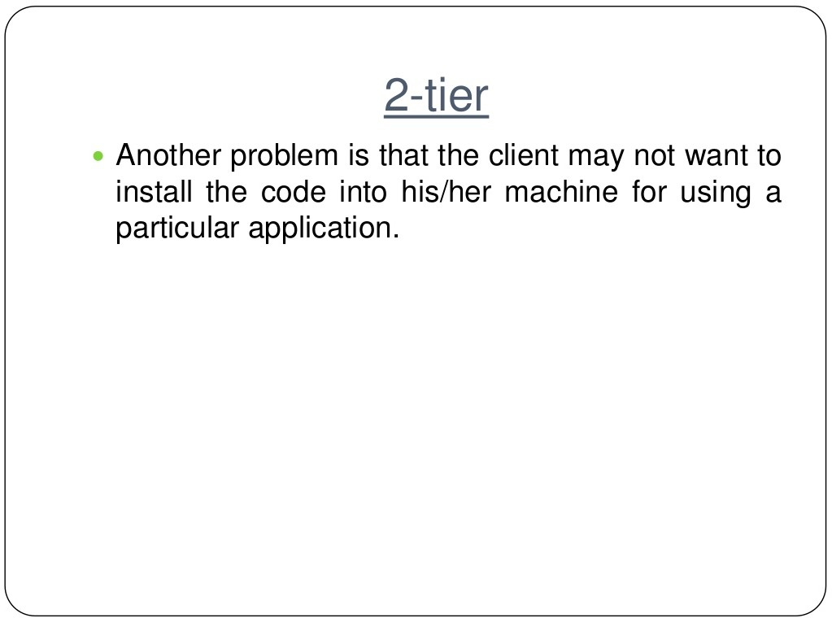

Slide 16
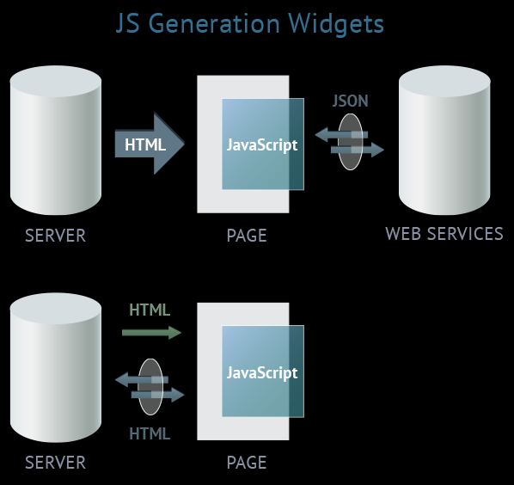
Type 2: JS generation widgets (AJAX)

Slide 17
AJAX = Asynchronous JavaScript and XML.
AJAX is a technique for creating fast and dynamic web pages.
AJAX allows web pages to be updated asynchronously by exchanging small amounts of data with the server behind the scenes. This means that it is possible to update parts of a web page, without reloading the whole page.
Classic web pages, (which do not use AJAX) must reload the entire page if the content should change.
Examples of applications using AJAX: Google Maps, Gmail, Youtube, and Facebook tabs.
JSON : Javascript Object Notation- is a lightweight data-interchange format

Slide 18
If updates from the server arrive only for the part of the page requested by the client. It's also good that widgets are separated functionally.
A particular widget is in charge of a part of the page; partial changes will not affect the whole page.
There's a problem with updating or caching the data displayed on the widget.
This functionality has to be implemented additionally: in the manifest one can indicate only names of the files that will be cached from the server.
Correlation between the widget template file, cached in the manifest, and the page behavior logic requires extra effort.

Slide 19
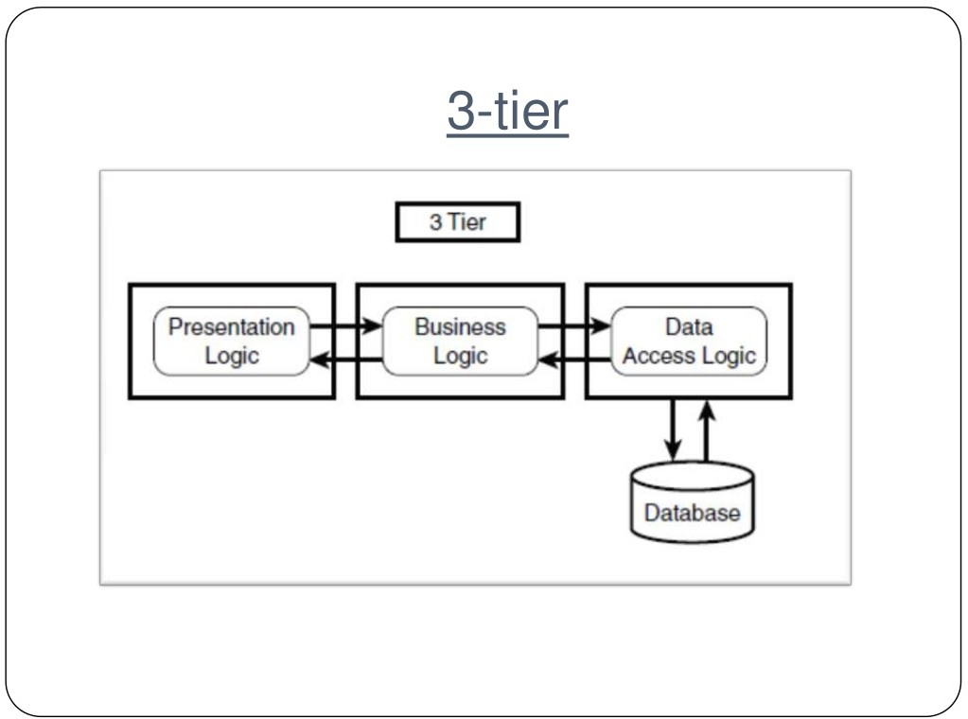

Slide 20
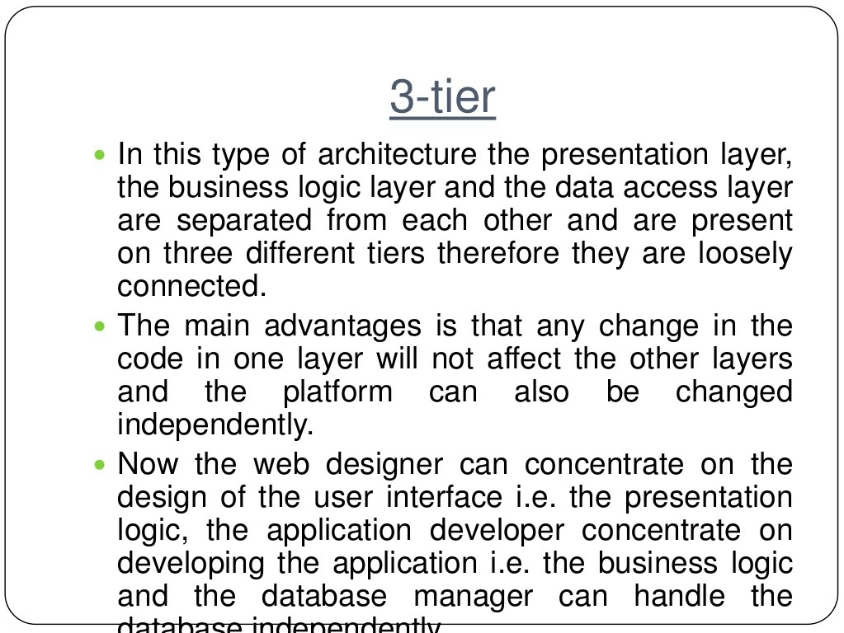

Slide 21
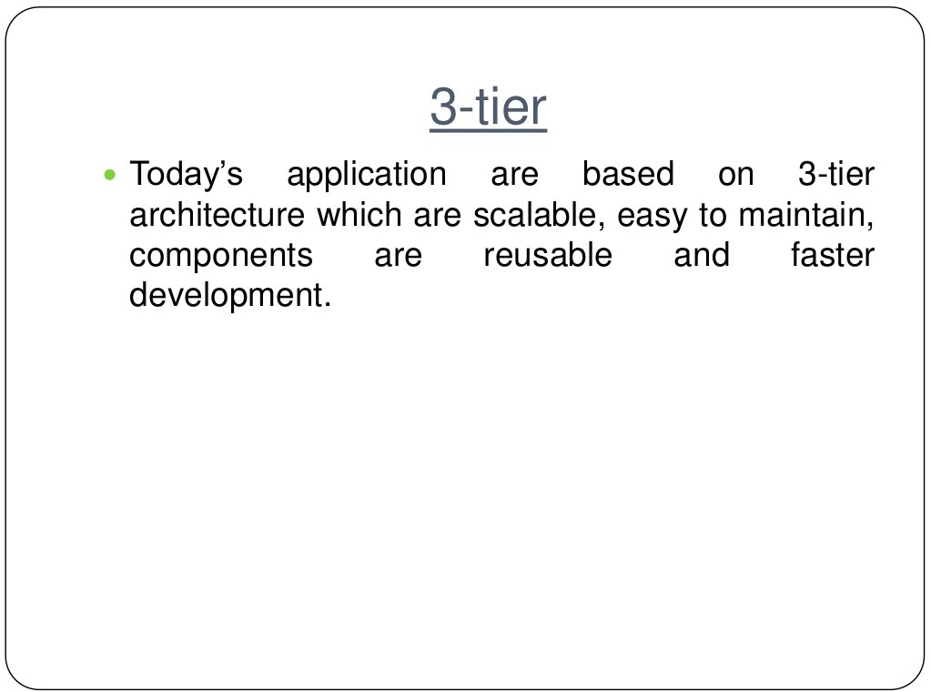

Slide 22
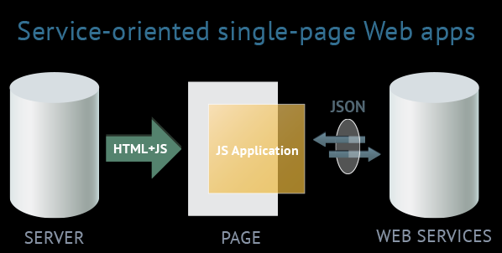
Type 3: service-oriented single-page web apps (Web 2.0, HTML5 apps)
The term ''Web 2.0'' isn't quite correct here. One of peculiarities of Web 2.0 is the principle of involving users into filling and repeated adjustments of content. Basically the term ''Web 2.0'' means projects and services which are actively developed and improved by users themselves: blogs, wikis, social networks. This means Web 2.0 isn't bound to one technology or a set of technologies.

Slide 23
Single Page Applications (aka SPA), and Service Oriented Architecture (aka SOA)
SPA refers to the architecture of the UI, specifically the Web UI.
SOA refers to the architecture of the back-end business layer, architecting for service reusability.
This approach avoids interruption of the user experience between successive pages, making the application behave more like a desktop application.
In an SPA, either all necessary code – HTML, JavaScript, and CSS – is retrieved with a single page load
Appropriate resources are dynamically loaded and added to the page as necessary, usually in response to user actions.
Thick and Thin architectures for client and server- Stateful and Stateless Versions

Slide 24
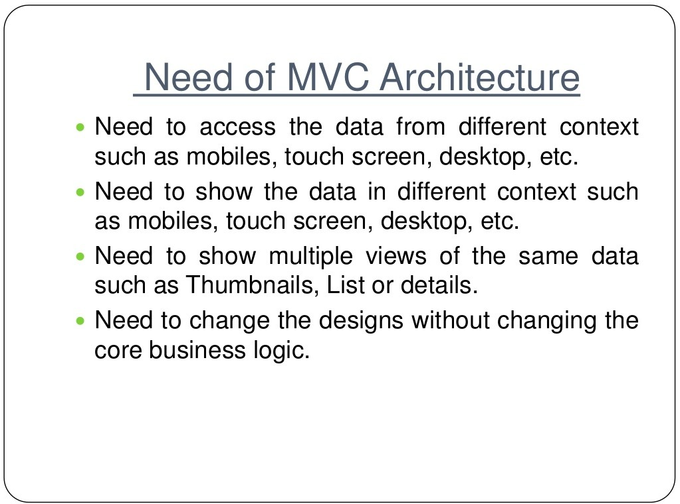

Slide 25
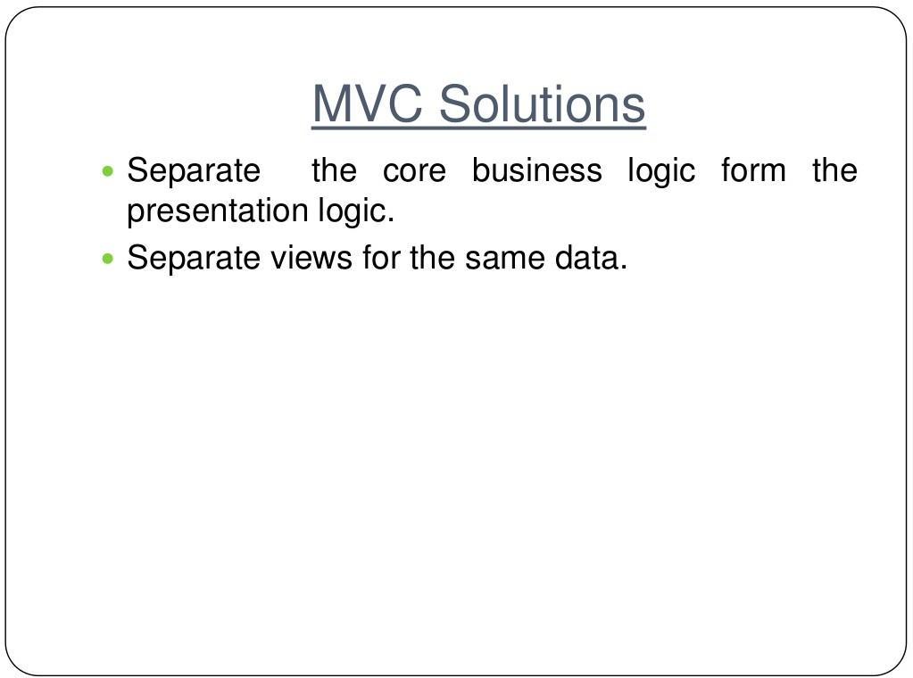

Slide 26
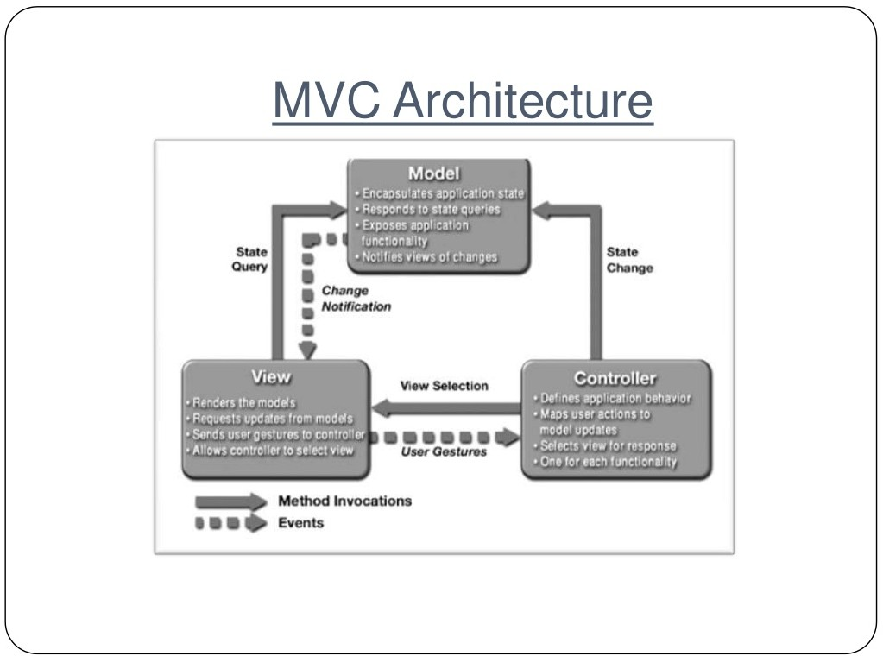

Slide 27
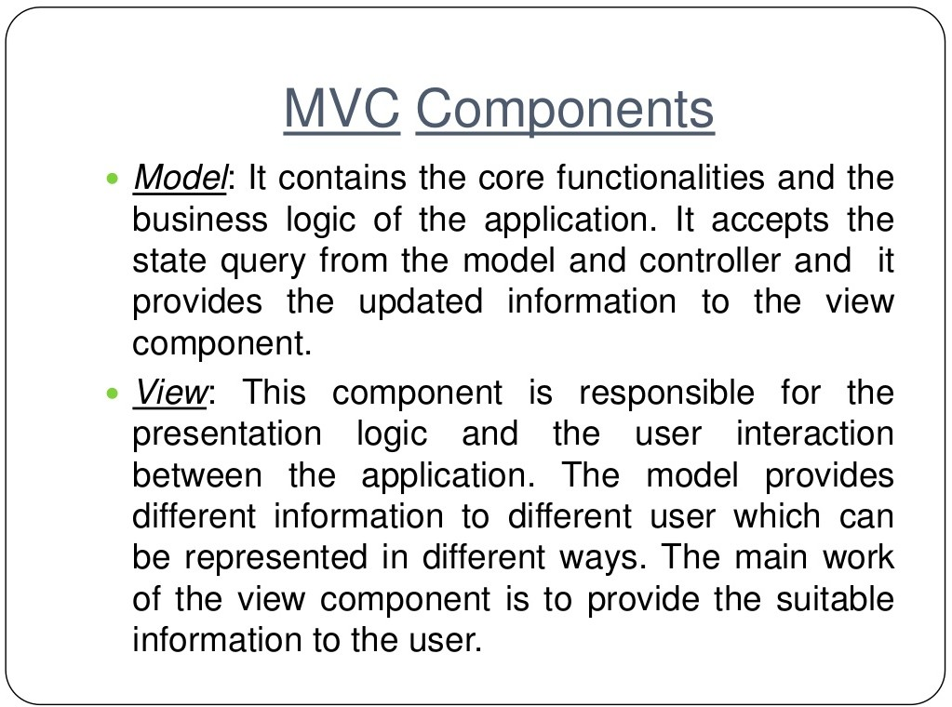

Slide 28
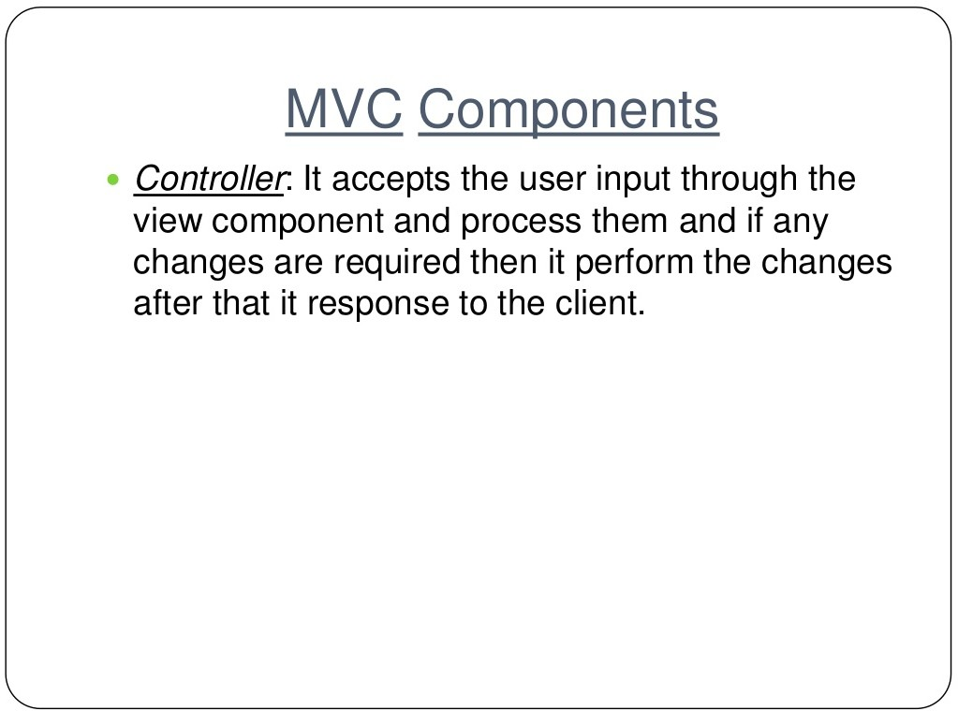

Slide 29
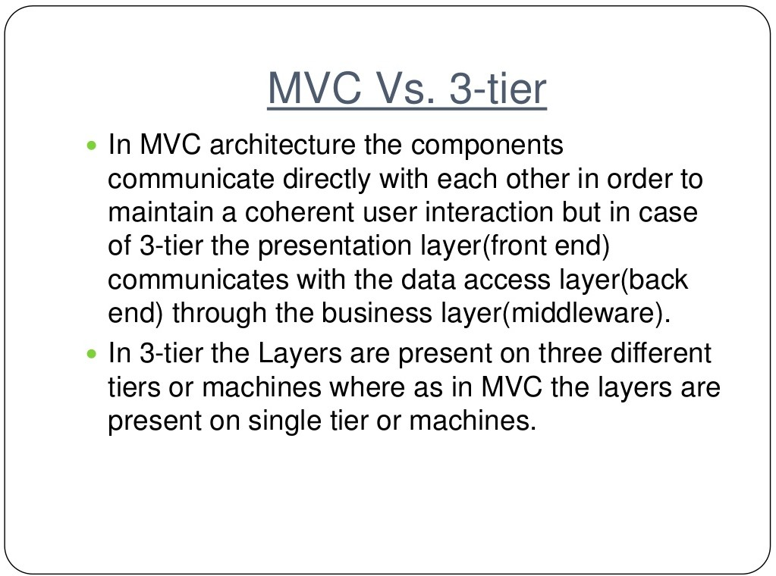

Slide 30


