Slide 1
JavaScript -objects
From arrays to the browser APIs
creation of own objects –packages - data containers.
properties and methods
Examples
    myString.split(',');
    const myDiv = document.createElement('div’);

Slide 2
JavaScript-Objects
const student =
{
name: [‘shan’, ‘priya'],
age: 32,
gender: ‘female',
greeting: function()
{ alert('Hi! I\'m ' + this.name[0] + '.'); }
};
//student.name[0]
// student[‘age’]

Slide 3
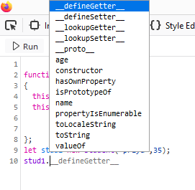
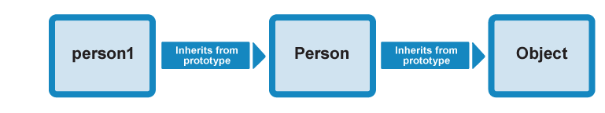
Prototype objects
objects can have a prototype object, which acts as a template object that it inherits methods and properties from.

Slide 4
Creating Objects
Declaring an Object literals
Using a Constructor function
The Object() constructor
Using create() method

Slide 5
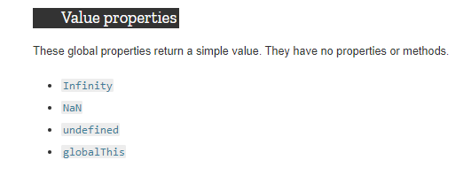
JavaScript-Std built in objects
numeric value representing infinity.
value representing Not-A-Number.
represents the primitive value undefined. It is one of JavaScript's primitive types.
you can access the global object in a consistent manner without having to know which environment the code is being run in.

Slide 6
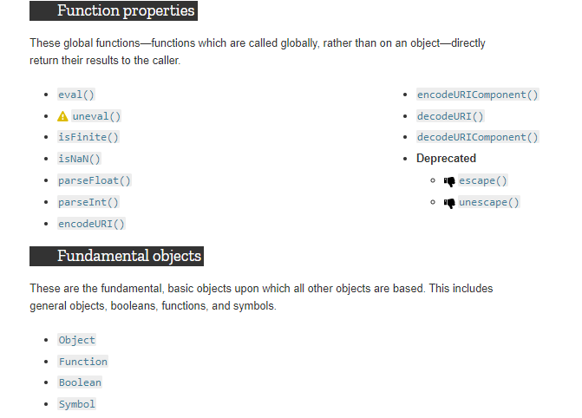
.
.
The Object class represents one of JavaScript's data types.All Objects created are instances
Every JavaScript function is actually a Function object. This can be seen with the code (function(){}).constructor === Function, which returns true
object wrapper for a boolean value.

Slide 7
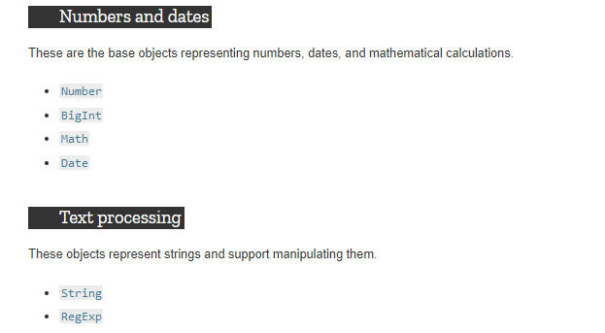

Slide 8
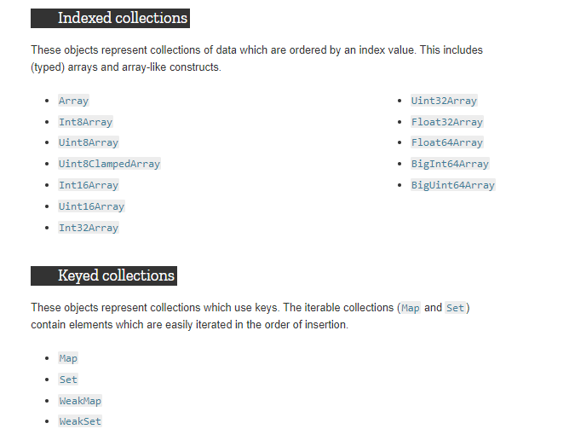

Slide 9
Examples
)
;
maxNumber === Infinity
123
Number(‘123’)
Number.Max_Value
Number.isNAN()
let o = new Object(Boolean())
let re = /ab+c/i;
let re = new RegExp('ab+c', ‘i’)
let years = [1950, 1960, 1970, 1980, 1990, 2000, 2010]
const hugeBin = BigInt("0b11111111111111111111111111111111111111111111111111111")
const num = Math.floor(Math.random() * (max - min + 1)) + min
let birthday = new Date(1995, 11, 17)
console.log(`The word "${word}" ${sentence.includes(word) ? 'is' : 'is not'} in the sentence`);
https://developer.mozilla.org/en-US/docs/Web/JavaScript/Reference/

Slide 10
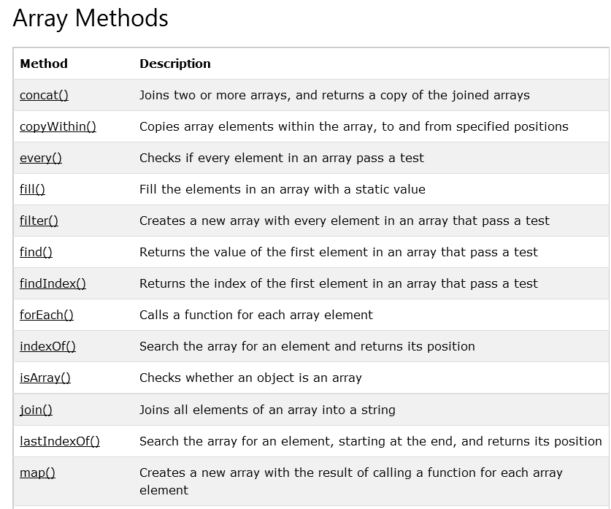
let names = [‘aaa', ‘bbb']

Slide 11
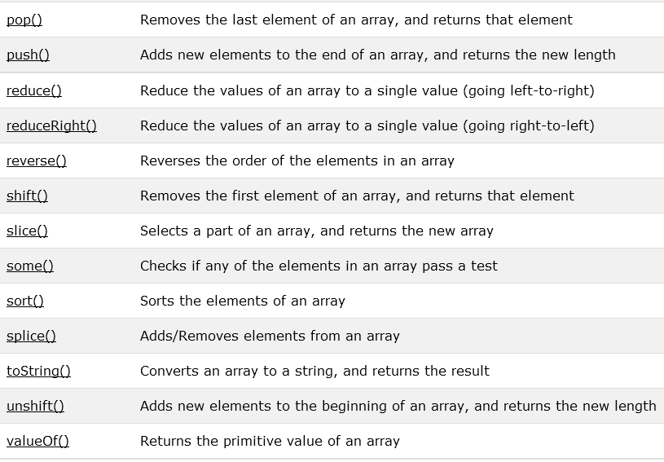

Slide 12
JAVASCRIPT STRINGS OBJECTS

Slide 13
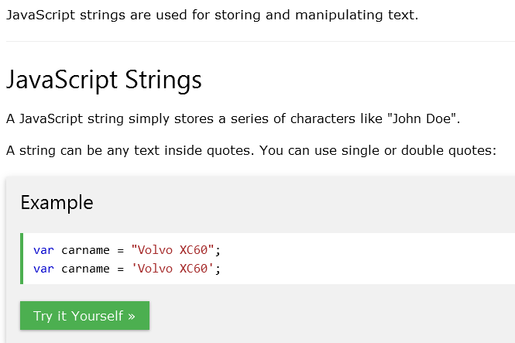
JavaScript Strings

Slide 14
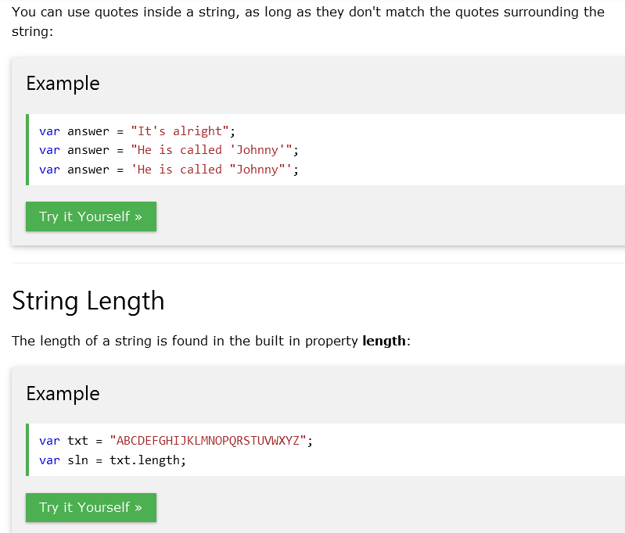

Slide 15
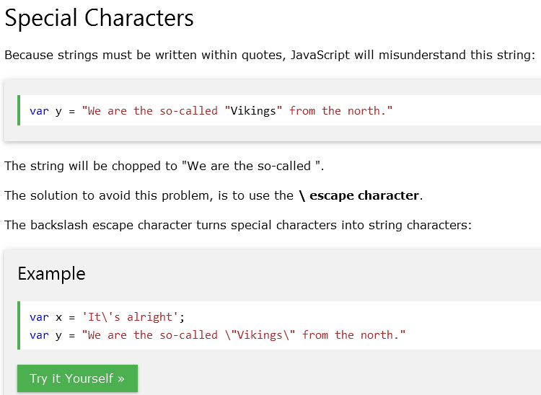

Slide 16
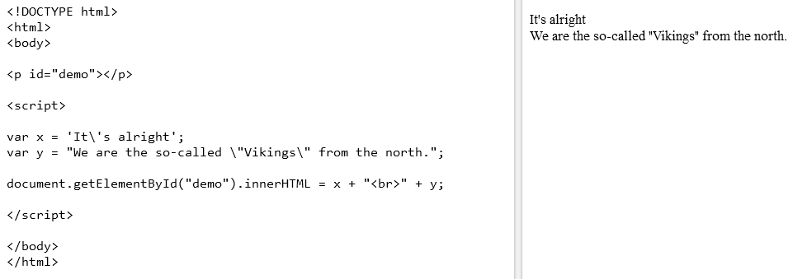

Slide 17
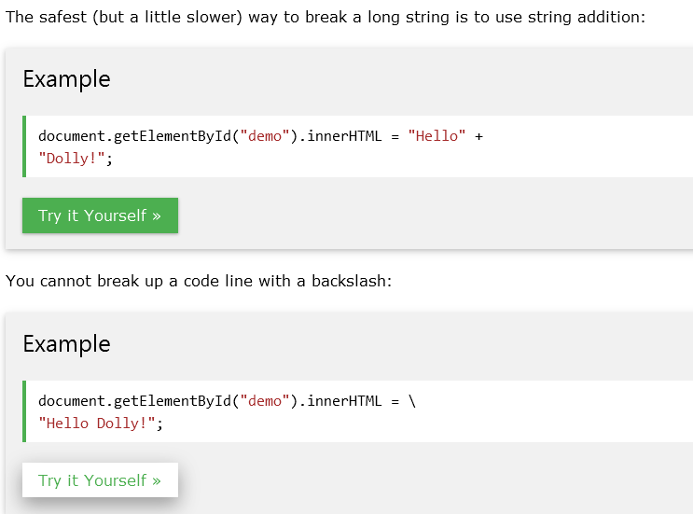

OUTPUT

Slide 18
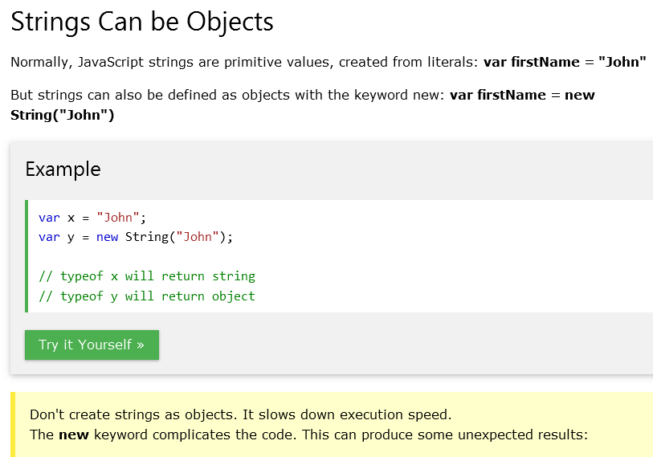

Slide 19
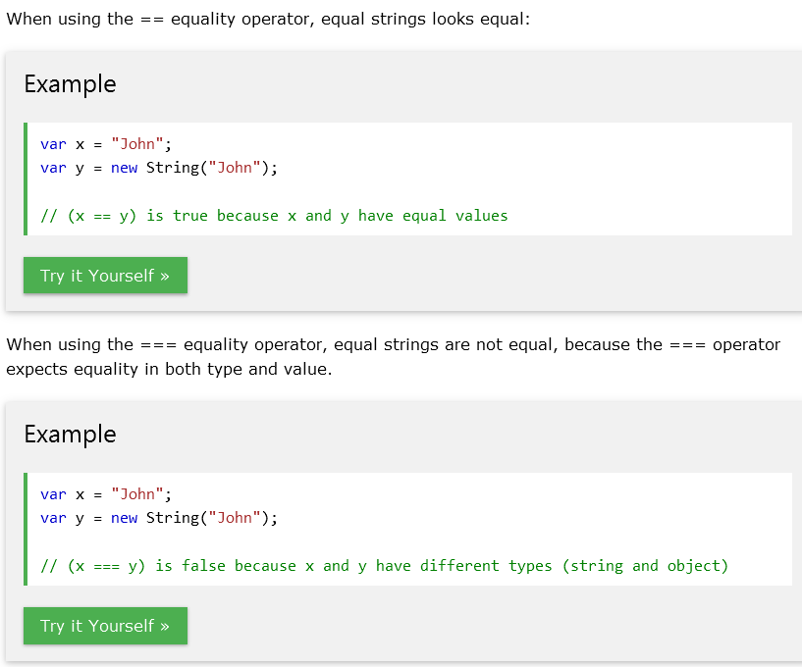

Slide 20
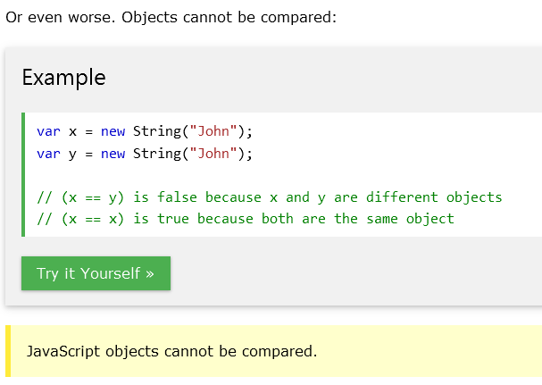

Slide 21
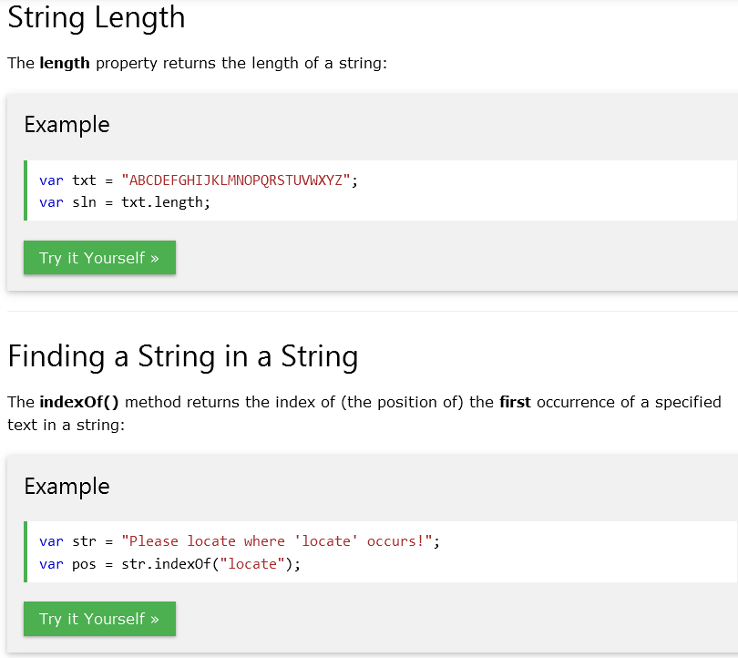
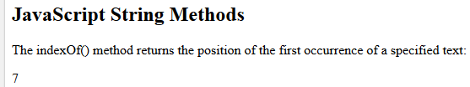

Slide 22
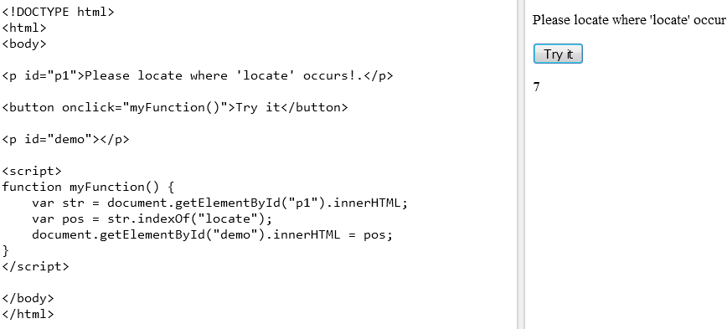

Slide 23
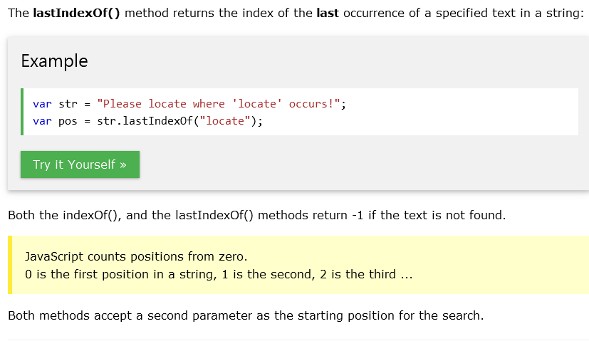

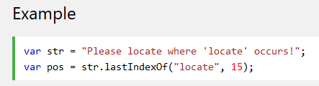
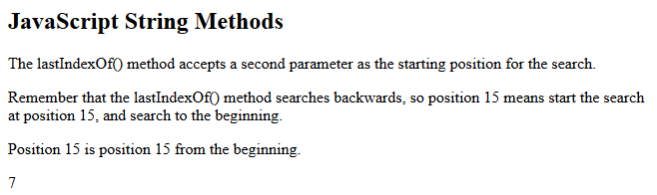

Slide 24
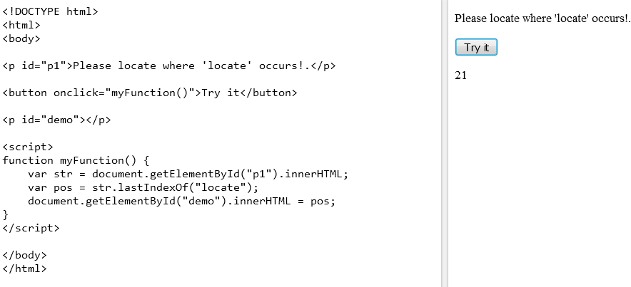

Slide 25
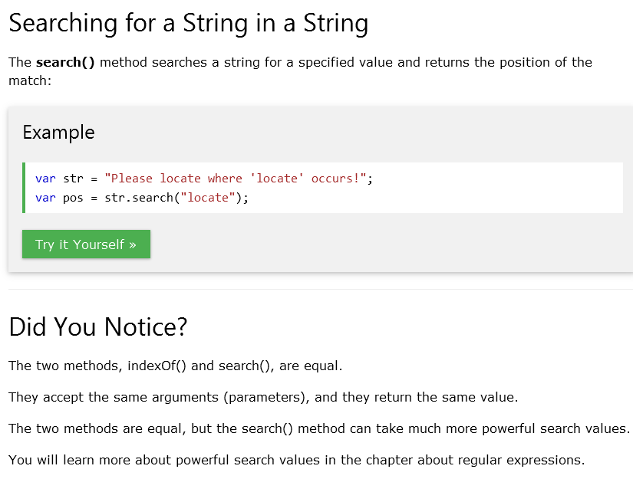

Slide 26
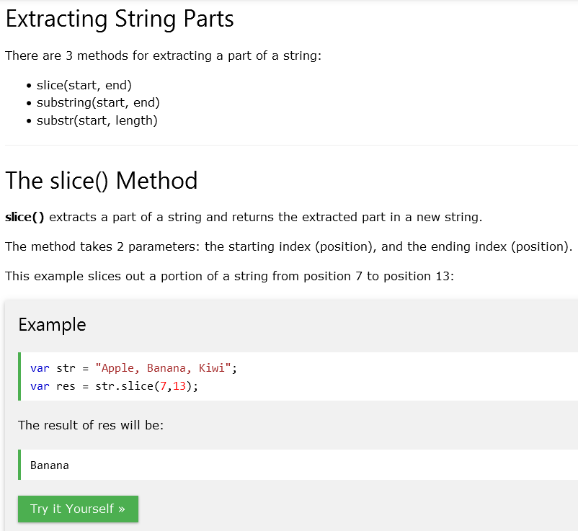

Slide 27
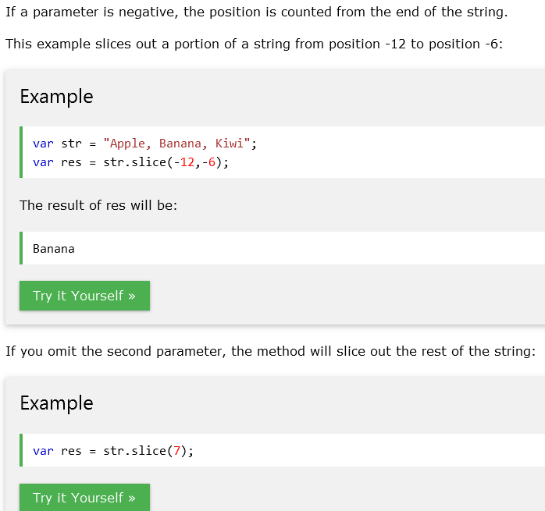

Slide 28
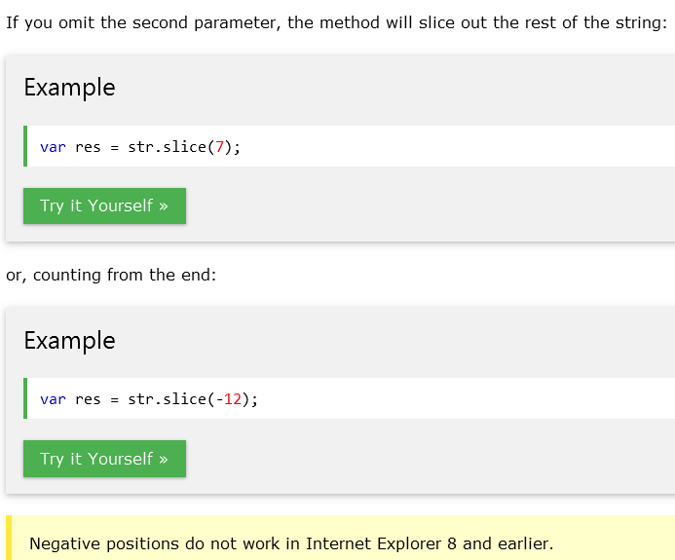
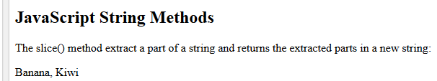

Slide 29
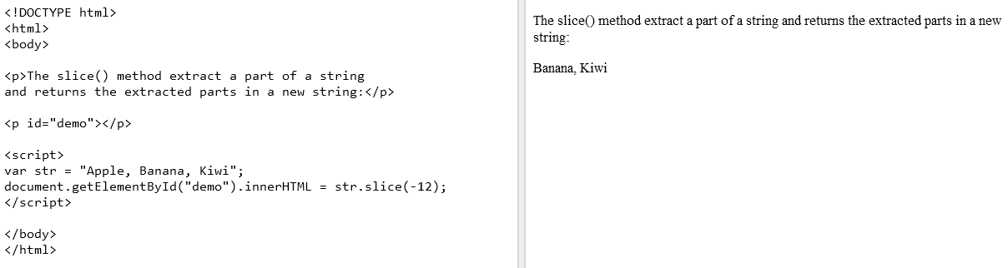

Slide 30
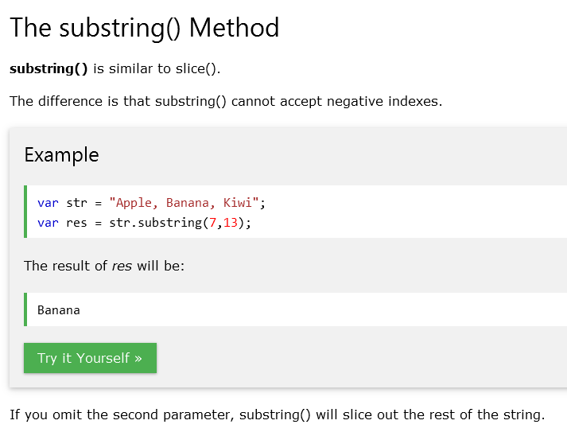

Slide 31
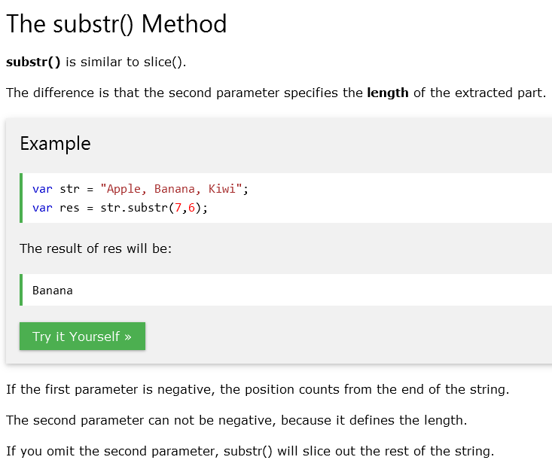

Slide 32
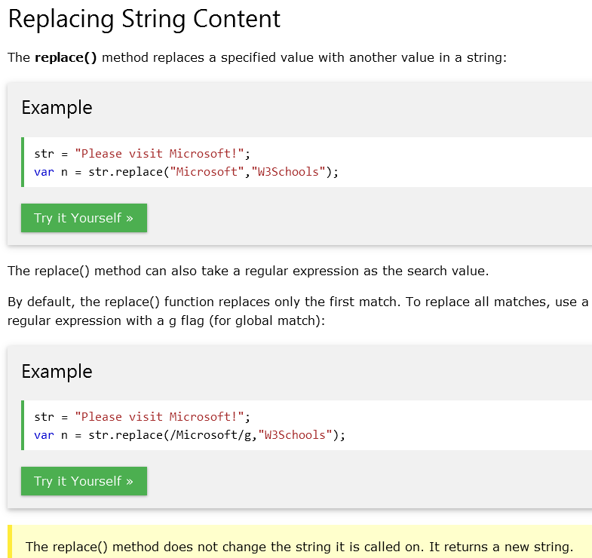

Slide 33
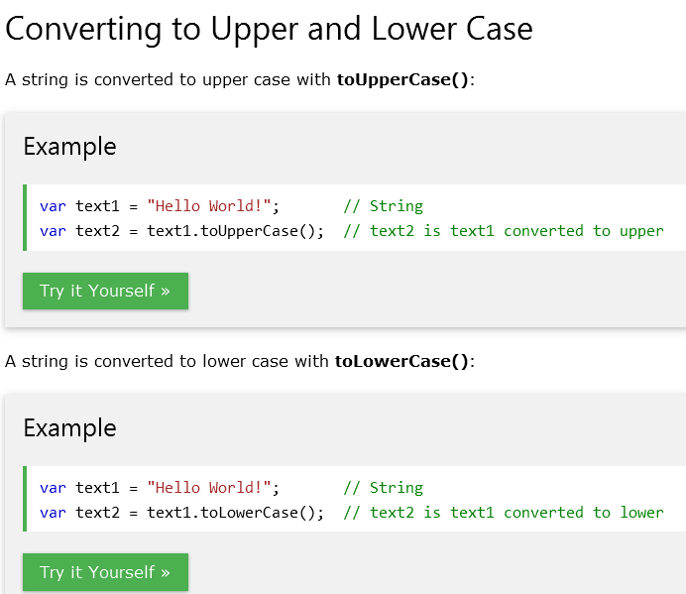

Slide 34
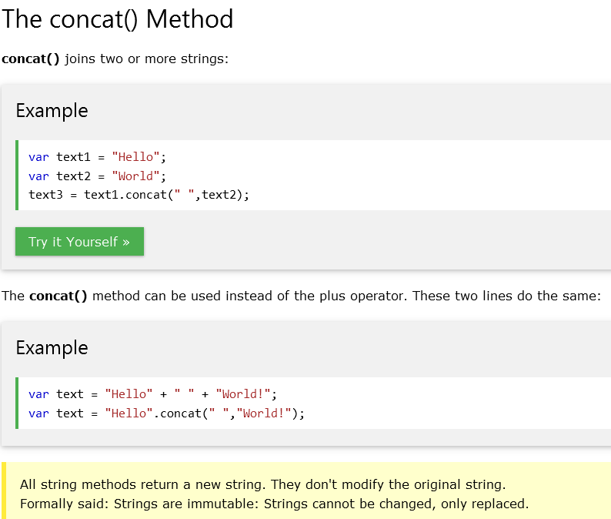

Slide 35
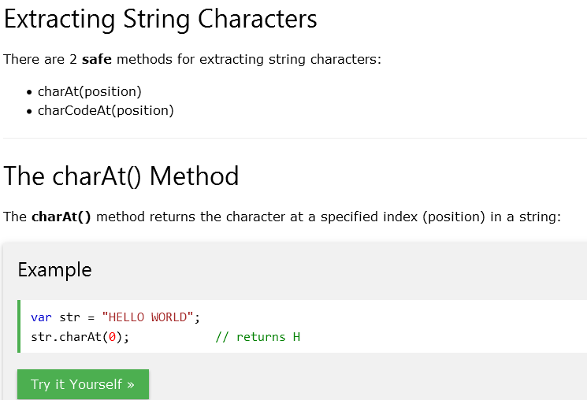

Slide 36
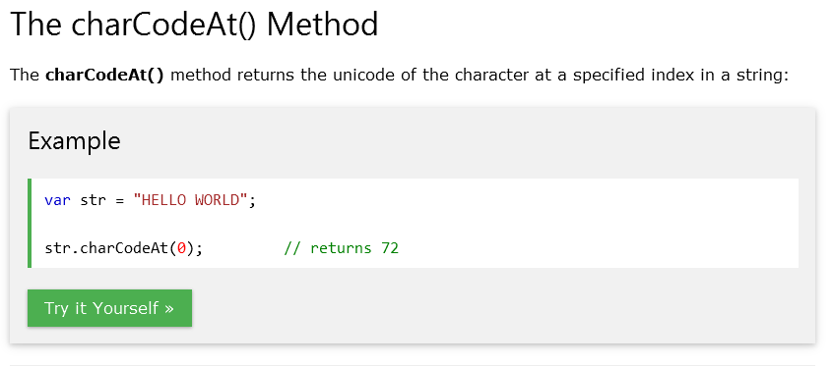

Slide 37
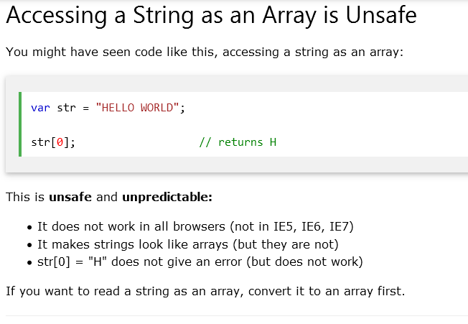

Slide 38
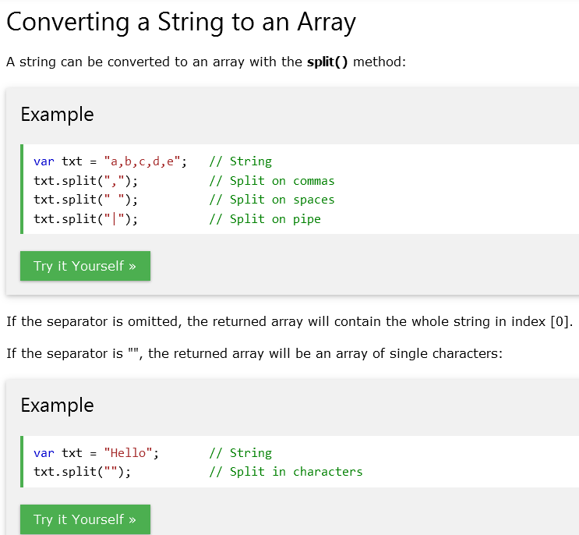


Slide 39
JAVASCRIPT MATH OBJECT

Slide 40
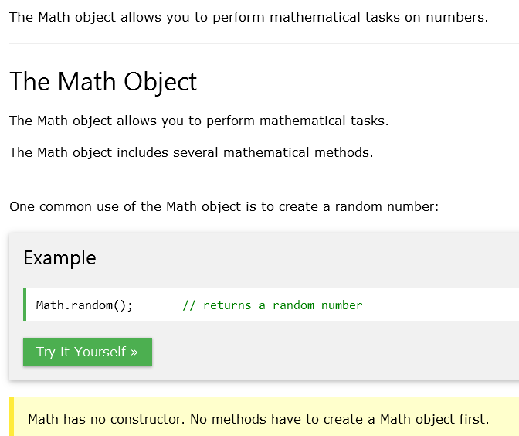

Slide 41
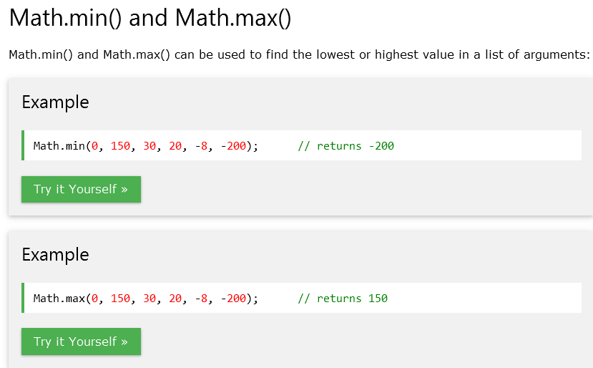

Slide 42
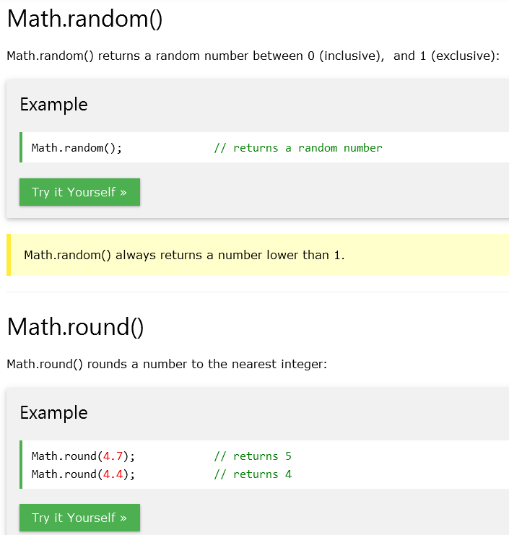

Slide 43
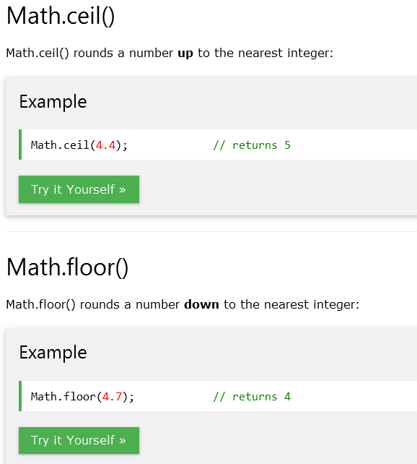

Slide 44
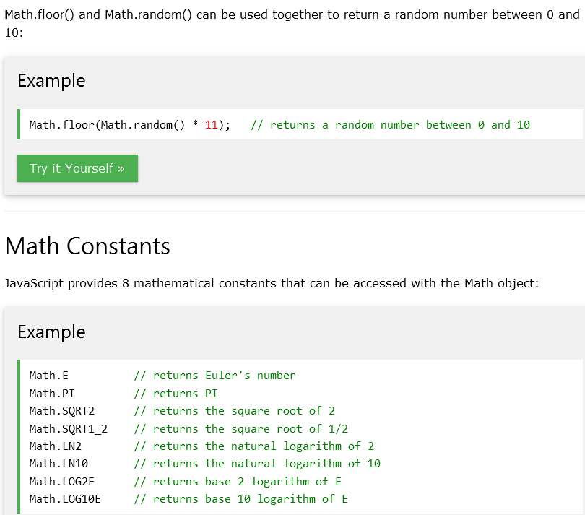

Slide 45
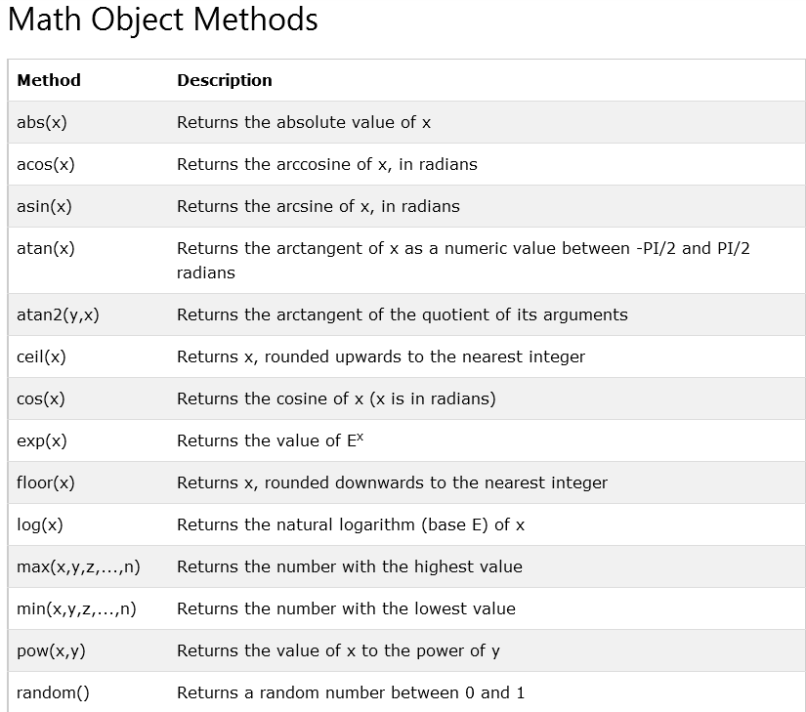

Slide 46
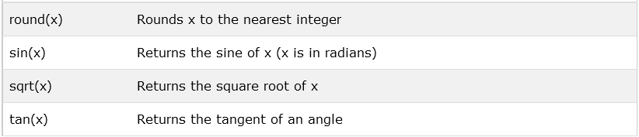

Slide 47
JAVASCRIPT DATES

Slide 48
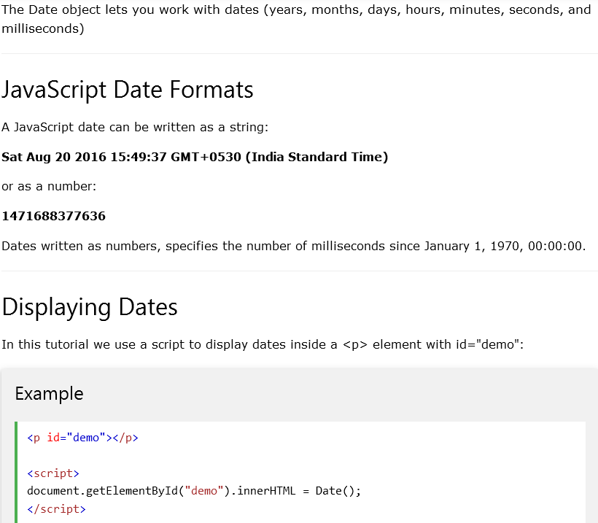

Slide 49
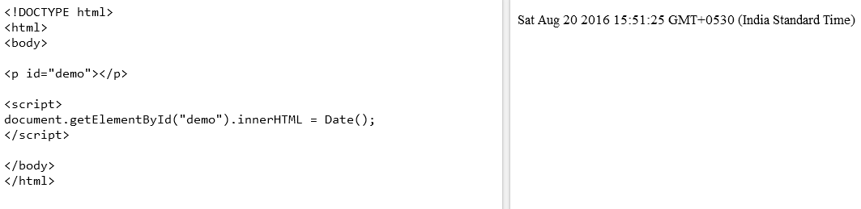

Slide 50
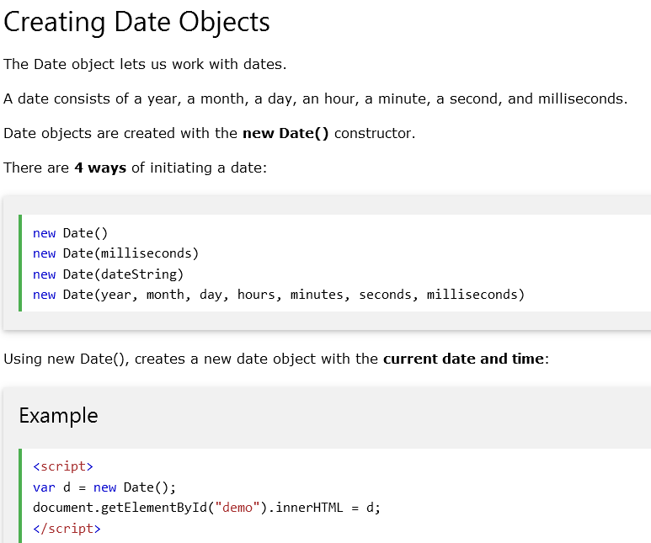

Slide 51
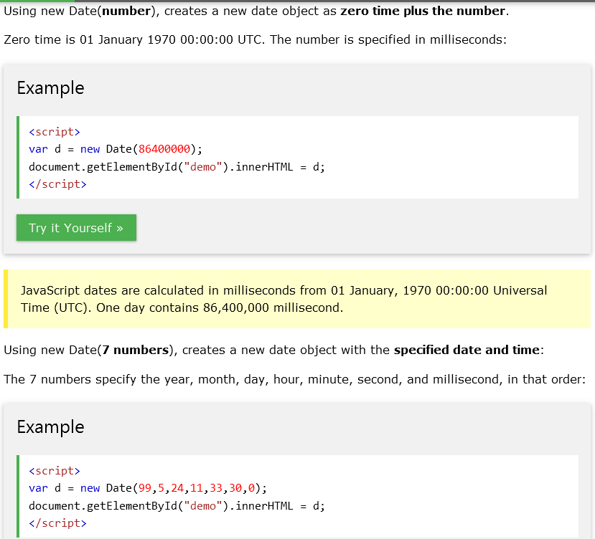

Slide 52
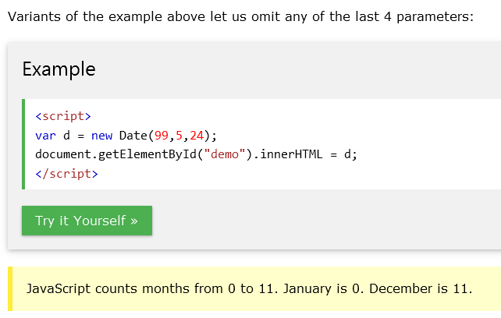

Slide 53


Slide 54


Slide 55



Slide 56
JAVASCRIPT DATE FORMATS

Slide 57


Slide 58


Slide 59


Slide 60


Slide 61


Slide 62


Slide 63


Slide 64
JAVASCRIPT DATE METHODS

Slide 65


Slide 66


Slide 67


Slide 68


Slide 69


Slide 70


Slide 71
Web Events
A site with registration form,
"This field is required" (You can't leave this field blank).
"Please enter your phone number in the format xxx-xxxx"
"Please enter a valid email address"
"Your password needs to be between 8 and 30 characters long and contain one uppercase letter, one symbol, and a number." (A very specific data format is required for your data).

Slide 72
Client-side validation
Built-in form validation
JavaScript
Server
Browser
Active Server-side
Code
POST or GET
Form
Response Page
ValidationRequest
ValidationResult
Validation
JavaScript
Validation Code
Update
Database
Client-side Validation
Server-side Validation

Slide 73
Objects in a Page
As appearing on the screen
As appearing in the JavaScript Document Object Model
window
Window
HTML document
A form
document
A text field
A checkbox
form
text
checkbox
COMP/DCOM 461 – CWB

Slide 74

Web Events
Event handler properties

Slide 75


Inline event handlers

Slide 76

addEventListener() and removeEventListener()
//e.target.style.backgroundColor = rndCol;

Slide 77

Web Form-Submission
https://developer.mozilla.org/en-US/docs/Learn/JavaScript/Building_blocks/Events

Slide 78


Slide 79


Slide 80


Slide 81


Slide 82


Slide 83


Slide 84


Slide 85



Slide 86


Slide 87


Slide 88
Email Validation
<script language=“text/javascript”>
function validate()
{
x=document.myForm
at=x.myEmail.value.indexOf(“@”)
if(at==-1)
alert(“Not a valid e-mail”)
return false
}
</script>

Slide 89



Value Validation
<script language=“text/javascript”>
function validate()
{
x=document.myForm
txt=x.myInput.value
if(txt>=1 && txt<=10)
{
return true
}
else
{
alert(“must be between 1 and 10”)
return false
}
</script>
if (isNaN(x) || x < 1 || x > 10) {
text = "Input not valid";
} else {
text = "Input OK";
}

Slide 90


Slide 91
Length Validation
<script language=“text/javascript”>
function validate()
{
x=document.myForm
input=x.myInput.value
if(input.length>5)
{
alert(“do not insert more than 5 characters”)
return false
}
else
{
return true
}
}
</script>

Slide 92
To Check for the number of characters specified in the password field
<script>
function validateform(){
var name=document.myform.name.value;
var password=document.myform.password.value;
if (name==null || name==""){
alert("Name can't be blank");
return false;
}else if(password.length<6){
alert("Password must be at least 6 characters long.");
return false;
}
}
</script>
<body>
<form name="myform" method="post" onsubmit="return validateform()" >
Name: <input type="text" name="name"><br/>
Password: <input type="password" name="password"><br/>
<input type="submit" value="register">
</form>

Slide 93


Slide 94
Validating user Name
function allLetter(uname)
{
var letters = /^[A-Za-z]+$/;
if(uname.value.match(letters))
{
return true;
}
else
{
alert('Username must have alphabet characters only');
uname.focus();
return false;
}
}

