Slide 1




Presentation
Department: Computer Science and Engineering
Course Code: CSE 2218
Section: D
Trimester: Spring 2022
Bipartite graph checking algorithm
Sahid Hossain Mustakim
011201274
Shanjida Rahman
011191216
Mobashera Israq
011202275
Instructor’s Name: Akib Zaman

Slide 2
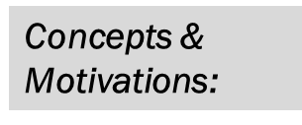
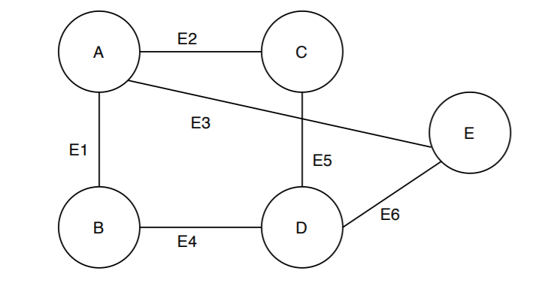
Here, we’ve taken a random graph. Now, to satisfy the definition of a bipartite graph, the vertex set needs to be partitioned into two sets such that each edge joins the two vertex sets.

Slide 3
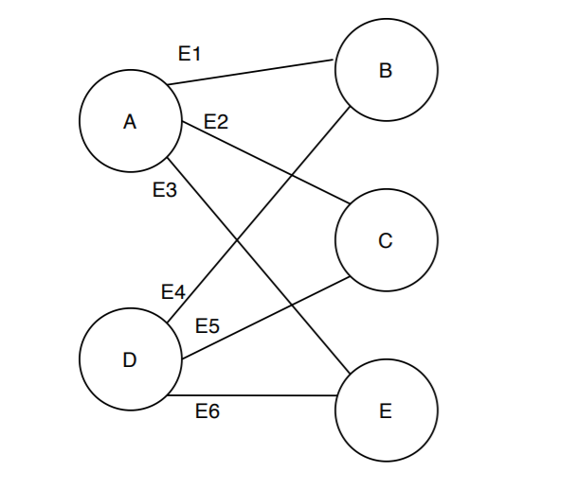
This is the same graph G, just with a different representation. Here, we partition the vertex set V = (A, B, C, D, E) into two disjoint vertex sets U = (A, D) and V = (B, C, E).
Also, we can see the edges from the edge set E = (E1, E2, E3, E4, E5, E6) follows the definition of a bipartite graph. Each has one endpoint in U and another in V.

Slide 4
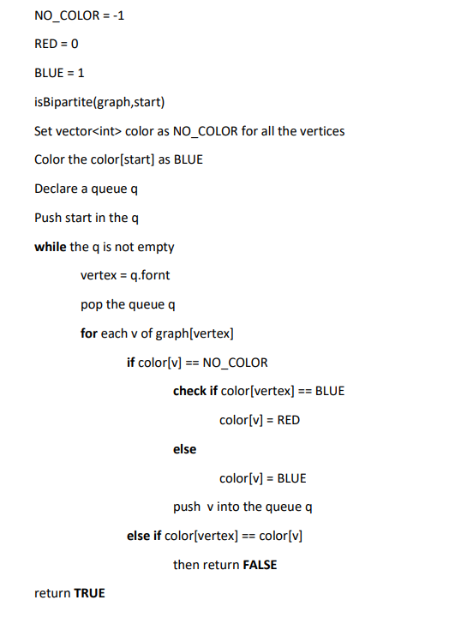
Pseudocode:

Slide 5
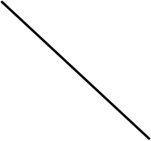
Bipartite Graph:
Red = 0
Blue = 1
2
1
3
Queue
1
2
3
4
4
-1
-1
-1
-1
Color[]

Slide 6
Red = 0
Blue = 1
2
1
1
3
Queue
1
2
3
4
1
-1
-1
-1
4
Color[]
Visiting node = 1

Slide 7
Red = 0
Blue = 1
2
2
4
1
3
Queue
1
2
3
4
4
1
0
-1
0
Color[]
Visiting node = 1

Slide 8
Red = 0
Blue = 1
2
4
3
1
3
Queue
1
2
3
4
4
1
0
1
0
Color[]
Visiting node = 2

Slide 9
Red = 0
Blue = 1
2
3
1
3
Queue
1
2
3
4
4
1
0
1
0
Color[]
Visiting node = 4

Slide 10
Red = 0
Blue = 1
2
1
3
= Ø
Queue
1
2
3
4
4
1
0
1
0
Color[]
Every node has different color adjacent nodes from it’s visiting node. So, this is a Bipartite Graph and will return TRUE.
Visiting node = 3

Slide 11
Non-Bipartite Graph:
Red = 0
Blue = 1
5
1
Queue
3
1
2
3
4
5
-1
-1
-1
-1
-1
2
Color[]
4

Slide 12
Red = 0
Blue = 1
5
1
1
Queue
3
1
2
3
4
1
-1
-1
-1
-1
2
Color[]
4
Visiting node = 1

Slide 13
Red = 0
Blue = 1
5
2
3
5
Queue
1
1
2
3
4
5
3
1
0
0
-1
0
2
Color[]
4
Visiting node = 1

Slide 14
Red = 0
Blue = 1
5
3
5
1
Queue
3
2
1
2
3
4
5
1
0
0
-1
0
4
Color[]
Here we are getting same color for the adjacent node 3. So, this is a Non-bipartite Graph and will return FALSE.
Visiting node = 2

Slide 15
Time Complexity:
Initializing the graph by connecting the edges takes O(E)
The queue operation takes O(V)

Slide 16
O(V) + O(E) = O(V + E)
(for adjacency list implementation)
Best case:
Ω(V + E)
Worst case:
O(V + E)
If we used an adjacency matrix, the time complexity would be O(V^2)

Slide 17
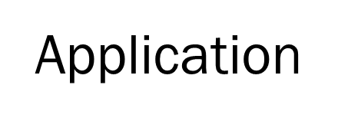
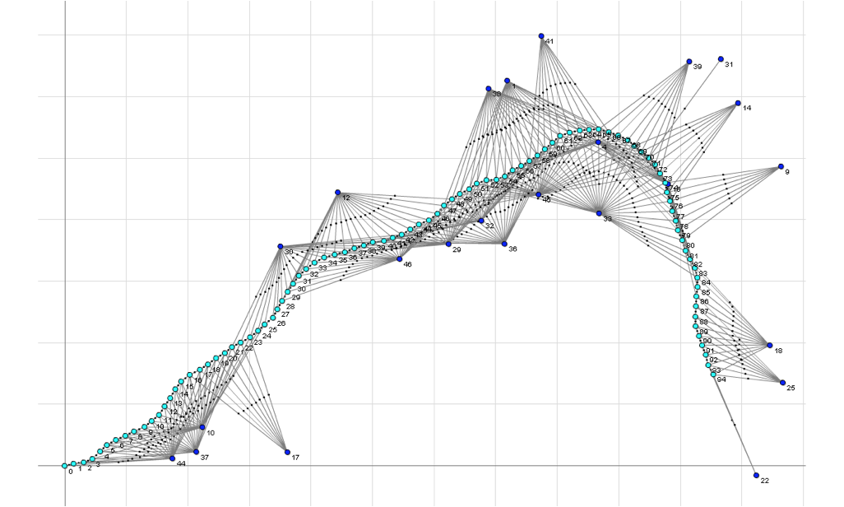

Job
In Football
Functional Dependency
Social Network Analysis.
SLAM(Simultaneous Localization and Mapping)

Slide 18
Thank You

