Slide 1
Algorithm Vs Program

Slide 2
Algorithm
An algorithm is a step-by-step and logical approach that defines a systematic process for computers to solve a specific problem.
It consists of rules defining a task's execution to get the expected results.
Algorithms are conceptual and can be described using language or flowcharts.
We can implement them in different programming languages.

Slide 3
Example
Using language
Step 1:Start
Step 2:Take two number inputs
Step 3:Add both the numbers using the + operator
Step 4:Display the result
Step 5:End

Slide 4
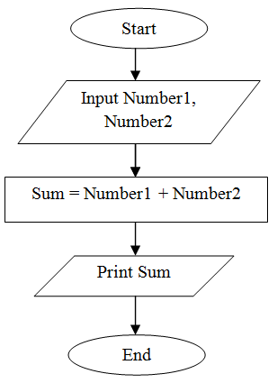
Example
Using flowchart

Slide 5
Program
A program is a set of instructions a computer follows to perform a specified task.
Many programming languages can be used to write computer programs.
Some popular programming languages include Python, Java, C++, JavaScript, PHP, and Ruby.
These high-level programming languages are human-readable and writable.
These languages are converted into low-level machine languages by compilers, interpreters, and assemblers within the computer system.

